Slide 1
MICMT Complex Care Management Course
Day in a Life Financial Aspect of a Care Manager’s Day
© 2018 by the Regents of the University of Michigan. For questions or permissions please contact micmrc-requests@med.umich.edu

Slide 2
Objectives
Relate care manager activities to the tracking and billing codes
Relate caseload and care management activity billing to sustainability
Demonstrate use of billing codes in daily care management work

Slide 3
Payment Redesign: Pay for Value
Value
  Decreased cost and Improved patient outcomes
Success for the practice
  Practice meeting the benchmark(s) earn financial incentives paid to the practice

Slide 4
BCBSM Provider Delivered Care Management (PDCM) - Goals
Physician Lead health are teams deliver services that are billed by qualified practitioners
Goals - Improved outcomes
  decrease emergency department visits
  decrease hospital readmissions
  consistent delivery of recommended services
    Controlled HgA1c
    Controlled Blood Pressure

Slide 5
Care Management Activities – Billing and Coding
Each Program sets benchmarks for number of patients receiving care management services at the practice level
Data Reports available to the practice – tracks the number of care management activities based on billing/coding
  Who shows up in the report?
    Ex. BCBSM: patients is seen at a PDCM-participating practice, is eligible for care management, and has an active Blue Cross contract
  For Complex Patients enrolled in care management – should have longitudinal follow up
    expectation over time, more than one visit/activity is billed

Slide 6
Patient List - BCBSM
BCBSM – provides patient list distributed monthly by Michigan Data Collaborative.
  Ex. BCBSM: patients is seen at a PDCM-participating practice, is eligible for care management, and has an active Blue Cross contract
The patient list is not an indicator of which patients are eligible for care management, rather, tis is a guide to assist clinical decision-makers in determine which patients are candidates for care management based on clinical indicators and previous health care utilization
  Commercial, Medicare Plus Blue patients
  Includes information based on claims history
    Risk scores, chronic condition flags, high cost flags, etc.
Important: confirm patient has an active health plan with the PDCM/care management benefit
  A Medicare Plus Blue member is not eligible for PDCM services if an insurer other than BCBSM is the primary insurer

Slide 7
Patient List – Priority Health

Slide 8
Incentive Programs for Care Management
BCBSM
Value Based Reimbursement (i.e. increase on every E&M code and PDCM code)
  Up to 150% available; average ACU at UMMG: 117.5%
    10% of this 50% opportunity is for 2 billed codes on 5% of the BCBSM commercial population.
Fee For Service on all codes billed; no patient co-pay
Additional 1 time yearly distribution of to the PO paid in 2018.
Priority Health
Annual PMPM payment if outreach to up to 4% of the population has 2 billed codes (average $2.64pmpm) – over $300K
Fee For Service on all codes billed; no patient co-pay
SIM
$2.75 - $7.00 PMPM care management and care coordination payments on Medicaid patients, assuming the goal of 2.5% eligible patients with a ‘billed’ code is achieved (reduction by $0.15 if not achieved).
CPC+ also includes care management, but it isn’t so specific in it’s funding.

Slide 9
Good news: BCBSM, PH, SIM use the same codes
And CMS doesn’t care which codes we use!
G9001 - Initiation of Care Management (Comprehensive Assessment)
G9002 - Individual Face-to-Face Visit
98961 - Education and training for patient self-management for 2–4 patients; 30 minutes
98962 - Education and training for patient self-management for 5–8 patients; 30 minutes
98966 - Telephone assessment 5-10 minutes of medical discussion
98967 - Telephone assessment 11-20 minutes of medical discussion
98968 - Telephone assessment 21-30 minutes of medical discussion
99487 - First hour of clinical staff time directed by a physician or other qualified health care professional with no face-to-face visit, per calendar month
99489 - Each additional 30 minutes of clinical staff time directed by a physician or other qualified health care professional, per calendar month. (An add-on code that should be reported in conjunction with 99487)
G9007 - Coordinated care fee, scheduled team conference
G9008 - Physician Coordinated Care Oversight Services (Enrollment Fee)
S0257 - Counseling and discussion regarding advance directives or end of life care planning and decisions

Slide 10
And the fees are pretty good…
(BCBSM & Priority Health are comparable; SIM tracks the codes submitted)

Slide 11
Care Management Billing Codes
  Face-to-Face: G9002
    BCBSM (Commercial and Medicare Advantage): Quantity Billing
      If the total cumulative time with the patient adds up to:
        1 to 45 minutes, report a quantity of one; 46 to 75 minutes, report a quantity of two;76 to 105 minutes, report a quantity of three;106 to 135 minutes, report a quantity of four
    Priority Health (Commercial, Medicare Advantage, Medicaid): No Quantity Billing
      1 time per date of service when billed under the same provider group
      Used for treatment plan, self management education, medication therapy, risk factors, unmet care, ,physical status, emotional status, community resources, readiness to change
      Telephone Services: 98966 for 5-10 minutes;98967 for 11-20 minutes; 98968 for 21-30 minutes

Slide 12
Care Management Billing Codes (cont’d)
  Team Conferences: G9007
    PCP and the care manager to formally discuss a patient’s care plan
    Can be billed once per day per patient regardless of time spent
  Provider liability if patient does not have Provider Delivered Care Management Benefit (BCBSM)

Slide 13
Priority Health
Priority Health reimburses for care management codes
  Reimbursement is available to primary care and specialty physicians
Patients enrolled in care management:
  Are classified as moderate or high risk based on health history
  Have one or more chronic conditions
  Have a completed care plan which includes the documentation requirements
  Receive care by a trained qualified health provider (QHP) and working within a structured care team
    QHPs include: RNs, certified PS-Cs, NPs, licensed Mater Social Workers, psychologists (LLPs and PHDs) certified diabetic educators (CDEs), Registered Dieticians, Masters’trained nutritionists, clinical pharmacists and respiratory therapists

Slide 14
Medicare Billing
We are not able to advise you on Medicare billing practices due to nuances in financial structure
However, the following slides contain information regarding “incident to” billing, which your practice may want to explore further

Slide 15
JHN Pharmacy Integration
Margaret Brown Erika Dochoda
Donna Eberly-Paquette

Slide 16
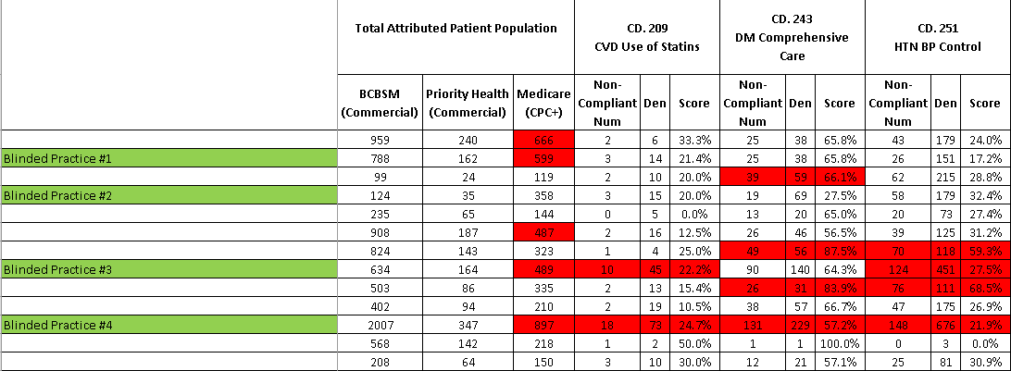
Practice Selection

Slide 17
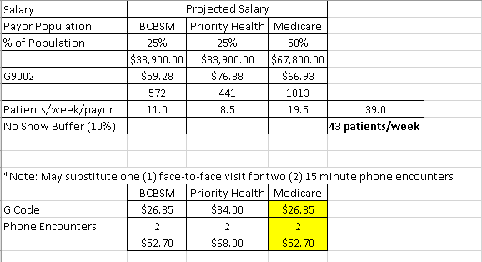
Financial Sustainability

Slide 19
Care Management Activities billed/coded per week
Daily work of care manager and office team
  Which patients will count in the program metrics: Patients who are attributed, have the health plan benefit, care is delivered and code is submitted
  What about the patient list – why it maters?
  See MDC handout

Slide 20
Billing Examples

Slide 21
Initial Assessment and Care Plan
A patient comes onto the office to be evaluated by their PCP. After the evaluation the PCP introduces the patient to the care manager (CM).
During the CMs conversation with the patient you assess that there is not a clear understanding about asthma management
CM conducts a medication review, teaches how to use peak flow and keep a log, provides an asthma action plan
CM and patient agree to follow up in one week via a phone visit.
This initial visit with the patient was 60 minutes. PCP and patient agree with the care plan
Identify the billing code: G9001, G9008

Slide 22
Coordination of Care
RN Care manager contacts the home health agency to schedule in-home visits and conduct a safety assessment.
In addition a call was made to the DME provider to arrange for delivery of home O2. Time spent coordinating care was 35 minutes.
Identify the billing code: 99487

Slide 23
Interdisciplinary Team Conference
Patient with diagnosis of diabetes, COPD and HTN. Patient screens positive for SDOH – food insecurity, struggling to afford medications, lacks caregiver support
An interdisciplinary team conference was held with the RN CM, SW CM and PCP to modify the plan and discuss the initial plan of care with the team.
Identify billing code: G9007

Slide 24
Phone Service
CM speaks with a patient via the telephone.
CM reviews the patient’s action plan and reinforces the symptoms that indicate exacerbations.
Also reinforces when to call the office.
In addition, CM asks the patient about interest in attending an asthma Group Visit. Patient indicates interest and CM provides the information regarding the asthma Group Visit.
CM and patient agree on follow up in one week via in person visit at the office.
This meeting takes 20 minutes.
Identify the billing code: 98967

Slide 25
Patient Visit – Face to Face
The patient returns to the office one week later to meet with CM:
During the visit CM and patient discuss symptoms, medications, SMART goals
Patient states he/she has not needed to use the rescue inhaler. and feels they now have a better understanding of how to care for them self. You again review the action plan and state you will follow up in one month.
Identify the billing code: G9002

Slide 26
Advance Directives
CM conducts a 20 minute in person meeting with a patient regarding their advance directives.
During the discussion information is given to the patient to review regarding advance directives
Discussion includes : how the patient prefers to be treated, what the patient wishes others to know
CM and patient agree to follow up via a phone call in 2 weeks
Identify the billing code: S0257

Slide 27
G/CPT Billing Code Resources – Care Management services
https://micmrc.org/training/care-management-billing-resources
New Billing/Coding Tools and Resources:
“Ready to Bill G/CPT Codes? What needs to be in Place in the PCP practice”
Place holder: micmrc.org NEW web page – Billing Operations
Financial Stability = Primary Care Practice Meeting the Goals for Financial Incentives – add link to : examples of tools to identify number of billed care management activities per month/week
Michigan Data Collaborative Handout

Slide 28
Appendix

Slide 29
Comprehensive Medication Review (CMR) Medicare Part D/Advantage Plans
Humana, Priority Health, BCBSM Advantage contract with OutcomesMTM to deliver CMR services to eligible members.
Priority Health:
  Medicare Advantage Plan: 4+ chronic medications, 3+ chronic conditions, and incur the CMS defined annual drug spend for CMR. Pharmacist can identify members outside of this criteria and “add” them for a CMR service. Must call OutcomesMTM to add a patient (3-day turn around).
  Commercial Plan/Medicaid: 4+ chronic medications Pharmacist can identify members outside of this criteria and “add” them for a CMR service. There is an option to “add patient” in the Connect platform. No need to call to OutcomesMTM.

Slide 30
Comprehensive Medication Review
CMR is generally provided once a year. However, per pharmacist’s discretion, more than 1 CMR can be reimbursed. Need to call OutcomesMTM for additional CMRs.
OutcomesMTM allows for either face to face or telephonic CMR. Virtual/telehealth visits = “in person” visit.
Standardized “Take Away” medication list must be documented and generated through OutcomesMTM Platform.

Slide 31
Additional Medicare Resources
Hospital-based Clinic – Pharmacist “incident to” billing
  Medicare Benefit Policy Manual – Chapter 6, 20.5.2
Office Based Clinic – 99211 billing
  Medicare Claims Processing Manual – Chapter 12, 30.6.4
“Incident to” billing information
  Medicare Benefit Policy Manual – Chapter 15, 60.1 and 60.3
“Incident to” Services – Documentation and Correct Billing
CMS Chronic Care Management Services
  https://www.cms.gov/Outreach-and-Education/Medicare-Learning-Network-MLN/MLNProducts/Downloads/ChronicCareManagement.pdf
CMS Transitional Care Management Services
  https://www.cms.gov/Outreach-and-Education/Medicare-Learning-Network-MLN/MLNProducts/Downloads/Transitional-Care-Management-Services-Fact-Sheet-ICN908628.pdf

Slide 32
“Incident to” Billing
“In your letter, you ask that we confirm your impression that if all the requirements of the "incident to" statute and regulations are met, a physician may bill for services provided by a pharmacist as "incident to" services. We agree.”

Slide 33
Medicare “incident to” Billing

