Slide 1
MICMT Complex Care Management Course
Care Management Delivery in the Primary Care Setting
© 2018 by the Regents of the University of Michigan. For questions or permissions please contact micmrc-requests@med.umich.edu
Notes:
Opening Statement
Welcome and thank you for joining us for the MiPCT Care Management Afternoon Session. We’re excited about the expert facilitators that we have today for this interactive educational activity. The focus for this afternoon will be Brief Action Planning (BAP), Patient Engagement & Agenda Setting
Before we get started, just a few points:
• In order to make best use of the time that we have with our experts this afternoon, we will not have scheduled break times. Snacks will be provided in this room, and please break as you need to.
• You will all stay in this room for the remainder of the afternoon, and our three experts facilitators will rotate through; each presenting a different topic for approximately one hour on each topic.
Does everyone have a packet of handouts? They include:
Agenda/Evaluation instructions
BAP Flow
Case Study

Slide 2
Learning Objectives
Describe Comprehensive Primary Care Functions
Explain the key elements of successful high need, high cost patient care models
Relate the Blue Cross Blue Shield of Michigan (BCBSM) PCMH PGIP Initiatives alignment with care management program metrics
Explain BCBSM PDCM, SIM, CPC+ program benchmarks, outcomes for patients, and success for the practice.

Slide 3
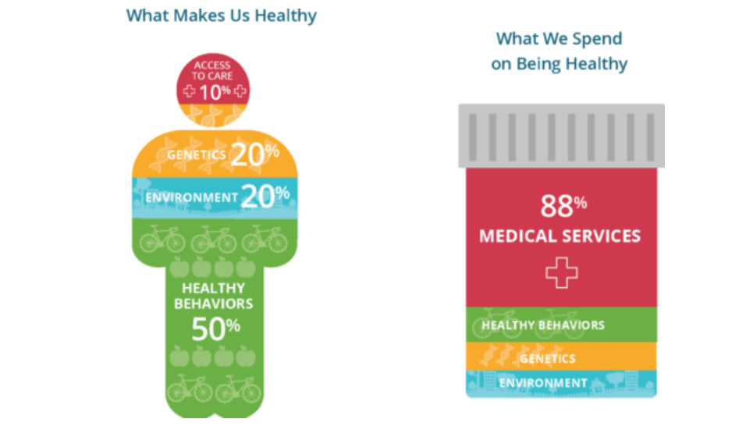
Reimagining Health Care in the US
https://pccinnovation.org/connected-communities-of-care/
Notes:
Focus is on Population health:
In Primary Care Practices the quality performance is based on all patients attributed to the practice –
If patients are attributed to the practice and have not been seen in over a year – they still contribute to the quality metrics for the practice.
Mounting expectations for outreach to work with ALL patients – rising risk patients, healthy/preventive and the complex patients.

Slide 4

Moving to Value

Slide 5
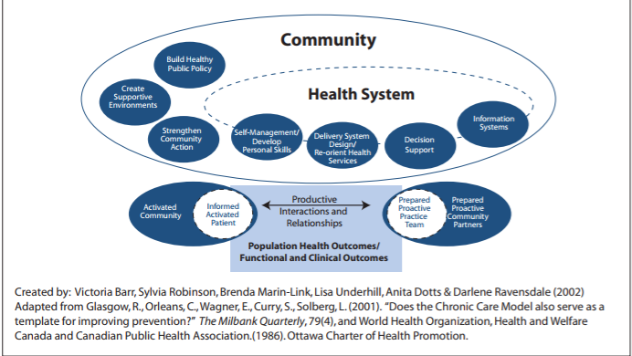
Expanded Chronic Care Model

Slide 6
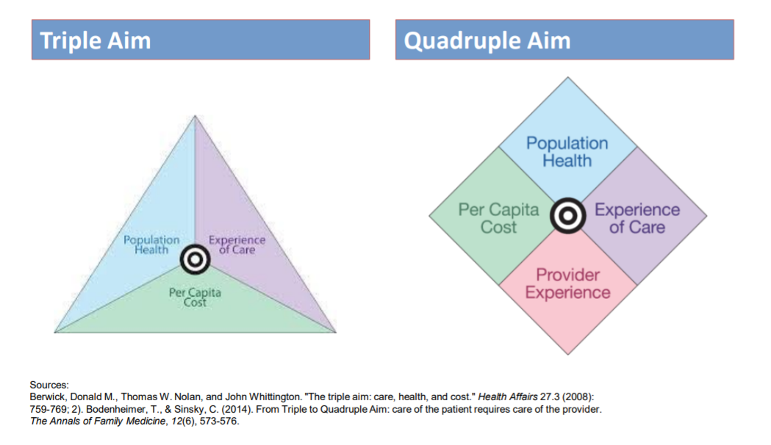
Including Providers

Slide 7
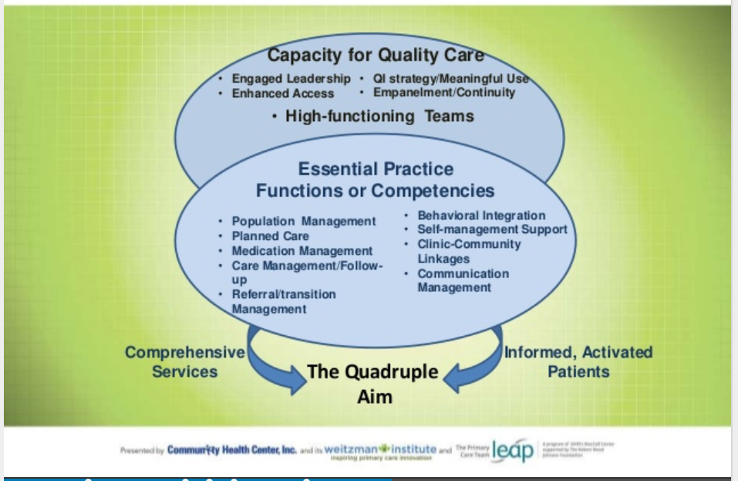
Primary Care Practice
https://www.slideshare.net/CHCConnecticut/advancing-teambased-care-building-your-primary-care-team-to-transform-your-practice

Slide 8
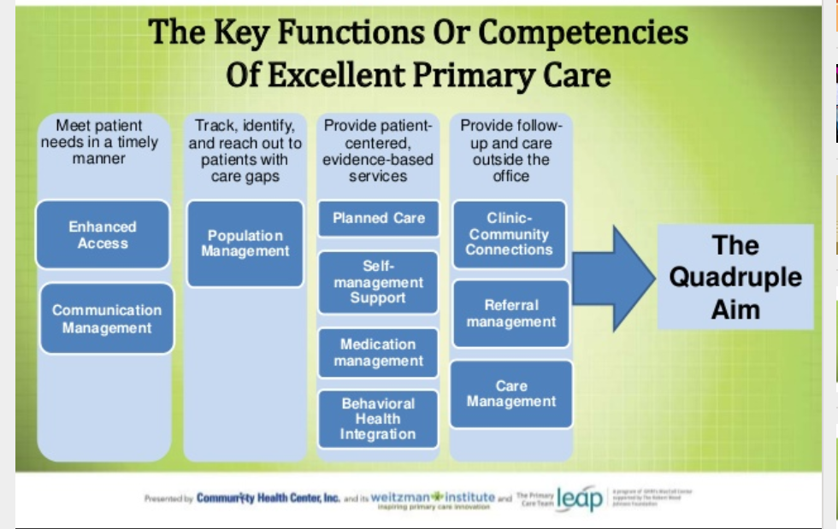
https://www.slideshare.net/CHCConnecticut/advancing-teambased-care-building-your-primary-care-team-to-transform-your-practice

Slide 9
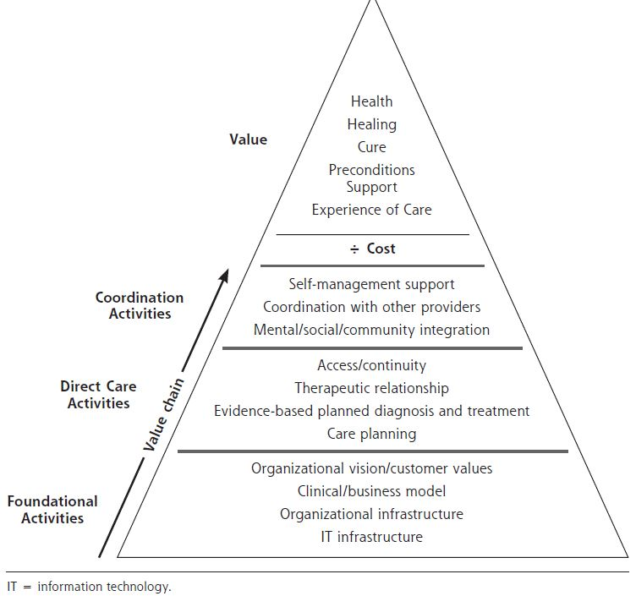
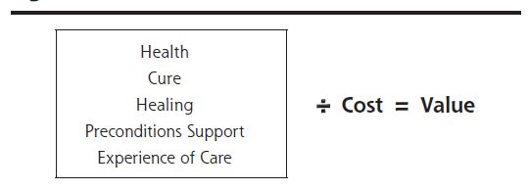
Achieving Value in Primary Care
Rollow, W., Cucchiara, P., Achieving Value in Primary Care: The Primary Care Value Model, Annals of Family Medicine, Vol.14, No. 2, Mar/Apr 2016

Slide 10
Reinforcing Elements of
Primary Care Value
Practice Transformation
Metrics: Outcomes and Quality
Care Management
Organizational Support
Make up the core of Patient Centered Medical Home

Slide 11
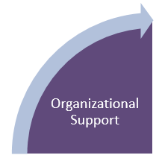
Organizational Support for Michigan Physician Offices
Examples of Organizations who support the Physician Office team(s):
  Provider Organizations (POs)
  Provider Hospital Organizations (PHOs)
  Federally Qualified Health Centers (FQHC)
  Rural Health Clinics (RHC)
  Leaders of Independent Practice
  Others
These organizations provide infrastructure and support.
  Examples include:
    Technology tools such as registries and/or discounted EHR
    Shared resources; such as care managers and quality improvement staff
    Support for practice transformation to attain PCMH recognition and other initiatives
Notes:
What is a PHO: An organization representing hospitals and physicians as an agent. A legal entity formed by a hospital and a group of physicians to further mutual interests and to achieve market objectives. A PHO generally combines physicians and a hospital into a single organization for the purpose of obtaining payer contracts.

Slide 12
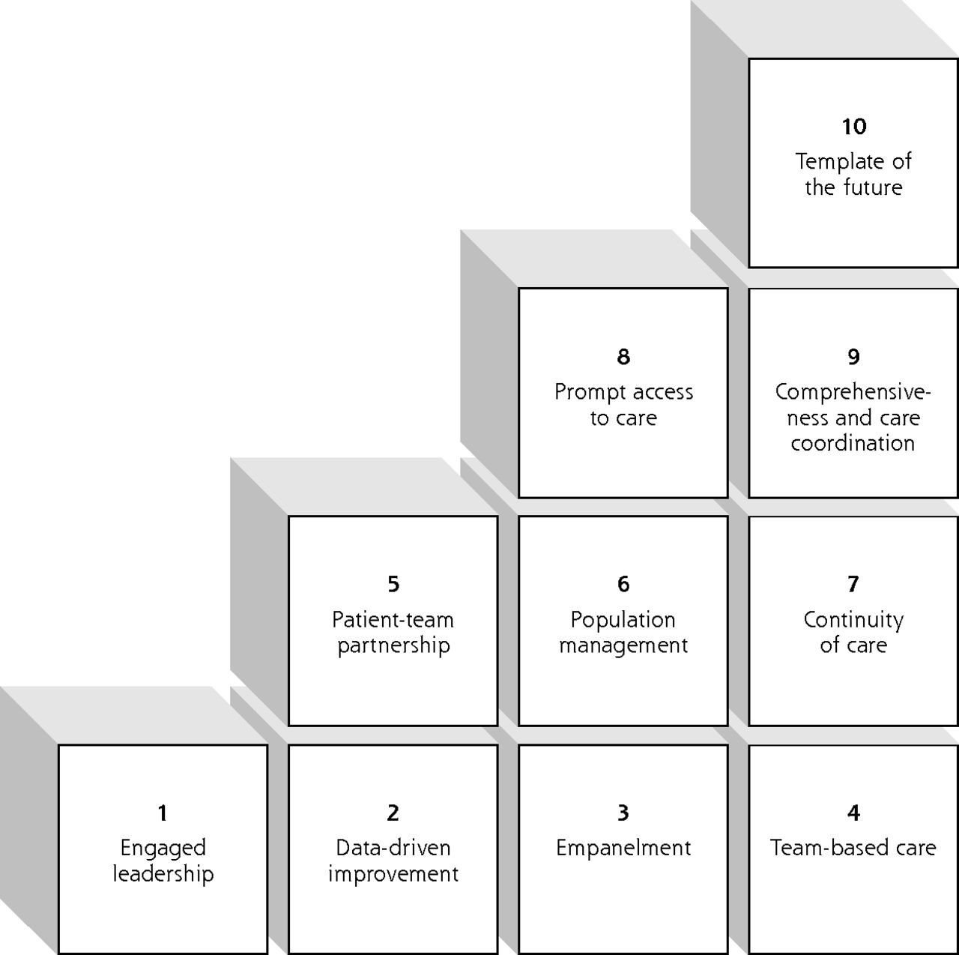
10 Building Blocks of Primary Care
Practice Transformation
Wagner, E. H., Flinter, M., Hsu, C., Cromp, D., Austin, B. T., Etz, R., Crabtree, B. F., … Ladden, M. D. (2017). Effective team-based primary care: observations from innovative practices. BMC family practice, 18(1), 13. doi:10.1186/s12875-017-0590-8
Notes:
Wagner, E. H., Flinter, M., Hsu, C., Cromp, D., Austin, B. T., Etz, R., Crabtree, B. F., … Ladden, M. D. (2017). Effective team-based primary care: observations from innovative practices. BMC family practice, 18(1), 13. doi:10.1186/s12875-017-0590-8

Slide 13
BCBSM Physician Group Incentive Program (PGIP)
BCBSM Physician Group Incentive Program (PGIP), established in 2005:
Supports provider partnership and transformation
  Brings together >40 Physician Organizations (POs)
  “Combination of incentive reward payments to POs and value-based reimbursement for individual physicians to ensure providers have the financial support needed to succeed”
Encourages all payer collaboration
Motto of “relentless incrementalism”
  Designs initiatives to support and reward step-by-step progress
About the Physician Group Incentive Program. Accessed 9/28/217. http://www.bcbsm.com/providers/value-partnerships/physician-group-incentive-prog.html
The Impact of Primary Care Practice Transformation on Cost, Quality, and Utilization A SYSTEMATIC REVIEW OF RESEARCH PUBLISHED IN 2016. Patient-Centered Primary Care Collaborative. July 2017. https://www.pcpcc.org/sites/default/files/resources/pcmh_evidence_report_08-1-17%20FINAL.pdf

Slide 14
BCBSM PGIP PCMH and PCMH-N
BCBSM’s Patient-Centered Medical Home program
  Largest recognition program in the country
  Practices adopt PCMH capabilities and tools to transform physician practices
  EVERY YEAR, practices are scored on capabilities, quality and use to earn PCMH designation
    Continuous improvement necessary
  PCMH-designated practices receive Value-Based Reimbursement
  Other health plans often reward this achievement
Practice transformation to build capabilities
Sufficient capabilities in place to nominate
Achieve/ maintain high quality of care
Earn PCMH designation and VBR
http://www.bcbsm.com/content/dam/public/Providers/Documents/value/patient-centered-medical-home-fact-sheet.pdf
Models of Care. Blue Cross Blue Shield of Michigan website. Accessed 9/28/217. http://www.bcbsm.com/providers/value-partnerships/physician-group-incentive-prog/models-of-care.html

Slide 15
The PGIP PCMH Capabilities
Patient-Provider Partnership
Patient Registry
Performance Reporting
Individual Care Management
Extended Access
Test Results Tracking and Follow-Up
Electronic Prescribing and Management of Controlled Substance Prescriptions
Preventive Services
Linkage to Community Services
Self-Management Support
Patient Web Portal
Coordination of Care
Specialist Pre-Consultation and Referral Process
BCBSM Physician Group Incentive Program, Patient-Centered medical Home and Patient-Centered Medical Home – Neighbor
Domains of Functions; Interpretative Guideline; 2018-2019
Value Partnerships – Improving Health Care in Michigan

Slide 16
2.0 Patient Registry
Goal:
Enable providers to manage their patients both at the population level and at point of care through use of a comprehensive patient registry
Capabilities:
A paper or electronic all-payer registry is being used to manage all established patients in the Practice Unit
Registry incorporates evidence-based care guidelines
Registry information is available and in use by the Practice Unit team at the point of care
Registry is being used to flag gaps in care for every patient currently in the registry
Registry is fully electronic, comprehensive and integrated, with analytic capabilities
Registry incorporates preventive services guidelines and is being used to generate routine, systematic communication to all patients in the practice regarding needed preventive services
Registry contains information identifying the individual care manager for every patient currently in the registry who has an assigned care manager

Slide 17
4.0 Individual Care Management
Goal:
Patients receive organized, planned care that also empowers them to take greater responsibility for their health
Capabilities:
Practice Unit has developed an integrated team of multi-disciplinary providers and a systematic approach is in place to deliver coordinated care management services that address patients' full range of health care needs for the patient population selected for initial focus
Medication review and management is provided at every visit for all patients with conditions requiring management
Systematic process is in place to identify patients who would benefit from care management services based on clinical conditions and ED, inpatient, and other service use
Systematic process is in place to inform patients about availability of care management services
Multi-disciplinary team meetings are held regularly to conduct patient case reviews, with development and review of comprehensive care plans for medically complex patients

Slide 18
10.0 Linkage to Community Services
Goal:
Expand the PCMH-Neighborhood to include community resources. Incorporate use of community resources into patients’ care plans and assist patients in accessing community services
Capabilities:
PO has conducted a comprehensive review of community resources for the geographic population that they serve, in conjunction with Practice Units
PO in conjunction with Practice Units has established collaborative relationships with appropriate community-based agencies and organizations
Systematic team approach is in place for educating all patients about availability of community resources and assessing and discussing the need for referral
Systematic approach is in place for referring patients to community resources
Systematic approach is in place for tracking referrals of high-risk patients to community resources made by the care team, and making every effort to ensure that patients complete the referral activity

Slide 19
11.0 Self-Management Support
Goal:
Systematic approach to empowering patients to understand their central role in effectively managing their illness, making informed decisions about care, and engaging in healthy behaviors
Capabilities:
Structured self-management support is systematically offered to all patients in the patient population selected for initial focus (based on need, suitability, and patient interest)
Systematic follow-up occurs for all patients in the patient population selected for initial focus who are engaged in self-management support to discuss action plans and goals, and provide supportive reminders
Support and guidance in establishing and working towards a self-management goal is offered to every patient, including well patients (e.g., asking well patients about health goals)

Slide 20
13.0 Coordination of Care
Goal:
Patient transitions are well-managed and patient care is coordinated across health care settings through a process of active communication and collaboration among providers, patients and their caregivers
Capabilities:
Process is in place for exchanging necessary medical records and discussing continued care arrangements with other providers, including facilities, for patient population selected for initial focus
Process is in place to systematically flag for immediate attention any patient issue that indicates a potentially time-sensitive health issue for patient population selected for initial focus
Process is in place to coordinate care with payer case manager for patients with complex or catastrophic conditions
Practice is actively participating in the Michigan Admission, Discharge, Transfer (ADT) Initiative
Notes:
MB Comment: Capabilities bullet 3: Does BCBSM use the term payer case manager or care manager?

Slide 21
Group Activity
BCBSM PGIP Patient-Centered Medical Home and Patient-Centered Medical Home- Neighbor Interpretive Guidelines 2017-2018 (see reference guide pg. 28)
2.0 Patient Registry
4.0 Individual Care Management
10.0 Linkage to Community Services
11.0 Self-Management Support
13.0 Coordination of Care

Slide 22
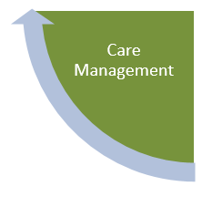
Care Management
Definition: “Care management programs apply systems, science, incentives, and information to improve medical practice and assist consumers and their support system to become engaged in a collaborative process designed to manage medical/social/mental health conditions more effectively.”
Ref: “Care Management Definition and Framework.” Center for Health Care Strategies, 2007 (www.chcs.org/usf_ doc/Care Management Framework. pdf).

Slide 23
Care Management
The goals of care management
  to improve patients’ functional health status,
  enhance coordination of care,
  eliminate duplication of services,
  reduce the need for expensive medical services,
  and increase patient engagement in self care
Ref: “Care Management Definition and Framework.” Center for Health Care Strategies, 2007 (www.chcs.org/usf_ doc/Care Management Framework. pdf).

Slide 24
Care Management
Care Management is maximized when
  Care Manager is embedded within practice care team
  Interventions and goals are aligned with patients’ goals and priorities
  Focus includes increasing patient engagement in self-care
  Targeting individuals likely to benefit and include team input
Successful evidence-based interventions
  Comprehensive care planning for complex patients
  Coordination with specialists and community resources
  Medication reconciliation
  Care transition support
  Individualized care plan

Slide 25
Methods for CM Success
Interdisciplinary team work
  Defined roles and responsibilities
  Use of team meetings
Relationship-focused
  Face-to-face contact with patients to build and sustain trust
  Collaborative relationship with physicians and team members
Use of standardized processes
  Particularly medication management, advanced care planning
Effective use of health IT
  Timely and reliable information on hospital use
  Analysis and patient risk information
Outcomes measurement to evaluate and improve performance

Slide 26
Characteristics of Successful Complex Care Management Models
Target individuals most likely to benefit from intervention
Comprehensive assessment of patients’ health-related risks and needs
Evidence-based care planning and routine patient monitoring
Promotion of patients’ and family caregivers’ engagement in patient self-care
Coordination of care and communication among the patient and care team
Facilitation of transitions
  from hospital to post- acute care and referral to community resources
Provision of appropriate care in accordance with patients’ goals and priorities
Reference: McCarthy Douglas; Ran, Jamie; Klein, Sarah “Models of Care for High-Need, High-Cost patients: An evidence Synthesis”,
Commonwealth Fund pub 1843 Vo 31; October 2015

Slide 27
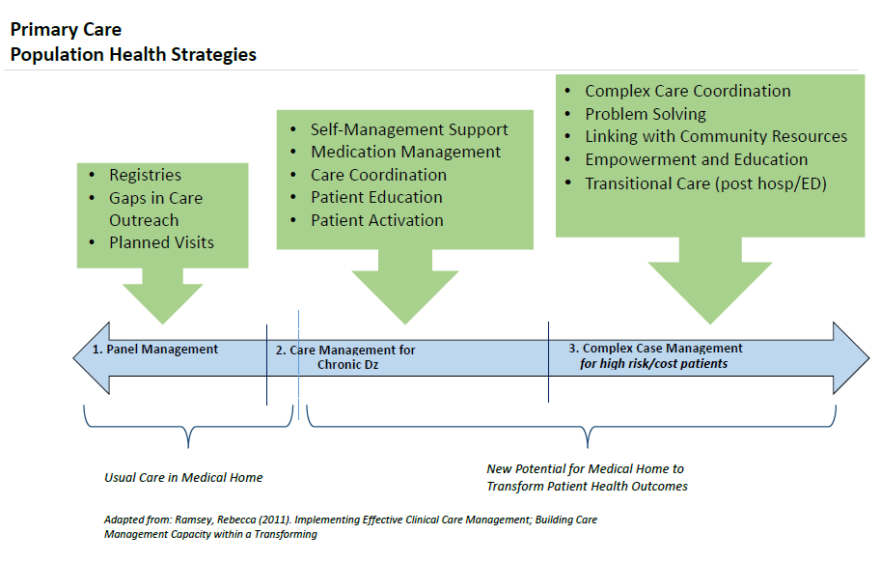
Primary Care - Care Management Continuum

Slide 28
MICMT Complex Care Management Course
BCBSM PDCM, SIM, CPC+ Program Benchmarks, Outcomes for Patients, and Success for the Practice
© 2015 by the Regents of the University of Michigan. For questions or permissions please contact micmrc-requests@med.umich.edu
Notes:
Opening Statement
Welcome and thank you for joining us for the MiPCT Care Management Afternoon Session. We’re excited about the expert facilitators that we have today for this interactive educational activity. The focus for this afternoon will be Brief Action Planning (BAP), Patient Engagement & Agenda Setting
Before we get started, just a few points:
• In order to make best use of the time that we have with our experts this afternoon, we will not have scheduled break times. Snacks will be provided in this room, and please break as you need to.
• You will all stay in this room for the remainder of the afternoon, and our three experts facilitators will rotate through; each presenting a different topic for approximately one hour on each topic.
Does everyone have a packet of handouts? They include:
Agenda/Evaluation instructions
BAP Flow
Case Study

Slide 29
2019 Michigan Demonstration and Care Management Programs
Michigan Commercial Health Plans
Centers for Medicare & Medicaid Services (CMS)
BCBSM Provider Delivered Care Management (PDCM)
  statewide
Priority Health Care Management
  statewide
BCBSM High Intensity Care Model (HICM)
  pilot
And Others
Michigan State Innovation Model (SIM)
  Medicaid Health Plans
  BCBSM, Priority Health
Comprehensive Primary Care Plus (CPC+)
  Medicare
  BCBSM, Priority Health, HealthScope Benefits

Slide 30
Michigan – Centers for Medicare & Medicaid Services (CMS) Funded Demonstrations
Demonstration | Brief Description of Intervention
Michigan State Innovation Model (MI-SIM) -Awarded to 11 States | 1) Design and testing of health care payment and service delivery models. 2) For Michigan the Care Delivery focus is Social Determinants of Health screening in PCP practice and Clinical Community Linkages.
Comprehensive Primary Care Plus (CPC+) -Awarded to 18 regions | Access and Continuity; Care Management; Comprehensiveness and Coordination; Patient and Caregiver Engagement; and Planned Care and Population Health
Ref: CCMI State Based Initiatives – Lessons Learned Nov 2018; https://innovation.cms.gov/Files/reports/statebasedinitiatives-lessonslearned.pdf

Slide 31
Metrics: Outcomes and Quality
Practice Transformation
Metrics: Outcomes and Quality
Care Management
Organizational Support

Slide 32
BCBSM PDCM, Priority Health, SIM, CPC+: Alignment of Program Metrics
Program | Quality Metrics | Utilization Metrics
BCBSM PDCM
PH
SIM
CPC+

Slide 33

BCBSM Provider Delivered Care Management (PDCM)
BCBSM Provider-Delivered Care Management is a model of care management delivered in the context of the doctor-patient relationship, which extends care management services into the clinical setting
2019 BCBSM PDCM Metrics focus:
Controlled Blood Pressure
Controlled HgA1C
Decrease Hospital Readmissions
Decrease Emergency Room Visits
Please see the PDCM Frequently Asked Questions document by emailing valuepartnerships@bcbsm.com.

Slide 34
PLACE HOLDER: Success for the Practice: DRAFT PDCM PGIP Scorecard

Slide 35
Success for the Practice
SIM
CPC+
Priority Health

Slide 36
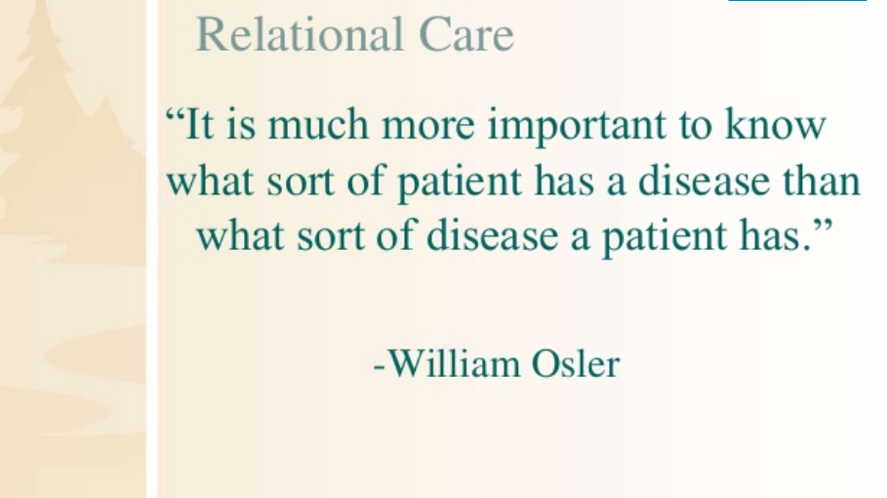
Outcomes for Patients
Outcomes for patients: focus on population health
Improved quality of life
Preventive care and chronic care addressed based on evidence based guidelines
Empowered to self manage, gain confidence and knowledge
Add information here about avoid rising risk
Chronic conditions managed optimally, delay or avoid diseade complications

Slide 37
Reference Guide
Acronym Definitions…………………………………………………….………………….….2
BCBSM Patient Centered Medical Home ……………………………………………15
SIM PCMH Key Roles of Care Coordinator/Care Manager………………..….17
BCBSM Physician Group Incentive Program…………………………………………28
BCBSM Billing Webinar Monthly Q&A….……………………………………………162

Slide 38
Appendix

Slide 39
CMS Demonstration Report: Lessons Learned
Clearly defined roles, careful identification of appropriate staff, and training support help promote effective integration of care managers and care coordinators.
In a number of models (ex. MAPCP), patients facing multiple socioeconomic barriers such as lack of adequate housing, food insecurity, and unmet dental and behavioral health needs were challenging to reach and engage.
Tailored outreach strategies based on culture, language, health literacy and social risk factors combined with multiple modes of approach (e.g., in-person, cell-phone, via community-based resource networks) increased beneficiary participation
Ongoing reimbursement as well as the removal of obstacles that limit their roles is needed to allow full use of care coordinators.
Ref: CCMI State Based Initiatives – Lessons Learned Nov 2018; https://innovation.cms.gov/Files/reports/statebasedinitiatives-lessonslearned.pdf
Notes:
New or refined staff roles focused on care coordination were central features of most initiatives. Irrespective of titles and credentials, across the models, these new staff (referred to as care coordinators) were credited with driving much of the improved care coordination that providers and patients experienced

Slide 40
Priority Health
Priority Health reimburses, fee for service, for care management codes. Reimbursement is available to primary care and specialty physicians
Eligible patients
Patients enrolled in care management should:
  Be classified as moderate or high risk based on health history
  Have one or more chronic conditions
  Have a completed care plan which includes the documentation requirements listed above
  Receive care by a trained qualified health provider* (QHP) and working within a structured care team

Slide 41
State Innovation Model (SIM)
Demonstration Project
  State Innovation Model (SIM) is funded by Centers for Medicare & Medicaid Services (CMS), led by the Michigan Department of Health and Human Services.
  Michigan is 1 of 11 states to receive funding.
  Timeline February 1, 2015 – January 1, 2020.
Model Overview
  Vision of empowerment: a person-centered health system that coordinates care across medical settings and with community organizations to address social determinants of health, improve health outcomes, and pursue community centered solutions to upstream factors related to poor health outcomes.
  References: Year 3 Michigan SIM Operational Plan, http://www.michigan.gov/documents/mdhhs/SIM_Operational_Plan_Year_3_FINAL_20180131_612773_7.pdf PCMH Initiative accessed 4/4/2018. Participation Guide v
  February 14th 2018 http://www.michigan.gov/documents/mdhhs/2018_SIM_PCMH_Initiative_Participation_Guide_604730_7.pdf Accessed 03/27/2018
Notes:
320 primary care practices are participating in the SIM PCMH Initiative. These practices represent more than 2,200 primary care providers and 340,000 Medicaid beneficiaries

Slide 42
Michigan-SIM Components
Care Delivery
Patient-Centered Medical Home (PCMH) Initiative
Advanced Payment Models
Population Health
Community Health Innovation Region (CHIR)
Focused on:
Clinical-Community Linkage
Supported by:
Stakeholder Engagement
Data Sharing and Interoperability
Consistent Performance Metrics

Slide 43
The SIM PCMH Initiative:
Core Components
1. Core Primary Care
  PCMH Accreditation
  24/7 access to a care team practitioner with real time access to the EHR
  Care organized by team
  Alternative to transitional office visits
  At least 30% of available appointments reserved for same-day care
2. Clinical Practice Improvement
  Clinical Community Linkage
    Screen clients for Social Determinants of Health needs using a brief screening tool.
    Provide Linkages to community-based organizations that support patient needs identified through screening.
    Periodically review linkages made and the outcome to determine effectiveness of the Practice’s processes and community partnerships; assess process improvement and partnership opportunities.
    Practices in CHIR regions: actively participate with the CHIR.
  Population Health Management
    Ensure engagement of clinical and administrative leadership.
    Empanel at least 95% of the Practice’s patient population.
    Use feedback reports provided by MDHHS, other payers and/or practice systems to improve population health.

Slide 44
The SIM PCMH Initiative:
Core Components (cont.)
3. Care Management and Coordination (examples)
  Embed Care Management and Coordination Staff Members functioning as integral, fully-involved members of every participating care team.
  Provide targeted, proactive, relationship-based (longitudinal) Care Management and coordination.
  Provide short-term (episodic) care management and coordination.
  Utilize a care plan.
  Implement self-management support for at least 1 high risk condition.
4. Health Information Technology (examples)
  Posses and utilize a fully implemented EHR.
  Posses and utilize an All-Patient Registry or Registry Functionality.
  Participate in the Michigan Health Information Network Health Information Exchange Use Cases.
  Posses and utilize an electronic care management and coordination documentation tool.
  Posses and utilize an electronic system capable of providing decision support prompts and care alerts to clinicians at the point of care.

Slide 45
SIM PCMH Initiative
Geographic Reach
  Statewide
  337 practices
  2,153 Providers participating
  Serving 340,192 beneficiaries *
  (*Number as of March 31, 2018)
For more information see the Care Delivery website which contains information on requirements, upcoming events, Newsletters, etc.

Slide 46
CPC+
Demonstration Program
  Comprehensive Primary Care Plus funded by CMS to test an advanced PCMH model that aims to strengthen primary care through payment reform and care delivery transformation
  Michigan selected as 1 of 18 regions
  Implementation Timeline Jan 1, 2017 – Dec 31, 2021
Multipayer: Led by CMS
  Commercial Health Plans: BCBSM, Priority Health, HealthSCOPE Benefits
Model Overview
  Regionally-based, multi-payer care delivery and payment model
  CPC+ Practice participating practices are either in Track 1 or Track 2
    Track 2 practices requirements: advanced health IT capabilities and advanced transformation
Geographic Reach
  Statewide, Practices were selected by CMS
  Reporting is at a practice level
https://www.cms.gov/Newsroom/MediaReleaseDatabase/Fact-sheets/2017-Fact-Sheet-items/2017-05-17.html

Slide 47
CPC+
Examples of Practice Transformation Focus (note this is a subset/overview of areas of focus. There are additional track 1 and 2 requirements)
Access and Continuity
  Empanelment to care practitioner or care teams
Care Management
  Use 2 step risk stratification, risk stratification algorithm + PCP team input
  Episodic care management - transitions of care
  Patient self-management support for at least 3 high risk chronic conditions
  Longitudinal care management – plan of care based on assessment with updates to the plan of care as needed
Reference: 2018 CPC+ IMPLEMENTATION GUIDE: GUIDING PRINCIPLES AND REPORTING (accessed Feb. 2018)

Slide 48
CPC+
Examples of Practice Transformation Focus (note this is a subset/overview of areas of focus. There are additional track 1 and 2 requirements) cont.
Patient and Caregiver Engagement
  Patient and Family Advisory Council
Comprehensiveness and Coordination
  Integrate behavioral health into care
  Clinical-community linkages- develop a process to ensure reliable resource connections for patients in your practice who have common social needs*
  Maintain collaborative care agreements with at least 2 groups of specialists
Planned Care and Population Health
  Care team meetings with data review
  Use data at the practice level
    At least 2 utilization measures
    At least 3 electronic clinical quality measures
*ex. Track 2 practice goal
Reference: 2018 CPC+ IMPLEMENTATION GUIDE: GUIDING PRINCIPLES AND REPORTING (accessed Feb. 2018)

Slide 49
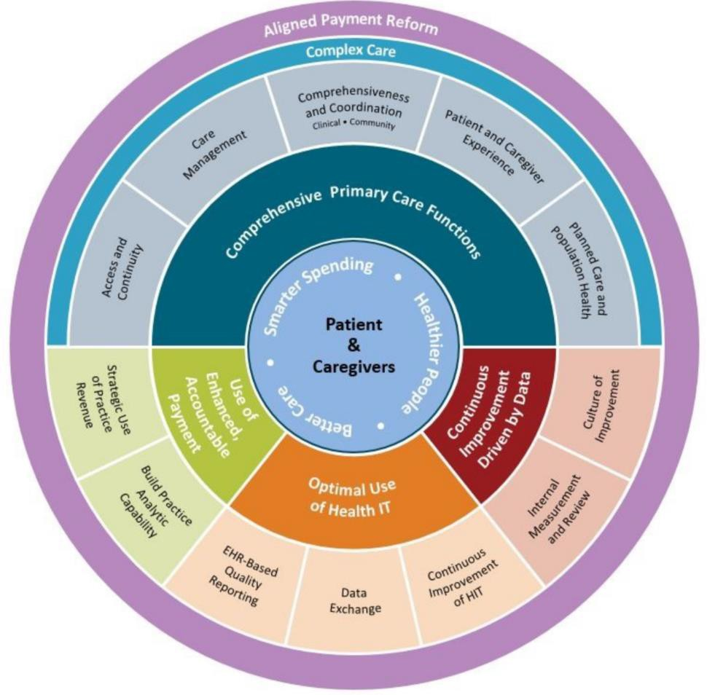
Alignment
Image Credit: CMS , CPC +
2017 CPC+ IMPLEMENTATION GUIDE: GUIDING PRINCIPLES AND REPORTING v May 10, 2017 accessed at 2017_CPCPlus_Implementation_Guide_FINAL

Slide 50

What does this all mean for you?

Slide 51
MiPCT Experience
Model Overview
  Primary care model with a heavy emphasis on care management to improve cost, quality, and patient experience within a PCMH
  Support practice level population management via proactive patient outreach and point of care alerts
  Care management for appropriate high and moderate risk individuals
  Improve access to primary care services
Evaluation of the Multi-Payer Advanced Primary Care Practice (MAPCP) Demonstration Final Report
By RTI International, Donald Nichols, Project Director June 2017. https://downloads.cms.gov/files/cmmi/mapcp-finalevalrpt.pdf

Slide 52
MiPCT Impact
Influence on primary care in Michigan
  Introduced care managers into advanced primary care practices
  Increased communication and uptake over the program
  Improved patient experience
  Improved care and quality processes
  Built strong foundation for growth of ACO’s in region
  Drew national attention, Michigan selected for demonstration programs
    State Innovation Model (SIM)
    Comprehensive Primary Care Plus (CPC+)
Notes:
CIN – look up

Slide 53
MiPCT Experience
MAPCP Demonstration Final Report: State Comparison
 |  |  | Vs. PCMH
State | Eligible beneficiary quarters | Total MAPCP Demonstration fees | Gross savings | Net savings | Return on fees
New York | 279,899 | $5,750,926 | −$3,892,202 | −$9,643,127 | −0.68
Rhode Island | 113,633 | $1,974,907 | −$12,383,617 | −$14,358,525 | −6.27
Vermont | 760,427 | $18,340,927 | $82,271,080* | $63,930,154* | 4.49
North Carolina | 243,933 | $6,524,816 | −$7,674,949 | −$14,199,765 | −1.18
Minnesota | 836,922 | $2,429,820 | — | — | —
Maine | 424,920 | $12,313,581 | −$52,558,003 | −$64,871,584* | −4.27
Michigan | 2,265,099 | $64,938,363 | $294,714,755* | $229,776,392* | 4.54
Pennsylvania | 324,051 | $5,338,237 | $36,633,819* | $24,158,656^ | 2.94^
*Statistically significant at the 10 percent level. ^ In Pennsylvania, net savings and return on fees include the shared savings payment in Year Three.
Evaluation of the Multi-Payer Advanced Primary Care Practice (MAPCP) Demonstration Final Report
By RTI International, Donald Nichols, Project Director June 2017. https://downloads.cms.gov/files/cmmi/mapcp-finalevalrpt.pdf

Slide 54
MiPCT Impact
“Among the many transformation activities in which practices engaged, care managers were described as the most central, transformative activity of the MAPCP Demonstration.”
“The most important staffing change related to MiPCT was the hiring, training, and embedding of the care managers. Given the large number of people to be hired, MiPCT virtually invented care management in Michigan by financing the hiring of more than 400 care managers.”
Evaluation of the Multi-Payer Advanced Primary Care Practice (MAPCP) Demonstration Final Report
By RTI International, Donald Nichols, Project Director June 2017. https://downloads.cms.gov/files/cmmi/mapcp-finalevalrpt.pdf

