Slide 1
Self-Management Support Training

Slide 2

Welcome!
HOUSE KEEPING
Notes:
Location of bathrooms etc.
Facilitators introduce themselves
Acknowledge the hard work done with the self study portion of the class. Let learners know that we will building on the self study material through the class today
Direct attendees to the notecards on their tables. These should be used throughout the day for attendees to write questions. Place them at designated spot in the room and try to answer them during the training. If unable to answer during the training day, follow up with emails to all with the questions and answers

Slide 3
Today’s Agenda
Introduction
Self-Management
Chronic Illness and Self-Management
Motivational Interviewing
Team Based Care and Self-Management
Action Planning and Problem Solving
Billing and Sustainability

Slide 4
Introduction

Slide 5
Learning Objectives:
Describe Michigan Institute for Care Management and Transformation goals and resources available for physician office team members
Apply behavior change to personal goals

Slide 6
Michigan Institute for Care Management and Transformation (MICMT)
Who we are:
  Partnership between University of Michigan and BCBSM Physician Group Incentive Program
Goal of MICMT:
  To help expand the adoption of and access to multidisciplinary care teams providing care management to populations served by the physician community in order to improve care coordination and outcomes for patients with complex illness, emerging risk, and transitions of care
Notes:
MICMT will comprehensively support the work of all care team members in the primary care setting
And provide a mechanism for data collection and analysis about care management around the state.
MICMT is a collaboration between Michigan Medicine and BCBSM

Slide 7
MICMT Team Members
Hae Mi Choe, PharmD
  Executive Director
Marie Beisel, MSN, RN, CCM, CPHQ
  Administrative Manager Senior Healthcare
Alicia Majcher, MHSA
  Operations Director
Julie Geyer, BBA
  Senior Project Manager
Sandy Becker, MA
  Data Analyst
Judy Avie, BSN, M.Ed. IT, RN
  Program Manager
Sarah Fraley, LMSW, ACSW
  Project Manager
Scott Johnson, BBA, MSA, RN
  Project Manager
Sarah Fraley, LMSW, ACSW
  Project Manager
Betty Rakowski, BSN, RN, MA Ed
  Curriculum Designer
Nicole Rockey, PharmD
  Pharmacist
Cindy Stevens
  Administrative Assistant Sr.
Julie Wolf
  Administrative Assistant Sr.

Slide 8
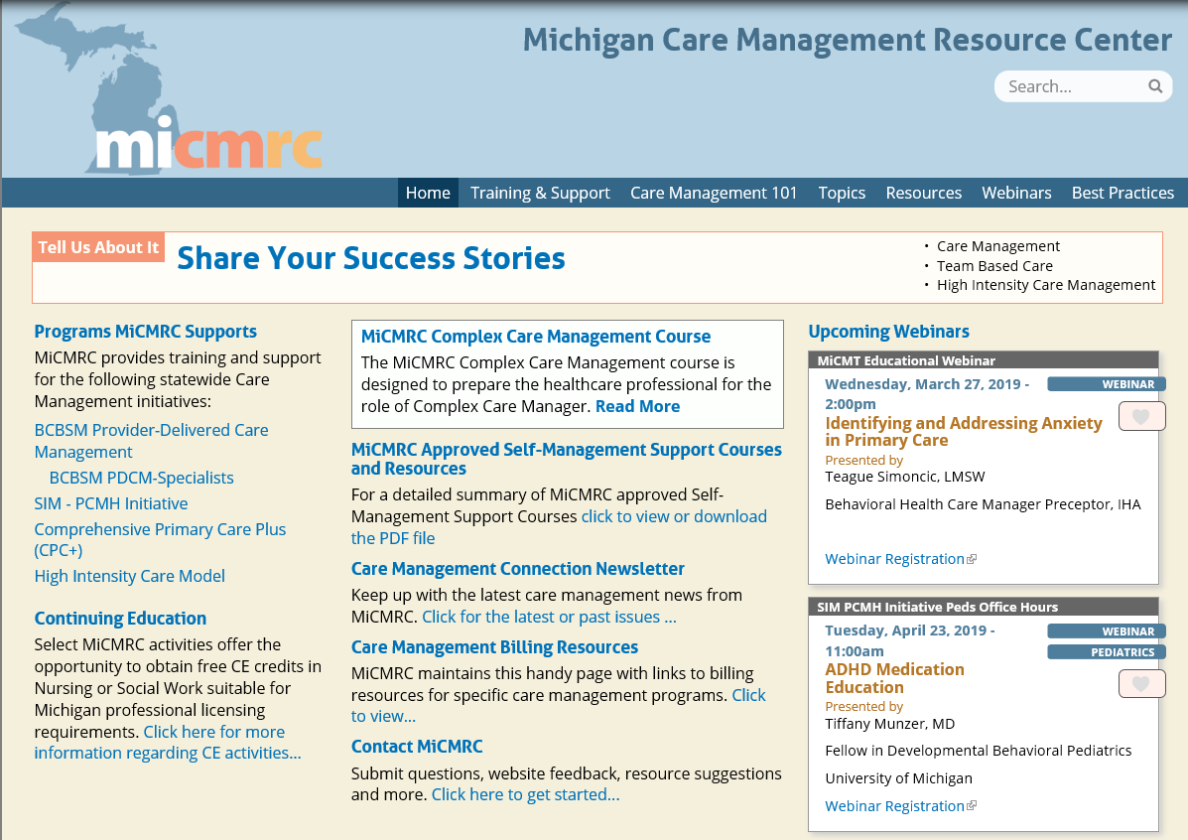
Notes:
Point out to participants where to find resources such as billing and upcoming webinars. Inform participants that webinars occur both live and recorded so they can be watched at any time. Some webinars have CEs attached.

Slide 9
MICMT Statewide Self-Management Support Course Post Test and Evaluation
Logistics:
The MICMT SMS Statewide Post Test and evaluation is web based
A web link to the SMS Post Test and evaluation will be sent to you via the e-mail you provided during registration
Test Scoring
  Occurs real-time when you submit your responses. You will receive Pass/Fail notification prior to closing the test
  Upon achieving a passing test score, you will continue on to the evaluation
  Lastly an e-mail is sent to you with notification of MICMT SMS Course Post test “Pass” status
  For Questions contact: micmt-requests@med.umich.edu
Notes:
Inform participants that they may re-take the test right away without any penalty

Slide 10
Statewide Self-Management Support (SMS) Course Completion
Successful Completion of the SMS course includes:
1. Completion of the self-study modules
2. Completion of the 1 day in-person
3. Complete the Michigan Institute for Care Management and Transformation (MICMT) SMS Post Test and the MICMT Statewide course evaluation
  Achieve a passing score on the Post Test of 80% or greater
    If needed, you may retake the Post Test
4. Complete a 30 minute Practice Phone Session

Slide 11
Statewide Self-Management Support (SMS) Course Completion
*Please note:
You will have 5 business days to complete the Statewide Self-Management Support Post Test and evaluation
You will need to complete a 30 minute practice session with the SMS course trainer following your successful (pass status)completion of the post test. An email will be sent to you within 1-2 weeks of completing the SMS post test enabling you to schedule the practice session.
You will receive a certificate (Nursing CE, Social Work CE, or certificate of completion) following the 30 minute practice session

Slide 12
Introductions:
What type of patient do you enjoy working with?
What type of patient do you find challenging?
Notes:
Go around the room and have attendees say their name, discipline and where they are practicing along with answering the questions on the slide
Keep in mind the type of patients that are challenging and attempt to use them as examples throughout the days

Slide 13
INTROSPECTION EXERCISE Activity #1*
Looking at our own attempts at behavior change
Notes:
Have attendees take Activity 1 out of their folder and fill it out
This will not be shared with other group members or the facilitator unless volunteered by attendee
I

Slide 14
Self-Management

Slide 15
Learning Objectives:
Define Self-Management
Describe Self-Management Support
Define the 5A’s Behavior Change Model

Slide 16
Looking Through a New Lens:
Standard Approach | Self-Management Support Approach
Focused on fixing the problem | Focused on the patient’s concerns and perspectives
Paternalistic relationship | Egalitarian partnership
Confront, warn, persuade | Emphasizes personal choice
Ambivalence means that the patient is in denial | Ambivalence is a normal part of the change process
Goals are prescribed | Goals are collectively developed
Notes:
Many people have learned how to work with patients in the standard approach. The challenge for this training, is to open our minds up to other more collaborative ways to work with our patients and produce positive outcomes
Post test question
A Self-Management Support patient centered approach to care management includes which of the following:
a. Focusing on the patient’s concerns and goals
b. Matching interventions to the patient’s stage of change
c. Accepting ambivalence as part of the change process
d. Addressing the patient by advising, warning, and persuading
a and b only
a, b, and c only (in class Looking through a new lens slide 12)
b and c only
All of a, b, c, d
None of a, b, c, d

Slide 17
Video
https://www.youtube.com/watch?v=0z65EppMfHk
Notes:
Explain to participants that this is what we will be learning about throughout the day

Slide 18
Self-Management
“The individual’s ability to manage the symptoms, treatment, physical and social consequences and lifestyle changes inherent in living with a chronic condition.”
Barlow et al, Patient Educ Couns 2002;48:177

Slide 19
The 6 principles of Self-Management
The Flinders Model
Knowledge of one’s condition
Follow a care plan
Actively share in decision-making
Monitor and manage signs and symptoms
Manage impact on physical, emotional and social life
Adopt lifestyles that promote health
https://www.flindersprogram.com.au/
Notes:
Post test question
The six principles of self-management include which of the following:
Knowledge of my condition
Following a plan of care
Actively participating in decision making
Monitoring and managing my signs and symptoms
Managing impact on physical, emotional and social life
Adopting a life style that promotes healthy behavior
a, c, d and e only
a, b, and c only
b and c only
All of a, b, c, d, e, and f (in class 6 Principles of Self-Management slide16)
None of a, b, c, d

Slide 20
What is self-management support?
According to Bodenheimer et al., "Self-management support involves:
collaboratively helping patients and their families acquire the skills and confidence to manage their chronic illness, providing self-management tools (e.g., blood pressure cuffs, glucometers, and referrals to community resources), and routinely assessing problems and accomplishments"
https://pdfs.semanticscholar.org/930c/f3266a05746c3cd49cb1fd15d7ed534f3ef2.pdf
Notes:
This is what the practice team is helping with

Slide 21
Self-management programs focus on preparing people with chronic conditions for the 99% of the time they live outside of the health care system
https://www.integration.samhsa.gov/about-us/CDSM_January_Webinar.pdf

Slide 22
Professionals are experts in diseases
Patients are experts about their own lives
https://healthydebate.ca/opinions/patients-as-experts
The risk of equating “lived experience “ with patient expertise, Frank Gavin 2/13/19

Slide 23
Chronic Illness and Self-Management
The patients we are serving…

Slide 24
Learning Objective:
Describe chronic illness care and the relationship to Self-Management

Slide 25
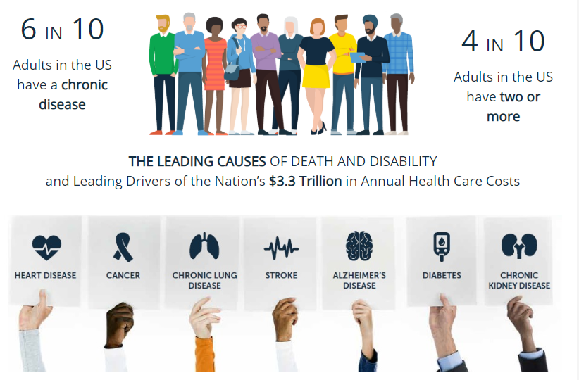
https://www.cdc.gov/chronicdisease/resources/infographic/chronic-diseases.htm
Notes:
Have attendees name different chronic conditions. Ask for any additional that are not on his slide
Posttest question
True or False: 6 out of 10 people in the US have a chronic condition and 4 out of 10 have two or more chronic conditions
True (in class slide 21)
False

Slide 26
What Patients with Chronic Illnesses Need
A “continuous healing relationship” with a care team and practice system organized to meet their needs for:
  Effective Treatment (clinical, behavioral, supportive)
  Information and support for their self-management
  Systematic follow-up and assessment tailored to clinical severity
  More intensive management for those not meeting targets
  Coordination of care across settings and professionals
Wagner, E., MD Redesigning Chronic Illness Care: The Chronic Care Model, accessed through http://www.improvingchroniccare.org/index.php?p=Presentations_&_Slides&s=397
"Copyright 1996-2018 The MacColl Center. The Improving Chronic Illness Care program is supported by The Robert Wood Johnson Foundation, with direction and technical assistance provided by Group Health's MacColl Center for Health Care Innovation".

Slide 27
What distinguishes good chronic illness care from usual care?
Informed,
Activated
Patient
Productive
Interactions
Prepared
Practice
Team
http://www.improvingchroniccare.org/index.php?p=Presentations_&_Slides&s=397
"Copyright 1996-2018 The MacColl Center. The Improving Chronic Illness Care program is supported by The Robert Wood Johnson Foundation, with direction and technical assistance provided by Group Health's MacColl Center for Health Care Innovation".
Notes:
The essential element of good chronic illness care is a productive interaction, versus current interactions that tend to be frustrating for both patients and providers. An interaction can be a face-to-face visit, a phone call or an email message. Productive means that the work of evidence-based chronic disease care gets done in a systematic way, and patient needs are met.
Wagner EH, Davis C, Schaefer J, Von Korff M, Austin B. A survey of leading chronic disease management programs: Are they consistent with the literature? Managed Care Quarterly. 1999; 7(3):56-66

Slide 28
What characterizes an “informed, activated” patient?
Informed,
Activated
Patient
Patient understands the disease process,
and realizes his/her role as the daily self manager.
Family and caregivers are engaged in the patient’s
self-management. The provider is viewed
as a guide on the side, not the sage on the stage!
http://www.improvingchroniccare.org/index.php?p=Presentations_&_Slides&s=397
"Copyright 1996-2018 The MacColl Center. The Improving Chronic Illness Care program is supported by The Robert Wood Johnson Foundation, with direction and technical assistance provided by Group Health's MacColl Center for Health Care Innovation".
Notes:
We need to help our patients become more involved in their care. We need to allow for cultural and age cohort variations and personal preference in the amount of involvement. Our interactions need to foster the patient’s sense of control and responsibility.
Anderson R. Patient empowerment and the traditional medical model: A case of irreconcilable differences? Diabetes Care. 1995; March. 18(3): 412-415.
Bodenheimer T, Lorig K, Holman H, Grumbach K. Patient self-management of chronic disease in primary care. JAMA. 2002; November. 288(19):2469-75.
Lorig K, Holman H, Sobel D, Laurent D, Gonzalez V, Minor M. Living a healthy life with chronic conditions. Bull Publishing, Palo Alto, CA. 2000
Posttest question
What are the characteristics of activated patient?
Understands their disease process
Realizes their role in daily self-management monitoring and managing symptoms
Engaged family/care giver
Views provider and staff as guides
Uses the emergency room for symptom management
a, c, d and e only
a, b, c and d only (in class Informed and activated patient slide24)
b and c only
All of the above a, b, c, d, and e
None of the above a, b, c, d, and e

Slide 29
What characterizes a “prepared” practice team?
Prepared
Practice
Team
At the time of the visit, they have the patient
information, decision support, people,
equipment, and time required to deliver
evidence-based clinical management and
self-management support
http://www.improvingchroniccare.org/index.php?p=Presentations_&_Slides&s=397
"Copyright 1996-2018 The MacColl Center. The Improving Chronic Illness Care program is supported by The Robert Wood Johnson Foundation, with direction and technical assistance provided by Group Health's MacColl Center for Health Care Innovation".
Notes:
Let’s look at the two sides of the interaction in more detail.
Taplin S, Galvin MS, Payne T, Coole D, Wagner E. Putting Population-Based Care Into Practice: Real Option or Rhetoric? J Am Board Fam Pract. 1998;11(2):116-26.
Posttest question
What are the characteristics of a Prepared Practice?
Provides Patient Information for education and coaching
Decision Support
Delivers Evidence Base Care
Delivers Self-management support
Limits access to care
a, c, d and e only
a, b, c and d only (in class Prepared Practice Team slide25)
b and c only
All of the above a, b, c, d, and e
None of the above a, b, c, d, and e

Slide 30
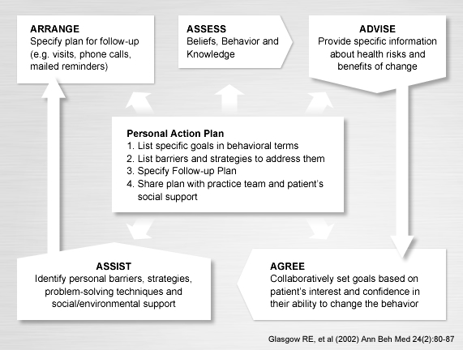
The 5 As of Self-Management Behavior Change
Notes:
Have attendees pull out handout # from their folder as this slide is difficult to see. Encourage attendees to keep this close at hand as we’ll be referring to it throughout the day
Posttest Question
What are the 5 As of Self-Management Behavior Change?
Assess: patient’s beliefs, behaviors and knowledge
Advise: provide specific information
Agree: Collaboratively set goals
Assist: Identify barriers, problem solving and supports
Action Plan: Based on clinical team’s goals
Arrange: Plan for follow-up
a, c, d and e only
a, b, c, d and f only (in class 5 As of change slide26)
b and c only
All of the above a, b, c, d, e and f
None of the above a, b, c, d, e and f

Slide 31
“Self-Management is inevitable”
T. Bodenheimer, MD

Slide 32
Motivational Interviewing
Having conversations with patients…

Slide 33
Ruler Line Up Activity #2
1
2
3…

Slide 34
Learning Objectives:
Provide an understanding of the MI spirit
Illustrate how strategies and applications of MI can support patient self-management

Slide 35
Motivational Interviewing:
A collaborative conversation style for strengthening a person’s own motivations and commitment to change
    Person centered counseling style for addressing the common problems of ambivalence about change
Miller and Rollnick 2013

Slide 36
MI spirit
OARS
Change
talk
MI processes
MI
Notes:
MI Elements
Post test question
Motivational Interviewing comprises what four skills?
OARS
Spirit of MI
Right Reflex
Change Talk
Process MI
a, c, d and e only
a, b, d and e only (in class MI slide32)
b and c only
All of the above a, b, c, d, and e
None of the above a, b, c, d, and e

Slide 37

Partnership
Acceptance
Compassion
Evocation
Spirit
Notes:
The "Spirit" of Motivational Interviewing (MI) is more than the use of a set of technical interventions. It is characterized by a particular "way of being." This way of being is described as the "Spirit of MI." The "Spirit of MI" is the foundation of every MI conversation that takes place. It communicates compassion, acceptance, partnership, and respect

Slide 38
Why don’t people just do what they should?
Notes:
Solicit answers: Lack of resources, paralysis, fear, don’t want to change, don’t know what to do about it, lack of motivation. resistance, comfort in what is familiar etc.

Slide 39
Knowledge ≠ Behavior Change
Remember that what people know may not determine what they do.
Example:
Behavior
Intention
Knowledge
Better Indicators
Notes:
This slide illustrates the point that
what people know may not determine what they do. Although someone may know the dangers of smoking they continue to engage in smoking cigarettes

Slide 40

Motivational Interviewing and Behavior Change
R Resist the “Righting Reflex”
U Understand your patient’s motivations
L Listen to your patient
E Empower your patient
Notes:
We often, (especially in the standard approach), want to tell our patients what they are doing wrong, It is more effective to bring out from our patients what their concerns are about their health

Slide 41
Roll with Resistance
Resistance is what happens when we expect or push for change when the patient is not ready for that change.
Resistance often stems from fear of change
How we as providers respond to patient resistance is a big determining factor in the outcome of our interaction with that patient and the ability to help the patient move toward behavior change.
https://health.mo.gov/living/healthcondiseases/chronic/wisewoman/pdf/MIRollingwithResistance.pdf
Notes:
We will introduce the techniques used in motivational interviewing to learn how to have conversations with patients and roll with resistance when we encounter it

Slide 42
MI spirit
OARS
Change
talk
MI processes
MI
Notes:
MI Elements

Slide 43
MI Interviewing Strategies/Skills
Open ended questions
Affirmations
Reflections
Summaries

Slide 44
Open Ended Questions
Activity…..
OARS
Activity #3*
Notes:
Reference the ASSESS part of the 5 As. These questions help with the assessment process – Beliefs, Behavior and Knowledge

Slide 45
Asking Questions
Many patients have never been asked how they feel about their health or what they would like to change.
Asking questions can also help us understand why a patient may not be making progress
Questions help in the engagement process

Slide 46
Explore --- Offer --- Explore
Explore – ask what the patient knows, has heard, or would like to know
  “When it comes to diabetes, what would be most helpful to know more about?”
Offer - offer information in a neutral, nonjudgmental manner
  “Research suggests…”
  “What we generally recommend is…”
Explore – ask about thoughts, feelings, and reactions
  “What do you think about this information?”
  “Based on these ideas for healthy eating, what could you see yourself doing?”

Slide 47
Affirmations
OARS
In order to encourage and support the client during the change process, the MI provider frequently affirms the patient in the form of statements of appreciation or understanding ~e.g. – “It took courage to do that.” “You have a lot of great ideas on how to move forward.”

Slide 48
“If you treat an individual as he is, he will stay as he is, but if you treat him as if he were what he ought to be and could be, he will become what he ought to be and could be.”
- Johann Wolfgang von Goethe
Notes:
This is part of strengths based practice along with the SPIRIT of MI
We can’t control our patients but we can control ourselves

Slide 49
OARS
Reflections:
An active process (the provider decides what to reflect or ignore, what to emphasize, preferentially reflecting change talk)
Statements rather than questions
Mirror meaning of a preceding statement(s)

Slide 50
Reflections
Help with letting our patients know we are listening to them
Help us understand if we’re on the right track in listening to our patients
Help our patients move forward in their thought process
Help patients look at their ambivalence

Slide 51
Simple Reflections
“I’ve been taking my medication but my depression is getting worse”
Repeat – repeating an element of what the speaker said.
Rephrase – staying close to what the speaker has said with some rephrasing and synonyms
“You’ve been more depressed lately.”
“So your sadness is getting worse and you don’t know why.”

Slide 52
Complex Reflections
I’ve been taking my medication but my depression is getting worse”
“It’s scary not to be able to understand your depressed feelings.”
“You’re worried about your depression getting worse and you’re looking for ways to manage your symptoms”
Reflect feeling – Emphasizing the emotional dimension through feeling statements
Double-sided (reflect both sides of a patient’s ambivalence)

Slide 53
Activity #4
Reflections Activity
One thing that I like about myself is that….
One thing you should know about me is….
One thing about myself I’d like to change is…..

Slide 54
Activity #5*
Reflections Practice
“I really hate pricking my finger!”
“I’m not going to stop eating steak no matter what!”
“Well, I do drink most days, but not that much really.”
“I’m usually the rock of the family, and even at work, but now this!”
“I wouldn’t say that I miss many days, (of medication) but it’s not always so easy.”
“I really want to lose weight, but I hate exercising!”

Slide 55
Summaries
OARS
Show that the provider has been listening
Link material together and can help emphasize certain points
Can reinforce “change talk”
Help to end talking points without losing material or end a session

Slide 56
Seek first to understand
before
seeking to be understood
Franklin Covey https://www.franklincovey.com/the-7-habits/habit-5.html

Slide 57
“What people really need is a good listening to.”
Mary Lou Casey
55% of communication is non-verbal
38% is tone
7% is words
https://www.psychologytoday.com/us/blog/beyond-words/201109/is-nonverbal-communication-numbers-game
Notes:
55% of communication is non-verbal, 38% is tone and 7% is words

Slide 58
Video – TV example
https://www.youtube.com/watch?v=4VOubVB4CTU

Slide 59
2 Reflections to every question
Q - “Tell me what you typically eat at dinner.”
“Usually some kind of meat, maybe a potato and a vegetable.”
R - “Vegetables are included in your dinners.”
“Yes, I know they’re important.”
R - “Healthy eating is important to you.”

Slide 60
Virginia Reel
Activity #6
Activity……

Slide 61
MI spirit
OARS
Change
talk
MI Processes
MI
Notes:
MI Elements

Slide 62
Guiding Through Change Talk Activity #7

Slide 63
Change Talk: Any patient speech that favors movement toward a particular change goal
Sustain Talk: Any patient speech that favors status quo rather than a movement toward a change goal

Slide 64
Change Talk
DARN C
Desire “I really want to fit into my old clothes.”
Ability “I could maybe not have a cigarette right when I wake up.”
Reasons (to, not to) “It would be better for my husband too if we ate better.”
Need “The doctor said if I don’t start taking my insulin, my diabetes could get a lot worse.”
Commitment “I’m going to buy a scale on my way home from here.”
Notes:
Have attendees try reflections related to this change talk

Slide 65
Responding to Change Talk
Reflection – “You don’t like the way this makes you feel sometimes, and you’re looking for ways you might change things.”
Elaboration – “What other concerns have you had about…? What other things have people told you about this? Tell me more about…”
Summarizing – “Let me see if I’ve got it so far…”(summarize client statements, including ambivalence)
Affirming – “; that sounds like a good idea”
Clarifying Ambivalence – explore both sides (e.g., “what do you like about drinking… what is the other side, things you don’t like?”)
Clarify Values – helps move beyond ambivalence, important aspects of tipping the decisional balance in favor of change “your children are really important to you”
Notes:
Posttest question
Effective responses to change talk would be.
Elaborating on the change talk with an open-ended question
Reflect the patient’s change talk
Ask the patient to commit to a care plan
Summarize the patient change talk language
a, c, and d only
a, b, and d only (in class change Talk slide 61)
b and c only
All of the above a, b, c, d,
None of the above a, b, c, d

Slide 66
Enhancing Patient Confidence
Evocative Questions – First steps? How might you…?
Confidence Ruler – How confident are you that you can start on this goal tomorrow from 0-10?
Review Past Successes – Other times in your life where you made up your mind about something and did it…
Elicit Personal Strengths and Supports – What strengths do you have that will help you succeed in changing?
In an ideal world, what would you like to be able to say about yourself?
Hypothetical Change – Suppose you made a change and are looking back on it now. How did it happen? What would you tell or say to someone else in this situation?

Slide 67
Readiness Ruler:
Using a scale to determine:
Importance
Readiness
Confidence
___________________
2 3 4 5 6 7 8 9 10
Not Ready Unsure Ready
Notes:
How ready is the person to make the change related to each – if someone is ready, they may not have the confidence necessary to complete the goal
If someone sees the goal as important yet is not ready or confident, they require more attention.

Slide 68
Video Examples
Activity #8*
https://www.youtube.com/watch?v=_VlvanBFkvI
https://www.youtube.com/watch?v=67I6g1I7Zao

Slide 69
MI spirit
OARS
Change
talk
MI processes
MI
Notes:
MI Elements

Slide 70
4 Broad Processes of MI
Engaging
Focusing
3. Evoking
4. Planning
Notes:
Posttest question
The process of MI involves what four practices?
Evoking: Drawing out patient’s ideas and reasons for change
Engaging: Introduction and rapport building
Directing: Telling patient clinical goals
Focusing: Clarifying goals and direction for change
Planning: Collaboratively developing change plan
a, c, d and e only
a, b, d and e only (in class MI slide 68 to 72)
b and c only
All of the above a, b, c, d, and e
None of the above a, b, c, d, and e

Slide 71
Processes of MI
1. Engaging
Appropriate introduction and rapport building
  Introduction of self and role
  Establish agenda (“Dr. Smith asked me to talk with you about your diabetes.”)
  Set a timeframe (“We have about 15 minutes to talk today.”)
  Ask permission (“Dr. Smith asked me to talk with you today about your diabetes. Is it okay if we spend the next 15 minutes together?”)
Notes:
Review self-study E-Learning Patient and Family Engagement

Slide 72
Processes of MI
2. Focusing
Clarifying a particular goal or direction for change
Bubble Sheet for Agenda Mapping
What would you like to focus on?
exercise
Physical
activity
support
Eating habits
Checking blood sugar
Notes:
What is important to the patient? It may be something seemingly outside of their “health condition.” Explain that this is part of agree portion of the 5 As

Slide 73
Processes of MI
3. Evoking
Drawing out patient’s own ideas and reasons for change
  “What are some reasons you chose this goal to work on?”
  “What would be some benefits if you made this change?”
  “How do you see your life being different if you decide to make this change?”
Assess readiness and confidence
Notes:
Evoking is part of ASSESSING– what are the patients beliefs, behaviors and knowledge about their chronic illness. We’ll be talking about this more throughout the day. The person’s reasons for making a change may be, “I want to be able to watch my grandson play baseball – walk to the bleachers etc. instead of “I want to lower my blood pressure.”
We need to listen for our patient’s stories about their lives

Slide 74
Processes of MI
4. Planning
Collaboratively developing a specific change plan that a patient is willing to implement
Use SMART
Notes:
This is part of AGREE. We’ll dive into this when we talk about ACTION PLANNING (difference between action plan/care plan etc.)

Slide 75
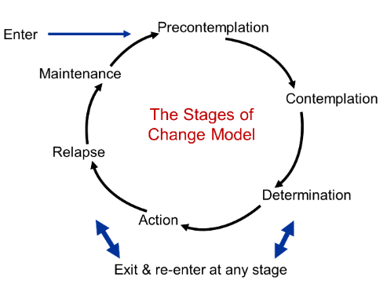
Stages of Behavior Change:
Transtheoretical model
http://sphweb.bumc.bu.edu/otlt/MPH-Modules/SB/BehavioralChangeTheories/BehavioralChangeTheories6.html

Slide 76
Stages of Change
Stage | Patient Characteristic/Behavior
Pre-contemplation | Not thinking about making a change
Contemplation | Ambivalence about making a change
Preparation | Decision made to change in the near future
Action | Taking definite action to change (<6 months)
Maintenance | Making an effort to maintain new behavior over time (>6 months)
Relapse | Return to old behavior can occur at any stage causing feelings of disappointment, and frustration, focus on why - triggers

Slide 77
Planned Visits
How often do you see your patients?
Ex. A patient with diabetes with an appointment every 3 months.
How can you support self-management goals during a planned visit?

Slide 78
Team Based Care and Self-Management Support

Slide 79
Learning Objective:
Define and relate team based care to self-management support

Slide 80
Team Based Care and Self-Management Support
2 or more healthcare staff….
working toward shared goals within and across settings to achieve coordinated, high-quality care
utilizing specific skills and roles within the practice to help patients toward self-management
  MA, health coach, community health worker, care coordinator calling patient to check on action plan
  Pharmacist addressing medication management
  Behavioral health staff working with patients on psychosocial issues
https://www.pcmh.ahrq.gov/page/creating-patient-centered-team-based-primary-care#fig1
Notes:
Review self-study information
Resource http://www.improvingchroniccare.org/downloads/selfmanagement_support_toolkit_for_clinicians_2012_update.pdf Toolkit

Slide 81
Who is on the Team?
Mi Bridges
Health Plans
211
MIHP
MDHHS
Housing
Transportation
Area Agency on Aging
Food Pantry
Churches
Acute Care
Skilled Care
Mental Health
Homecare
Specialists
Paramedic
RN
Social Worker
Pharmacist
Community Health Worker
Educators
Patient Centered Medical Home
Medical Neighborhood
Community
State
Providers
MA
Patient
Office Staff
Communication
Notes:
.
Each member of the virtual team plays a unique role in guiding, providing or authorizing care.
The patient may have needs that require going OUTSIDE of the primary care offec.
A patient in need of cardiac care may need services from PCP, cardiologist, personal care assistant, transportation, pharmacist, meal delivery and health plan
Care manager starts by engaging all parties to understand goals and roles.
Establish a communication system to communicate urgent needs as well as provide updates or changes to care.

Slide 82
Health Coaching
Once a goal is established, how do we follow up and continuing working with our patient?
  Give support, “how did you do with walking around the block this week?”
  Address barriers/challenges, “you weren’t able to walk this week, tell me about what got in the way”
  Increase confidence, “you’ve done well with accomplishing your goal this week, you’re moving toward better management of your diabetes”
  Who can make these calls on the Care Team?

Slide 83
Action Planning and Problem Solving
Notes:
Reference AGREE and ASSIST in the 5A process

Slide 84
Learning Objectives:
Define an action plan
Describe the use of brief action planning
Understand how problem solving can be helpful in addressing barriers to care planning

Slide 85
Health Behavior Change
Progress not perfection
Guiding –
“I can help you to solve this for yourself.”
Notes:
We are not looking for perfection from our patients. Small changes can make a big difference in symptoms of illness. We look to guide our patients not direct them. It’s much stronger for patient to maneuver their path with a guide.

Slide 86
Know WHEN to call your provider office and HOW
Even when the office is closed
Ex: Asthma Action Plan

Slide 87
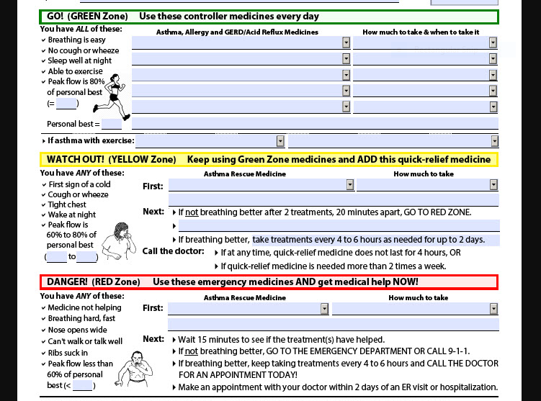
https://getasthmahelp.org/images/aim-action-plan-adult-revised-3-2019.jpg
Notes:
Here is an example of an asthma action plan (explain the sections of green, yellow and red)

Slide 88
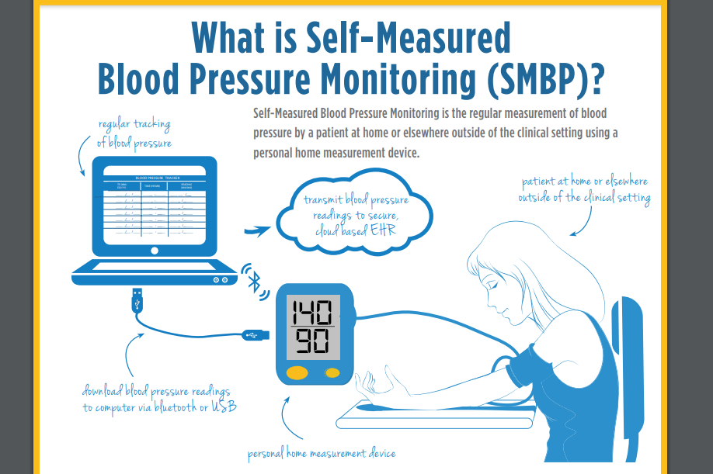
Self - Monitoring
Notes:
Self monitoring is an important part of any disease management

Slide 89
Brief Action Planning
A structured conversation to help people make concrete action plans
Person centered approach
Based on the principles and practice of Motivational Interviewing

Slide 90
3 Questions of Brief Action Planning
“What, if anything, would you like to do for your health in the next week or two?”
“How confident or sure do you feel about carrying out your plan (on a scale from 0-10)?”
“Would it be helpful to set up a time to check up on your plan?”

Slide 91
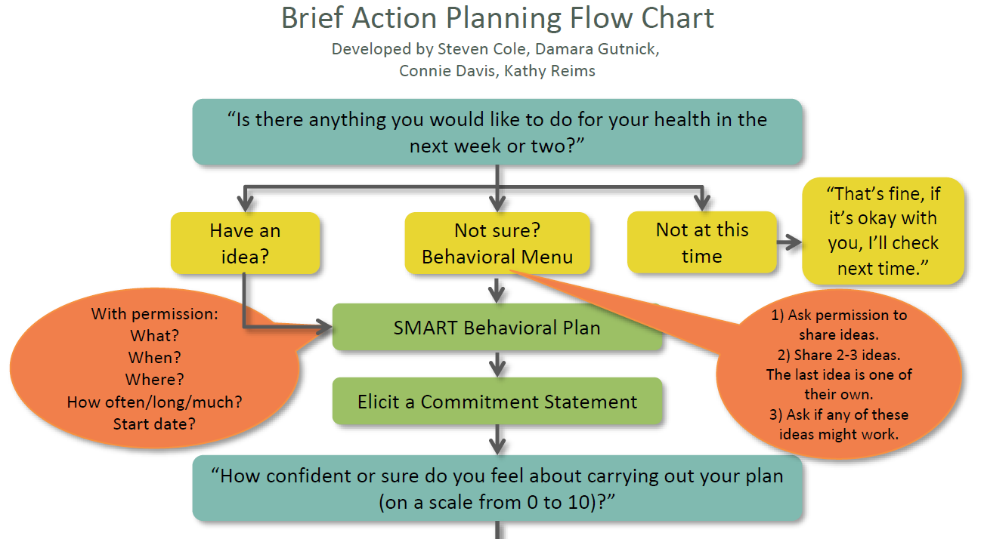
Brief Action Planning Activity #9*
Notes:
Have attendees take their handout out of their folder. Go through flow chart explaining:
Questions in blue you do every time
Green boxes vary depending on how the person responds to yellow
Tips and details are in orange
Remind attendees of the importance and effectiveness of asking permission to address issues of their health. “Is it alright if I share with you what has worked for other patients of mine?”
Posttest question
The three questions of Brief Action Planning used to help patients to create smart goals are:
Is there anything you would like to do for your health in the next week or two?
How confident or sure do you feel about carrying out your plan on a scale of 0 to 10?
Would it be helpful to set up a time to check up on your plan?
How do you think your life would be different if you changed?
a, c, and d only
a, b, and c only (in class BAP slide 89)
b and c only
All of the above a, b, c, d,
None of the above a, b, c, d

Slide 92
Parts of an Action Plan:
Something YOU want or decide to do
Achievable
Action Specific Confidence of
Answers the questions: 7 or more
  What?
  How much?
  When?
  How often?
Notes:
Review the 5 As
Reminder: if someone is a 7 or higher, they are more likely to engage in change

Slide 93
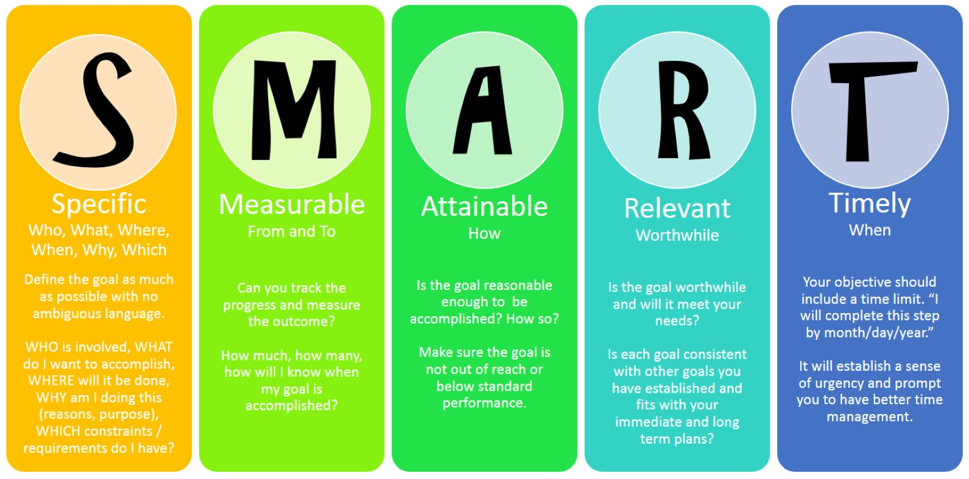
SMART Goals

Slide 94
Teach Back Video
https://www.youtube.com/watch?v=bzpJJYF_tKY

Slide 95
Teach back
Teach back is not a test of a patient’s knowledge. It’s a test of how well you explained the concept.
Chunk and Check
Clarify and check again
Use the show-me method
Ask open ended questions
Ask the patient to explain back using their own words
https://www.ahrq.gov/professionals/quality-patient-safety/quality-resources/tools/literacy-toolkit/healthlittoolkit2-tool5.html

Slide 96
Teach Back Video
https://vimeo.com/48471644

Slide 97
Ask – Tell – Ask
https://vimeo.com/85555368
Notes:
Reference the ADVISE step of the 5 As

Slide 98
Action Plan Completed: Activity 10*

Slide 99
What if my patient hasn’t followed his/her action plan?
Notes:
Example: “What if anything would you like to focus on regarding your health?” response: “nothing” “okay, if you’re not ready to set a goal today, we still have 10 minutes together, what would you like to talk about?”

Slide 100
Barriers to Self Management
Review from Self-Study Curriculum
Social Determinants of Health
Health Literacy
Physical Barriers
Notes:
This information was presented in the self-study curriculum attendees completed before the course.
Explain that we are going to review that material now. Ask the following questions:
What are Social Determinants of health? What are potential impacts on self-management?
What does health literacy mean? Have attendees take out their homework assignment: 1)Relate a scenario from the video to the primary care environment. 2)How would you ASSESS for health literacy in this example and what would you do to assist the patient in overcoming the barriers of health literacy. Then ask, “what aspects of the Team approach would come into play with this example? and what are a couple of examples from the video attendees viewed during self-study.
What are some examples of physical barriers and how do we help patients with these?
Posttest question
Which of the following represent an example of a health literacy issue?
Taking 2 pills in morning when the script reads 2x/day
Unable to understand medical terminology for procedures
Unable to read the forms given to the patient by the office staff
Unable to pay for medication
Unable to select correct Motrin dose for child
a, c, and d only
a, b, c and e only (Video from self-study & in class Barriers slide 98)
b and c only
All of the above a, b, c, d, e
None of the above a, b, c, d, e

Slide 101
Problem Solving
“We cannot direct the wind but we can adjust the sails.”

Slide 102
The Problem
Problems represent a discrepancy between your current state (what is) and your desired state (what I want). This discrepancy is a problem because of the existence of various obstacles that block the path when trying to reach your goals.

Slide 103
The Solution:
A solution is a person’s attempt to change that nature of the situation so that it no longer represents a problem (obstacles are overcome) or changes a negative reaction to situations that cannot be changed.

Slide 104
Steps of Problem Solving
Define the problem and explore the problem, (who, what, where, when, how)
Define the goal
Generating solutions (brainstorming)
Decision making (pros and cons, decisional balance)
Decide on a solution
Implement the solution
Evaluate the outcome

Slide 105
ACTION PLAN FOLLOW UP

Slide 106
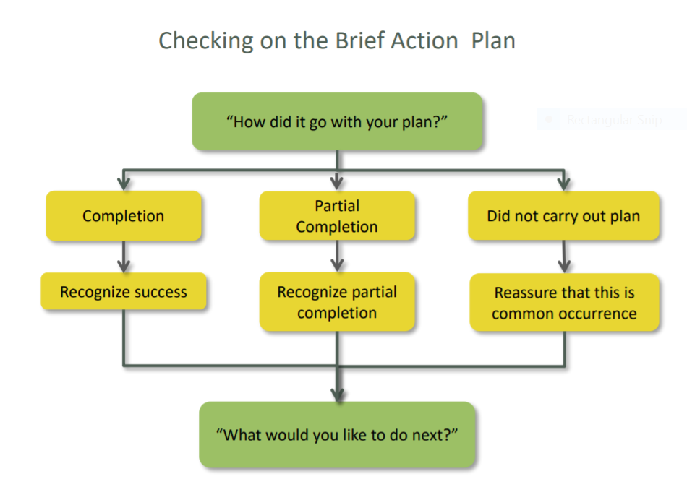
www.centreCMI.ca

Slide 107
Follow-Up with Action Planning
Discuss Action Plans and Goals with supportive reminders:
Check often with new actions plans (remember to use the care team as appropriate)
Decrease frequency as behavior is more secure
Introduce problem solving as needed
Change goals if appropriate
Goal is for patients to conduct BAP on their own
Notes:
Discuss follow up by phone, patient portal etc. and in-person

Slide 108
Case Study – Jim Activity #11A & B*

Slide 109
Sustainability and Billing

Slide 110
Objectives
Relate care manager activities to the tracking and billing codes
Relate caseload and care management activity billing to sustainability
Demonstrate use of billing codes in daily care management work

Slide 111
Key Topics
Describe the payment and value model for care management programs
Review the sustainability model for care management
Describe patient care situations and the corresponding billing codes

Slide 112
Payment and Value Model

Slide 113
The Value of Care Management: a Practice Perspective
Value
  Decreased cost and improved patient outcomes
Success for the practice
  Making it easier to take care of patients
  Improving performance on payer quality / utilization programs (i.e. earning incentive money and being financially sustainable)

Slide 114
The Value of Care Management: a Payer Perspective
Payer programs that fund care management use billing codes and outcomes to evaluate the success of care management programs.
  Billing shows how much of the population we’re able to reach
  Outcomes show the impact of that outreach (focus on A1c, BP, Inpatient Utilization, and ED Utilization)

Slide 115
Good news: BCBSM, PH, SIM use the same codes
G9001 - Initiation of Care Management (Comprehensive Assessment)
G9002 - Individual Face-to-Face Visit
98961 - Education and training for patient self-management for 2–4 patients; 30 minutes
98962 - Education and training for patient self-management for 5–8 patients; 30 minutes
98966 - Telephone assessment 5-10 minutes of medical discussion
98967 - Telephone assessment 11-20 minutes of medical discussion
98968 - Telephone assessment 21-30 minutes of medical discussion
99487 - First 31 to 75 minutes of clinical staff time directed by a physician or other qualified health care professional with no face-to-face visit, per calendar month
99489 - Each additional 30 minutes after initial 75 minutes of clinical staff time directed by a physician or other qualified health care professional, per calendar month. (An add-on code that should be reported in conjunction with 99487)
G9007 - Coordinated care fee, scheduled team conference
G9008 - Physician Coordinated Care Oversight Services (Enrollment Fee)
S0257 - Counseling and discussion regarding advance directives or end of life care planning and decisions
Face to face w/ patient
Group Visits w/ patient
Telephone w/ patient
Care Coordination on behalf of patient (not with patient or provider)
Provider engaging codes
Advanced Care Planning
  For all BCBSM PDCM codes: Provider liability if patient does not have Provider Delivered Care Management Benefit (BCBSM)
Notes:
Give as a handout in addition to the slide

Slide 116
G9001 – Comprehensive Assessment
BCBSM
  Individual, face to face (or video for commercial)
  One per patient per day
Priority Health
  Individual, face to face
  May be billed once annually for patients with ongoing care management
The goal is to develop a plan of care that is based on how well the patient is able to steward their own care and the provider’s care plan goals.
  Patient self-management goals are an integral piece.

Slide 117
G9001
The Comprehensive Assessment / G9001 is a face to face meeting that results in a care management plan that all care management team members and the patient will follow.
The Care Management Plan consists of 2 main things:
Patient-driven goals
Follow up and support plan

Slide 118
  G9002 – Face to Face Visit
BCBSM (Commercial and Medicare Advantage): Quantity Billing
  Individual, face to face or video
  If the total cumulative time with the patient adds up to:
    1 to 45 minutes, report a quantity of one; 46 to 75 minutes, report a quantity of two;76 to 105 minutes, report a quantity of three;106 to 135 minutes, report a quantity of four
Priority Health (Commercial, Medicare Advantage, Medicaid): No Quantity Billing
  In person visit with patient, may include caregiver involvement
  Used for treatment plan, self management education, medication therapy, risk factors, unmet care, physical status, emotional status, community resources, readiness to change

Slide 119
G9001 vs. G9002
G9001 is used to develop the holistic care management plan that will be followed by you and the patient.
G9002 is used to discuss specific aspects of a care plan either as part of the follow up steps within a developed care management plan or for the development of a focused care plan in the absence of a comprehensive care management plan.
** The G9001 doesn’t have to be the first code billed on a patient.

Slide 120
G9007 – Team Conference
    PCP and a care team member formally discuss a patient’s care plan
    Can be billed once per day per patient regardless of time spent

Slide 121
Phone Service Codes – 98966, 98967,98968
    98966 for 5-10 minutes;
    98967 for 11-20 minutes;
    98968 for 21-30 minutes

Slide 122
Incentive Programs for Care Management:
BCBSM
Value Based Reimbursement (i.e. increase on every E&M code and PDCM code)
  Up to 150% available
  In 2019:
    5% of this is VBR for the billing codes for having 2 touches on 3% of the population
    6% is for Quality and Outcomes, focusing on A1c, BP, IP utilization, and ED utilization
Fee For Service on all codes billed
  no patient co-pay / provider liability
Priority Health
Annual PMPM payment if outreach to up to 5% of the population has 2 billed codes (average $2.64 pmpm)
Fee For Service on all codes billed
  no patient co-pay
SIM
$2.75 - $7.00 PMPM care management and care coordination payments on Medicaid patients, assuming the goal of 2.5% eligible patients with a ‘billed’ code is achieved (reduction by $0.15 if not achieved).
Incentive payment opportunity in 2019
CPC+ also includes care management, but it isn’t so specific in it’s funding.
Notes:
Measurement Year = calendar year; Payment year = 9/1 – 8/31 the following year
Baseline BCBSM is traditional fee schedule, which hasn’t changed in YEARS.
PCMH = 10%
Clinical Quality = 5-15% (5%: 80th – 85th percentile; 10%: 85th – 95th percentile; 15%>95th percentile)
Cost Benchmark, graded at the PO Level = 5 – 15% unclear how the percentiles go, based on rankings of POs
PDCM Touches = 5% VBR for 3% outreach with 2 touches
PDCM Outcomes (graded at the PO level) = If the practice gets at least 1%, then they’re eligible. They get the additional VBRs if the PO performance is high enough. 1.5% for each of the 4 measure: A1c, BP, EDU, IPU

Slide 123
Activity / Billing Progress Reports
Each Program sets benchmarks for number of patients receiving care management services at the practice level.
Each program also sends a progress report to the PO; work with your PO to devise a best strategy for tracking progress towards program goals.
  Priority Health sends through Filemart to PO Representatives on a monthly basis.
  BCBSM sends through the EDDI mailbox on approximately a quarterly basis.
  SIM program updates through the MDC reports on an approximately monthly basis.

Slide 124
Common Outcomes Goals
Quality
  Controlled HgA1c
  Controlled Blood Pressure
Utilization
  decrease emergency department visits
  decrease hospital admissions
Notes:
Emphasis on this slide!!
All of our payers are looking at these 4 outcomes goals, so the care managers should work with their office and PO to understand what the strategy is and how they fit in.

Slide 125
Outcomes Goals –
Be Part of the Strategy
Each Care Manager should learn their PO’s strategy and which of the core measures the PO is focusing on.
Then, the Care Manager and office leadership should develop a plan for how they will also impact the selected metrics.

Slide 126
Sustainability Model

Slide 127

What is sustainability?
Sustainability is how the care manager service in your office maintains itself financially…
  i.e. it’s how you pay for yourself!

Slide 128
How can you help make your service sustainable?
Program Financial Support
Billing Revenue
Identify which programs your office(s) are in that support care management:
CMs help achieve program goals, and therefore can increase the program revenue.
Each CM should track and make sure that the outreach levels dictated by the payer programs are achieved.
  PO Leads can help provide reports that show progress.
  Some office managers don’t want to share the financial revenue. If that’s the case, ask them to work with the PO lead to understand the program revenue coming to their office for care management work.
Work with the office manager / PO lead to identify a billing goal based on case mix in your office.
It’s important for everyone to start out with common expectations of a billing goal.
What is an example of a billing goal?
  Some start with a minimum of 8-10 billable codes / day or 40-50 billable codes / week. This includes face to faces, team conferences, etc.
Some offices only allow their care managers to work with patients whose insurance covers the service. Others are more inclusive.

Slide 129
Is a minimum of 8-10 codes in a day feasible??
Week-long review:
Pre-work (before the week starts):
  review schedule & identify potential patients based on payer, risk, diagnoses. Send those patients as a list to the provider.
Scheduled weekly 15 minutes with Provider to review complex patients and face to face patients for that week (10 patients; 10 G9007 codes)
Target seeing 1-3 new patients per week and 3-4 existing patients in face to face visits per day
  1-3 G9001 codes
    15-20 G9002 codes
Conduct follow up phone call visits; at least 4 phone calls per day
  20 phone calls / week (98966 -98968)
That sums to 46 - 53 codes per week.
Many groups don’t evaluate on a day to day basis. It’s easier to look at a month or a week, as the patient load on a given day is variable.
Review the example to the right for a “day in the life” that shows how you might get up to 10 billable type activities per day or 50 per week.

Slide 130
Billing Examples

Slide 131
Before we start… Activity #12
The following series of examples are intended to show a couple of common situations for billing codes.
They are NOT comprehensive.
The 1st Thursday of every month is a BCBSM Monthly Billing Q&A session at noon (see reference guide for details, or www.micmrc.org/training/care-management-billing-resources)
If you have questions on specific situations, please reach out to valuepartnerships@bcbsm.com

Slide 132
High Risk Patient
Patient is flagged as high risk by a payer list.
Care manager discusses overall care plan goals with provider, and it is determined the patient is appropriate for care management.
Care manager reviews the chart, recent screenings (SDOH, PHQ-9), problem list, medications, and utilization history.
Care manager sees the patient in a face to face visit and evaluates the patient’s current ability to steward their health, identifying strengths, weaknesses, opportunities, and barriers.
Patient develops a SMART goal, and the care manager connects the patient with various resources that address identified barriers.
Care manager discusses care plan with the provider. Provider agrees with the care plan.
Patient and care manager agree on a follow up plan.
Care manager documents in the chart and adds the appropriate billing codes.
Identify the billing code: G9007, G9001

Slide 133
Face to Face Visit and Follow Up Care Plan
A patient comes into the office to be evaluated by their PCP. After the evaluation the PCP introduces the patient to the care manager (CM).
During the conversation with the patient the CM assesses that there is not a clear understanding about asthma management.
CM conducts a medication review, teaches how to use peak flow and keep a log, provides an asthma action plan.
CM and patient agree to follow up in one week via a phone visit.
This initial visit with the patient was 60 minutes. PCP and patient agree with the care plan.
Note how this is different from the G9001!
Identify the billing code: G9002, G9008

Slide 134
Coordination of Care
Care manager contacts the home health agency to schedule in-home visits and conduct a safety assessment.
In addition a call was made to the DME provider to arrange for delivery of home O2.
Time spent coordinating care was 35 minutes.
Identify the billing code: 99487

Slide 135
Gaps in Care
RN notices during chart review that several of the patients who are in his/her patient population have not received their cancer screenings, even though the RN and provider reminded them.
RN shows the list to the Medical Assistant.
Medical Assistant calls the patient to discuss gaps in care and facilitate closing the gaps.
Identify Billing Code: 98966

Slide 136
Interdisciplinary Team
Patient with diagnosis of diabetes, COPD and HTN. Patient screens positive for SDOH – food insecurity, struggling to afford medications, lacks caregiver support.
An interdisciplinary team conference was held with the Clinical Pharmacist, SW CM and PCP to modify the plan and discuss the initial plan of care with the team, which includes:
  The SW CM schedules a virtual face to face visit with the patient regarding the lack of caregiver support and social isolation, which is linked with admissions.
  The Clinical Pharmacist follows up on the ability to afford medications and the chronic diseases, conducting a comprehensive assessment of the patient.
  Both SW CM and Clinical Pharmacist follow up with the team at their regular huddle.
Identify billing code: G9007, G9001, G9002

Slide 137
Advance Directives
CM conducts a 20 minute in person* meeting with a patient regarding their advance directives.
During the discussion information is given to the patient to review regarding advance directives.
Discussion includes:
  how the patient prefers to be treated
  what the patient wishes others to know
CM and patient agree to follow up via a phone call in 2 weeks.
Identify the billing code: S0257
* Note: this code allows for phone visit and meeting may be with the patient, care giver, or family member.

Slide 138
Reducing ED visits
Proactive patient education to consider the PCMH practice first for acute healthcare needs, suggesting nearby urgent care, or ED for true emergency.
Follow up each ED visit with a call to identify issues, coordinate follow up care, and encourage seeking care through the practice rather than the ED when appropriate. Often, this can be performed by a medical assistant.
Medical assistants, operating under a protocol, may call patients, ask if the ED physician recommended follow up care, coordinate the needed care, transfer to clinician for issues requiring immediate medical assessment or guidance, encourage the patient to bring in all medications, etc.
Identify Billing code: 98966

Slide 139
Phone Service
CM speaks with a patient via the telephone.
CM reviews the patient’s asthma action plan and reviews the symptoms that indicate worsening symptoms and asthma exacerbation.
Also reinforces when to call the office.
In addition, CM asks the patient about interest in attending an asthma Group Visit. Patient indicates interest and CM provides the information regarding the asthma Group Visit.
CM and patient agree on follow up in one week via in person visit at the office.
This meeting takes 20 minutes.
Identify the billing code: 98967

Slide 140
Patient Visit – Face to Face
The patient returns to the office one week later to meet with CM:
During the visit CM and patient discuss symptoms, medications, SMART goals.
Patient states he/she has not needed to use the rescue inhaler and feels they now have a better understanding of how to care for his/her self. You again review the action plan and state you will follow up in one month.
Identify the billing code: G9002

Slide 141
G/CPT Billing Code Resources – Care Management Services
Billing resources – Michigan Care Management Resource Center website
BCBSM - PDCM Billing online course, PDCM Billing Guidelines for Commercial and Medicare Advantage
Priority Health
State Innovation Model
Centers for Medicare & Medicaid – Transitional Care Management, Chronic Care Management, Behavioral Health Integration
Additional Billing resources: https://micmrc.org/training/care-management-billing-resources

Slide 142
Medicare Billing
We are not able to advise you on Medicare billing practices due to nuances in financial structure.
However, the following slides contain information regarding “incident to” billing, which your practice may want to explore further for Pharmacist billing.

Slide 143
FINAL STEP of Training: Activity#13*
Review Activity 13 in your folder.
An email will be sent to you enabling you to make an appointment with the trainer
Complete the 30 minute practice session (if you are unable to make your appointment time, please email Sarah Fraley svoor@med.umich.edu to re-schedule).
After completing the practice session, you will be considered as having completed the course.

Slide 144
MICMT Statewide Self-Management Support Course Post Test and Evaluation
Logistics:
The MICMT SMS Statewide Post Test and evaluation is web based
A web link to the SMS Post Test and evaluation will be sent to you via the e-mail you provided during registration
Test Scoring
  Occurs real-time when you submit your responses. You will receive Pass/fail notification prior to closing the test
  Upon achieving a passing test score, you will continue on to the evaluation
  Lastly an e-mail is sent to you with notification of MICMT CCM Course Post test “Pass” status
  For Questions contact: micmt-requests@med.umich.edu

Slide 145
Statewide Self-Management Support (SMS) Course Completion
*Please note:
You will have 5 business days to complete the Statewide Self-Management Support Post Test and evaluation
You will need to complete a 30 minute practice session with the SMS course trainer following your successful (pass status)completion of the post test. An email will be sent to you within 1-2 weeks of completing the SMS post test enabling you to schedule the practice session.
You will receive a certificate (Nursing CE, Social Work CE, or certificate of completion) following the 30 minute practice session

Slide 146
Statewide Self-Management Support (SMS) Course Completion
*Please note that you will have 5 business days to complete with a “Pass” score on the Statewide Self-Management Support Post Test and evaluation in order to receive a certificate (CE, certificate of completion)

Slide 147
THANK YOU!!
http://www.youtube.com/watch?v=Pwe-pA6TaZk
Notes:
Remind participants that Motivational Interviewing is a dance not a wresting match

Slide 148
Bibliography
Improving Chronic Illness Care – The Chronic Care Model, Self Management Support http://www.improvingchroniccare.org/index.php?p=Presentations_&_Slides&s=397
Barlow, J., Wright, C., Sheasby, J., Turner, A., & Hainsworth, J. (Oct-Nov. 2002). Self-management approaches for people with chronic conditions: a review. Patient Education Council, 48(2) 177-187
Glasgow, R.E., Emont, S., & Miller, D.(September 2006). Assessing delivery of the 5 A’s for person centered care. Health Promotion International, 21(3)245–255
Green, S.D. et al . (2012). Processes of self-management in chronic illness. J Nurs Scholarsh., 44(2) 136-144
Lorig, K.R., & Holman, H.R.. (August 2003). Self-management education: History, definition, outcomes, and mechanisms. Annals of Behavioral Medicine, 26(1) 1-7
Rollnick, S., Miller, W.R., & Butler, C.C. (2008). Motivational interviewing in healthcare. New York, New York: Guilford Press
Miller, W.R., & Rollnick, S. (2013). Motivational Interviewing, helping people change, third edition. New York, New York: Guilford Press
Sherson, E.A., Jimenez, E.Y., & Katalanos, N. A review of the use of the 5 A’s model for weight loss counseling: differences between physician practice and patient demand. (2014) Family Practice, 31(4)389-398
Notes:
Need to add more here

