Slide 1

The Benefits of Team-Based Care in a Clinical Practice

Slide 2
Reference Guidelines
Material in this presentation was developed by the Michigan Institute for Care Management and Transformation (MICMT) and participating MICMT Training Organizations.
Questions about this curriculum should be sent to: micmt-requests@med.umich.edu.

Slide 3
Learning Objectives
Define the team-based model of care
Demonstrate the advantages of team-based care
Explain how the model improves patient outcomes
Identify financial opportunities related to team-based care

Slide 4

What is Team-Based Care?
AHRQ Definition:
The provision of health services to individuals, families, and/or their communities by at least two health care providers who work collaboratively with patients and their caregivers, to the extent preferred by each patient, to accomplish shared goals within and across settings to achieve coordinated, high-quality care.
Some people also refer to Team-Based Care as Care Management.
https://pcmh.ahrq.gov/page/creating-patient-centered-team-based-primary-care
Notes:
Reinforce:
Two or more health care providers
Working collaboratively with patient and caregiver
Accomplish shared goals in and across settings
Achieve coordinated high-quality care

Slide 5
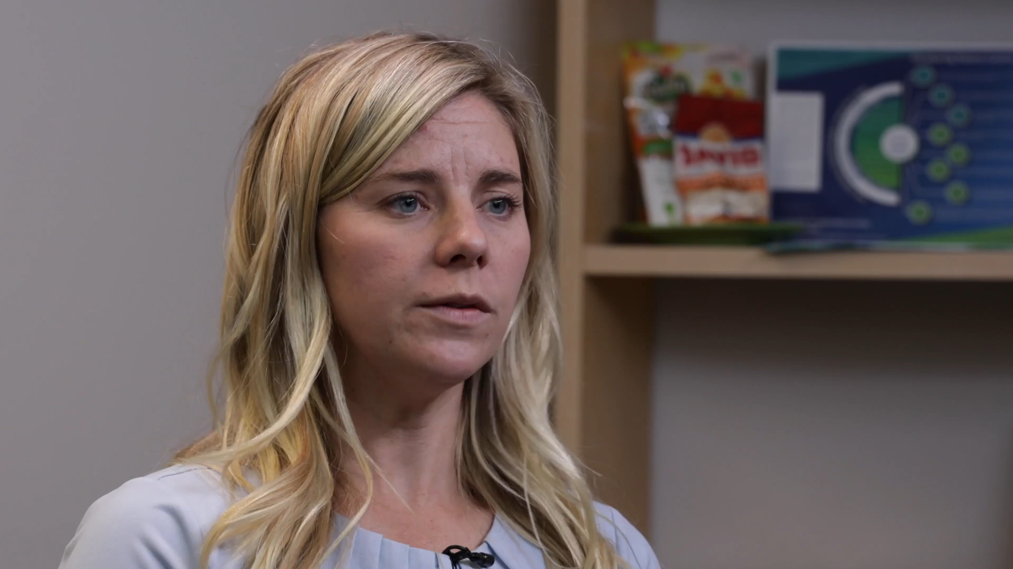
How the Team Can Make a Difference
Elizabeth Haberkorn, MSN, FNP-BC
Family Nurse Practitioner at Judson Center Family Health
Associate Medical Director, Medical Network One PC

Slide 6
What is Team-Based Care?
Practical Definition:
Adding expertise to a current care team to improve outcomes and care delivery.
This can be through:
Additional training to support role expansion (e.g. MA to Community Health Work or Care Coordinator)
Additional team members, including (but not limited to) a Registered Dietitian, Pharmacist, Social Worker, or Registered Nurse.
https://pcmh.ahrq.gov/page/creating-patient-centered-team-based-primary-care
Notes:
Reinforce:
Two or more health care providers
Working collaboratively with patient and caregiver
Accomplish shared goals in and across settings
Achieve coordinated high-quality care

Slide 7














What Role Fits Your Practice’s Needs?
Expanding the team should be driven by your patient population and the types of barriers that prevent your patients from being able to follow their care plans.
For example:
If your patients experience many social determinants of health barriers… maybe a CHW is appropriate.
If your patients need a lot of education about their diseases… Maybe an RN is appropriate.
If your patients experience a lot of behavioral health challenges… maybe an MSW is appropriate.
If your patients struggle with diabetic lifestyle management or weight navigation… maybe an RD is appropriate.
If you have an older population with polypharmacy… maybe a PharmD is appropriate.
Physician, Advanced Practice Practitioners
Asthma Educator
Diabetes Educator
Paramedic
Community Health Worker
Social Worker
Nurse
Dietitian/ Nutritionist
Professional Counselor
Medical Assistant
Respiratory Therapist
Pharmacist
Notes:
The next slide will expand on the various roles.

Slide 8

Build Your Team to Support Your Patients
Health Coaching Outreach
Medication Management
Symptom Management Assessment
Planned Visit Preparation
Gaps in Care outreach
Follow up to determine barriers
Adjustment of the care plan
Transitions of Care Calls
ED follow up call
Connect with Community Resources
Notes:
Health coaching call (MA, CMW, RN based on pre-established guidelines)
Medication Management call (RN, pharmacists… based on pre-established guidelines)
Symptom Management Assessment and reinforcement – weight gain, elevated BP, peak flow … (MA, CMW, RN, SW based on pre-established guidelines)
Planned visit preparation (MA, CHW, …)
Outreach for Gaps in Care (Office staff, MA, volunteers again based on pre-established guidelines)

Slide 9

Why Adopt This Model?
Quintuple Aim
Notes:
Team-based Care can add value to the practice both in the increased utilization of resources and the increased services to the patient and family. Yes initially is an increased cost during implementation before patient outcomes are seen and VBR changes
Success for the practice:
Full utilization of practice team
Increased employee engagement
Ownership of roles
Specific examples how costs are decreasing:
Early contact for yellow or early symptom management at the practice can avoid ED visit and hospitalization
Improving patient understanding of medication can increase adherence and improve control of condition demonstrated by Lab or BP
improved workflow can make provider visits more efficient and effective
The Quintuple Aim for Health Care Improvement incorporates health equity as another key element necessary to achieving improved patient care, outcomes, and costs.
Social determinants of health drive 70% of health care outcomes.
The pursuit of health equity purposefully includes focusing on individuals and communities who need it most in all improvement and innovation efforts.

Slide 10

Advantages of Team-Based Care:
Patient & Provider Experience
This video features Anthony W. Clarke, MD from Health Centers Detroit describing how having a team helps him provide better care to his patients.

Slide 11
Advantages of Team-Based Care:
Why Do it?
Increases quality scores
Increases incentive payments
Increases physicians’
compensation
Expanded care team members have opportunity to engage patients/caregivers with time which builds trust and improves patient engagement and outcomes.
Increases patient satisfaction

Slide 12
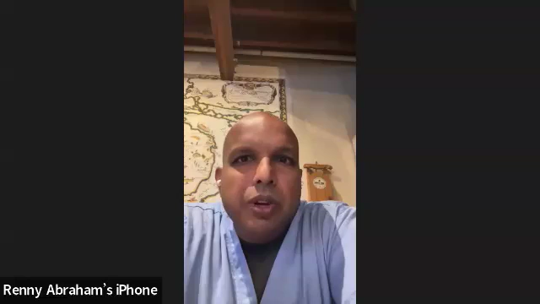
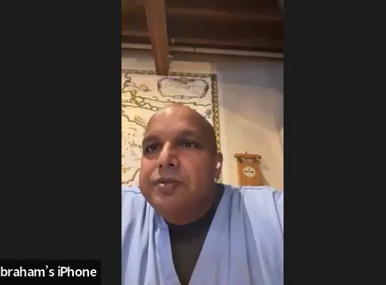
Advantages of Team-Based Care:
Patient & Provider Experience
Discuss how care management has affected your quality
Discuss how care team members’ billing has affected patient care and financial opportunities
Dr. Renny Abraham, Clarkston Medical Group

Slide 13

Building Trust In Another Team Member
Role Clarity
Providers can and should play a role in determining what patient populations should receive support from the Care Team Member.
Scope of practice agreements or collaborative practice agreements can outline expectations.
Communication
Providers and Care Team Members should plan frequent, short touch-bases to communicate about patient care plans and progress.
  Bonus: this is billable time!
It’s also very helpful to have structured meetings, particularly at the beginning, to figure out workflows.
Continuing Education
Free CE opportunities
Required training
Billing training opportunities
Notes:
We recognize it isn’t that easy to just bring on another person. But, there are communication strategies and structures that can be put in place to help alleviate concerns and make sure that everyone is on the same page.
Payers have expectations of team having a source of education, requirement of basic training related to TBC along with ongoing expectation of knowledge of how TBC can work with their patients. MICMT provides this expected training.

Slide 14
How Does Team-Based Care Impact Outcomes?
Team Structure
Tracking Quality & Utilization
Productive Interactions
Common Outcomes goals (AIC/BP)
Design a patient-centered process that supports timely and evidence-based care.
Using metric resources such as ADT notifications, EHR, registry and payer reports can help evaluate success.
Productive interactions are those that support the patient and their self-management goals to accomplish the Care Plan that was designed by the provider.
Establish common outcomes and where the team is in achieving their goals
Notes:
Team Structure/Communication -
Define the structure, roles and responsibilities for care team.
CPA; A legal agreement that formally defines the relationship between the physician and care team member (usually used with Pharmacists) that expands the role of the care team member beyond the normal licensure confines. For pharmacists, this frequently gives the ability to provide medication management through titration of meds and ordering supplies.
Standing Orders/Agreements facilitate team-based care by giving blanket agreement for proactive outreach by the care team
Huddle/Meeting- Describe the differences:
Tracking Quality - Metrics resources:
EHR can provide a report on practice level performance
Registry can provides a report on metrics
List by payer or practice.
List of patients who are not in control or who are missing evidence-based care
Payer reports and websites will additionally show your performance and the list of patients with a ‘gap’ in their care
Health care teams that communicate effectively and work collaboratively reduce the potential for error, resulting in enhanced patient safety and improved clinical performance. A key aspect in improving teamwork and communication in health care is engaging patients and families. Determining how patients and families want to be involved in their care and then engaging them in designing their plan of care increases their understanding of tests, procedures, and anticipated care outcomes. This results in an activated patient, one willing and able to self-manage. A lack of teamwork is often identified as a primary point of vulnerability for quality and safety of care. Health care teams that communicate effectively and work collaboratively reduce the potential for error, resulting in enhanced patient safety and improved clinical outcomes.
Common Goals =
Common Outcomes like utilization are the final measure of program success, but quality metrics and management of the patient’s disease drive the outcome measures as well.
Many factors impact a patient’s health status. Addressing the social needs and behavioral health and clinical management within the assigned population leads to improved out come measures. (ie. decreased ED and hospital utilization).

Slide 15
Impact of Team-Based Care on Utilization
Emergency Department
  One care management encounter reduces the risk of ED by 34.4% (Hazard Ratio 0.656) compared
  to no CM encounters
  Two care management encounters reduces the risk of ED by 54.8% (Hazard Ratio 0.452) compared to no CM encounters
Inpatient
  One care management encounter reduces the risk of hospitalization by 26.2% (Hazard Ratio 0.738) compared to no CM encounters
  Two care management encounters reduces the risk of hospitalization by 45.9% (Hazard Ratio 0.541) compared to no CM encounters
Analysis conducted in 2022 using BCBSM claims from 2018-2020.
Notes:
Longitudinal approaches of patients enrolled in 2018-2020 to better understand how PDCM affects healthcare utilization
Our analysis, but BCBSM also did parallel analysis with similar results

Slide 16

The Transition of Care Experience
Nada Farhat, PharmD, BCPS, BCACP
Clinical Pharmacist Specialist, Michigan Medicine
Clinical Lead, MICMT

Slide 17
Sustainability
Fee For Service (FFS)
  BCBSM, BCN, Priority Health, HAP all pay for the “Provider Delivered Care Management” Codes
  Medicare and other payers pay for select codes.
  Essentially all patient-related activities, except for email/in-basket work, are billable.
Incentives
  BCBSM:
    Population Engagement – 7% VBR for Primary Care
    PDCM Outcomes – PaMPM for Primary Care
    Specialist Team-Based Care
    Pharmacists Optimizing Oncology Care Excellence in Michigan (POEM)
  Medicaid HMOs per PO Contract
  Medicare – ACOs and Advanced Primary Care Services
  Priority Health
  HAP
Notes:
Recommendation is to organize efforts so that care team members bill consistently for all interactions and have at minimum an average of 4 billable interactions per half day.
To receive value-based reimbursement: providers must meet criteria related to being PCMH designated, billing PDCM services for a
proportion of eligible patients and having an engaged physician and staff. The third, started in
2020, is that providers can also receive a per attributed member per month payment (PaMPM)
for performance or improvement on clinical quality/use metrics.

Slide 18
Provider Delivered Care Management (PDCM) Codes
Care Team Codes
Physician Service Codes
G9001* - Coordinated Care Fee - Initial Assessment
G9002* - Coordinated Care Fee -Maintenance or follow up
98961* - Group Education 2–4 patients for 30 minutes (quantity billed)
98962* - Group Education 5–8 patients for 30 minutes (quantity billed)
98966* - Phone Services 5-10 minutes
98967* - Phone Services 11-20 minutes
98968* - Phone Services 21-30 minutes
99487* - Care Management Services First 60 minutes per month (care coordination in the medical neighborhood)
99489* - Care Management Services, every additional 30 minutes per month after initial 60 minutes (care coordination in the medical neighborhood)
S0257* - Counseling and Discussion Regarding Advance Directives
G9007* - Team Conference (Physician/APP)
G9008* - Physician Coordinated Care Oversight Services (Physician only)
S0257* - Counseling and Discussion Regarding Advance Directives (Physician/APP)
Billing resources can be found here: https://micmt-cares.org/pdcm-reference-materials
Notes:
Explanation of the codes additional details of these codes can be found on the MICMT website: https://micmt-cares.org/g9001-comprehensive-assessment

Slide 19
Primary Care Incentive Programs
Practice needs to stay PCMH designated to qualify.
BCBSM
Value Based Reimbursement - increase on every E&M code and PDCM code
PDCM Encounters – (measured at practice level) for attributed population:
4% with 2 encounters = 7% VBR
Adult Outcomes VBR & Pediatric Outcomes VBR (measured at PO/subPO level)
To be eligible to earn outcomes VBR, practices must meet 1% outreach with 2 encounters
These are subject to change every year – so stay connected with your PO for updates!
Priority Health
Annual PMPM incentive payment if outreach achieved for 2- 5% of the patient population.
2 billed codes on different dates of service.
Fee For Service on all codes billed.
No patient co-pay.
Notes:
Incentive Program by Payer change year to year. These differences occur over a Measurement Year, Calendar Year or a Payment year. Your practice can help you know differences and impact.
PCMH = 15%
PDCM encounters = 7% VBR for 4% outreach with 2 encounters
PDCM Outcomes PO performance is high enough. $0.40 PaMPM% for each of the 4 measure: A1c, BP, EDU, IPU.
Clinical Quality = 5-15% (5%: 80th – 85th percentile; 10%: 85th – 95th percentile; 15%>95th percentile)
Cost Benchmark, graded at the PO Level = 5 – 15% unclear how the percentiles go, based on rankings of POs

Slide 20
2026 BCBSM PDCM Outcomes VBR – Adult
Payment Period: 09/1/2027-08/31/2028
Measure | Performance Threshold | Improvement Percent
ED Visits (per 1000 members per year) | 160 | 10%
IP Discharges (per 1000 members per year) | 32 | 10%
Comprehensive Diabetes Control: HbA1c < 8% | 74.0 | 10%
High Blood Pressure (<140/90 mm Hg for all adults age 18–64 with hypertension) | 80.5 | 10%
Notes:
Note that this isn’t measured at a practice level for BCBSM. Rather, it’s measured at a group level. BCBSM takes all of the practices that have been identified as “PDCM Practices” and lumps them together for performance.
A “PDCM Practice” is one that has reached at least 1% of their population with 2 billed and paid touches.
Performance Source
ED - Milliman Loosely Managed Benchmark (2018)
IP -- Milliman Loosely Managed Benchmark (2018)
HbA1c -- NCQA 75th percentile (2018)
BP -- NCQA 50th percentile (2018)

Slide 21
2026 BCBSM PDCM Outcomes VBR - Pediatric
Payment Period: 09/01/2027-08/31/2028
Measure | Composite Measure | Performance Threshold | Improvement Percent
ED Visits (per 1000 members per year) | N/A | 160 | 10%
IP Discharges (per 1000 members per year) | N/A | 13 | 10%
Weight Management – age 5to 17 by 12/31/23 | N/A | 22 | 5%
Follow-Up After Emergency Department Visit for Mental Illness | PEDCOMP1 | 0.720 | N/A
Follow-Up Care for Children Prescribed ADHD Medication - Continuation and Maintenance Phase | PEDCOMP1 | 0.58 | N/A
Asthma Medication Ratio - 5 to 11 Ratio > 50% | PEDCOMP1 | 0.960 | N/A
Asthma Medication Ratio - 12 to 17 Ratio > 50% | PEDCOMP1 | 0.910 | N/A
Notes:
Can earn based on Performance or Improvement.
*Please remove the Peds slide if not needed in your presentation.

Slide 22
BCBSM Specialty Programs
Collaborative Care Model
Specialist Team Based Care (STBC)
Notes:
Specific BCBSM specialty programs

Slide 23

Sustainability Recipe
Sustainability for team-based care is dependent upon:
Size of your clinic
Licensures that would best support your patient population
Payer mix in your clinic
Relevant incentive program opportunities
Opportunities for ‘sharing’ care team members through your PO
This Photo by Unknown Author is licensed under CC BY

Slide 24
Determining Costs At Your Clinic
Determine which type of care team member your practice needs.
Determine the average salary of that licensure in your area.
Size matters:
  If your clinic has less than 2 full time providers, find out if your PO supports ‘sharing’ a care team member. Your clinic might not need a full-time care team member to start with, so potentially working with the PO for 2-3 days might be best.
  If your clinic has more than 2 full time providers, you might be better off starting with a closer to full-time (4-5 days/week) of a care team member.
Based on the amount of time and the hourly rate, you now understand the costs of a care team member.

Slide 25

Determining Revenue
Revenue hinges on the population of patients who will be supported.
  Will your office only support those patients with coverage? If so, how will you identify this population and limit support?
  If your care team member will support all patients regardless of payer, consider a ‘baseline’ of patients for whom there is either fee-for-service (FFS) or other incentive opportunity that will off-set costs.
    If the average commercial video or face to face encounters is worth $100, how many commercial patients per day make this role sustainable?

Slide 26
Determining Sustainability
If your care team member’s hourly rate is $50/hr, and they work 20 hours per week, that’s $1000/week.
That means your care team member would need to have 10 commercial encounters per week to break even.
Note that the minimum recommendation is 4 encounters per half day.
Caveats:
Licensed care team members can bill higher level codes than unlicensed. They also have a higher hourly rate.
Available volume of patients and payer mix might determine whether you have enough commercial patients to break even.

Slide 27
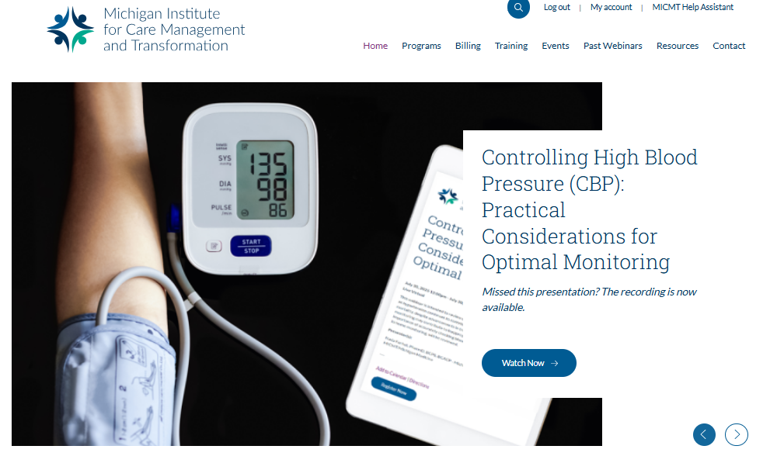
MICMT Resources & Next Steps
Program Details
  PDCM
  CoCM
Training Courses
  Introduction to Team-Based Care
  Patient Engagement Foundations
Billing Resources
Webinar Library
https://micmt-cares.org/

Slide 28

Key Takeaways
Improvement of patient and provider experience
Care teams can impact outcomes by using evidence-based care, productive interactions, tracking quality and utilization
Team structure and roles help define how the team can work together
Sustainability of team-based care is identifying important members of the care team, assigning appropriate classification codes, documenting services rendered and billing consistently
Next steps can be supported with resources at the MICMT website.
Notes:
https://nam.edu/wp-content/uploads/2015/06/VSRT-team-based-Care-Principles-Values.pdf

