Slide 1
MICMT Approved Statewide Trainers Orientation
Updated 6/16/2023
Notes:
Thank you for joining today. My name is Linny West – Project Coordinator
(Let Marie introduce self)
Our agenda for today:
Share an overview of the trainer application and approval process
The trainer integration process (marketing your event, accessing trainer material, marking attendance, and receiving post-evaluation data)
The second part of the agenda is an overview of the CE Process. If you do not plan on using MICMT for your CE’s, feel free to jump off.
As a reminder, this will be posted on our website along with the slide deck later this week

Slide 2
Trainer Approval Process
Notes:
Brief overview of what the trainer approval process looks like for all new applicants

Slide 3
Submit Individual Trainer/Training Organization Application
Meeting with MICMT Representative to discuss:
Resume/Qualifications
Prerequisites
Memorandum of Understanding/Training Agreement
Financial Disclosure
Anticipated Training Dates
Modality (in-person or live virtual)
CE Process / Terms of Social Work(SW) and Nursing Application
Complete remaining prerequisites if not met.
Meeting with BCBSM Representative to discuss billing*
* Required for Introduction to Team-Based Care and Foundational CM Code and Billing Opportunities
Meeting with Training Lead or MICMT to review course content
(train a portion of the course to demonstrate understanding of material)
Meet with MICMT Representative to review details of
Continuing Education Requirements and overview of MICMT website
Complete first training events!
Notes:
After an application is completed:
MICMT is meeting with the candidate to discuss their resume and qualifications
The prerequisites to teaching
The Training Agreement
Training Dates
Training Modalities
CE Process
Applicants will be expected to meet with BCBSM to discuss billing when teaching Intro to TBC or Intro to STBC
Lastly, applicants will be required to train a portion of the content before being approved

Slide 4
Process Overview
Getting your training posted on the website
Uploading your attendance
Preparing to teach the course
Reviewing post-test and evaluation data
Notes:
The four elements we’re going to address today
Getting your training posted on the website
Preparing to teach the course
Uploading your attendance to our website
Reviewing post-test and evaluation data

Slide 5
Getting your training posted on the website
Notes:
Let’s start with getting your training on the website

Slide 6
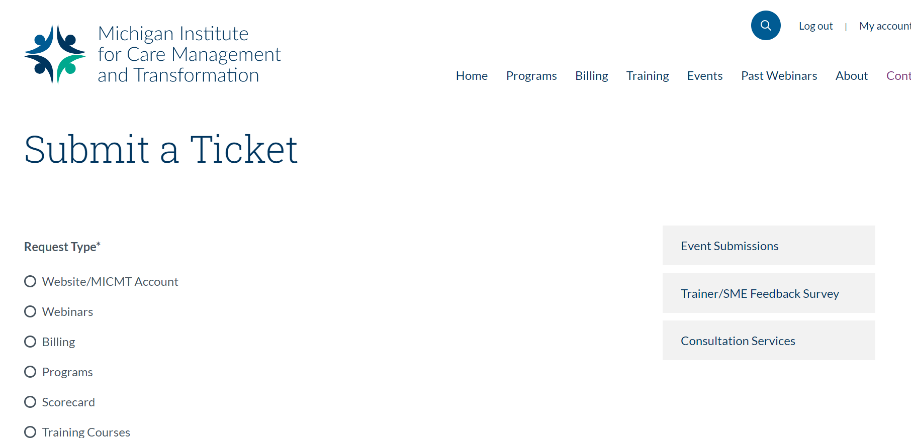
Submitting Event Information
Please go to https://micmt-cares.org/contact and click on Event Submission
Please submit survey at least five (5) weeks in advance for external training and at least one (1) week in advance for internal training.
After your submission is completed, your event will be posted. You will be notified by MICMT when your event is posted on the website.
Notes:
Anytime you have a new event, we’d ask that you complete this Qualtrics survey which collects all of your event details
Your event will be posted within five business days and we will let you know when its up

Slide 7
Survey Fields
General Information | To be completed by all trainers
PO/Organization | Identify your PO or Organization
Contact information | Provide contact information if MICMT needs to reach out with questions about the event.
Training | Select the type of training that you will be providing
What training are you providing | Select the course you will be teaching
Training Details | Date(s) and time of training
Training Description | Any additional details you would like to provide
Will your training be restricted to your organization? | Select no if you would like it to be open to the public
Training Cost | Include any costs per learner
When will registration close? | Provide time and date to close registration
Identify format of training | Live or Live virtual
If virtual | You will be asked to provide a webinar link
If in person | You will be asked to provide information on the location of training
Additional/back up point of contact | Should not be trainer, but an additional contact who is available the day of training
Do you plan to use MICMT Registration? | If no, you will need to provide a link for the external registration If yes, you will need to provide a cap/maximum for participants
Payment Process | Include how learners will provide payment for the course
Special Requests | If you have any pre-work for learners or other special requests, please indicate here
Notes:
General information: everyone will complete
MICMT Registration: if you are going through us
Organization Internal Registration: if you intend on managing your own registration
CE Approval: if you plan to be under MICMT for CE’s

Slide 8
Preparing to teach the course
Notes:
Now let’s review preparing to teach

Slide 9
Preparing to teach the course
Decide how you will monitor learner attendance.
Make sure presentation is at least as long as time allocated in timed agenda.
Must use CE Disclosure slide and Course Learning Objectives and Outcome (no modifications allowed). The standardized slide deck may be individualized for PO/practices. Training materials can be located at on MICMT website (see next slide).
Test camera and audio before session. Trainer must remain on camera for the entire training.
Notes:
Marie

Slide 10
All training material is available
on each training page
Training | URL
Foundational Care Management Codes & Billing Opportunities | https://micmt-cares.org/training/foundational-care
Introduction to Team Based Care | https://micmt-cares.org/training/introduction-team
Patient Engagement | https://micmt-cares.org/training/patient-engagement
Notes:
Training Material is on each individual training page under Trainer Materials

Slide 11
Criteria for Learner Attendance
Trainers must monitor learner attendance
Virtual course:
Learner must join by audio and video
Attendance is monitored by video conference/webinar attendance report or roll call at start and end of the course
Face to Face:
Must utilize the MICMT sign-in and sign-out sheet
A copy of the completed sheet should be sent to https://micmt-cares.org/contact
Notes:
Marie

Slide 12
Attendance Requirements (In Person and Live Virtual courses)
Trainer Responsibilities
Trainer reviews the attendance for the course and submits to MICMT website within 24 hours of course completion (see instructions below).
If learner misses more than 30 minutes of the course, trainer will not check off “attended course”, and the learner will need to take the course in the future.
Learner responsibilities
Learner must have video and audio capabilities for virtual courses.
Course evaluations include the required question: “I attest to attending the entire session.”
Learners can view the course materials located on MICMT website https://micmt-cares.org/training/pdcm
Notes:
Marie

Slide 13
Uploading your attendance to the website
Notes:
We’re going to review how to get your attendance uploaded into the website.

Slide 14
Log into your MICMT account
1) Log in to your account.
2) Scroll down to see your Active Trainings.
3) Click on View/Record Attendance.
Notes:
If you plan on having MICMT manage your registration:

Slide 15
If you have used MICMT for registration:
3) Check off your attendees
4) Click send post-event e-mail
YOU ARE DONE!

Slide 16
If you managed your own registration:
3) Click on Import Attendance Data account.
4) Click on Download attendance template file
Notes:
The attendance template file was sent to you prior to this webinar.

Slide 17
Attendance Template File
Required fields are e-mail, first name, last name, and PO/organization.
These fields should match their profiles in the website.
This is a CSV file and needs to be remain as a CSV file.
Watch out for spaces!

Slide 18
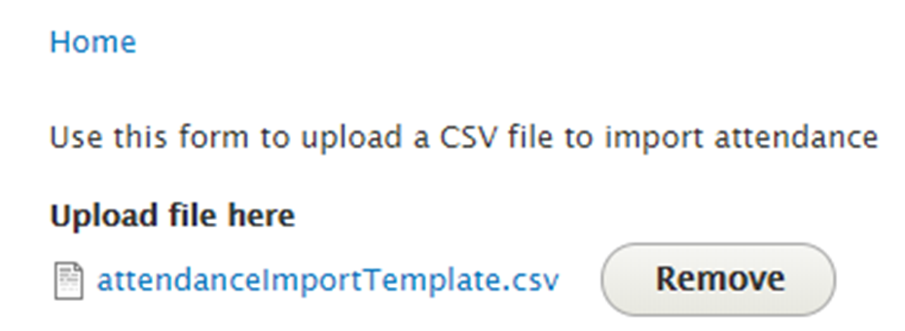
You can download a list of Physician Organizations to help with completing the template.
5) After you complete the attendance log, save as a CSV
6) Upload file and click Upload CSV

Slide 19
7) Your attendees will appear and be checked off.
8) Click send post-event e-mail
YOU ARE DONE!

Slide 20
Post-test and evaluation data
Notes:
Last, getting your post-test and evaluation data.

Slide 21
Post-Event Process
After attendance is submitted and email is sent, learners receive link to evaluation and post-test.
Learners have five business days to complete. After successful completion, certificates appear on learner dashboards.
Trainers have access to review the training information on their dashboard in real time at any time.
Any questions or issues with accessing the evaluation or post-test should be directed to https://micmt-cares.org/contact

Slide 22
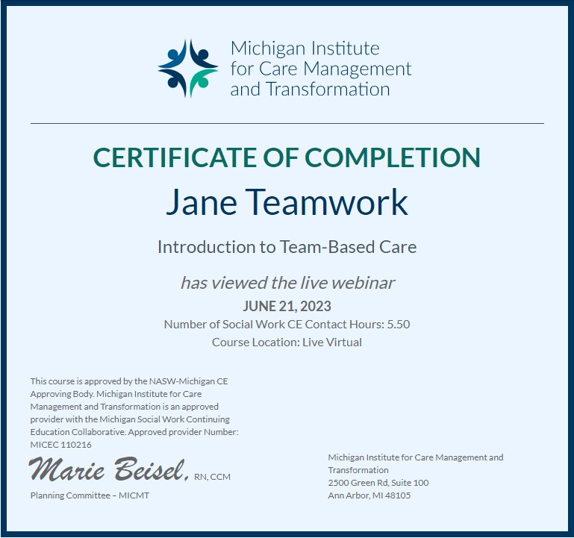
Post-Event E-Mail
Thank you for attending [course name] on [date]hosted by [Training Organization]. To receive credit for this course, please complete the evaluation and post-test here. You have (5) business days to complete. If you have questions or concerns, please contact https://micmt-cares.org/contact.
Notes:
Learners will see Credit Hours as well as Learning Credits.
The Certificates of Completion will remain unbranded (without MICMT Logo)

Slide 23
Additional Tool: Trainer Dashboard
Notes:
Last, getting your post-test and evaluation data.

Slide 24
Trainer Dashboard*
Trainers have a summary of learne evaluations and test scores organized by each training
Trainers also have an individual course breakdown for those trainings completed in the last three months
* Click on My Account and scroll down to access this information

Slide 25
Trainer Dashboard
Trainers can view and access trainings to monitor registration, obtain contact information, and complete attendance logs

Slide 26
Trainer Dashboard
Course Overview Report - Trainers can see a course breakdown by training, date, time, evaluation average, credits, test scores, and learner.

Slide 27
Important Reminders
ALL trainings need to be submitted to MICMT to be able to:
Track attendance
Set up the post-event e-mail with evaluations and post-test
Attach CE’s and Certificates
Learners should create an account on the website BEFORE the training so they can:
Receive the post-event email with links for the evaluation and test
Complete the evaluation and test to receive their CE’s and certificates without delay
ALL attendance records need to be submitted within 24 hours to be able to:
Allow learners the (5) business days to complete the post-test and evaluation
Ensure learners receive their CE’s and certificates

Slide 28
Everything you need to know about Continuing Education Requirements

Slide 29
CE Contact Hours
Course Title | CE Contact Hours Nursing and SW for License Renewal
Introduction to Team-Based Care* | 5.5
Patient Engagement* | 5.5
Foundational Care Management Codes & Billing Opportunities** | 3.5
* If you are interested in offering Pharmacy CE for these courses, please contact MICMT
** Also qualifies for AAPC credit hours

Slide 30
Successful Completion of a MICMT course includes:
Completion of entire MICMT course
(in-person or live virtual)
Completion of post- test with a score of 80% or greater (repeat attempts allowed)
Completion of the MICMT course evaluation
Certificate is awarded and posted on Learner’s Dashboard
Learner has five (5) business days to complete the evaluation and post-test.

Slide 31
Sample Disclosure MICMT Patient Engagement Course
No one in control of content has any relevant financial relationships with ineligible companies.
Successful completion of the Patient Engagement course includes:
Attendance at the entire session - if attending live virtual must have audio and see the slides live
Completion of the course post test within 5 business days post live event: need to have a score of 80% or greater on the post-test
Completion of the course evaluation within 5 business days post live event
Participate in a phone practice session with a course presenter
Nursing:
Upon successful completion of the Patient Engagement the participant will earn 5.5 Nursing CE contact hour.
Michigan Institute for Care Management and Transformation is approved as a provider of nursing continuing professional development by the Wisconsin Nurses Association, an accredited approver by the American Nurses Credentialing Center’s Commission on Accreditation.
Social Work:
Upon successful completion of the Patient Engagement participant will earn 5.5 Social Work CE contact hours.
This course is approved by the NASW-Michigan CE Approving Body. Michigan Institute for Care Management and Transformation is an approved provider with the Michigan Social Work Continuing Education Collaborative. Approved provider Number: MICEC 110216.
Registered Dietitian:
Upon successful completion, Registered Dietitians can use the MICMT Nursing CE certificate for their CPEUs. See CDRnet core criteria for details https://www.cdrnet.org/core-criteria
Community Health Worker:
For today’s webinar, CHWs can use the MICMT certificate of completion for their CEUs. For details, access the Michigan Community Health Worker Alliance (MiCHWA) CHW Continuing Education Fact Sheet https://www.michwa.org/continuing-education
322222222222222

Slide 32
Review
Notes:
Lets review!

Slide 33
Trainer Responsibilities
Complete event posting survey
Access trainer and learner material on training pages
Conduct training, monitor attendance, follow attendance protocol
Upload attendance within one business day and send hard copy sign-in sheets to MICMT
Utilize dashboard to review training results

Slide 34
MICMT Responsibilities
Receives event posting survey and posts to MICMT website within five business days
Monitors evaluations and post-tests; assist learners as needed
Generate certificates as applicable
Provide evaluation results to trainers

Slide 35
MICMT CE Responsibilities
Provide required information to CE Approver Organizations
Audit courses to ensure standardization of course content
Generate the appropriate CE certificates for learners who successfully complete the course
Maintain all CE records and documentation as required by Approver Organizations

Slide 36
I have questions! Who can I contact?
https://micmt-cares.org/contact

