Slide 1
CKD Management: Pharmacist Perspective
June 2023

Slide 2
Nada M. Farhat, PharmD, BCPS, BCACP
Michigan Medicine, Clinical Pharmacist Specialist
Michigan Institute For Care Management & Transformation, Clinical Lead

Slide 3
Objectives
Review potentially nephrotoxic medications
Explain the significance of adjusting and discontinuing medications as needed based on kidney function
Review new medications for CKD, specifically SGLT2 inhibitors
Discuss the importance of team-based care in managing CKD

Slide 4
AB is a 66 yo male (height = 5’5”, weight = 200 lbs, BMI 33.16 kg/m²) with a PMH of hypertension, type 2 diabetes, arthritis, and GERD. He presents to clinic today with the lab findings shown below. He is very concerned about his new CKD diagnosis, and he is eager to discuss how his medications impact this condition.
Medication List
Ibuprofen 600 mg as needed
Lisinopril 40 mg daily
Basaglar 20 units daily
Trulicity 3 mg weekly
Metformin 1000 mg BID
Aspirin 81 mg daily
Rosuvastatin 10 mg daily
 | Latest Reference Range & Units
Sodium | 136 - 146 mmol/L | 137
Potassium | 3.5 - 5.1 mmol/L | 4.5
Chloride | 98 - 108 mmol/L | 102
CO2 | 20 - 31 mmol/L | 27
Urea Nitrogen | 8 - 20 mg/dL | 58 (H)
Creatinine | 0.70 - 1.30 mg/dL | 1.88 (H)
Glucose | 70 - 180 mg/dL | 149
Calcium | 8.6 - 10.3 mg/dL | 8.1 (L)
Phosphorus | 2.7 - 4.6 mg/dL | 2.8
eGFR, Creatinine-based formula (CKD-EPI 2021) | >=60 mL/min/1.73m² | 39 (L)
HbA1c | Diabetes >=6.5% | 8.0

Slide 5
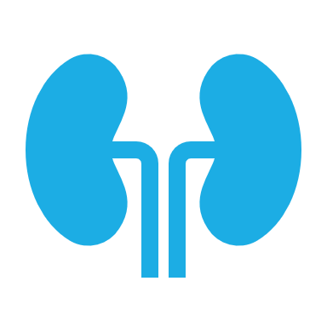
CKD Overview

Slide 6
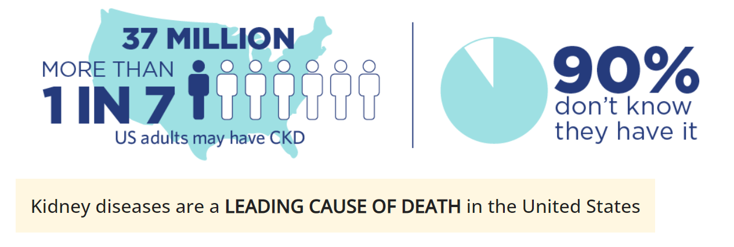
Epidemiology

Slide 7
Risk Factors
Diabetes
Hypertension
Heart Disease
Obesity
Family History
Older Age
Race

Slide 8
Causes
Diabetes
Hypertension

Slide 9
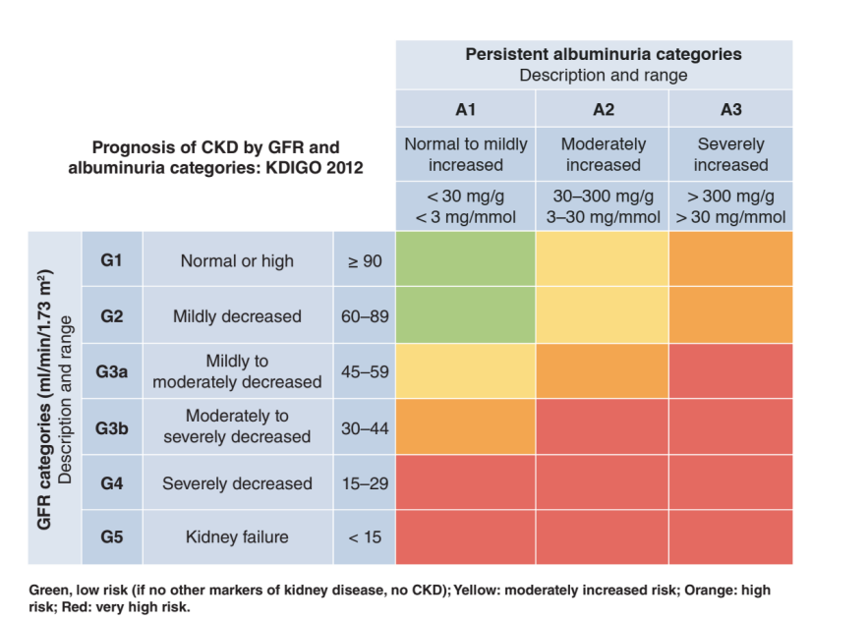
Classification & Prognosis

Slide 10
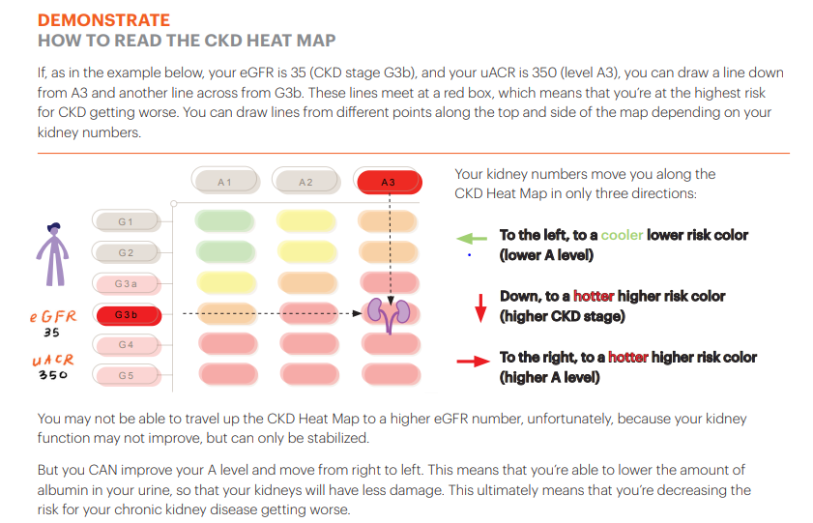
Resource - Classification & Prognosis
Heat Map Link

Slide 11
CKD Prevention
Keep blood pressure and blood sugar in target range
Ensure kidney function is tested every year
Encourage physical activity
Promote weight loss
Eat a healthy diet
Avoid medications that can cause or worsen CKD

Slide 12
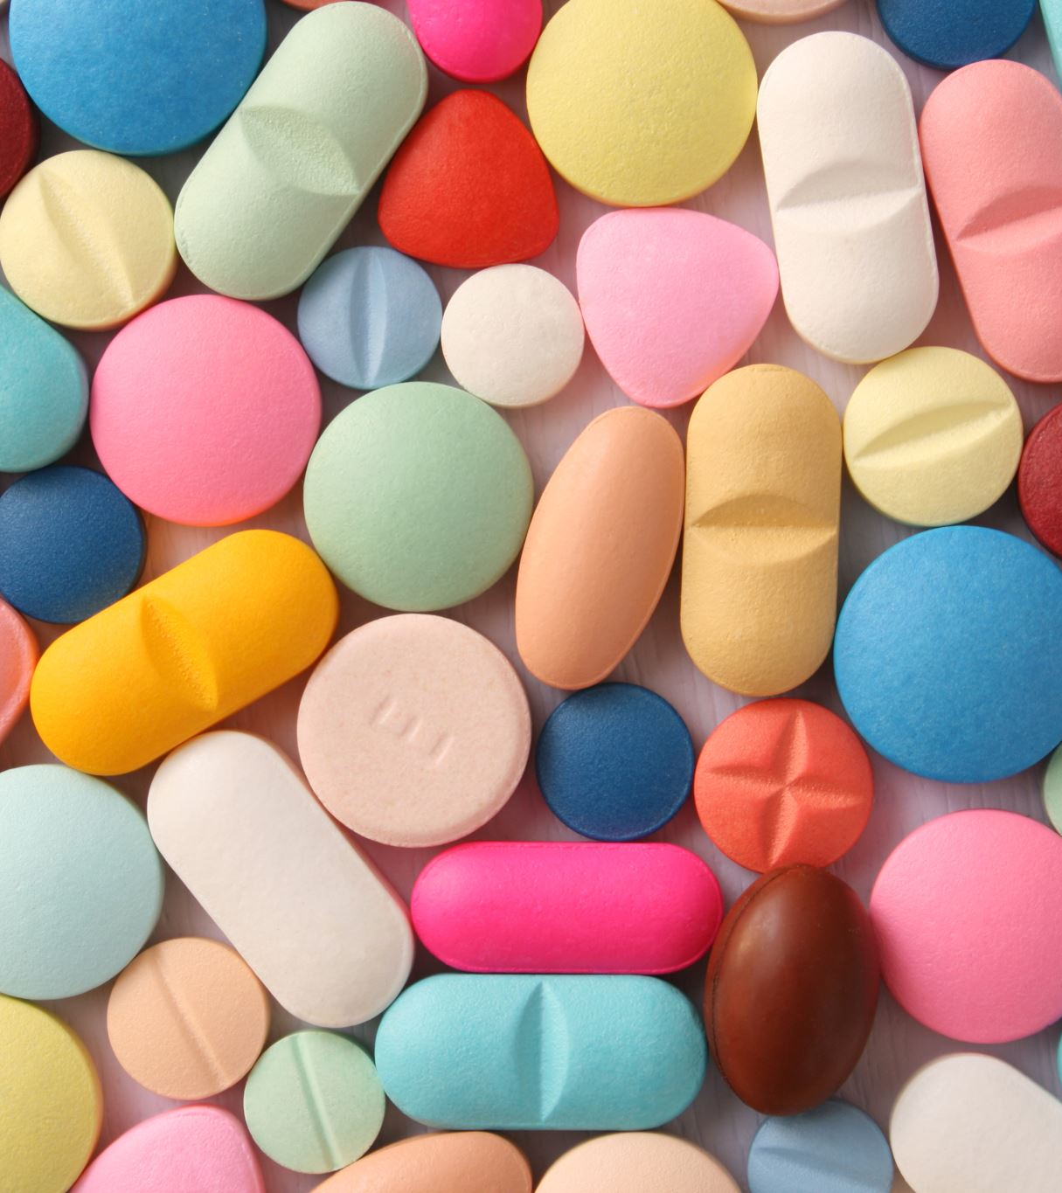
Medication Related Considerations

Slide 13
Nephrotoxic Medications
Pain medications
Contrast dye
Antibiotics
Immuno-suppressive agents
Prescription laxatives
Herbal medications
Cytotoxic chemotherapy
Use the lowest effective dose for the shortest duration!

Slide 14
NSAIDs (Nonsteroidal Anti-Inflammatory Drugs)
Ibuprofen (Motrin, Advil)
Naproxen (Aleve, Naprosyn)
Diclofenac (Voltaren)
Celecoxib (Celebrex)
Aspirin

Slide 15
Diclofenac
Well-tolerated
Potent efficacy
Shorter half-life
Less renal excretion
Topical gel

Slide 16
Pain Control
Avoid NSAIDs if possible
If needed, use the lowest required dose for the shortest duration
Avoid especially if GFR < 30 ml/min/1.73 m²
Prolonged therapy not recommended if GFR < 60 ml/min/1.73m²
Avoid in patients taking other potentially nephrotoxic medications
Topical may be used, but not effective for widespread pain

Slide 17
Pain Control
Best option for pain control is acetaminophen (Tylenol)
May take up to 3000 mg per day
OTC products may contain NSAIDs or acetaminophen
Ensure to double check labels
Always ask patients about OTC medication use
Opioids may be an option, however, use with caution
Renal metabolism
OTC: Over-the-counter

Slide 18
Resource – Pain Control
The National Kidney Foundation of Michigan offers a Chronic Pain PATH (Personal Action Toward Health) workshop
Chronic Pain PATH is a no-cost, six-week workshop led by trained leaders
The workshop helps people living with chronic pain manage their health conditions
Learn more at www.nkfm.org/PATH

Slide 19
Iodinated Contrast
Consider iodinated contrast-induced AKI prevention in high-risk circumstances
Avoid iodinated contrast or minimize dose
Consider isotonic saline infusion before, during, and after procedure
Hold metformin at time of or before procedure
Consider withholding other nonessential potentially nephrotoxic agents
AKI: acute kidney injury

Slide 20
Medications Requiring Dose Adjustments
Diabetes
Metformin
Insulin
Other oral antidiabetic agents
Hypertension
Diuretics
RAAS inhibitors
Narrow therapeutic index medications
Digoxin
Lithium
Other
Statins
Antibiotics
H2RA (i.e., ranitidine)
RAAS inhibitors: renin-angiotensin-aldosterone system inhibitors, H2RA: histamine type-2 receptor antagonist

Slide 21
Diabetes Medications
Metformin
eGFR (ml/min/1.73m²) | Dose recommendations
> 60 | No adjustment needed
45-60 | Monitor eGFR in 3-6 months
30-45 | Do not initiate if not taking If already taking metformin, consider 50% dose reduction: suggested dose of 500 mg twice daily
< 30 | Contraindicated

Slide 22
Diabetes Medications
Insulin and oral anti-diabetic agents may require dose adjustment given reduced clearance and risk of hypoglycemia
See specific package insert labeling depending on medication and indication
Sulfonylureas (i.e., glipizide)
Special attention should be given to insulin dose adjustments given risk of hypoglycemia
DPP-4i (i.e., sitagliptin)
SGLT2i (i.e., empagliflozin)
SGLT2i: sodium-glucose cotransporter 2 inhibitor, DPP-4i: dipeptidyl peptidase 4 inhibitor

Slide 23
Hypertension Medications
Diuretics
Require dose adjustment as CKD progresses due to mechanism
Thiazide-like diuretics (i.e., hydrochlorothiazide)
Loop diuretics (i.e., furosemide)
RAAS inhibitors
Include ACEi, ARBs, direct renin inhibitors, aldosterone antagonists
Beneficial long term for CKD, but may require dose adjustments and more frequent monitoring
Other anti-hypertensives may require dose adjustments based on reduced clearance of medication
RAAS inhibitors: renin-angiotensin-aldosterone system inhibitors, ACEi: angiotensin-converting enzyme inhibitors, ARB: angiotensin receptor blockers

Slide 24
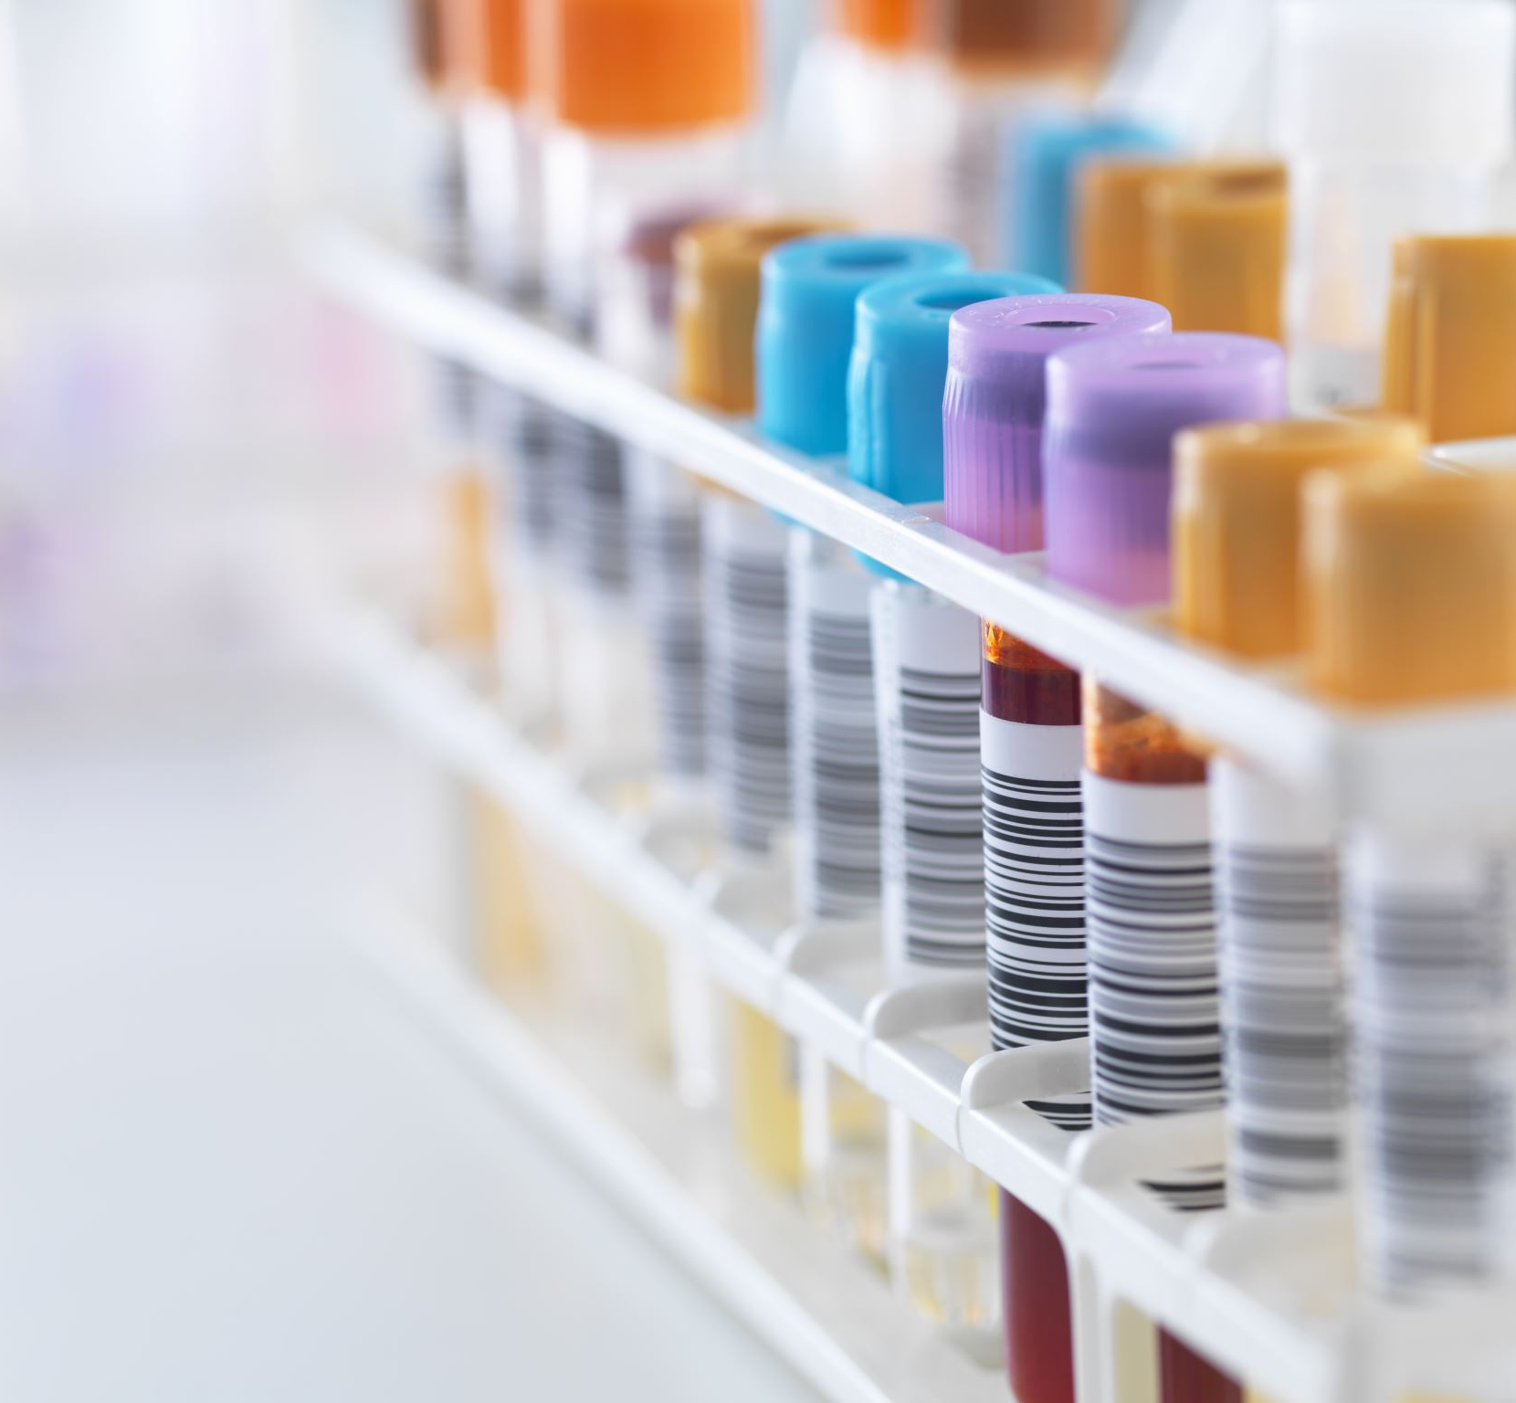
Disease Specific Recommendations

Slide 25
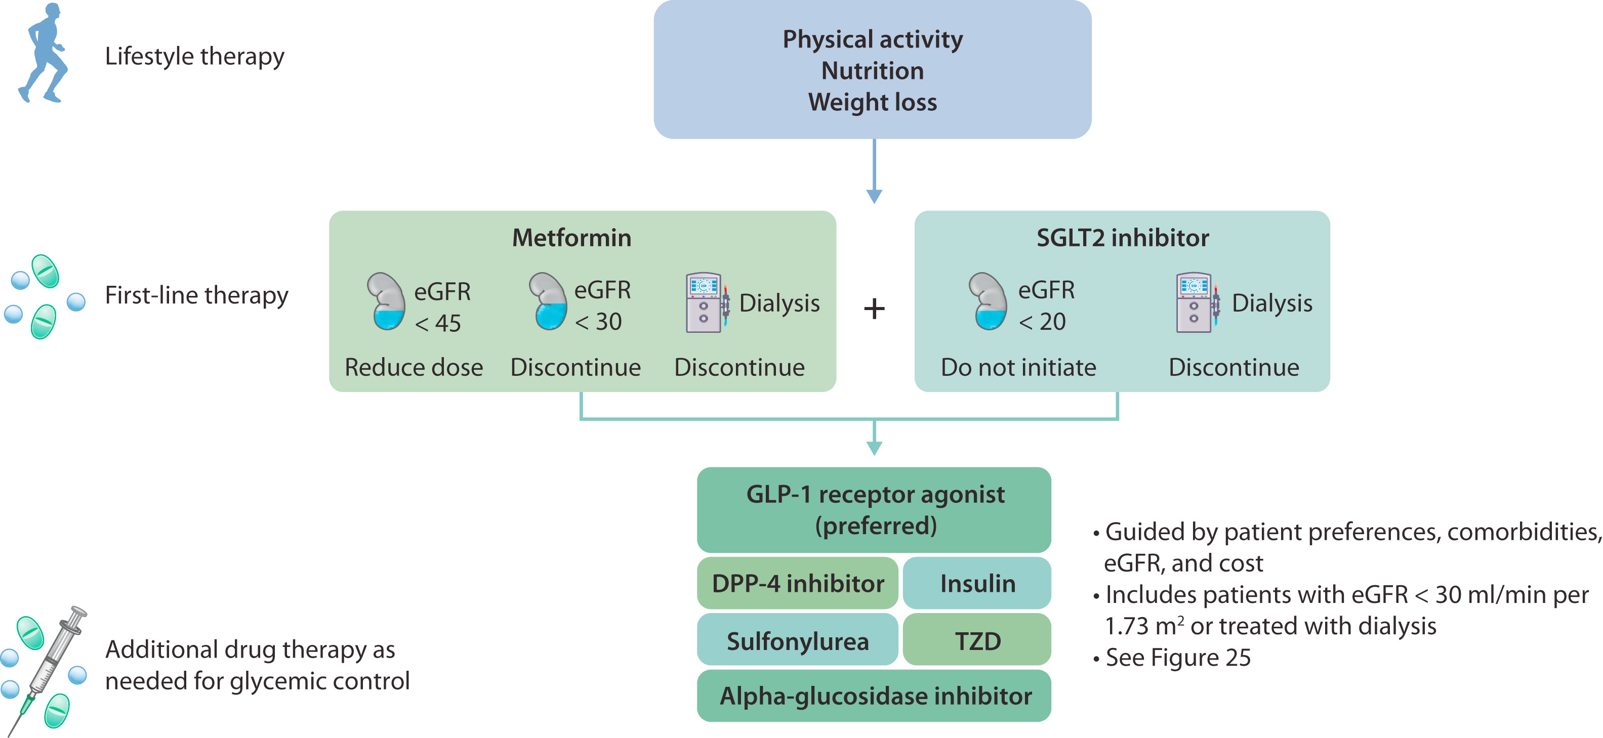
CKD/DM Management

Slide 26
Role of SGLT2 Inhibitors
Diabetes
Cardiovascular Disease/Heart Failure
Chronic Kidney Disease

Slide 28
SGLT2i – Dosing
Drug | Dose
Canagliflozin (Invokana®) | 100-300 mg daily
Dapagliflozin (Farxiga®) | 5-10 mg daily
Empagliflozin (Jardiance®) | 10-25 mg daily
Ertugliflozin (Steglatro™) | 5-15 mg daily
*Dose varies based on indication*

Slide 29
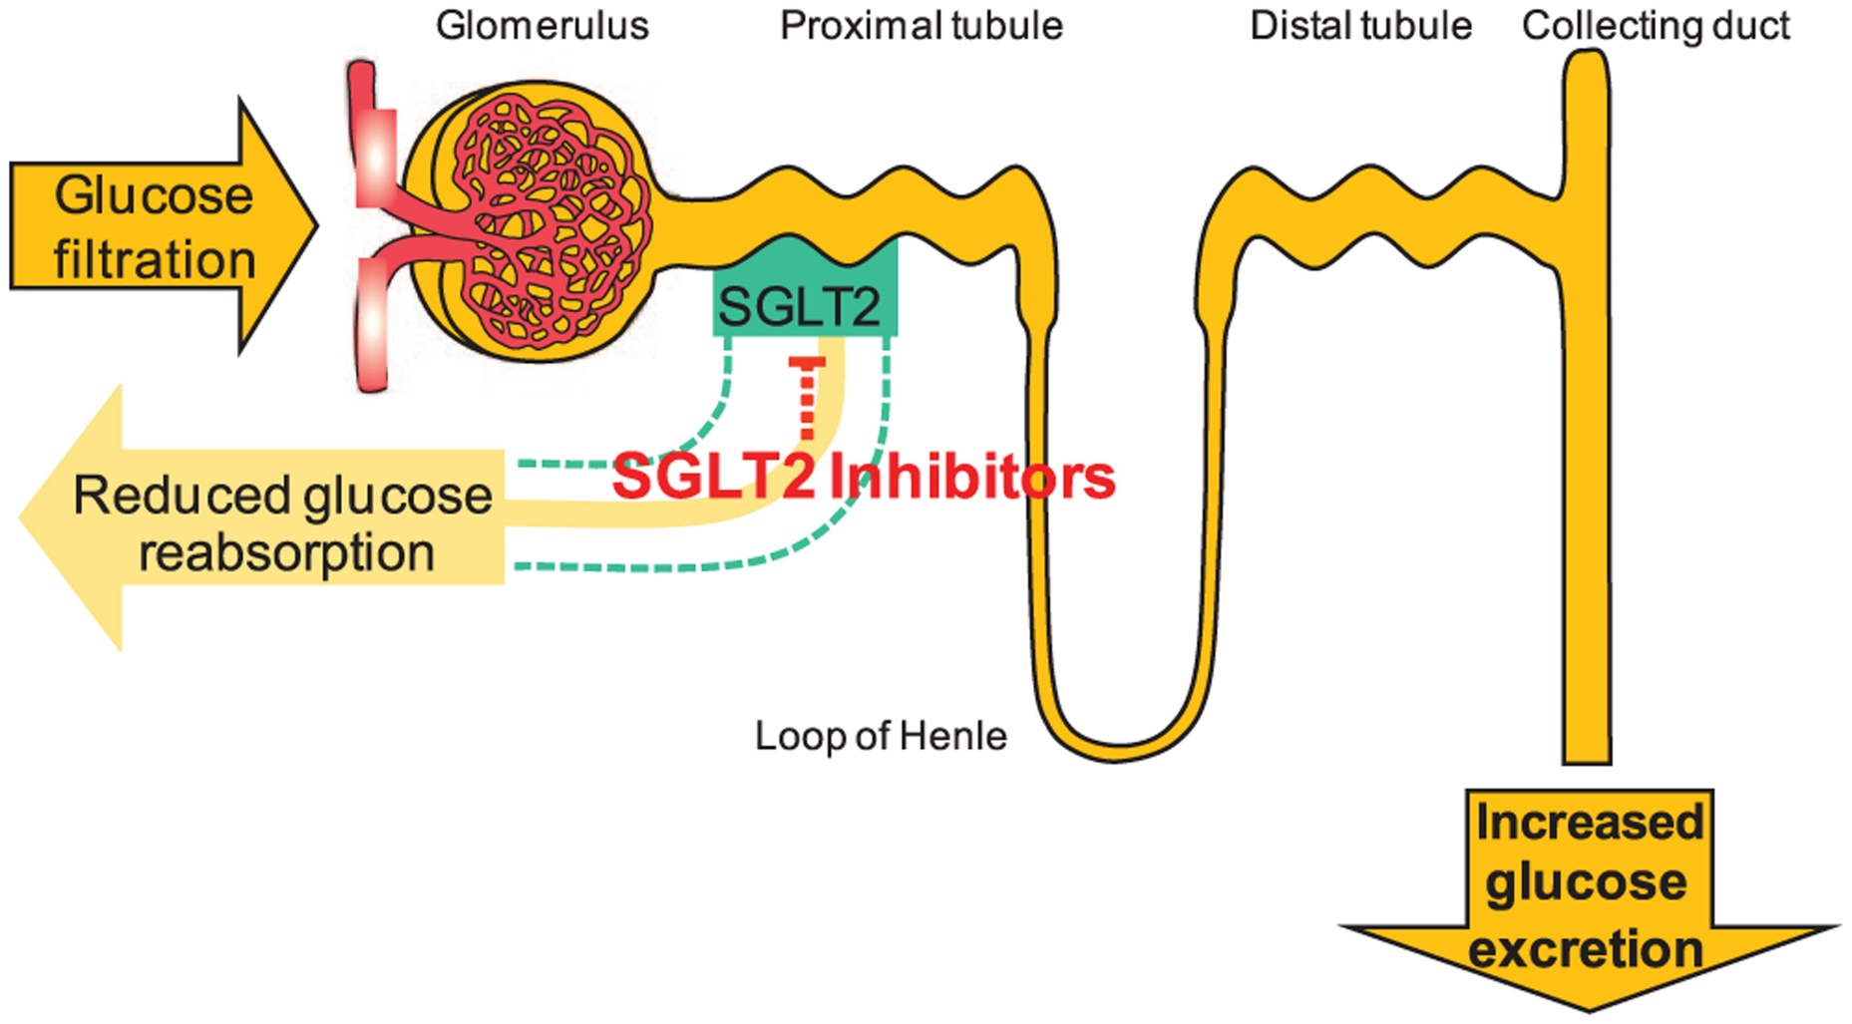
SGLT2i – Pathophysiology

Slide 30
SGLT2i – Clinical Considerations
Dependent on indication, always double check dose prior to prescribing
Avoid prescribing in patients who are prone to dehydration
Consider reductions in diuretic dosing given the glycosuric effects
Monitor renal function regularly

Slide 31
Cost and Affordability
Rebates/coupons through manufacturer
Manufacturers offer assistance programs for low-income patients who qualify
See drug manufacturer website –> savings and support section
Always ask about inability to afford medications
Explore other barriers such as knowledge deficits, side effects, etc.

Slide 32
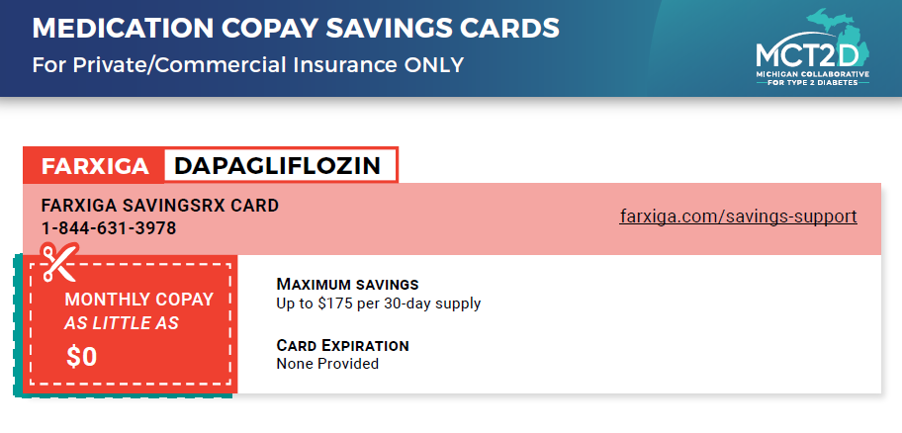
Resources – Cost and Affordability
MCT2D Resource Library Link

Slide 33
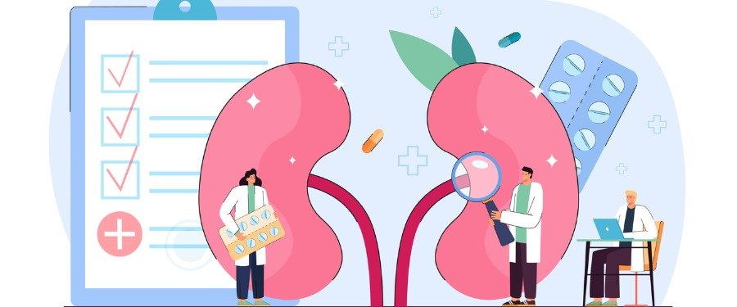
Team Based Care

Slide 34
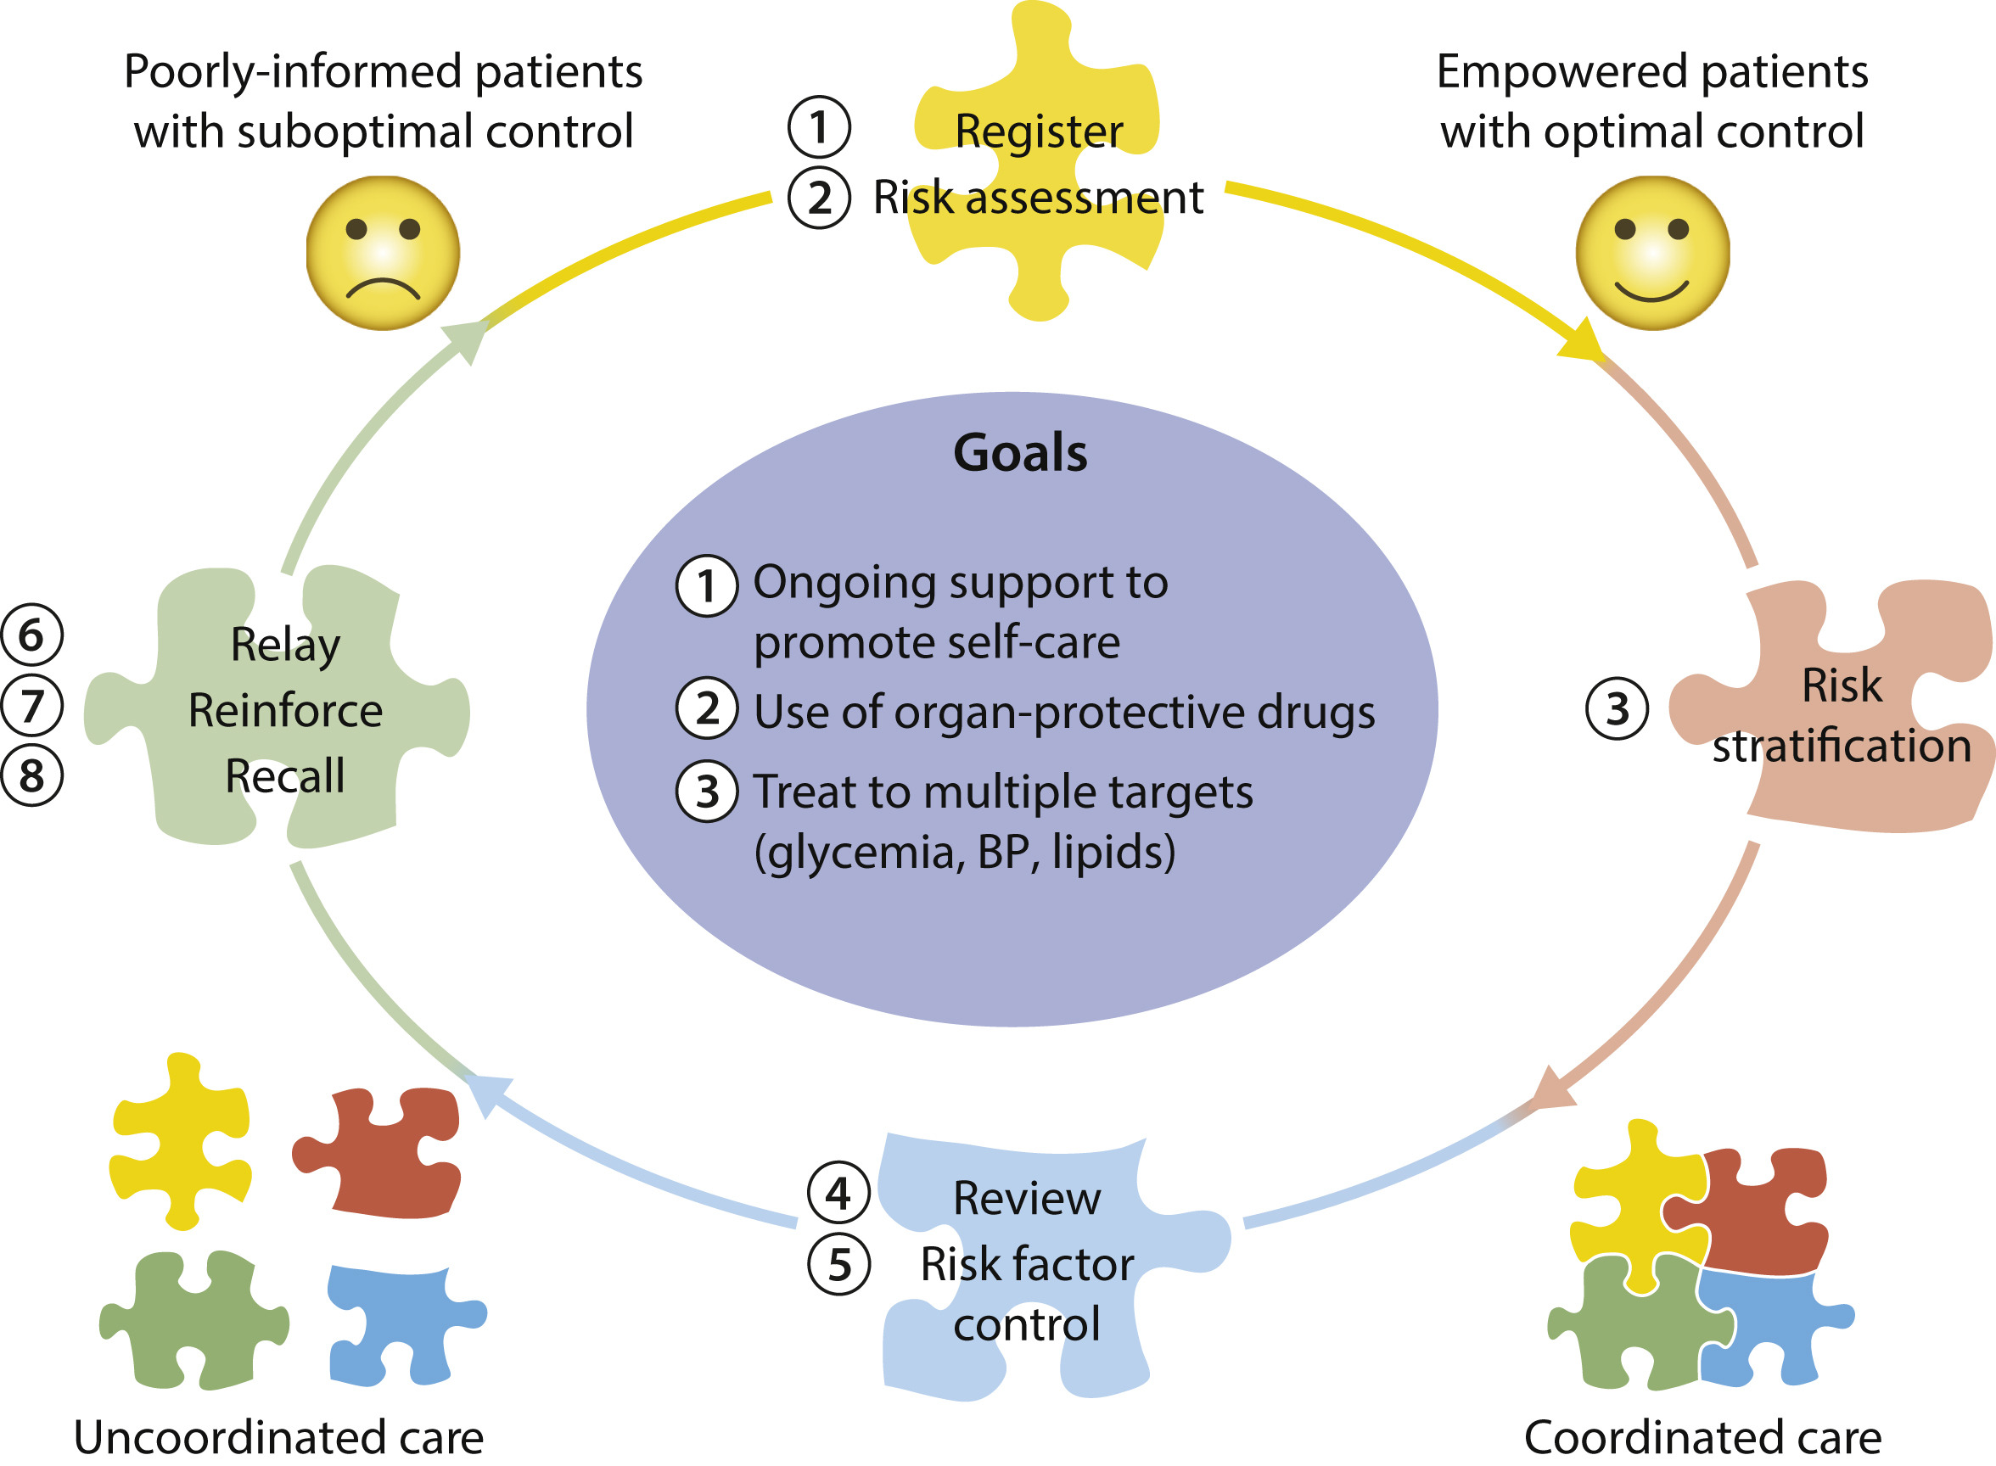
Team-Based Care

Slide 35
Resources
NKF – National Kidney Foundation. https://kidney.org
NKFM – National Kidney Foundation of Michigan. https://nkfm.org
KDIGO – Kidney Disease Improving Global Outcomes. https://kdigo.org
ADA - American Diabetes Association. https://diabetes.org
AACE – American Association of Clinical Endocrinology. https://pro.aace.com
MCT2D – Michigan Collaborative for Type 2 Diabetes https://www.mct2d.org

Slide 36
Additional References
Centers for Disease Control and Prevention (CDC). Chronic Kidney Disease: Common – Serious – Costly. Feb 2022.
Can NSAIDs Be Used Safely for Analgesia in Patients with CKD? Kidney360. 2020 Nov 25; 1(11): 1184–1188.
Sheth, S et al. Safe and appropriate use of diclofenac in chronic kidney disease: An Indian perspective. J Family Med Prim Care. 2021 Jul; 10(7): 2450–2456.
Pugh D, et al. Management of Hypertension in Chronic Kidney Disease. Drugs. 2019 Mar;79(4):365-379.
National Kidney Foundation. Herbal Supplements and Kidney Disease. 2019.

Slide 37
Patient Case

Slide 38
AB is a 66 yo male (height = 5’5”, weight = 200 lbs, BMI 33.16 kg/m²) with a PMH of hypertension, type 2 diabetes, arthritis, and GERD. He presents to clinic today with the lab findings shown below. He is very concerned about his new CKD diagnosis, and he is eager to discuss how his medications impact this condition.
Medication List
Ibuprofen 600 mg as needed
Lisinopril 40 mg daily
Basaglar 20 units daily
Trulicity 3 mg weekly
Metformin 1000 mg BID
Aspirin 81 mg daily
Rosuvastatin 10 mg daily
 | Latest Reference Range & Units
Sodium | 136 - 146 mmol/L | 137
Potassium | 3.5 - 5.1 mmol/L | 4.5
Chloride | 98 - 108 mmol/L | 102
CO2 | 20 - 31 mmol/L | 27
Urea Nitrogen | 8 - 20 mg/dL | 58 (H)
Creatinine | 0.70 - 1.30 mg/dL | 1.88 (H)
Glucose | 70 - 180 mg/dL | 149
Calcium | 8.6 - 10.3 mg/dL | 8.1 (L)
Phosphorus | 2.7 - 4.6 mg/dL | 2.8
eGFR, Creatinine-based formula (CKD-EPI 2021) | >=60 mL/min/1.73m² | 39 (L)
HbA1c | Diabetes >=6.5% | 8.0

Slide 39
Question #1
Which additional medication would be most beneficial for this patient to start based on his lab results and comorbid conditions?
Ozempic
Farxiga
Hydrochlorothiazide
Losartan

Slide 40
Question #1
Which additional medication would be most beneficial for this patient to start based on his lab results and comorbid conditions?
Ozempic
Farxiga
Hydrochlorothiazide
Losartan

Slide 41
Question #2
2. Which of the following medications should be avoided, if possible, given new CKD diagnosis?
Lisinopril
Ibuprofen
Trulicity
Rosuvastatin

Slide 42
Question #2
2. Which of the following medications should be avoided, if possible, given new CKD diagnosis?
Lisinopril
Ibuprofen
Trulicity
Rosuvastatin

Slide 43
Question #3
3. Which of the following medications will require dose adjustment given current stage of CKD? Select all that apply.
Rosuvastatin
Trulicity
Basaglar
Metformin

Slide 44
Question #3
3. Which of the following medications will require dose adjustment given current stage of CKD? Select all that apply.
Rosuvastatin
Trulicity
Basaglar
Metformin

Slide 45
Summary
Several medications may require dose adjustment or discontinuation for patients with CKD
Medication therapy should be assessed at each visit and should include an assessment of OTC medications
SGLT2i should be prescribed to prevent CKD progression, and may be beneficial for other comorbid conditions

Slide 46
Questions contact nmhammou@med.umich.edu

Slide 47
MICMT Resources
https://micmt-cares.org/
MICMT Contact: https://micmt-cares.org/contact

