Slide 1
Enhancing Team Based Care in the Outpatient Setting
A Care Manager’s Guide to Understanding Nutrition and Early Chronic Kidney Disease
June 2023
Notes:
MICMT Team: Must use “Enhancing Team Based Care in the Outpatient Setting” as the overarching title for webinars which are part of this series. You can determine if the webinar is included in the Enhancing TBC webinar series, by viewing the Events Data in google docs or check with Marie.
If webinar is not included in Enhancing TBC webinar series …; remove this from the title slide.

Slide 2
Amy Schneider, MS, RD, CDCES
University of Michigan Health
Outpatient Registered Dietitian
Michigan Institute For Care Management & Transformation
Clinical Lead and Patient Engagement Specialist

Slide 3
By the end of today’s session, you will be able to:
Explain the benefits of following an eating pattern that helps manage early kidney disease in addition to the most commonly co-existing conditions of diabetes and hypertension
Increase your confidence when it comes to supporting the use of this eating pattern with patients
Understand the process of referring patients to a Registered Dietitian (RD) for more detailed support

Slide 4
AB is a 66 yo male (height = 5’5”, weight = 200 lbs, BMI 33.16 kg/m²) with a PMH of hypertension, type 2 diabetes, arthritis, and GERD. He presents to clinic today with the lab findings shown below. He is very concerned about his new CKD diagnosis, and he is eager to discuss how his lifestyle impacts this condition.
Medication List
Ibuprofen 600 mg as needed
Lisinopril 40 mg daily
Basaglar 20 units daily
Trulicity 3 mg weekly
Metformin 1000 mg BID
Aspirin 81 mg daily
Rosuvastatin 10 mg daily
 | Latest Reference Range & Units
Sodium | 136 - 146 mmol/L | 137
Potassium | 3.5 - 5.1 mmol/L | 4.5
Chloride | 98 - 108 mmol/L | 102
CO2 | 20 - 31 mmol/L | 27
Urea Nitrogen | 8 - 20 mg/dL | 58 (H)
Creatinine | 0.70 - 1.30 mg/dL | 1.88 (H)
Glucose | 70 - 180 mg/dL | 149
Calcium | 8.6 - 10.3 mg/dL | 8.1 (L)
Phosphorus | 2.7 - 4.6 mg/dL | 2.8
eGFR, Creatinine-based formula (CKD-EPI 2021) | >=60 mL/min/1.73m2 | 39 (L)

Slide 5
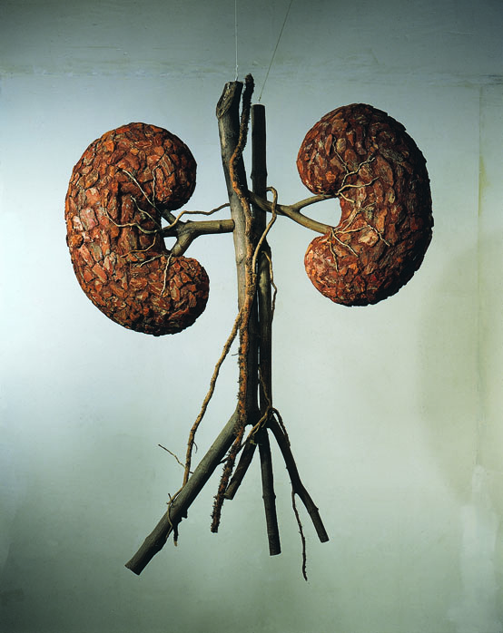
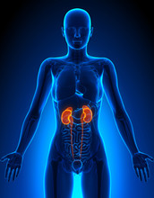
Why are the kidneys important?
Filter 200 liters of
blood every day
Involved in the following processes:
Removing waste
Balancing fluids & minerals
Controlling blood pressure
Keeping bones healthy
Regulating hormones
Making red blood cells
This Photo by Unknown Author is licensed under CC BY-SA
Notes:
Every day, kidneys filter 200 liters of blood.

Slide 6
What is Chronic Kidney Disease (CKD)?
According to the National Kidney Foundation (NKF):
“a chronic renal disease/condition that is characterized by a gradual loss of kidney function over time, occurring for at least 3 months.”
What causes CKD?
High blood sugar (diabetes)
High blood pressure (hypertension)
High weight (obesity)
More rare causes include kidney inflammation, inherited diseases, birth defects, autoimmune diseases, obstructions, & enlarged prostate
Notes:
Diabetes and high blood pressure cause 2/3 of the cases of CKD
https://www.kidney.org/atoz/content/about-chronic-kidney-disease
https://www.kidney.org/sites/default/files/kidney-numbers-ckd-heatmap.pdf – HEAT MAP

Slide 7
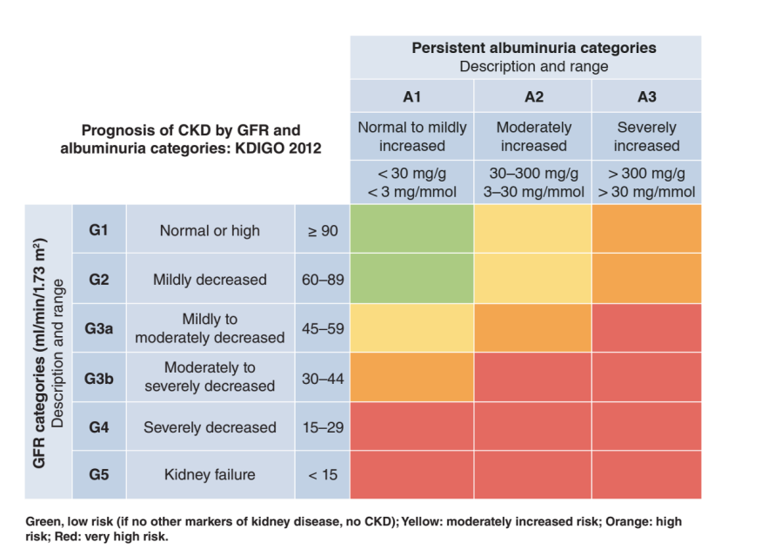
Classification & Prognosis
Notes:
This heat map helps with CKD classification and prognosis.
If you do have chronic kidney disease, then your doctor can use the CKD Heat Map to find out your risk for CKD getting worse and your risk for kidney disease.
There are 5 stages of CKD, * early CKD usually consists of the green and yellow areas… Orange and red areas should be individualized ( protein intake may vary due to high albuminuria or lower GFR)
On the left side of the map, your eGFR number matches up with a CKD stage. A higher eGFR number is better because it means you have a lower CKD stage.
The top shows the amount of albuminuria present and this is measured by the urine albumin to creatinine ratio (uACR) and the goal is to have < 30 mg/g
A Green box means you do NOT have chronic kidney disease, or that you are at the lowest risk for CKD getting worse. Yellow means increased risk for CKD getting worse. Orange means high risk for CKD getting worse. Red means the highest risk for CKD getting worse.
NKFM describes it best - In the same way that rust is the sign of a damaged fence, albuminuria is the sign of damaged kidneys. We may not be able to remove the rust on the fence that’s already formed, but we can protect the fence so that no more rust will form. By doing so, the fence will still be useful. Likewise, we can stop further damage to the kidneys by protecting them with proper care. By doing so, albuminuria will not get worse or could improve, and the kidneys will still function.

Slide 8
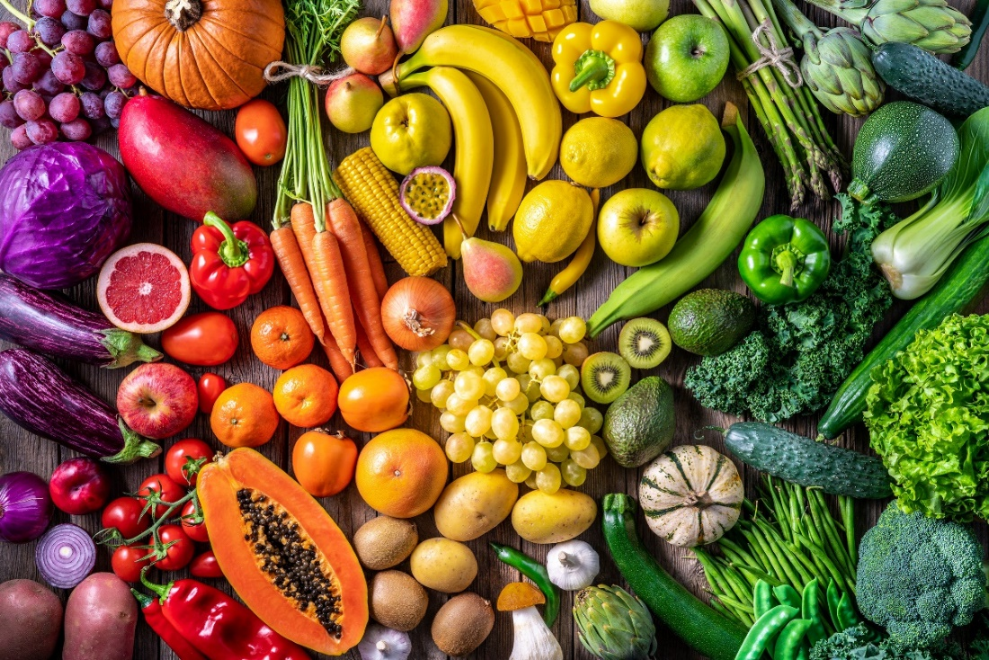
What diet is recommended for someone living with CKD?
Dietary
Approaches to
Stop
Hypertension
Diet
+ low sodium
DASH Eating Pattern

Slide 9
Why is the DASH eating pattern (DASH + sodium restriction) considered one of the best?
Improves blood pressure
Promotes better kidney function
Promotes better heart function
Improves lipid panel
Promotes better heart function
Helps weight loss/maintenance
Promotes better heart and kidney function
Promotes a lower risk of type 2 diabetes
Promotes better management of already diagnosed type 2 diabetes
Notes:
Nearly 3 decades of studies have shaped the NHLBI’s DASH eating plan recommendations, which include following a DASH diet with reduced sodium intake for the greatest effect on lowering blood pressure.

Slide 10
What’s included in the DASH diet?
Low in total, saturated and trans fats
Adequate protein, focused on plant-produced
Moderate in total carbohydrate
low in added sugar
Rich in potassium, calcium, magnesium, fiber

Slide 11
2300mg
1500mg
Notes:
Average American consumes 3400mg of sodium according to the Center for Disease Control

Slide 12
What about fluid?
Keeping the kidneys well hydrated is a top priority
Considered a “moving target”
Temperature
Health status/advancement of CKD
Age
Activity
Food choices
Adequate Daily Intakes (National Academy of Medicine)
Men = 13 cups (104 ounces)
Women = 9 cups (72 ounces)

Slide 13
What if my patient is living with CKD and type 2 diabetes?
DASH eating pattern is not specifically a low carb eating pattern, but is very safe for people living with diabetes
Which DASH friendly foods are high fiber carbs?
Whole grains
Oats – bran, oatmeal
Whole grain wheat
bread/crackers/pasta/cereal
Brown rice
Quinoa
Whole fruits
Starchy vegetables
Potatoes/sweet potatoes
legumes (beans, peas, lentils)
Corn
Winter squashes

Slide 14
What is most important when it comes to eating for CKD management (as well as others)?
Eating at regular intervals during the day
Eat breakfast within 1-2 hours of waking up
Space meals/snacks every 4 to 5 hours while awake
Leave 2-3 hours between eating and bedtime
Choosing minimally processed food more often
The closer to the farmer’s field, the better
Using the Plate Method to plan meals/snacks
Balanced in food groups, moderate in high fiber carbs
Portion control, smaller in size than standard

Slide 15
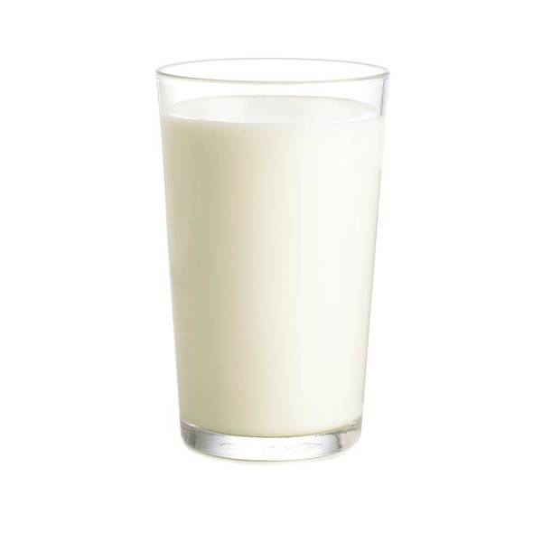
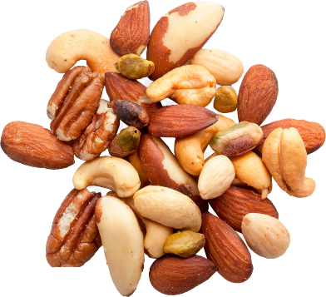
Aim to use a smaller plate; 9 inches is best!
Notes:
MORE BASIC, GREAT starting point

Slide 16
AB has been a lawyer for many years, and he finally made partner last year. Now that money is even more plentiful, and time is not, he ends up going out to eat at least 5 nights per week. His most typical order will be a salad topped with chopped steak and extra salad dressing.
He finds himself skipping lunch because he is so busy at work even though he knows this is not the best for him. He starts every morning with a cappuccino he makes at home with milk and a mix from the store, but he doesn’t drink much water during the day because he feels the extra trips to the bathroom cause a loss in work productivity.

Slide 17
What is the best way for a Care Manager (who is not an RD) to immediately help AB?
Use the Ask, Tell, Ask strategy
Care Manager:
“What, if anything, do you already know about nutrition and kidney health?”
After TELLING the patient 1-2 pieces of new information, ASK them for their feedback/thoughts before continuing.

Slide 18
Nutrition Question #1
What would be the best way to start the nutrition conversation with AB?
Tell him that going out to eat is horrible for him, and he should stop it.
Ask “What concerns do you have about your current eating habits?”
Don’t say anything because you aren’t a Dietitian.
Agree that going out to eat makes sense because he has a lot of money.

Slide 19
Nutrition Question #2
Which of the following is the most concerning when it comes to CKD and diabetes management?
Drinking coffee in the morning instead of water
Extra salad dressing on dinner salad
Skipping meals and water during the day, followed by eating a large restaurant meal
Limited vegetable intake

Slide 20
Nutrition Question #3
Which of AB’s current habits would be positive to focus on affirming?
Preparing his coffee at home every morning with high potassium milk
Including an unprocessed vegetable in his typical out to eat order
Knowing the importance of eating regularly throughout the day
Getting extra salad dressing because it is tasty
A, B, C above

Slide 21
What are the specific recommendations for AB?
Discuss underlying motivation to improve kidney health
Reinforce that there is no restriction on potassium or phosphorus
lab values in range
Change morning coffee by suggesting decrease in use of mix
Increase decaffeinated fluid during the day
Promote food intake every 4/5 hours instead of skipping
Moderate protein, more plant-based options
Daily recommendation of 50 – 60 g per day using IBW and 0.8g/kg weight
Consider swapping/decreasing animal protein for plant protein at dinner since this would promote a more CKD friendly meal

Slide 22
Red meat is hardest on the kidneys
White meat/animal protein is the second hardest on the kidneys
Notes:
In the past kidney patients have been told to avoid protein from plants. New research show that not only is vegetable protein easier for the kidneys to process, but it also slows progression of kidney disease in stages 3 and 4. As this chart demonstrates plant protein has about the same potassium and phosphorous as the animal protein it replaces

Slide 23
Notes:
MORE ADVANCED/DETAILED

Slide 24
A Week with DASH
https://www.nhlbi.nih.gov/sites/default/files/publications/WeekOnDASH.pdf

Slide 26
When is it best to bring in an RD?
Any time you have one available!
Complex nutritional needs
(beyond kidney dysfunction)
Detailed nutrition questions
Patient interest/request

Slide 27
Does my patient qualify to see an RD?
Medicare Guidelines for Medical Nutrition Therapy (MNT)
Referred by medical provider
Diagnosed with diabetes, renal disease or had kidney transplant within last 36 months
Services must be delivered by a Registered Dietitian
Patient pays $0 – Part B deductible and coinsurance don’t apply
Frequency – 3 hours the first year, 2 hours subsequent years
Private Insurances often follow Medicare guidelines, but this varies
Patient may need to call insurance to check their coverage

Slide 28
How do I find an RD qualified to help?
Kidney Dietitians (google.com) – CKD Dietitian Directory NKF
Find a Nutrition Expert (eatright.org)
Check with your local hospital system, ask for renal dietitians especially for advanced CKD
Call insurance company
Ask other doctors/healthcare professionals

Slide 29
Resources
Nutrition | National Kidney Foundation
DASH Eating Plan | NHLBI, NIH
afternoonrounds | Shivam Joshi, MD
The DASH Diet for Healthy Weight Loss, Lower Blood Pressure and Cholesterol
Diet Review: DASH | The Nutrition Source | Harvard T.H. Chan School of Public Health
Understanding the DASH diet: MedlinePlus Medical Encyclopedia
Cooking Matters
PATH | Chronic Disease Self-Management | NKFM
Home | Diabetes Prevention Program (readysetprevent.org)

Slide 30
References
Your Guide to Lowering your Blood Pressure with DASH: DASH Eating Plan; National Institutes of Health and National Heart, Lung, and Blood Institute; 2006. https://www.nhlbi.nih.gov/files/docs/public/heart/new_dash.pdf
Kidney Disease Improving Global Outcomes https://kdigo.org/
National Academy of Medicine https://nam.edu/
National Kidney Foundation https://www.kidney.org/

Slide 31
Questions?
Feel free to email me! amyberns@med.umich.edu

Slide 32
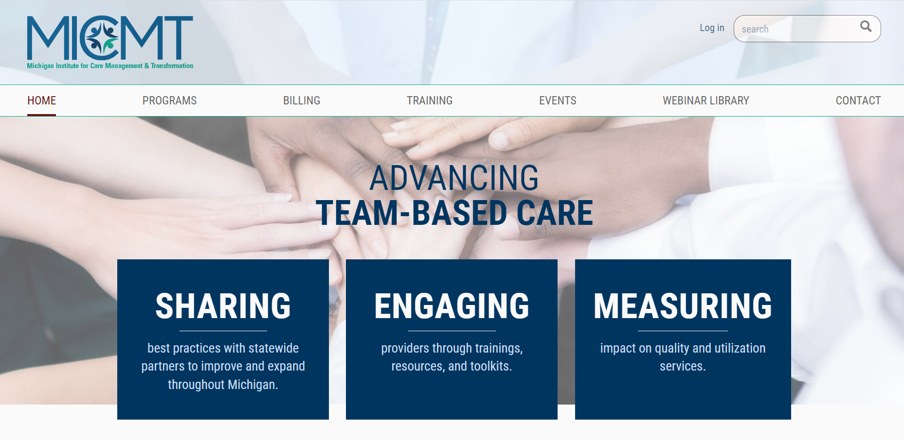
MICMT Resources
https://micmt-cares.org/
MICMT Contact: https://micmt-cares.org/contact

Slide 33
Disclaimer
Each physician organization and/or practice is solely responsible for all medical care and services delivered to its patients and all decisions related to such medical care and services. Neither MICMT or the Regents of the University of Michigan shall be responsible for any delivery of medical care or other services to any patient, or any decisions, acts or omissions of persons in connection with the delivery of medical care or other services to any patient.

