Slide 1
The Benefit of Team-Based Care in a Clinical Practice

Slide 2
Reference Guidelines
Please provide the following as an appropriate reference if you use this material:
“Material based off of the the Benefit of Team-Based Care in Clinical Practice was developed by Michigan Institute for Care Management and Transformation and participating Training Organizations.”
Questions about this curriculum should be sent to: micmt-requests@med.umich.edu.

Slide 3
Learning Objectives
Define the team-based model of care
Demonstrate the advantages of team-based care
Explain how the model improves patient outcomes
Identify financial opportunities related to team-based care

Slide 4
What is Team-Based Care?
AHRQ Definition:
The provision of health services to individuals, families, and/or their communities by at least two health care providers who work collaboratively with patients and their caregivers, to the extent preferred by each patient, to accomplish shared goals within and across settings to achieve coordinated, high-quality care.
Some people also refer to Team-Based Care as Care Management.
https://pcmh.ahrq.gov/page/creating-patient-centered-team-based-primary-care
Notes:
Reinforce:
Two or more health care providers
Working collaboratively with patient and caregiver
Accomplish shared goals in and across settings
Achieve coordinated high-quality care

Slide 5
How the Team Can Make a Difference
Elizabeth Haberkorn, MSN, FNP-BC
Family Nurse Practitioner at Judson Center Family Health
Associate Medical Director, Medical Network One PC

Slide 6
What is Team-Based Care?
Practical Definition:
Adding expertise to a current care team to improve outcomes and care delivery.
This can be through:
Additional training to support role expansion (e.g. MA to Community Health Work or Care Coordinator)
Additional team members, including (but not limited to) a Registered Dietitian, Pharmacist, Social Worker, or Registered Nurse.
https://pcmh.ahrq.gov/page/creating-patient-centered-team-based-primary-care
Notes:
Reinforce:
Two or more health care providers
Working collaboratively with patient and caregiver
Accomplish shared goals in and across settings
Achieve coordinated high-quality care

Slide 7
What Role Fits Your Practice’s Needs?
Expanding the team should be driven by your patient population and the types of barriers that prevent your patients from being able to follow their care plans.
For example:
If your patients experience many social determinants of health barriers… maybe a CHW is appropriate.
If your patients need a lot of education about their diseases… Maybe an RN is appropriate.
If your patients experience a lot of behavioral health challenges… maybe an MSW is appropriate.
If your patients struggle with diabetic lifestyle management or weight navigation… maybe an RD is appropriate.
If you have an older population with polypharmacy… maybe a PharmD is appropriate.
Physician, Nurse Practitioner, Physician Assistant
Asthma Educator
Diabetes Educator
Paramedic
Community Health Worker
Social Worker
Nurse
Dietitian/ Nutritionist
Professional Counselor
Medical Assistant
Respiratory Therapist
Pharmacist
Notes:
The next slide will expand on the various roles.

Slide 8
Build Your Team to Support Your Patients
Health Coaching Outreach
Medication Management
Symptom Management Assessment
Planned Visit Preparation
Gaps in Care outreach
Follow up to determine barriers
Adjustment of the care plan
Transitions of Care Calls
ED follow up call
Connect with Community Resources
Notes:
Health coaching call (MA, CMW, RN based on pre-established guidelines)
Medication Management call (RN, pharmacists… based on pre-established guidelines)
Symptom Management Assessment and reinforcement – weight gain, elevated BP, peak flow … (MA, CMW, RN, SW based on pre-established guidelines)
Planned visit preparation (MA, CHW, …)
Outreach for Gaps in Care (Office staff, MA, volunteers again based on pre-established guidelines)

Slide 9
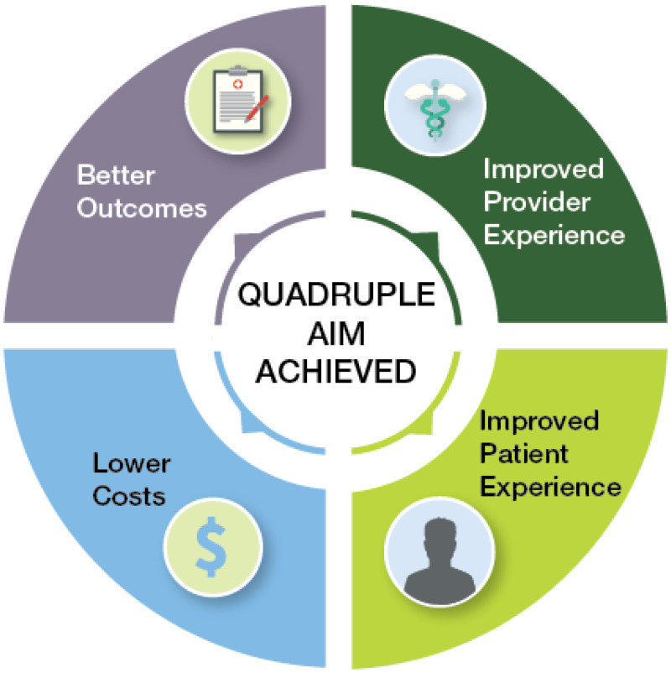
Why Adopt This Model?
Notes:
Team-based Care can add value to the practice both in the increased utilization of resources and the increased services to the patient and family. Yes initially is an increased cost during implementation before patient outcomes are seen and VBR changes
Success for the practice:
Full utilization of practice team
Increased employee engagement
Ownership of roles
Specific examples how costs are decreasing:
Early contact for yellow or early symptom management at the practice can avoid ED visit and hospitalization
Improving patient understanding of medication can increase adherence and improve control of condition demonstrated by Lab or BP
improved workflow can make provider visits more efficient and effective

Slide 10
Advantages of Team-Based Care: Patient & Provider Experience
This video features Anthony W. Clarke, MD from Health Centers Detroit describing how having a team helps him provide better care to his patients.

Slide 11
Dr. Joyce Leon, Henry Ford Health System
Advantages of Team-Based Care: Patient & Provider Experience
Can you provide a specific example of how an intra-professional team created the opportunity for a care team member to work at the top of their licensure to meet the needs of a complex patient?
How has working with an inter-professional care team made you more efficient in your role?

Slide 12
Building Trust In Another Team Member
Role Clarity
Providers can and should play a role in determining what patient populations should receive support from the Care Team Member.
Scope of practice agreements or collaborative practice agreements can outline expectations.
Communication
Providers and Care Team Members should plan frequent, short touch-bases to communicate about patient care plans and progress.
Bonus: this is billable time!
It’s also very helpful to have structured meetings, particularly at the beginning, to figure out workflows.
Continuing Education
Free CE opportunities
Required training
Billing training opportunities
Notes:
We recognize it isn’t that easy to just bring on another person. But, there are communication strategies and structures that can be put in place to help alleviate concerns and make sure that everyone is on the same page.

Slide 13
How Does Team-Based Care Impact Outcomes?
Team Structure
Tracking Quality & Utilization
Productive Interactions
Common Outcomes goals (AIC/BP)
Design a patient-centered process that supports timely and evidence-based care.
Using metric resources such as ADT notifications, EHR, registry and payer reports can help evaluate success.
Productive interactions are those that support the patient and their self-management goals to accomplish the Care Plan that was designed by the provider.
Establish common outcomes and where the team is in achieving their goals
Notes:
Team Structure/Communication -
Define the structure, roles and responsibilities for care team.
CPA; A legal agreement that formally defines the relationship between the physician and care team member (usually used with Pharmacists) that expands the role of the care team member beyond the normal licensure confines. For pharmacists, this frequently gives the ability to provide medication management through titration of meds and ordering supplies.
Standing Orders/Agreements facilitate team-based care by giving blanket agreement for proactive outreach by the care team
Huddle/Meeting- Describe the differences:
Tracking Quality - Metrics resources:
EHR can provide a report on practice level performance
Registry can provides a report on metrics
List by payer or practice.
List of patients who are not in control or who are missing evidence-based care
Payer reports and websites will additionally show your performance and the list of patients with a ‘gap’ in their care
Health care teams that communicate effectively and work collaboratively reduce the potential for error, resulting in enhanced patient safety and improved clinical performance. A key aspect in improving teamwork and communication in health care is engaging patients and families. Determining how patients and families want to be involved in their care and then engaging them in designing their plan of care increases their understanding of tests, procedures, and anticipated care outcomes. This results in an activated patient, one willing and able to self-manage. A lack of teamwork is often identified as a primary point of vulnerability for quality and safety of care. Health care teams that communicate effectively and work collaboratively reduce the potential for error, resulting in enhanced patient safety and improved clinical outcomes.
Common Goals =
Common Outcomes like utilization are the final measure of program success, but quality metrics and management of the patient’s disease drive the outcome measures as well.
Many factors impact a patient’s health status. Addressing the social needs and behavioral health and clinical management within the assigned population leads to improved out come measures. (ie. decreased ED and hospital utilization).

Slide 14
Impact of Team-Based Care on Utilization
Emergency Department
One care management encounter reduces the risk of ED by 34.4% (Hazard Ratio 0.656) compared to no CM encounters
Two care management encounters reduces the risk of ED by 54.8% (Hazard Ratio 0.452) compared to no CM encounters
Inpatient
One care management encounter reduces the risk of hospitalization by 26.2% (Hazard Ratio 0.738) compared to no CM encounters
Two care management encounters reduces the risk of hospitalization by 45.9% (Hazard Ratio 0.541) compared to no CM encounters
Analysis conducted in 2022 using BCBSM claims from 2018-2020.
Notes:
Longitudinal approaches of patients enrolled in 2018-2020 to better understand how PDCM affects healthcare utilization

Slide 15
A Big Help: The Transition of Care Experience
Erika Perpich, PharmD, BCACP
Director of Clinical Services, Ambulatory Care Clinical Pharmacist
Olympia Medical LLC

Slide 16
Sustainability
Fee For Service (FFS)
BCBSM, BCN, Priority Health, HAP all pay for the “Provider Delivered Care Management Codes”
Medicare and other payers pay for select codes.
Essentially all patient-related activities, except for email/in-basket work, are billable.
Incentives
BCBSM:
Population Engagement – 7% VBR for Primary Care
PDCM Outcomes – PaPM for Primary Care
Specialist Team-Based Care
Pharmacists Optimizing Oncology Care Excellence in Michigan (POEM)
Medicaid HMOs per PO Contract
Medicare – ACOs and Primary Care First
Priority Health
HAP
Notes:
Recommendation is to organize efforts so that care team members bill consistently for all interactions and have at minimum an average of 4 billable interactions per half day.

Slide 17
Provider Delivered Care Management Codes
G9001* - Coordinated Care Fee – Initial Assessment
G9002* - Coordinated Care Fee – Maintenance or follow up (quantity billed >45 minutes)
98961* - Group Education 2–4 patients for 30 minutes (quantity billed)
98962* - Group Education 5–8 patients for 30 minutes (quantity billed)
98966* - Phone Services 5-10 minutes
98967* - Phone Services 11-20 minutes
98968* - Phone Services 21-30 minutes
99487* - Care Management Services 31-75 minutes per month (care coordination in the medical neighborhood)
99489* - Care Management Services, every additional 30 minutes per month (care coordination in the medical neighborhood)
G9007* - Team Conference
G9008* - Physician Coordinated Care Oversight Services (physician only service)
S0257* - Counseling and Discussion Regarding Advance Directives
*HCPCS Level II and CPT codes, descriptions and two-digit numeric modifiers only copyright 2019 American Medical Association. All rights reserved
Billing resources can be found here: https://micmt-cares.org/billing-resources
Notes:
Explanation of the codes additional details of these codes can be found on the MICMT website: https://micmt-cares.org/billing-resources

Slide 18
Primary Care Incentive Programs
Practice needs to stay PCMH designated to qualify.
BCBSM
Value Based Reimbursement - increase on every E&M code and PDCM code
PDCM Touches – (measured at practice level) for attributed population:
4% with 2 touches = 7% VBR
Adult Outcomes VBR & Pediatric Outcomes VBR (measured at PO/subPO level)
To be eligible to earn outcomes VBR, practices must meet 1% outreach with 2 touches
These are subject to change every year – so stay connected with your PO for updates!
Priority Health
Annual PMPM incentive payment if outreach achieved for 2- 5% of the patient population.
2 billed codes on different dates of service.
Fee For Service on all codes billed.
No patient co-pay.
Notes:
Incentive Program by Payer change year to year. These differences occur over a Measurement Year, Calendar Year or a Payment year. Your practice can help you know differences and impact.
PCMH = 15%
PDCM Touches = 7% VBR for 4% outreach with 2 touches
PDCM Outcomes PO performance is high enough. $0.40 PaMPM% for each of the 4 measure: A1c, BP, EDU, IPU.
Clinical Quality = 5-15% (5%: 80th – 85th percentile; 10%: 85th – 95th percentile; 15%>95th percentile)
Cost Benchmark, graded at the PO Level = 5 – 15% unclear how the percentiles go, based on rankings of POs

Slide 19
Example - 2023 BCBSM PDCM Outcomes VBR – Adult
Measure | Performance Threshold | Improvement Percent
ED Visits (per 1000 members per year) | 165 | 10%
IP Discharges (per 1000 members per year) | 34 | 10%
Comprehensive Diabetes Control: HbA1c < 8% | 72.2 | 10%
High Blood Pressure (<140/90 mm Hg for all adults age 18–64 with hypertension) | 80.2 | 10%
Notes:
Note that this isn’t measured at a practice level for BCBSM. Rather, it’s measured at a group level. BCBSM takes all of the practices that have been identified as “PDCM Practices” and lumps them together for performance.
A “PDCM Practice” is one that has reached at least 1% of their population with 2 billed and paid touches.
Performance Source
ED - Milliman Loosely Managed Benchmark (2018)
IP -- Milliman Loosely Managed Benchmark (2018)
HbA1c -- NCQA 75th percentile (2018)
BP -- NCQA 50th percentile (2018)

Slide 20
Sustainability Recipe
Sustainability for team-based care is dependent upon:
Size of your clinic
Licensures that would best support your patient population
Payer mix in your clinic
Relevant incentive program opportunities
Opportunities for ‘sharing’ care team members through your PO
This Photo by Unknown Author is licensed under CC BY

Slide 21
Determining Costs At Your Clinic
Determine which type of care team member your practice needs.
Determine the average salary of that licensure in your area.
Size matters:
If your clinic has less than 2 full time providers, find out if your PO supports ‘sharing’ a care team member. Your clinic might not need a full-time care team member to start with, so potentially working with the PO for 2-3 days might be best.
If your clinic has more than 2 full time providers, you might be better off starting with a closer to full-time (4-5 days/week) of a care team member.
Based on the amount of time and the hourly rate, you now understand the costs of a care team member.

Slide 22
Determining Revenue
Revenue hinges on the population of patients who will be supported.
Will your office only support those patients with coverage? If so, how will you identify this population and limit support?
If your care team member will support all patients regardless of payer, consider a ‘baseline’ of patients for whom there is either fee-for-service (FFS) or other incentive opportunity that will off-set costs.
If the average commercial video or face to face encounters is worth $100, how many commercial patients per day make this role sustainable?

Slide 23
Determining Sustainability
If your care team member’s hourly rate is $50/hr, and they work 20 hours per week, that’s $1000/week.
That means your care team member would need to have 10 commercial encounters per week to break even.
Note that the minimum recommendation is 4 encounters per half day.
Caveats:
Licensed care team members can bill higher level codes than unlicensed. They also have a higher hourly rate.
Available volume of patients and payer mix might determine whether you have enough commercial patients to break even.

Slide 24
MICMT Resources & Next Steps
Program Details
PDCM
POEM
CoCM
Training Courses
Introduction to Team-Based Care
Patient Engagement
Foundational CM Codes & Billing Opportunities
Billing Resources
Webinar Library
MICMT Contact: https://micmt-cares.org/contact
Notes:
PO’s can access resources related to programs, billing and training opportunities on the MICMT website

Slide 25
Key Takeaways
Team structure and roles help define how the team can work together
Care team members are required to complete training and receive continuing educational credits
Care teams can impact outcomes by using evidence-based care, productive interactions, tracking quality and utilization
Sustainability of team-based care is identifying important members of the care team, assigning appropriate classification codes, documenting services rendered and billing consistently
Next steps can be supported with resources at the MICMT website.
Notes:
https://nam.edu/wp-content/uploads/2015/06/VSRT-team-based-Care-Principles-Values.pdf

