Slide 1
A Care Manager’s Guide to Understanding Nutrition and Stage 4 and Stage 5 Chronic Kidney Disease
June 2023
Notes:
MICMT Team: Must use “Enhancing Team Based Care in the Outpatient Setting” as the overarching title for webinars which are part of this series. You can determine if the webinar is included in the Enhancing TBC webinar series, by viewing the Events Data in google docs or check with Marie.
If webinar is not included in Enhancing TBC webinar series …; remove this from the title slide.

Slide 2
Karen Greathouse, RD, CTCD
Karen Greathouse
Renal Nutrition Specialist, University of Michigan Kidney Transplant Program, Past National Chair National Kidney Foundation Council of Renal Nutrition

Slide 3
By the end of today’s session, you will be able to:
Explain the benefits of following an eating pattern that helps manage kidney disease in combination with diabetes, cardiovascular disease, and hypertension
Increase your confidence when it comes to supporting the use of this eating pattern with patients
Provide updates to current recommendations for the kidney diet and explain how the diet is tailored based on individual labs
Understand how the kidney diet has evolved in the past 10 years

Slide 4
AB is a 66 yo male (height = 5’5”, weight = 200 lbs, BMI 33.16 kg/m²) with a PMH of hypertension, type 2 diabetes, obesity, arthritis, and GERD. He presents to clinic today with the lab findings shown below. He is very concerned about his worsening kidney function, and he is now experiencing symptoms of gout.
Medication List
Ibuprofen 600 mg as needed
Lisinopril 40 mg daily
Basaglar 20 units daily
Trulicity 3 mg weekly
Aspirin 81 mg daily
Rosuvastatin 10 mg daily
 | Latest Reference Range & Units
Sodium | 136 - 146 mmol/L | 137
Potassium | 3.5 - 5.1 mmol/L | 5.2
Chloride | 98 - 108 mmol/L | 102
CO2 | 20 - 31 mmol/L | 19
Urea Nitrogen | 8 - 20 mg/dL | 58 (H)
Creatinine | 0.70 - 1.30 mg/dL | 4.0(H)
Glucose | 70 - 180 mg/dL | 180
Calcium | 8.6 - 10.3 mg/dL | 8.1 (L)
Phosphorus | 2.7 - 4.6 mg/dL | .4.5
HbA1c | Diabetes > or = 6.5% | 8.0
eGFR, Creatinine-based formula (CKD-EPI 2021) | >=60 mL/min/1.73m2 | 20(L)

Slide 5
How does the Kidney Diet change as Kidney Function Declines?
The kidney diet is individualized based on lab values. There is no one kidney diet for everyone. The Registered Dietitian will sit down with each client and do an individual diet recall.
Elevations in potassium can be result of constipation, elevated blood sugar, medications, and diet.
Notes:
Diabetes and high blood pressure cause 2/3 of the cases of CKD
https://www.kidney.org/atoz/content/about-chronic-kidney-disease
https://www.kidney.org/sites/default/files/kidney-numbers-ckd-heatmap.pdf – HEAT MAP

Slide 6
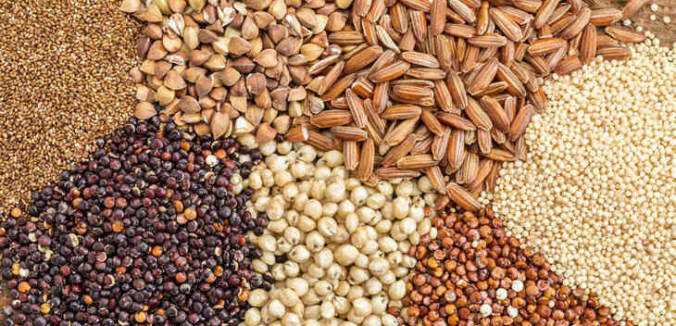
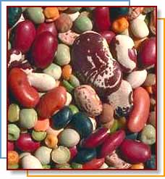
Renal Nutrition Myth Number 1: Whole grains and dried beans have too much phosphorous
This Photo by Unknown author is licensed under CC BY-SA.
While whole grains, nuts, seeds and beans do contain phosphorus, only about 50% of this phosphorus is absorbed, compared to 80- 100% of phosphorus in meat, fish, poultry, dairy and phosphorus additives in processed foods. KDOQI Guidelines recommend considering phosphorus bioavailability.
This Photo by Unknown author is licensed under CC BY-SA.

Slide 7
Renal Myth Number 2: People with CKD need a low potassium diet
The 2020 KDOQI guidelines recommend that only people who have high serum potassium restrict dietary potassium. A high potassium diet can help with blood pressure control.

Slide 8
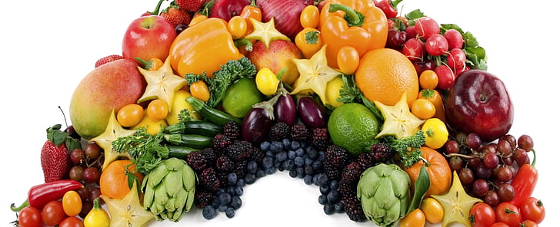
Renal Nutrition Myth Number 3: Fruits and vegetables should be limited
Even for people who need to limit potassium, care should be taken to include plenty of fruits and vegetables. Plant foods can help improve acidosis by correcting acid base balance. They can also decrease symptoms of gout. Dietary patterns rich in fruits and vegetables are associated with a slower progression and incidence of CKD.

Slide 9
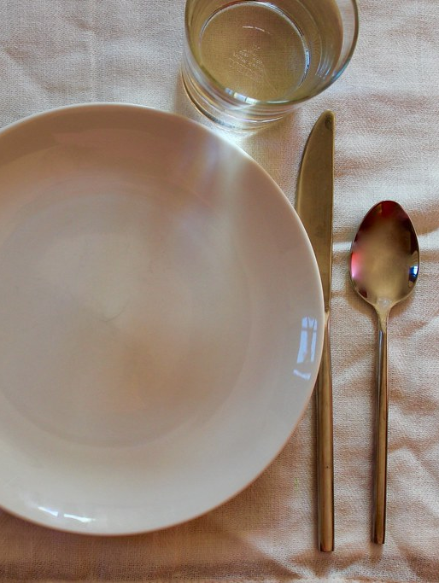
Renal Nutriton Myth Number 4: There is a single renal diet for everyone
CKD nutrition is different for everyone! A healthy eating pattern is based on each person's labs, past medical history, nutrition status and current eating habits.
A Registered Dietitian is the best person to help patients understand what is right for them to eat.
This Photo by Unknown author is licensed under CC BY.

Slide 10
KDIGO 2020 Clinical Practice Guidelines Nutrition Recommendations for CKD Patients with Diabetes
Nutrition Intake
Encourage a balanced, healthy diet that is high in vegetables, fruits, whole grains fiber, legumes, plant-based proteins, unsaturated fats, and nuts
Limit processed meats, refined carbohydrates, and sweetened beverages
Limit sodium to less than 2000 mg daily
Recommend protein to .8 g/kg IBW
Glycemic Monitoring
Recommended monitoring (CGM may be useful)
Reliability of A1C decreases with declining kidney function
Glycemic Targets should be individualized ranging from less than 6.5 to less than 8.0

Slide 11
What about Protein?
Large amounts of protein may harm kidney function by increasing waste products and causing the kidneys to work harder during stage 3, 4, and 5 not on dialysis
Not getting enough protein can cause malnutrition and muscle wasting, causing increased risk for illness and infections
Eating protein frequently through day stabilizes blood sugar and increases its absorption
Plant protein is easiest for kidney to filter; poultry and fish are easier on the kidney than red meat
One or two vegetarian meals a week can benefit both kidneys and diabetes and have a comparable amount of potassium and phosphorous
Protein is needed to build muscle, heal from injury or surgery, and fight infection

Slide 12
Protein Requirements for Diabetics with CKD
CKD stages 4 and 5 not yet on dialysis
42-65 grams or 6-9 ounces of high-quality animal or plant protein
1 ounce protein = 7 grams protein
Dialysis patients have increased protein needs
Hemodialysis (HD) patients need 70 to 90 grams or 10 to 13 ounces protein daily of high-quality animal or plant protein
Peritoneal Dialysis(PD) patients have higher protein needs than HD and need 80 to 100 grams or 11 to 14 ounces daily of high-quality animal or plant protein

Slide 13
What about Potassium?
Research demonstrates that plant-based foods have less effect on potassium then animal and processed foods
Potassium has important role in nerve and muscle function, including heart
As the GFR decreases, the kidneys do not adequately filter out potassium, which could cause potassium to build up in the blood and be dangerous
Elevated blood sugars can cause elevations in potassium
Cooking methods can increase or decrease potassium levels
Should not stop eating vegetables and fruit to control potassium levels
Not all patients need to restrict/limit potassium
Potassium typically limited to 2000 mg daily when potassium lab values on upper end of acceptable
Dietary intake is not only cause of hyperkalemia
Constipation
Medications
Poorly managed diabetes

Slide 14
Not All Potassium Foods are the Same
Potassium from these foods
Potassium from these foods

Slide 15
What about Phosphorous?
Phosphorus is a mineral that helps keep bones and blood vessels healthy and muscles working properly
High phosphorous levels can cause itching, joint pain, and calcification
It is found naturally in foods rich in protein, whole grains, dairy, beans and lentils
It is often added to foods and drinks as a preservative – called phosphorus additives
100%of phosphorous in additives are absorbed, but only 67% of naturally occurring phosphorous is absorbed
Whole grains are better option than white bread
Pills are often prescribed to act as a magnet to absorb phosphorous in the gut and eliminate it in the poop

Slide 16
What about Fluid?
Managing salt intake and blood glucose will decrease thirst and help prevent gaining excess fluids
Anything that melts or pours counts as fluid, you can not pour salad, vegetables and fruit, so they do not count as fluid!
Fluid needs are different for people with CKD
Stages 3, 4, and early stage 5 usually require 64 oz. of fluid to keep kidney hydrated*
Dialysis patients typically need 40 ounces of fluid plus what they urinate out
HD patients should not gain more than 5% of their bodyweight between treatments (including weekend)
PD patients often do not have to restrict fluid
* May differ if history of CHF

Slide 17
What about Sodium?
Helps keep fluids balanced in the body
When kidneys are not working well, extra sodium and fluid build up in the body
swollen ankles
puffiness
rise in blood pressure
shortness of breath
sometimes fluid around your heart and lung
Sodium increases thirst and can cause excessive
Interdialytic weight gain in hemodialysis patients
Aim for less than 2400 mg sodium per day
500-700 mg per meal
400 mg for snacks

Slide 18
Diabetes and Kidney Disease
Diabetes often appears better managed when a person has kidney disease
Insulin in body today will still be here tomorrow
Appetite often decreased with kidney disease
A1C is not as accurate marker of glucose control
Anemia is common and affects accuracy of A1C
Glucose Monitoring is better indicator of diabetes management
Managing blood sugars can maintain kidney function
Hypoglycemia is common, especially with Type 2 Diabetes
Hemoglobin A1C combined with home glucose monitoring remains the mainstay for assessing glycemic control in diabetics with renal disease

Slide 19
Glucose/Insulin Homeostasis
Decreased adiponectin concentrations are seen in CKD and may contribute to the insulin resistance
Recent data suggest that alterations in body metabolism with CKD may alter adipose tissue patterns that are consistent with a more pro-inflammatory and insulin-resistant state
Erythropoietin deficiency may contribute to insulin resistance
Increased insulin resistance may contribute to increased risk of cardiovascular disease in patients with CKD
Low Vitamin D leads to decreased insulin production and results in muscle breakdown

Slide 20
Combining Kidney Diet with the Diabetic Diet
Focus on similarities, not differences
Provide guidelines for assistance
Stress need to eat 3 balanced meals at regular times
Renal practice group has some good handouts with diabetic renal material
NKF recently updated diabetic kidney material on their website

Slide 21
Balance matters
Slow and steady.
Fat, fiber and protein slow the break down of food in the stomach, slowing the rise in blood sugar.
Mouth

Slide 23
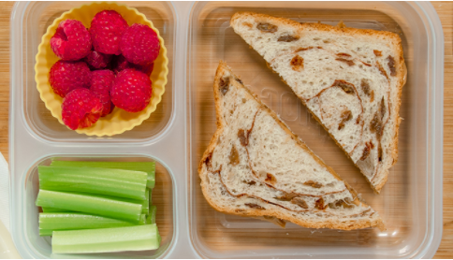
Sample Meals
DaVita.com
Breakfast
Acai Berry Bowl
Lunch
Peanut Butter Sandwich lunch box
Dinner
Easy Chicken and Pasta Dinner
Calories 192
Carbs (g) 28
Potassium (mg) 349
Phosphorus (mg) 140
Sodium (mg) 82
Fiber (g) 7
Calories 456
Carbs (g) 50
Potassium (mg) 489
Phosphorus (mg) 322
Sodium (mg) 510
Fiber (g) 8
Calories 400
Carbs (g) 45
Potassium (mg) 455
Phosphorus (mg) 270
Sodium (mg) 328
Total | Calories 1,048 | Potassium 1,293 mg | Sodium 920 mg I Phosphorous 732 mg

Slide 24
Lifestyle Changes Can Improve Diabetes Management
Eating 3 balanced meals at regular times
Meals should contain 45 to 60 grams of carbohydrates
150 to 300 minutes of weekly physical activity
Eating 5 servings vegetables/fruit daily
Less potassium absorbed from plants than animal foods
Prevents constipation and helps maintain potassium in target range
Aids weight loss

Slide 25
AB has been a lawyer for many years, and he finally made partner last year. He was referred to the dietitian and started making the following changes. He has been trying not to skip lunch and is trying to limit restaurant eating to 3 times a week. He is checking his blood sugar 3 times a week and wonders if he can stop checking since A1C has improved and diabetes medications are being reduced. He is eating 3 times daily most days. He expressed interest in increasing physical activity. He is working hard to increase intake of caffeine free beverages.

Slide 26
Nutrition Question # 1
Your Patient AB asks about the increase in potassium, which of the following should you not do?
Tell him to limit high potassium fruits/vegetables
Ask if he is having regular bowel movements
Ask what his sugars have been like when he is testing at home

Slide 27
Nutrition Question # 2
AB’s A1C has improved from 8.0 to 6.5, which of the following should you not do?
Congratulate him on his improvement, and tell him better blood sugar management can slow progression ok kidney disease
Tell him he no longer needs to check his blood sugar
Encourage him to continue to eat balanced meals, balanced meal should contain complex carbohydrate, lean protein(plant protein, poultry or fish), and vegetables.

Slide 28
Nutrition Question # 3
Dialysis patients should never consume potatoes, tomatoes, bananas, dried beans, whole-grains, and nuts.
True
False

Slide 29
What are the specific recommendations for AB?
Reinforce no restriction on phosphorus
lab values in range
Moderate protein, more plant-based options
Daily recommendation of 60 – 70g per day
Absorb less potassium from plant based protein than animal protein
Encourage intake every 4/5 hours and congratulate him on not skipping meals
Encourage plate method to encourage balanced eating and increase intake of vegetables/fruit to increase loss of phosphorous, potassium, and fluids in stool.
Encourage him to read labels for potassium additives, carbohydrates, and sodium
Encourage limiting sodium to 2000 mg daily or 600 mg per meal
Encourage regular monitoring of blood sugar at home.
Encourage 64 ounces of water daily
Encourage 150 minutes physical activity weekly. May break into 10 minute intervals.

Slide 30
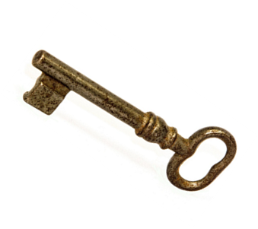
Key nutrition components for preserving kidney health
Eat an adequate amount of protein
Limit salt intake to help keep blood pressure under control
Maintain potassium within recommended range
Maintain phosphorus within recommended range
Well managed blood sugars
Take in amount of fluid as directed by kidney team

Slide 31
When is it best to bring in an RD?
Complex nutritional needs
Example = CKD + Diabetes
Should consider nutrition referral when GFR drops below 50.
Detailed nutrition questions
Patient interest/request

Slide 32
Does my patient quality to see an RD?
Medicare Guidelines for Medical Nutrition Therapy (MNT)
Referred by medical provider
Diagnosed with diabetes, renal disease or had kidney transplant within last 36 months
Delivered services by Registered Dietitian Nutritionist
Patient pays $0 – Part B deductible and coinsurance don’t apply
Frequency – 3 hours the first year, 2 hours subsequent years
Private Insurances often following Medicare guidelines, but vary
Patient may need to call insurance to check their coverage

Slide 33
How do I find an RD qualified to help?
Find a Nutrition Expert (eatright.org)
Check with your local hospital system
Call insurance company
Ask other doctors/healthcare professionals

Slide 34
Resources
Nutrition | National Kidney Foundation
DASH Eating Plan | NHLBI, NIH
The DASH Diet for Healthy Weight Loss, Lower Blood Pressure and Cholesterol
Diet Review: DASH | The Nutrition Source | Harvard T.H. Chan School of Public Health
Understanding the DASH diet: MedlinePlus Medical Encyclopedia
Cooking Matters
PATH | Chronic Disease Self-Management | NKFM
Home | Diabetes Prevention Program (readysetprevent.org)

Slide 35
MICMT Resources
https://micmt-cares.org/
MICMT Contact: https://micmt-cares.org/contact

Slide 36
Disclaimer
Each physician organization and/or practice is solely responsible for all medical care and services delivered to its patients and all decisions related to such medical care and services. Neither MICMT or the Regents of the University of Michigan shall be responsible for any delivery of medical care or other services to any patient, or any decisions, acts or omissions of persons in connection with the delivery of medical care or other services to any patient.

