Slide 1
Foundational Care Management Codes & Billing Opportunities

Slide 2
Welcome!!! Housekeeping

Slide 3
Setting the Expectations
This course builds upon team-based care focusing on reimbursement for care management services for BCBSM and Priority Health. Some details discussed maybe similar to other payers. This course was designed to support and train physician organizations and practice staff on care management billing. This course is open to PO billing subject matter experts, care management staff and administrators.
Notes:
Today's course will focus primarily on BCBSM and Priority Health however some details maybe similar to other payer guidelines.

Slide 4
Virtual Etiquette
Meeting participation:
We will be using the raise your hand feature by clicking on the little blue hand.
We will be using chat function
When we are taking breaks be sure not to leave the meeting but rather mute your audio and video
Environment:
Be aware of your backgrounds to not be distracting
Position yourself in the light
Notes:
https://www.gend.co/blog/best-practice-tips-for-using-zoom

Slide 5
Successful Completion Requirements
Attend the entire course, in person or live virtual
Attendance Criteria:
If the learner misses > 30 minutes; the learner will not be counted as “ attended” and will need to retake the course.
If the learner misses <30 minutes; the learner will be counted as “attended”. The learner will need to review the missed course content located here: https://micmt-cares.org/training
If course is virtual – must attend by audio and video/internet.
Complete the Michigan Institute for Care Management and Transformation (MICMT) post-test and evaluation.
Achieving a passing score on the post-test of 80% or greater. If needed, you may re-take.
Notes:
Attendance is monitored by the trainer.
Attendance criteria:
•If the Learner misses > 30 minutes; the Learner will not be counted as “attended” and will need to retake the course.
•If the Learner misses < 30 minutes; the Learner will be counted as “attended”. The Learner will need to review the missed course content located here: https://micmt-cares.org/training

Slide 6
Please take the post test within 5 days for credits!

Slide 7
Foundational Care Management Codes & Billing Opportunities
No one in control of content has any relevant financial relationships with ineligible companies.
Successful completion of the Foundational Care Management Codes and Billing Opportunities course includes:
Attendance at the entire session - if attending live virtual must have audio and see the slides live
Completion of the course post test within 5 business days post live event: need to have a score of 80% or greater on the post-test
Completion of the course evaluation within 5 business days post live event
Nursing:
Upon successful completion of the Foundational Care Management Codes and Billing Opportunities the participant will earn 3.5 Nursing CE contact hour.
Michigan Institute for Care Management and Transformation is approved as a provider of nursing continuing professional development by the Wisconsin Nurses Association, an accredited approver by the American Nurses Credentialing Center’s Commission on Accreditation.
Social Work:
Upon successful completion of the Foundational Care Management Codes and Billing Opportunities the participant will earn 3.5 Social Work CE contact hours
This course is approved by the NASW-Michigan CE Approving Body. Michigan Institute for Care Management and Transformation is an approved provider with the Michigan Social Work Continuing Education Collaborative. Approved provider Number: MICEC 110216.
Billers/Coders:
Upon successful completion of the Foundational Care Management Codes and Billing Opportunities the participant will earn 3.5 continuing education hours, American Academy of Professional Coders.
Registered Dietitian:
Upon successful completion, Registered Dietitians can use the MICMT Nursing CE certificate for their CPEUs. See CDRnet core criteria for details https://www.cdrnet.org/core-criteria
Foundational CM Codes & Billing Opportunities- updated 05/17/2023
Notes:
Successful completion of the Patient Engagement course includes:
Attendance at the entire session
Completion of the course post test: need to have a score of 80% or greater on the post-test
Completion of the course evaluation
Participate in a phone practice session with a course presenter

Slide 8
Curriculum development in partnership with
Alicia Majcher, Michigan Medicine, MICMT
Ruth Clark, Integrated Health Partners
Ewa Matuszewski, MedNetOne & PTI
Erika Perpich, Olympia Medical
Anavia Mitchell, Olympia Medical
Notes:
Highlight those who participated in the creation of the content! Thank you!

Slide 9
Reference Guidelines
Please provide the following as an appropriate reference if you use this material: “Material based off of the Foundational Care Management Codes & Billing Opportunities course developed through a collaborative effort facilitated by Michigan Institute for Care Management and Transformation and participating Training Organizations.”
Questions about using or replicating this curriculum should be sent to: https://micmt-cares.org/contact
Please follow this link if you are interested in becoming an approved trainer for this curriculum: https://micmt-cares.org/contact

Slide 10
Agenda
Intro
Care Team Coding and Billing It’s a Team Sport
Billing Applications
Billing Optimization Opportunities
Billing Resources & Wrap Up
Notes:
Here is a review of todays agenda. You will see that were starting with “Care Team Coding and Billings: It’s a Team Sport”.

Slide 11
Introductions
Your name
Your discipline
Your practice location
How long have you been in your role?
What’s most important for you to learn today?
Notes:
•Chat and Raise Hand
•If you have more than 15/16 participants adapt this to a 5 minute discussion at tables if in-person.
•If virtual and you have more than 15/16, have participants say their name and their discipline and have them think about patients they enjoy working with and those they find a little frustrating

Slide 12
Learning Objectives and Learning Outcome
Learning Objective
Identify members of a care team
Define health care coding and health care billing
Describe the two common health care coding classification systems
Explain the importance of documenting the encounter
Illustrate how a care team may impact risk adjustment and the financial model of a practice
Learning Outcome
Participants can describe how documentation of the encounter, billing the encounter and utilizing the care team procedure codes contributes to successful team-based care and supports value-based reimbursement.

Slide 13
Agenda
Intro
Care Team Coding and Billing It’s a Team Sport
Billing Applications
Billing Optimization Opportunities
Billing Resources & Wrap Up
Notes:
Here is a review of todays agenda. You will see that were starting with “Care Team Coding and Billings: It’s a Team Sport”.

Slide 14
Setting the Foundation
“The primary goal of medical teamwork is to optimize the timely and effective use of information, skills, and resources by teams of health care professionals for the purpose of enhancing the quality and safety of patient care”.
~Agency for Healthcare Research in Quality (AHRQ)

Slide 15
Team-Based Care - What Does it Take?
Holistic, person-focused and family-centered approach to health including behavioral, social and physical aspects
Care coordination across settings and organizations
A common set of quality outcome metrics
Reimbursement for care management services, care coordination
Shift from fee-for-service to value-based reimbursement
Billing the encounters contributes to successful value-based reimbursement

Slide 16
Care Team Coding and Billing It’s a Team Sport
Identify members of a care team
Define health care coding and health care billing
Describe the two common health care coding classification systems
Explain the importance of documenting the encounter
Illustrate how a care team member may impact risk adjustment and the financial model of a practice
Notes:
The interaction between the facilitator and participant is important. Let the group know how you’d like them to interact with you as the facilitator. Are you willing to be interrupted and take questions verbally rather than through the chat function? Provide a brief overview of the session: “This session was developed to help the care team members acquire basic coding and billing skills.”
In addition to the learning objectives the facilitator may want to ask about their learning goals. Below are a few examples of questions that might be asked.
1)What one thing do you want to learn from today’s session?
2)Why is this topic important to your work?
3)What should I do with what I learn?
4)With whom should I “tell” or share the information

Slide 17
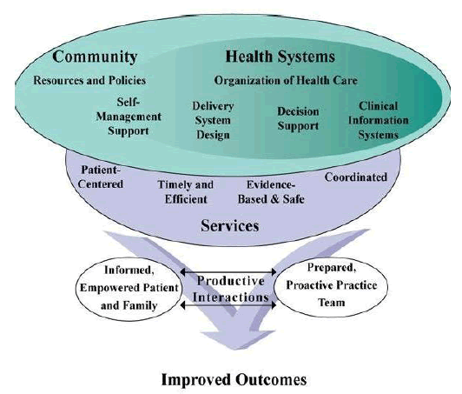
Productive Interactions, Outcomes, and Sustainability
Many productive interactions with patients will lead to improved outcomes that can be measured at a population level
Productive interactions are billable interactions, which support the sustainability of the care management program through payments and successful incentive program participation
Notes:
The facilitator should ask if the participants are familiar with the Chronic Care Model and reinforce its importance by providing an overview of the Chronic Care Model. The facilitator should review the components of the Chronic Care Model (refresher) and that it has six essential elements of a health care system that when woven together encourages high-quality chronic illness care. Those essential elements include community resources, health systems, self-management support, delivery system design, decision support and clinical information systems.
The facilitator should also focus on the importance of teamwork and that teamwork is essential for providing care and is therefore prominent in healthcare organizations. Improving teamwork in a PCMH should receive top priority. The effectiveness of healthcare teams can be improved by team interventions such as participating in learning events including simulation-based activities; utilizing new tools/templates and of course use of the PDSA ramping method.
Health care teams that communicate effectively and work collaboratively reduce the potential for error, resulting in enhanced patient safety and improved clinical performance. A key aspect in improving teamwork and communication in health care is engaging patients and families. Determining how patients and families want to be involved in their care and then engaging them in designing their plan of care increases their understanding of tests, procedures, and anticipated care outcomes. This results in an activated patient, one willing and able to self-manage. A lack of teamwork is often identified as a primary point of vulnerability for quality and safety of care. Health care teams that communicate effectively and work collaboratively reduce the potential for error, resulting in enhanced patient safety and improved clinical outcomes.

Slide 18
Fact Finding…
What is your most pressing issue/question about coding and billing?
What don’t you know about coding and billing?
What concerns you about coding and billing?
What do you know about the electronic health record (EHR) and the payment management system (PMS) you’ll be using and why is it important?
Receptionist, biller and coder: friends or foes??
Notes:
Facilitators should turn this slide into an interactivity. Each bullet point could be discussed with the last one turned into a “poll” question. Reinforce the composition of the entire care team

Slide 19
Care Team Member:
Physician, Advanced Practice Providers (APP), Registered Nurse (RN), Pharmacist (PharmD), Master Social Worker(MSW), Registered Dietician (RD), and Certified Diabetic Educator (CDE)
Virtual, telephonic and in-person visits:
Create individualized care plans
Identify barriers
Engage in care coordination activities
Provide health education and coaching
Catalog community resources
Oversee disease management activities
Communicate in between visits
Federal Government beneficiaries – documentation of approval for care management is required at start of care
Notes:
The facilitator should review the licensed care team members and include an LPN. Reinforce the use of virtual and phone encounters. Refrain from using the term “touches” when talking about the patient visits, but rather use the word “encounters.” Include the participants by asking if there is anything missing in the activities/services the care team member provides.

Slide 20
Care Team Member: Front Desk Staff or Scheduler
Captures patient demographics
Reviews current insurance information
Verifies eligibility and benefits
Contract is effective
Care team services are a benefit
Source of truth for eligibility: Availity plus care management exclusion list; monthly list is to help identify risk only
Determines financial responsibility BEFORE the visit
Sets financial expectations
Notes:
The facilitator may begin by asking the participants how frequently they interact with the front desk person or the scheduler and whether they know their name. The facilitator may ask if any of the participants have ever checked eligibility or understand the significance of a benefit plan. Remind the participants some BCBSM benefit packages do not include care management and that a list is located on the collaborative site. Also remind them that hosted members may have a deductible and/or copayment for care management services, which should be discussed with the patient prior to services being rendered.
**Availity - BCBSM online information provider identification system . You can use this to look up eligibility, copays, benefits and claims for al plans expect for BCBSM complete (Medicaid HMO)

Slide 21
Care Team Member: Unlicensed Professionals Medical Assistant (MA) & Community Health Worker (CHW)
BCBSM: The care team is comprised of any health care or behavioral health professional the provider believes is qualified to serve on the care team.
Unlicensed professionals must work under a written protocol or standing orders signed by the physician or APP.
Example: Scope of service
Unlicensed care team members support licensed care team members through implementation of specific aspects of care plan, self-management support and follow-up, care coordination with other health care organizations, etc.
Priority Health: The care team is comprised of PH designated qualified health professionals (QHPs)
Notes:
The facilitator may describe the education received by a medical assistant and a community health worker. Compare and contrast the roles and responsibilities of the two professions. Medical assistants are cross-trained to perform administrative and clinical duties. The American Association of Medical Assistants (AAMA) offers certification to graduates of medical assisting programs accredited by the Commission on Accreditation of Allied Health Education Programs (CAAHEP) or the Accrediting Bureau of Health Education Schools (ABHES). Michigan does not require medical assistants be certified. Medical assistants are essential members of the ​PCMH team and are ranked as one of the top five professionals necessary on a PCMH team.
Community Health Workers (CHW) typically live in the community where they work and they provide support to local healthcare organizations and systems through various tasks, depending on what type of community they are serving. Some of the duties performed by a CHW include: home visits, health education, maternal and child health support, family planning activities, and community development activities. They are important in the work around SDOH and are often key in connecting patients to community resources (reference Chronic Care Model). Ultimately, CHWs have a unique opportunity to reach community members where they live, eat, work, and more. There is no national standard for community health worker education, training, or certification.
A physician or APP should ensure a signed protocol (standing orders) is in the MA or CHW employee file. A job description with roles and responsibilities signed by the MA, CHW, physician or APP is acceptable.
The facilitator should highlight the difference of a team member: Priority Health vs Blue Cross and other payers.

Slide 22
Introducing a New Care Team Member

Slide 23
New Care Team Member: Coder
Transforms the diagnosis and treatment provided into an appropriate numeric or alphanumeric code
Liaison between the healthcare team and billing activities
Proper procedure (CPT/HCPCS) and diagnosis (ICD-10) coding is critical for obtaining appropriate payment and ensuring proper compliance with the law
Notes:
The facilitator should introduce the coder as an important new care team member and explain why they are a crucial member of the care team. It should also be mentioned that the coder/biller identifies the codes used but ultimately, the physician is responsible for proper documentation and correct coding. Possible consequences of inaccurate coding and incorrect billing are denied claims/reduced payments, prison sentences, and/or significant fines. Legally, when a physician, APP, psychologist enroll in a Medicare, Medicaid or commercial insurance, the practitioner signs an agreement attesting that accurate claims will be submitted. Practitioners are responsible for claims submitted under their NPI. Coders can become too conservative, strangling revenue. Some have avoided submitting claims for PDCM activities. It is critical that coders understand the nuances of health plan differences in coding. Many of the health plans do not specifically adhere to the CPT or HCPCS coding guidelines for the care management codes.
Coders can help with the care team members by providing coding education and even audit charts.

Slide 24
Define Coding
Health care coding involves extracting billable information from the health care record after reviewing clinical documentation
Health care billing uses codes to create insurance claims and bills for patients
Health care claims is where health care billing and coding intersect to form the backbone of the practice’s revenue
Notes:
The facilitator should explain the difference between coding and billing and this is where the revenue stream begins. Everyone in the practice should share the same goals of providing excellent care for patients and also collecting enough revenue to keep the practice’s doors open and ensure that the care team members remain in their jobs.

Slide 25
Roles and Responsibilities of the Biller & Coder
Relies on front end activities to ensure clean claims
Relies on electronic claim scrubbers
Monitors lag time of charge entry
Reviews claims submitted
Ensures electronic remittance posting
Pays close attention to adjustments- coded correctly.
Denial management –
Develops experts with tiered levels of sophistication
Measures denial percentages
Monitors aged trial balance
Sends patient statements and conducts patient collections
Adheres to key performance indicators (KPI) and benchmarking
Coding &compliance Initiatives, Inc.
Notes:
The facilitator should mention that in some organizations (health systems), coding is centralized out of the practice location, reducing the interactions and opportunities for asking a quick question and getting feedback. If that’s the case, the coding department and practice management and care team should set up regular meetings to increase the interaction and improve the relationship between the providers and coders.
Each care team member should know how many encounters they have performed and inquire about the number paid and denied. If the denials are significant there should be discussion about methods to get claims paid. Common denials should be investigated to determine if the code is not being properly applied, benefits limit the code, or other reason that can be remedied. Some methods may include a letter to the medical director of the health plan with supporting documentation such as reduced ED visits or admissions.

Slide 26
Questions for the Care Team
Do all the care team members understand the significance of the CPT, ICD-10 and PDCM Codes?
Do care team members engage in chart reviews?
What is the purpose of a chart review?
Do the care team members have a vested interest in coding correctly or is it “not my problem?”
Notes:
The facilitator should be familiar with the various codes used in health care practice. Those codes include ICD-10, CPT, HCPC and PDCM specific codes. While introducing the slides to the participants inquire about chart reviews to enhance team learning and to determine if the appropriate codes are being used.
The facilitator should reinforce the importance of correct coding

Slide 27
Close Encounters of the Coding Kind

Slide 28
Trigger for Coding and Billing: Clinical Documentation
Clinical Documentation Improvement (CDI) – is a process that continually looks for ways to best maximize the health care record integrity with the goal of providing a complete and accurate picture of a patient's condition(s) and the care services they receive most often specific to the setting where services were provided.
Notes:
The facilitator should stress that CDI essentially helps “ ensure the events of the patient encounter are captured accurately, and the electronic health record properly reflects the services that were provided. “So, it basically ensures that all members of a patient’s care team have the information necessary to properly treat the patient and assist the patient in designing their own self management plan. CDI works with coding to ensure that the care team member’s documentation is timely, complete, and specific.
A side note.. All coders and billers should be familiar with the mandatory compliance plan that addresses fraud, waste and abuse within claims submitted to payers and more specifically Medicare. Poor documentation without supporting coding can lead to large fines and take-backs by the payer.

Slide 29
Let’s Start with the Basics…
What does “coding” mean to you?
What does “billing” mean to you?
Notes:
The facilitator should ask these two questions of the participants and be ready to reinforce the link between coding and billing. A claim cannot be submitted to the payer without a diagnosis code and procedure code. It would not make it through the clearinghouse.

Slide 30
CPT Code Overview
The Current Procedural Terminology (CPT®) codes offer health care professionals a uniform language for coding procedures to streamline reporting, increase accuracy and efficiency.
CPT® Codes are used for administrative management purposes such as claims processing and data extraction
Notes:
The facilitator should first ask the participants who owns the CPT code, the payers or another entity. Many persons believe the CPT codes are created by the payer to hinder adequate/appropriate payments. Although the codes and descriptions are developed by the AMA, many health plans/payers develop additional guidelines for the codes and often times may even create their own codes.
Point out that the “AMA-CPT” code is a registered trademark. The small “R” in a circle that appears to the right of a logo, symbol or phrase, you've seen the registered trademark symbol. This symbol is legally stating that the mark has been registered with the U.S. Patent and Trademark Office (USPTO). Trademarks are a form of intellectual property that protect symbols, words, phrases, designs, logos and other unique marks that identify a commercial source for goods and services. The AMA publishes CPT code books annually. Its important to purchase the new books since there are always revisions.

Slide 31
Types of Codes
ICD-10: International Classification of Disease version 10
CPT: Current Procedure Terminology, document the mental health, medical, and surgical procedures
HCPCS: Healthcare Common Procedure Coding System Level II (Supplies and products not directly related to providers such as ambulance services, drugs, etc..)
Notes:
The facilitator should introduce the ICD tool and provide a bit of background. The International Classification of Diseases, 10th Revision (ICD-10) is a diagnostic and procedure coding system endorsed by the World Health Organization (WHO). ICD-10 is a complete revision of its ICD-9 counterpart. It improves clinical communication by providing more information per code and better support for care management, quality measurement and analytics. It also offers an improved ability to understand risk and severity. All entities covered by HIPAA were switched to ICD-10 beginning October 1, 2015.
Some of the ICD-10 codes might seem strange. Remind the participant that a person can get “sucked in by a jet engine - V97.33XD” or “bitten by a pig, initial encounter – W55.41XA.”
For more information about ICD-10, visit the Centers for Medicare & Medicaid Services ICD-10 website at www.cms.gov/ICD10.
Additional ICD-10 resources can be found on the following websites:
•American Medical Association (AMA)
•American Health Information Management Association
•American Academy of Professional Coding

Slide 32
Billing and Coding Chain of Accountability
Physician
Advanced Practice Practitioner (APP)
Care Team Member
Biller and Coder
Notes:
The facilitator should again mention that the physician is responsible/liable for the billing and coding that occurs in their medical practice. While medical coders and billers don't have to worry about medical malpractice claims, they can be sued for negligence if they make errors or mistakes. For instance, if a coder’s error resulted in significant financial loss to a patient or practice, they might be sued to recover damage.
There are also other “illegal” issues that a coder/biller must be aware of. The issue of liability under the Federal False Claims Act occurs where a defendant (coder/biller) (a) knowingly presents (or causes to be presented) a false or fraudulent claim for payment; (b) knowingly makes, uses, or causes to be made or used, a false record or statement material to a false or fraudulent claim; or (c) conspires with others to increase revenue.

Slide 33
Why Code?
Provide evidence for health care services rendered
Track potential public health threats (such as COVID-19, influenza, lead poisoning, etc.)
Measure quality of care
Evaluate utilization of resources
Exchange health data with other organizations including government agencies
Drive program sustainability through accurate coding capture and billing
Notes:
The facilitator should address HEDIS, STARS and even gap closure while presenting this slide

Slide 34
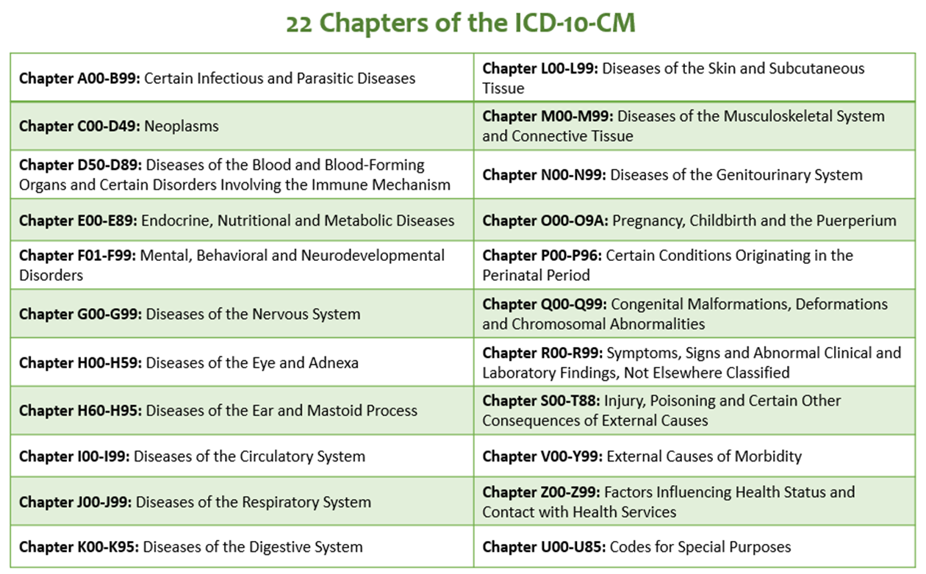
ICD- 10 Overview
Notes:
The facilitator should note that there are 22 chapters of the ICD-10 code book. Not all chapters apply to the work being done by the care team members.

Slide 35
ICD-10 and Hierarchy of Chronic Conditions
Facts about ICD- 10
70,000 + ICD 10 Diagnosis Codes
805 Disease Groups
189 Condition Categories
86 Hierarchical Condition Categories (HCCs)

Slide 36
Coding for Specificity: ICD-10

Slide 37
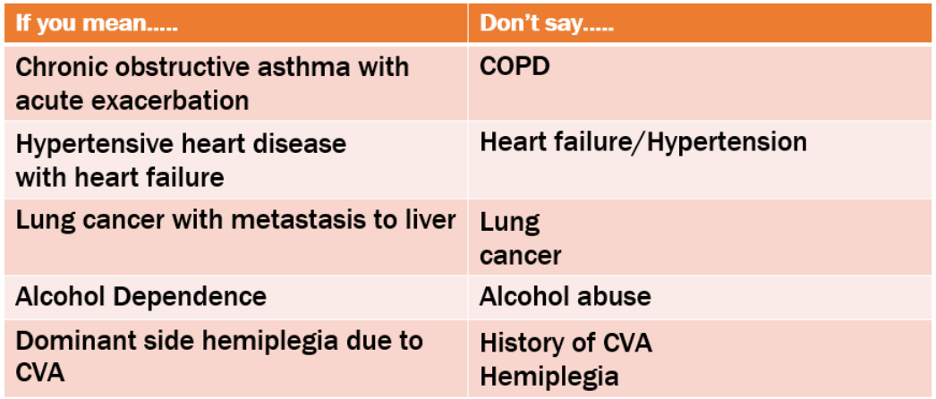
Drill Down to Specifics
Documentation should be as specific as possible
Specific documentation and coding guidelines are mandated by HIPAA.
Notes:
This slide addresses the importance of “drilling” done…specificity not ambiguity.

Slide 38
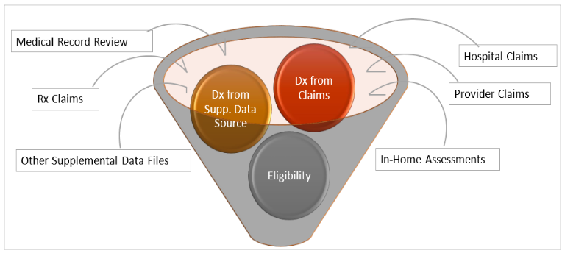
Risk Score Calculation
Notes:
Various payers/health plans have proprietary risk score calculation methodologies. Practices may also have risk calculation methodology embedded in their electronic health records. Regardless of the specific risk calculator, these are common factors that go into the determination of the patient’s risk. The health plan/payer’s calculation helps determine the risk burden of the patient and plays into determination of the risk within a practice’s population impacting its expected utilization and cost performance, which will be discussed in more detail later in the presentation.

Slide 39
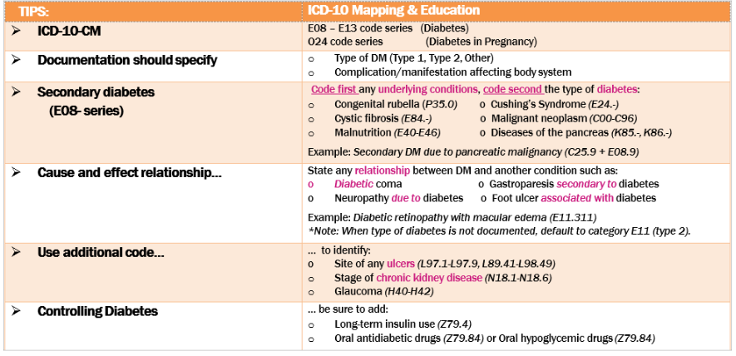
HCC: Diabetes Care
Notes:
Discuss need for specificity

Slide 40
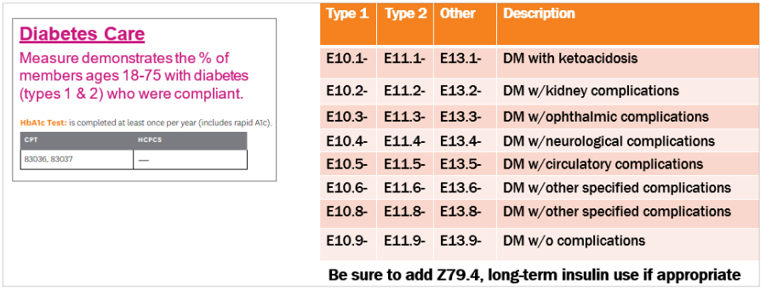
HEDIS and Diabetes
Notes:
Focus on specificity, coding, and impact on HEDIS metrics

Slide 41
Coding for Specificity: CPT and HCPCS

Slide 42
Care Team Procedures Codes
G9001* - Coordinated Care Fee – Initial Assessment
G9002 *- Coordinated Care Fee – Maintenance or follow up (quantity billed >45 minutes)
98961*- Group Education 2-4 patients for 30 minutes (quantity billed)
98962*- Group Education 5-8 patients for 30 minutes (quantity billed)
98966 *- Phone services 5-10 minutes
98967*- Phone services 11-20 minutes
98968 *– Phone services 21-30 minutes
99487 *– Care Management services 31-75 minutes per month (care coordination in the PCMH neighborhood)
99489* – Care Management services, every additional 30 minutes per month (care coordination in the PCMH neighborhood)
G9007* - Team Conference
G9008* - Physician Coordinated Care Oversight services (physician only service and can only be billed by the physician)
S0257* - Counseling regarding Advance Directives
*HCPC Level II and CPT codes, descriptions and two-digit numeric modifiers only copyright 2021 American Medical Association. All rights reserved.
Notes:
Facilitator should emphasize that there are only 12 care management codes. The entire care team should recognize that those are the only codes the care team is responsible for. They do not bill the traditional E&M codes.

Slide 43
Care Management for Medicare Beneficiaries
Medicare will reimburse for non-face to face care coordination services performed on behalf of eligible beneficiaries enrolled in one of the following programs:
Chronic Care Management (CCM): (99490, 99491, 99437, 99439/G2058)
Eligible patients must have 2 or more chronic conditions expected to last 12 months or until death.
20 Minutes of CCM services, per month, is required before billing
Principal Care Management (PCM): (99424 -99427)
Eligible patients must have a single chronic condition expected to last 6-12 months or until death
30 minutes of PCM services, per month, is required before billing
Practices should have a process in place to track time for care coordination services to bill these codes
Only 1 practitioner can bill CCM/PCM codes per Medicare beneficiary per month.
Patient consent required as cost-sharing applies
Program and billing code descriptions can be found: https://www.cms.gov/outreach-and-education/medicare-learning-network-MLN/MLNproducts/downloads/chroniccaremanagement.pdf
Notes:
High-level overview of Medicare Care Management Program
CCM/PCM
Codes are for behind the screens care coordination efforts by the physician or care team
Billing involves tracking total time spent per month.
Patient consent is REQUIRED.
Cost-Sharing (co-pay) applies
Only 1 physician can bill PER MONTH
Patient may discontinue services at any time.
ASK YOUR AUDIENCE:
Are any practices here billing these codes (CCM - 99490, 99491, 99437, 99439/ PCM: 99424 -99427)
Is anyone willing to share their process for tracking time for billing

Slide 44
Billing for Care Team Activities is Important
Billing for services and being paid for services places value on the patient care that you provide
Billing, along with care team incentive programs, is how team-based care can be sustainable
Sustainability comes from:
Engaging a minimum number of patients in a day
Minimum of 4 encounters on average per half day (8 or more/day)
Be sure there is a mix of encounter types to support staff expense
Could include telephone or virtual for in-person encounters
Billing consistently for services
Notes:
Mix of encounter types is critical. Four, 10-minute phone calls in a half day will not sustain the program as it will not cover the salary of a care team member. Examples of the type of mix needed in encounters will be discussed in more detail later in the presentation.

Slide 45
Process or Revenue Generation
Document the encounter in the patient’s chart
1
Assign appropriate codes
2
Submit the claim electronically
3
Interpret the payer's response
4
Prepare for post- payment actions (audits, document requests, etc.)
5
Notes:
Each of these steps is necessary to assure you capture what you did, the correct code was submitted, it was paid or, if denied, the denial was “worked.”

Slide 46
Key Takeaways
Team-Based Care is derived from the chronic care model and patient- centered medical home.
Sustainability of team-based care is identifying important members of the care team, assigning appropriate classification codes, documenting services rendered and billing consistently.
Notes:
The facilitator should ask the participant if their individual goals and objectives for this session were met and what to share one take-way. Also ask about what worked and what didn’t work and what else could have been introduced by the facilitator.
Stress that this session was designed to help the participant learn more about documentation, coding and billing.

Slide 47
Break - 5 minutes
Notes:
Please use this time to stretch, take a bio break, grab a snack. We will resume in 5 minutes.

Slide 48
Agenda
Intro
Care Team Coding and Billing It’s a Team Sport
Billing Applications
Billing Optimization Opportunities
Billing Resources & Wrap Up
Notes:
Here is a review of todays agenda. You will see that were starting with “Billing Optimization Opportunities”

Slide 49
Billing Optimization Opportunities
This section is a practical review of how to optimize the use of billing diagnoses to support better billing and better participation in incentive programs.
We’ll review different patient examples and discuss the billing related to that patient flow, touching on several key optimization opportunities:
Preventive Care Support
Chronic Care Support
Social Determinants of Health (SDOH)
Hierarchical Care Coding (HCC)

Slide 50
Two different perspectives
Scenario 1 -- A patient’s journey through a new diagnosis
Scenario 2 -- A clinician’s typical day
We’ll walk through each of these two perspectives and talk through the billing, documentation, and how to optimize coding

Slide 51
Lets’ start with a story about Mrs. Jones
Mrs. Jones has a daughter who is getting married.
Mrs. Jones was so busy worrying about the wedding and COVID that she hadn’t engaged with her PCP (Dr. Miller) in a long time.
This caused her to show up on a list of patients who hadn’t been seen for their annual HME.
Notes:
This is the beginning of the 1st scenario, which follows Mrs Jones throughout a new diagnosis of Diabetes.

Slide 52
Mrs. Jones’s Journey with her PCP…
1
At Dr. Miller’s office, the Medical Assistant/Panel Manager (Renee) in the office pulls the list of patients who are due for a well visit the first Friday of the month and calls the patients.
Luckily, Mrs. Jones was available when called and Renee was able to set up an appointment . During that call, Renee talked with Mrs. Jones about the importance of preventive care and asked her to get some labs done before the visit. She also set up a mammogram and colonoscopy.
Notes:
This slide discusses Mrs. Jones’ first interaction with the Panel Manager (Renee) who re-engages Mrs. Jones with her care. The green star indicates that there is a billing opportunity into which we’re going to take a deeper dive.

Slide 53
Billing Deep Dive
1
When Renee calls Mrs. Jones for the first time, she’s reaching out to close the gaps in care. Scheduling the mammogram and colonoscopy took a little longer, so it was a 12- minute phone call.
Appropriate code: 98967
Appropriate DX: Z12.39 (for mammogram)
* See next slide for decision tree on dx codes for preventive care **
Notes:
The star connects the slide with the previous slide. It discusses the billing code most appropriate for the interaction between Renee and Mrs. Jones – As well as identify an opportunity for using a diagnosis

Slide 54
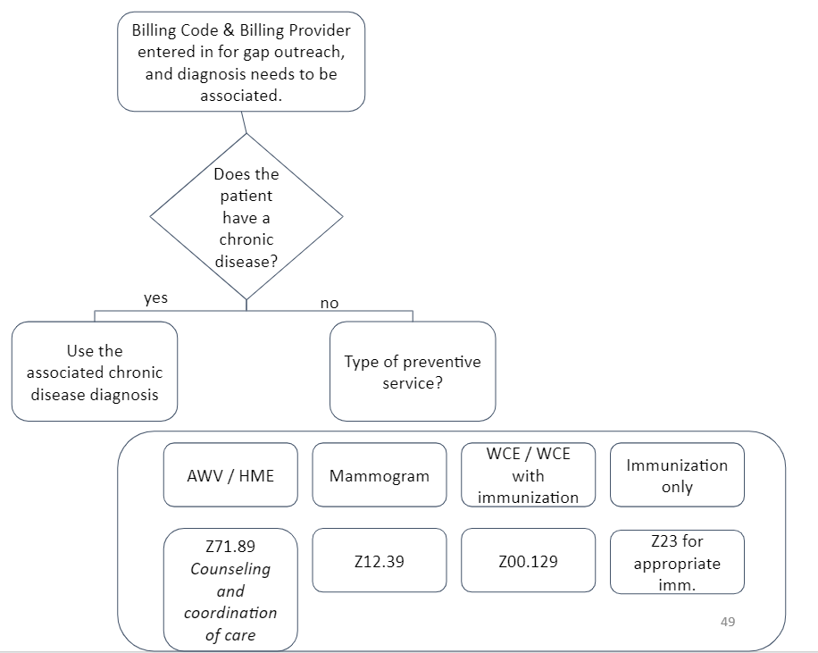
Preventive Care & Associated Diagnosis for gap outreach
Notes:
This flow shows a quick decision tree for how to determine which diagnosis is most appropriate for each kind of service. The Z71.89 is particularly useful as it is for counseling and care coordination, which most care management services can be categorized under.
https://www.cms.gov/Medicare/Prevention/PrevntionGenInfo/medicare-preventive-services/MPS-QuickReferenceChart-1.html 🡪 the link goes to a list of preventive services. If you click on it, it’ll show you which diagnoses to use.
Question: do your clinics have this same process in place? Do you bill for it?

Slide 55
Mrs. Jones’s Journey (cont’d)
The week before Mrs. Jones’s scheduled visit, Renee pulls another list: the patients who are coming in the next week and need reminders.
Mrs. Jones is on the list, as her appointment is the following week. Renee calls Mrs. Jones and reminds her to get her labs drawn before the visit. Renee also goes through Social Determinants of Health (SDOH) Screening tool questions. Mrs. Jones doesn’t have any SDOH needs currently.
2
Notes:
Similar to before the blue star indicates a billable opportunity.

Slide 56
Billing Deep Dive
2
Renee’s 2nd call with Mrs. Jones lasted 7 minutes. Renee reviewed the important things to do before the upcoming visit and conducted a SDOH screening.
Appropriate code: 98966
Appropriate DX: Z71.89 Counseling & Care Coordination for the well visit
* See slide - 49 for decision tree on dx codes for preventive care **

Slide 57
When to use a Z code for SDOH
https://www.cms.gov/files/document/zcodes-infographic.pdf
Notes:
https://www.cms.gov/files/document/zcodes-infographic.pdf
https://www.cms.gov/files/document/z-codes-data-highlight.pdf
Health Care Administrators→ used for incentives and opportunities for partnering with the community because of a better understanding of what the community needs are and the barriers keeping people from being successful for their care plan.
Health Care Team → helps the care team members understand the situation of the patient and how they can meet the patient where they are.
Coding Professionals → helps with completeness of the problem list and aligning risk with the situation.

Slide 58
The Most Common Z Codes:
Care team members can add Z-codes as a diagnosis for billing purposes
There are several payers with incentive plans around SDOH and Z- codes (Priority Health for Medicare/Medicaid, BCBSM both have incentive programs
Notes:
This table shows the most common Z codes in 2019.

Slide 59
Mrs. Jones’s Journey (cont’d)
Day of the Visit
Mrs. Jones was able to get her labs drawn before the visit, that allowed Dr. Miller to diagnose Mrs. Jones with Diabetes. Dr. Miller decided to talk with Mrs. Jones about Theresa, the RN who helps follow up with new diagnoses. Dr. Miller asked Mrs. Jones if she had the time to stay and talk with Theresa. Unfortunately, Mrs. Jones was unable, so they discussed scheduling another appointment
3
At Checkout, Renee helps Mrs. Jones schedule an appointment with Theresa for the next Thursday.
Notes:
This slide reviews a bit more of Mrs. Jones’ series of visits.

Slide 60
Billing Deep Dive
3
Dr. Miller discussed a new diagnosis with Mrs. Jones and introduced her to Theresa, RN in the care team.
Appropriate code: G9008
Appropriate DX: E11.65
Notes:
We want to highlight the importance of the Provider Care Oversight referrals. Dr. Miller placed this and completed a warm handoff between Mrs. Jones and Theresa.

Slide 61
Mrs. Jones’s Journey (cont’d)
4
On Monday of the following week, Dr. Miller, Renee, Theresa, and some other team members have set aside 15 minutes to talk about some of the patients who are coming in that week.
They discuss 3 patients that day: a patient who has been struggling with transportation and might need some extra support getting to their visit later that week; a patient who has been working on end-of-life planning and might need help with their Durable Power of Attorney (DPOA) coming in later that day; and finally, Mrs. Jones.

Slide 62
Billing Deep Dive
5
G9007 for each of the patients discussed
This is a physician or APP code, BUT…
It’s preferable to bill under the physician rather than APP because the APP will be paid at 85% of the fee schedule while the physician will not only get the fee schedule but the value-based reimbursement for BCBSM.
Care Team Members can do the documentation and send the bill through on behalf of the physician or APP.
Notes:
One of the many goals of care management is to have all providers work to the top of their licensure. While some have APPs billing care management codes, they should not be billing care management codes on the same visit as when they’re acting as the provider. APPs are fully able to be care managers, but care management is supposed to be an extension of the provider - not additional billing opportunities for the provider.

Slide 63
Billing Deep Dive
6
G9002 for the face-to-face visit
Diagnosis: All active diagnoses - and potentially a conversation with the provider if there are diagnoses that you consider to be missing. This will help with Hierarchical Condition Categories (HCC) effort that was discussed earlier.
Example: Mrs. Jones and Theresa Appointment
Notes:
Note the link back to HCC coding!
This is an opportunity for the care manager to help the clinic assure their highest risk patients have complete diagnoses at the payer level.
Url: for video - https://youtu.be/RNR-Ly6kw44

Slide 64
Hierarchical Condition Categories (HCC)
HCC coding is a way of predicting the cost of a population through assigning a risk score. Payers use the previous year’s diagnoses to predict how much they anticipate that population to cost. Then, a risk contract is created that makes a deal with the physician organization to try to reduce the cost of care. The payer and PO can then ‘share’ in whatever savings are realized.
If diagnoses aren’t completely reported on patients on an annual basis, then the expected amount of expenditure is underestimated - which means that even if the care teams are working extremely hard, it will not show up in the numbers.
Care team members can help with assuring that there is complete diagnosis reporting by conducting a comprehensive assessment and include all the diagnoses on their bills.
If you want to learn more, this video is very helpful!
Notes:
HCC description: the video is very helpful and about 10 minutes long. The recommendation is to only show it if there are a lot of HCC questions and if the training has extra time.
Video- https://youtu.be/A2voyLfJyvI

Slide 65
Complete Problem Lists are a Challenge
This example shows the comorbidities of the Complex Care Management Program (CCMP) at Michigan Medicine. These are the 250 most complex patients… but it looks like 32% of them don’t have any of the major problem list categories on their problem list!
Notes:
This graph shows the Complex Care Management Program at Michigan Medicine, which takes care of the highest risk 250 patients at Michigan Medicine. The bottom part shows the diagnoses evident for this population. The top part of the illustration shows the overall disease burden for the primary care population. As can be seen, there are clearly some diagnoses missing if a full third only have 1 diagnosis!

Slide 66
Scenario 2
Optimizing Billing From the Clinician’s Perspective --Theresa’s Monday

Slide 67
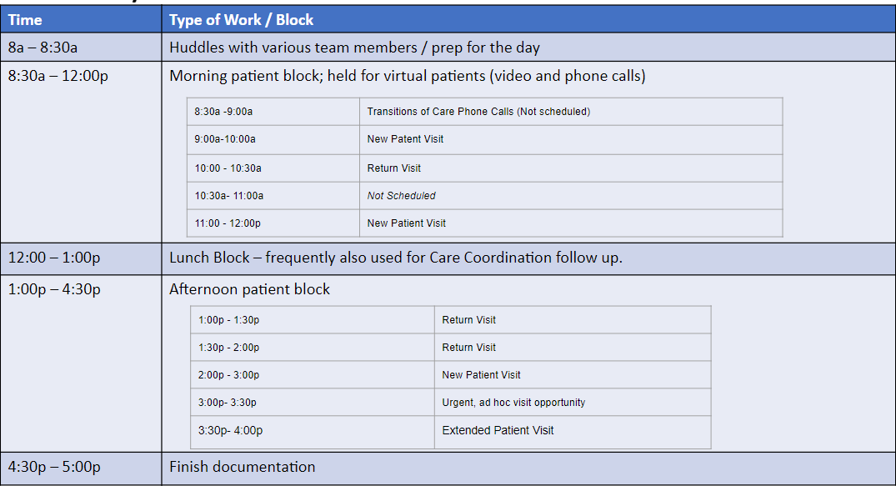
Monday Schedule
Notes:
The next series of slides show the 2nd scenario: showing billing from the perspective of a care manager.

Slide 68
Optimization Through the Story
8:00 – 8:30am Timeframe:
Huddle with Dr. Miller (total of 15 Minutes) to discuss complex patients for the week.
Discussed 3 patients this week, spending just a few minutes on each - remember the scenario from earlier?
Mrs. Jones
Patient who would need support with Advance Care Planning
Patient with identified SDOH needs
Remember that while there is a limit of one G9007 per patient per day (BCBSM only), it’s Ok to bill the G9007 and direct patient care code on the same day.
Review patients’ charts for morning patients.
Codes Applied
G9007 *3
Diagnosis: Mrs. Jones- Diabetes ACP patient - Discussed Diagnoses SDOH patient - Appropriate SDOH need

Slide 69
Optimization through the Story
08:30- 9:00 Timeframe:
Called 2 Transitions of Care Patients:
Patient 1:
While this specific phone call isn’t billable because Theresa is focusing on the TOC, Theresa also conducts a SDOH screening on all discharged patients. She discovered that this patient needed support with purchasing a new medication. Theresa told the patient she would investigate resources and call them back.
Patient 2:
This patient had so many medication questions that Theresa decided to review all the medications during this call. Now, she can add 1111F to the mix. This a Med Rec Code that can be coded in a bundle with the TCM codes that the provider uses. 1111F is more for tracking code for payers, but it helps with the STARS incentives for Medicare Advantage and BCBSM Advantage will reimburse.
Best Practice:
Confirm that both patients have a provider visit within 7-14 days so that the Transitions of Care Codes (99495/99496) can be billed).
Schedule a follow-up visit post provider visit with the care team member to support avoiding a readmission.
Codes Applied
1111F
Diagnosis: Admission diagnosis
Notes:
Reminder that SNF other post acute discharges are also important for follow up.

Slide 70
Optimization through the Story
09:00-10:00am- New Patient Visit
Patient discussion took 35 Minutes
Patient was referred because they had been going to the ED for frequent visits. After SDOH and depression screening, Theresa did an initial assessment of the patient. The SDOH screening showed that the patient was struggling with transportation; they couldn’t use their shared car during the day to get to Dr. Miller’s office.
Theresa told the patient that she would review resources available and call them later today. They agreed that she would f/u around 3PM.
Theresa used 10 more minutes to look up resources and send to patient.
Theresa used 10 minutes to finish up documentation and send a portal message to the patient with all the information.
Codes Applied
G9001
Care Coordination – 10 Min
Diagnosis: All the diagnoses on the problem list, supporting HCC risk score completeness.

Slide 71
Optimization through the Story
10:00-10:30 AM - Return Visit
Patient discussion took 15 minutes via phone because the patient’s video wasn’t working.
They discussed the patient’s lifestyle goals, specifically how to exercise and eat better when the patient seemed to always have one of her kids home because of COVID exposure.
After the visit, Theresa followed up with Dr. Miller to discuss the goals that were set and to discuss the patient’s situation. Theresa also asked if Dr. Miller wanted to update the problem list.
Codes Applied
G9002 G9007
Diagnosis: All relevant diagnoses on the problem list, assuring that any missing from the list are discussed with Dr. Miller

Slide 72
Optimization through the Story
10:30- 11:00AM – No Patients
Theresa took a quick walk around the block for a break, grabbed a snack and started to prep for her 11am visit.

Slide 73
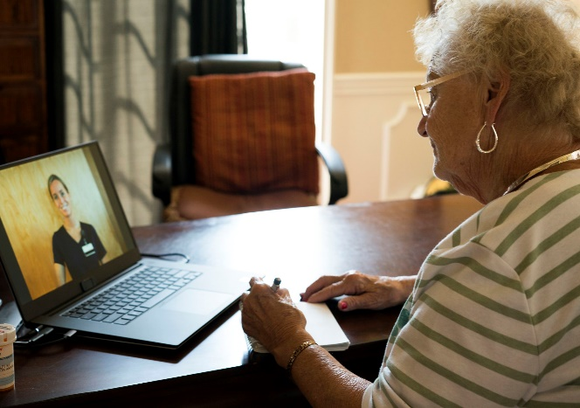
Optimization through the Story
Codes Applied
G9001 Diagnoses: All that apply from problem list, adding SDOH diagnosis
Care Coordination – 10 Minutes * 1 patient 8 Minutes – *1 Patient
S0257
11:00am – 12:00pm – New Patient Visit
Patient’s daughter & patient were part of the video visit – this is one of the great benefits of video visits! The patient’s daughter lives about an hour away from the patient, and this allows them to hear the same support together.
As part of her initial visit, Theresa always does a SDOH screen and tries to get a sense for the patient’s understanding of their health and ability to self-manage.
This patient mentions that she doesn’t always eat properly because she doesn’t feel like going to the supermarket. They’re just too big, and she’s too tired. Plus, everything seems so much more expensive, and she doesn’t always know if she can afford both food and medicine.
Theresa asks if they’d like to set up Meals on Wheels, which both the patient and her daughter think is a good idea. So, Theresa says she’ll send them some information on the portal and call back when it’s set up.
Theresa also mentioned Advance Care Planning, as the patient was over 65 years old. She explained what it was and wondered if they would be interested in going through the process of a DPOA. The patient and her daughter said they’d talk it over with some more family members.
Theresa set up a return visit for two weeks from now, when both the patient and the patient’s daughter could participate.
That whole conversation took about 45 minutes, which left Theresa some time to contact Meals on Wheels and get things coordinated.

Slide 74
Morning Block Summary
Discussion- How close does this mirror the experience in the clinics you support? What other kinds of barriers do you see?
Time | Appointment Type | Billing Codes
8:00 – 8:30a | Huddle with Dr. Rachel | G9007*3
8:30a – 9:00a | Transitions of Care Phone Calls | 1111F
9:00a – 10:00a | New Patient Visit | G9001 Care Coordination minutes: 10
10:00a – 10:30a | Return Visit | G9002 G9007
10:30a – 11:00a | Not scheduled | None
11:00a – 12:00p | New Patient Visit | G9001 Care Coordination minutes: 8 S0257
Notes:
9 codes for the morning!
This might not be the same schedule for everyone - unlicensed care team members might be able to carve out a couple of hours or some time for making outreach efforts.
Having a grid allows for being a more prepared practice team, as you can huddle with the provider or perhaps contact the patient ahead of time.

Slide 75
Optimization through the Story
Lunchtime:
20 minutes of eating
Finished some documentation
Began prepping for the afternoon

Slide 76
Optimization through the Story
1:00 - 1:30pm – Return Patient Visit
The scheduled Return Patient Visit took 10 minutes via phone; patient didn’t want a video visit. Theresa and the patient discussed the previous goal, which was to take his medications at the same time every single day – thereby helping make sure that they were all taken appropriately. So far, this worked! Theresa set up a follow up meeting for 3 weeks from now.
Dr. Miller had a patient who was already in the office and needed some additional support with a new Diabetes diagnosis. Theresa used the rest of this visit time to see this patient, set up some time for a full initial visit, and provide some additional education.
Codes Applied
G9002 * 2 ( 1 for each patient)
Diagnosis: All relevant diagnoses on the problem list

Slide 77
Optimization through the Story
1:30 - 2:00pm – Return Patient Visit
This patient is Theresa’s first scheduled in-person visit of the day.
Theresa and this patient have been seeing each other for the past 6 months for weight management and lifestyle changes. This patient had some serious trauma in her history, and she opened up to Theresa about it. Theresa recently connected her with a community Social Worker, and they discuss how that’s going and next steps.
This patient visit takes up nearly the entire time slot, leaving just enough time for Theresa to schedule their next visit in a month.
Codes Applied
G9002
Diagnosis: All relevant diagnoses on the problem list
Notes:
Note that BCBSM is the only one to allow phone to convert to video!
Red Text - Unplanned scheduled visit/referral

Slide 78
Optimization through the Story
2:00 - 3:00pm – New Patient Visit
Theresa’s 2pm patient is a new geriatric patient, who just moved across the State and is living with his son and daughter-in-law. The patient is still able to drive and is relatively good health, but because of his age (75 years old) and several diagnoses, Dr. Miller wanted him to meet with Theresa.
Theresa reviewed the patient’s understanding of his diagnoses, medications, and ability to self-manage. The patient has a good understanding of his health situation. However, when Theresa asks if he has completed a DPOA or if the patient has a plan for potential end of life care, the patient indicates that he’s avoided doing that because he’s worried about how it will affect his family.
Theresa takes the opportunity to review the benefits of Advance Care Planning, and she offers to mediate a family meeting to help explain to more of his immediate family about why it’s a good idea.
The patient agrees, and they set up a time in 2 weeks when she’ll be able to at least speak with him, his son, and his daughter-in law.
The whole visit takes 25 minutes, so Theresa has some time to catch up on documentation.
She also has a chance to call back her 9am patient and let them know about her success with setting up Meals on Wheels. She confirmed their upcoming appointment during that call.
Codes Applied
G9001 S0257
Diagnosis: All relevant diagnoses on the problem list
98966
Notes:
Note that BCBSM is the only one to allow phone to convert to video!
Red Text - Unplanned scheduled visit/referral

Slide 79
Optimization through the Story
3:00 - 3:30pm – No scheduled visits – open for Ad Hoc patient needs
Today, Theresa doesn’t have any scheduled visits during this time. Also, she was able to connect with the patient who Dr. Miller wanted her to see that day.
Therefore, Theresa pulls up a list of patients who are high risk and who haven’t engaged her services yet. Theresa calls 2 people. The first patient declines her support. The second patient is worried about a COVID exposure, and she talks through with Theresa about what she should do. Theresa recommends a PCR test, and she reviews with the patient how to contact either the PCP office, an urgent care, or the ED based on the patient’s symptoms.
Codes Applied
98967
Diagnosis: All relevant diagnoses on the problem list
Notes:
Opportunity for involvement from the audience: do the licensed care team members usually have those lists? Lists from the health plans can be used because they come with risk scores. Or, they can pull a list of chronic diseases. It helps keep things flowing.
Care Team Members have more luck when they’re saying they’re from the PCP’s office and the PCP recommended that the care team member call.
Red Text - Unplanned opportunity

Slide 80
Optimization through the Story
3:30 - 4:30pm – Extended Return Patient Visit
This patient has health literacy challenges that were identified after his first referral from Dr. Miller.
Ever since these were identified, Theresa schedules an extended return visit after each of his return visits with Dr. Miller so that they can review the information, the visit, and the next steps. This is Theresa’s 3rd visit with the patient, and he’s beginning to better understand what’s going on with his health.
Theresa and the patient set an interim goal for before the next visit with Dr. Miller, and she suggests a visit between the next visit with Dr. Miller. The patient agrees, and they schedule it.
The visit takes nearly the full hour (55 minutes), but Theresa finishes the day with a sense of accomplishment with this patient!
Codes Applied
G9002*2
Diagnosis: All relevant diagnoses

Slide 81
Afternoon Block Summary
In person opportunities as need
Time | Appointment Type | Billing Codes
1:00p – 1:30p | Return Visit | G9002 G9002
1:30p – 2:00p | Return Visit | G9002
2:00p – 3:00p | New Patient Visit | G9001 S0257 98966
3:00p – 3:30p | Urgent, ad hoc visit opportunity | 98967
3:30p – 4:30p | Extended Patient Visit | G9002 *2
Notes:
8 Codes in the afternoon

Slide 82
Theresa’s Billing Summary
Morning
1111F
G9001 *2
Care Coordination
10 minutes *1
8 minutes * 1
G9002
S0257
Afternoon
G9002 * 5
G9001
S0257
98966
98967
14 billable activities for the day!
Notes:
Compare the summary with a coder/biller and assure that there’s clarity that since these are the codes that Theresa has pushed out and has the billing occurred.

Slide 83
Key Takeaways
It’s important to match the diagnosis with what’s going on in the visit, but Care Team Members can also take the opportunity to make sure that the patient’s diagnoses are correct by reviewing the problem list and making recommendations to the provider.
Care Team Members should make sure to comprehensively bill for all their interactions. The frame of mind should be that ALL interactions are billable. - So, the question is HOW do I bill, not SHOULD I bill.
Notes:
The facilitator should ask the participant if their individual goals and objectives for this session were met and what to share one take-way. Also ask about what worked and what didn’t work and what else could have been introduced by the facilitator.

Slide 84
Break

Slide 85
Next up!
Intro
Care Team Coding and Billing It’s a Team Sport
Billing Applications
Billing Optimization Opportunities
Billing Resources & Wrap Up

Slide 86
Billing Applications: Applying Care Management Codes to Clinical Practice
Review and understand the PDCM billing codes and their application in care management to work performed in the practice
Select the appropriate billing code in various clinical scenarios
Examine documentation examples for the PDCM billing Codes
Notes:
Now that we’ve gone through the various codes and reviewed their details, we are next going to walk through example billing scenarios and how these codes can be applied to care management work within the practice.

Slide 87
Billing Scenarios
Transitions of Care
Chronic Disease
Social Determinants of Health Screening
Specialty/Primary Care Interactions
Gaps in Care
Substance Use Disorder
Notes:
There are a variety of ways to incorporate care management codes into everyday practice. And most often you will find it may be work you are already doing. The next step is to learn how to identify these processes and recognize their ties to care management and billing. Listed here are some examples of billing scenarios we will review in detail, along with some additional suggestions at the end.

Slide 88
Documentation Suggestions
Documentation should include at minimum:
Patient name, MRN, DOB, PCP Name
Date of visit and type (face-to-face, virtual, telephone)
Duration of visit
Care team members name and credentials
Name of caregiver/relationship (if included in visit)
Diagnoses discussed
Consent for services: Yes, verbal consent, or decline
Treatment plan, medication therapy, risk factors, unmet care, physical, emotional status, community resources, readiness to change (as applicable)
Care plan, including challenges and interventions and patient’s understanding of agreement with plan
Patient SMART goals identified
S.O.A.P format when applicable
Notes:
As we walk through each scenario, we’re going to take a look at sample documentations for each billing code. Here are some suggestions to get you started. All EHRs systems are different, and you may already have templates built in for CM type visits. Check with your team and leadership.
Explain what S.O.A.P means:
Subjective (information the patient tells you)
Objective (information about the patient in the chart, like labs, etc)
Assessment (the CM’s assessment of the patient’s treatment plan, barriers, etc)
Plan (what are the goals identified, treatment plan for the patient discussed)

Slide 89
Meet Mrs. Johnson
Mrs. Johnson is a 70-year-old African American female who recently complains of increased shortness of breath (SOB) and severe difficulty breathing, increased weight gain, and fatigue. She is concerned with these worsening symptoms.
Chronic conditions include CHF, HTN, pre-diabetes, gout, chronic back pain
Medications include furosemide, losartan, metoprolol succinate, aspirin, oxycodone/acetaminophen, allopurinol, and multivitamin
She is followed closely by her PCP and cardiologist, for management of her CHF

Slide 90
ED Admission
Transitions of Care
Mrs. Johnson decides to call 911 and is brought to the ED where she is admitted for observation and further workup.
In the meantime, her PCP is alerted of her ED admission.
Her PCP telephones the ED physician managing Mrs. Johnson’s care and discusses the case, care plan, and medical interventions.
Her PCP documents her conversation with the ED physician in Mrs. Johnson’s chart.
If Mrs. Johnson has BCBSM insurance, what billing code may the PCP bill?
Notes:
(Can discuss ways the PCP might have been alerted. Most common via ADT messages – can review these types of notifications in more detail).
*Put an audience poll in for the learners to submit their answers, if course is virtual. If live, trainer can call on participants for an answer.

Slide 91
And the answer is….
Transitions of Care
Transitions of Care
G9008 - Physician Code
G9008: Physician Coordinated Care Oversight Services (Enrollment Fee)
Communication with paramedic, patient, other health care professionals not part of the care team when consulting about patient
Face to face, video, or telephone (excludes email or EMR messaging)

Slide 92
Documentation Example
Transitions of Care
G9008 – Physician Visit
Telephone encounter:
Patient Name: Mrs. Johnson DOB: 2/12/52 MRN: 123456 PCP Name: Dr. Johns
Diagnosis: Acute on Chronic CHF: I50.23
Care Team Member Name & Licensure: Dr. Johns, MD
Date of service: 12/18/21
Patient presented to ED today complaining of SOB, difficulty breathing, increased weight gain and fatigue. Called ED and spoke with medical resident managing patient’s care. Reviewed medications and treatment plan. Agreed upon care plan and adjustments were made to patient’s medications. Increased furosemide. Patient scheduled for urgent clinic follow-up in 2 days. Patient not to be admitted to hospital; plan to discharge from ED later today. Will obtain repeat labs in office at follow-up appointment.
Total time of visit: 10 min
Time stamp. Signature.

Slide 93
Transition of Care
Transitions of Care
Mrs. Johnson returns home from the ED feeling a little better.
The next day, Eric, a medical assistant from her PCP’s office calls Mrs. Johnson to check-in. He asks Mrs. Johnson about symptoms, coordinates her follow-up appointment to see PCP tomorrow and encourages a follow-up with her cardiologist as well.
Mrs. Johnson reports better breathing, not feeling as tired. Her weight has returned to baseline.
Eric encourages Mrs. Johnson to bring in all medications to her appt. Call takes 12 minutes.
If BCBSM insurance, what billing code may the PCP bill?
Notes:
If Gloria has BCBS insurance, what billing code may the MA submit?

Slide 94
And the answer is….
Transitions of Care
Transitions of Care
98967- Telephone Code
Call with patient or caregiver to discuss care issues and progress towards goals.
98967 for 11-20 minutes
Notes:
Animated slide (three clicks)
And the answer is…
98967 code
98967 description

Slide 95
Documentation Example
Transitions of Care
98967 – Telephone Visit
Telephone Encounter:
Patient Name: Mrs. Johnson DOB: 2/12/52 MRN: 123456 PCP Name: Dr. Johns
Diagnosis: Acute on Chronic CHF: I50.23
Care Team Member Name & Licensure: Eric, MA
Date of service: 12/19/21
Consent for care management: Yes, verbal consent
Pertinent details of visit: Spoke to patient today regarding her recent ED visit. She reports feeling better overall, with improved breathing and her weight has returned to baseline. Patient with no questions or concerns.
Reminded her to schedule follow-up appt with her cardiologist. Scheduled PCP visit for tomorrow for repeat blood work. Reviewed all medications with patient. Reminded her to bring all medications to PCP appt tomorrow. Patient verbalized understanding.
Total time of visit: 12 min
Time stamp. Signature.

Slide 96
PCP ED Follow-Up Visit
Transitions of Care
Mrs. Johnson presents to PCP’s office for scheduled appointment.
PCP draws repeat labs and adjusts her BP and diuretic medications. PCP assesses Mrs. Johnson’s understanding of CHF and determines she would benefit significantly from education on CHF management and care management (CM) program.
PCP introduces Mrs. Johnson to the CM program and obtains verbal consent from Mrs. Johnson to participate.
PCP refers Mrs. Johnson to the RN care manager, Laura, for CHF education and chronic care management.
What code applies?
Notes:
PCP introduces Mrs. Johnson to the care management program and obtains verbal consent to participate from Mrs. Johnson . PCP delivers her “CM elevator speech” explaining the program and introduces her team to Mrs. Johnson.

Slide 97
And the answer is….
Transitions of Care
Transitions of Care
G9008 - Physician Code
G9008: Physician Coordinated Care Oversight Services (Enrollment Fee)
Communication with paramedic, patient, other health care professionals not part of the care team when consulting about patient
Face to face, video, or telephone (excludes email or EMR messaging)
Notes:
No example documentation slide for this code. Documentation would be similar to the standard note the PCP would document. Make sure to have a statement that says, “Patient verbally consented to care management services.” And some type of statement that states Care management services were discussed with the patient.
Note how this ED follow-up differs from an IP follow-up. The TCM codes 99495 and 99496 can be used for IP discharge follow-up as part of the transition of care visit. But remember, you can’t double dip and bill CM codes as part of a TCM visit (24-48 call and PCP TCM visit).

Slide 98
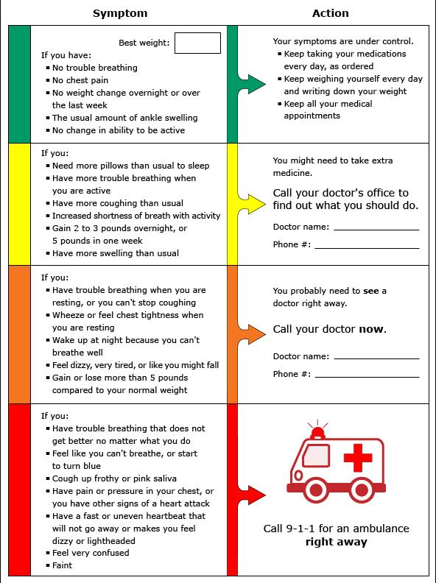
Care Management (CM) Office Visit
Chronic Disease
RN Care Manager Laura meets with Mrs. Johnson face to face that same day, and provides education on CHF, reviews CHF action plan, and monitoring parameters for Mrs. Johnson to follow at home.
Time spent together was 20 min. Mrs. Johnson agrees to come into the office next week for follow-up.
What code applies?

Slide 99
And the answer is….
Chronic Disease
G9002 – Patient Visit Code
Face-to-Face or video visit that is focused on addressing a piece of the care management plan.
Also address the patient’s goals and follow-up plan
Notes:
Reminder that you can quantity bill this code. For visits >45 min may quantity bill (BCBS). But because this visit was 20 min, no need to quantity bill.

Slide 100
Documentation Example
Chronic Disease
G9002 – Patient Visit
Care Management Encounter: Face to face
Patient Name: Mrs. Johnson DOB: 2/12/52
MRN: 123456 PCP Name: Dr. Johns
Care Team Member Name & Licensure: Laura, RN
Date of service: 12/20/21
Consent for care management: Yes, verbal consent
Current Diagnoses: CHF-I50. 23, HTN-I11.0, pre-DM-R73.09, gout-M10.9, chronic back pain-M54.9
Patient self-reported problems and concerns: Mrs. Johnson asking questions today about when and how often to check her weight and BP at home.
Medication List Reviewed with patient:
furosemide 40 mg daily, losartan 25 mg daily, metoprolol succinate 50 mg daily, aspirin 81 mg daily, oxycodone/acetaminophen 5/325 mg every 6 hrs as needed for pain, allopurinol 100 mg daily, and multivitamin tablet daily
Adherence Assessment: Patient is adherent to her medications
Self-management Action Plan: CHF
Short team goal identified: Track weights daily at home, track home BPs daily
Pertinent details of visit: Provided detailed education on CHF dx including management, monitoring parameters.
Reviewed CHF action plan in detail with patient.
Follow-up planned: 2 weeks face to face
Level of understanding: Good
Readiness for change: 8 out of 10
Total time of visit: 20 min
Time stamp. Signature.
Notes:
Documentation may vary depending on type of licensed care manager delivering the service. I.e. pharmacist note may be different from an RN

Slide 101
Office Visit - Comprehensive Assessment
Social Determinants of Health Screening
Chronic Disease
Mrs. Johnson presents 1 week later for face-to-face follow-up with Laura, care manager. Laura completes a comprehensive assessment.
Laura provides Mrs. Johnson with two screenings to complete: Social Determinants of Health Screening (SDOH), as well as a Patient Health Questionnaire -2 (PHQ-2) Screening
Her SDOH screening is positive for difficulty reading and understanding medical language as well as transportation issues, as she does not drive and relies on family/friends to take her to appointments. Her PHQ-2 screening is negative for depression.
Her CHF management is discussed further, and Mrs. Johnson identifies a SMART goal to reduce her salt intake.
They also discuss Advance Care planning. Mrs. Johnson states she has an advance directive and living will in place.
Laura connects Mrs. Johnson with various resources to help address her identified barriers.
Patient and care manager agree on a follow-up plan. Mrs. Johnson will meet with PharmD via phone in 2 weeks to follow-up on patient identified goals.
Total time of visit 45 min
What code applies?
Notes:
Total Time of Visit – 45 Minutes

Slide 102
And the answer is….
Chronic Disease
Social Determinants of Health Screening
G9001 – Comprehensive Assessment
Face-to-Face or video visit lasting at least 30 minutes, results in a care management plan that all team members and the patient will follow.
Notes:
Reminder that you can quantity bill this code. For visits >45 min may quantity bill (BCBS). But because this visit was 20 min, no need to quantity bill.

Slide 103
And…
Chronic Disease
Social Determinants of Health Screening
S0257- Counseling Regarding Advance Directives
Face-to-Face, video or telephone visit counseling and discussion regarding advance directives or end of life care planning and decisions, with patient and/or surrogate

Slide 104
Documentation Example
Chronic Disease
Social Determinants of Health Screening
G9001 & S0257- Comprehensive Visit & End of Life Counseling
Care Management Encounter: Face to face
Patient Name: Mrs. Johnson DOB: 2/12/52 MRN: 123456 PCP Name: Dr. Johns
Care Team Member Name & Licensure: Laura, RN
Date of service: 1/3/22 Consent for care management: Yes, verbal consent
Current Diagnoses: CHF-I50. 23, HTN-I11, pre-DM-R73.09, gout-M10.9, chronic back pain-M54.9
Hospitalization/ED Summary: 1 ED visit in last 6 months
Review of outpatient services: none
SDOH Screening: positive for reading difficulty and transportation limitations
Social History: lives alone, husband passed away, has a daughter who visits once a week
Mobility Status: able to walk with some limitation
Diet: eggs and toast for breakfast, canned soups for lunch most days and frozen meals for dinner, sometimes will cook steak with potato and mixed veggies
Exercise: none, limited due to her chronic back pain
Cognitive Assessment: no reported problems with memory
Mental health assessment: negative for depression on PHQ-2 screening
Smoking: non-smoker
Advance Care Planning: Advance Directive reviewed and placed in chart
Screenings Up to date: mammogram, influenza, pneumococcal vaccines, etc.
Patient self-reported problems and concerns: Mrs. Johnson is doing well, no major concerns or questions today. Reports doing well at monitoring her daily weights and BP.
Medication List Reviewed with patient:
furosemide 40 mg daily, losartan 25 mg daily, metoprolol succinate 50 mg daily, aspirin 81 mg daily, oxycodone/acetaminophen 5/325 mg every 6 hrs as needed for pain, allopurinol 100 mg daily, and multivitamin tablet daily
Adherence Assessment: Patient is adherent to her medications
Care Management assessment:
Self-management Action Plan: CHF
Short term goal identified: Maintain good tracking of daily weights and BPs
Short term goal identified: reduce salt intake to <2g/day
Barriers identified: difficulty buying fresh food from grocery store; easy to buy canned foods that have longer shelf-life
Follow-up planned: 2 weeks telephone
Level of understanding: Good Readiness for change: 8 out of 10
Total time of visit: 45 min
Time stamp. Signature.
Notes:
Documentation is more comprehensive and detailed.
Highlight the details of the note, such as additional assessments included – mobility status, social history, diet, exercise, mental health assessment, screenings, etc.

Slide 105
Follow-up CM Phone Visit
Chronic Disease
2 weeks later, Mrs. Johnson speaks with Monica, Ambulatory Care Pharmacist, for their scheduled telephone visit
Monica reviews patient’s medication list and discovers Gloria is not taking her furosemide as prescribed.
They discuss Mrs. Johnson’s progress with her short-term goals and explore ways to overcome barriers, as well as provide education
Total time of visit 25 min
What code applies?

Slide 106
And the answer is….
Chronic Disease
98968- Telephone Code
Call with patient or caregiver to discuss care issues and progress towards goals.
98968 for 21-30 minutes
Notes:
Animated slide (three clicks)
And the answer is…
98967 code
98967 description

Slide 107
Documentation Example
Chronic Disease
98968- Telephone Code
Telephone Encounter
Patient Name: Mrs. Johnson DOB: 2/12/52 MRN: 123456
PCP Name: Dr. Johns
Care Team Member Name & Licensure: Monica, PharmD
Date of service: 1/18/22
Consent for care management: Yes, verbal consent
Current Diagnoses: CHF-150. 23, HTN-I11, pre-DM-R73.09, gout-M10.9, chronic back pain-G89.4
Patient self-reported problems and concerns: Mrs. Johnson doing well, no major concerns or questions today. Reports doing well at monitoring her daily weights and BP. Having some difficulty reducing salt intake. She likes the taste as well as difficult to change her “easy meals” like canned soup which are easier to prepare.
Medication List Reviewed with patient:
furosemide 40 mg daily, losartan 25 mg daily, metoprolol succinate 50 mg daily, aspirin 81 mg daily, oxycodone/acetaminophen 5/325 mg every 6 hrs as needed for pain, allopurinol 100 mg daily, and multivitamin tablet daily
Adherence Assessment: After prompting, discovered that patient does not always take her furosemide due to frequent urination. Misses dose about 3 times per week.
Self-management Action Plan: CHF
Short term goal identified: Maintain good tracking of daily weights and BPs
Short term goal identified: reduce salt intake to <2g/day
Barriers identified: difficulty buying fresh food from grocery store
Pertinent details of visit: Provided alternative canned soup brands that have less sodium. Provided education and counseled patient on furosemide side effects and importance of taking consistently. Encouraged her to always take in the morning to avoid overnight urinating.
CHF medication assessment: patient taking ARB, BB, diuretic which are appropriate
Follow-up planned: 1 month phone visit with Laura, RN
Level of understanding: Good
Readiness for change: 8 out of 10
Total time of visit: 25 min
Time stamp. Signature.
Notes:
Documentation may vary depending on type of licensed care manager delivering the service. I.e. pharmacist note may be different from an RN

Slide 108
Care Team Conference
Chronic Disease
Eric
Laura
Monica
Dr. John
Mrs. Johnson
Dr. Johns meets with Eric, Laura, and Monica to discuss Mrs. Johnson’s care plan and progress towards her goals
They explore additional ways to assist Mrs. Johnson with her goals. Laura will take the suggestions and discuss them with Mrs. Johnson at their follow-up visit together.
What billing code can the physician submit?

Slide 109
And the answer is….
Chronic Disease
G9007 - Team Conference
Face to face, video, telephone or secure web conference between PCP and care team members to formally discuss a patient’s care plan.
Notes:
Animated slide (three clicks)
And the answer is…
98967 code
98967 description

Slide 110
Documentation Example
Chronic Disease
G9007- Team Conference
Team Conference Encounter: Face to face
Patient Name: Mrs. Johnson DOB: 2/12/52 MRN: 123456 PCP Name: Dr. Johns
Care Team Members Present: Laura RN, Eric MA, Dr. Johns MD, Monica PharmD
Date of service: 1/21/22
Diagnoses discussed: CHF-I50.03
Pertinent details of visit: Care team presented and discussed patient’s progress towards her identified self-management goals including monitoring daily BP and weights, along with her goal to reduce salt intake to <2 g/day. Explored ways to assist patient, including shopping around for food sales and referral to dietitian for additional dietary management given her pre-diabetes diagnosis. Monica discussed patient’s non-adherence with furosemide. Dr. Johns will re-check labs and assess fluid status at next PCP follow-up visit to assess if dose should be adjusted.
Total time of visit: 10 min
Time stamp. Signature.
Notes:
Documentation includes:
Date of conference
Care team names and credentials
Diagnoses discussed
Treatment plan, self-management education, medication therapy, risk factors, unmet care, physical status, emotional status, community resources, readiness to change
Care plan updates

Slide 111
Specialty/PCP Interactions
Specialty/Primary Care Interactions
Specialty/Primary Care Interactions
In the meantime, Mrs. Johnson went to see her cardiologist, Dr. Davis, to update him on changes to her medications.
Mrs. Johnson mentions to Dr. Davis that she now has a care management team with her PCP who have been helping her with self-management goals and optimizing her medications.
Cardiologist proceeds to call Mrs. Johnson’s PCP to discuss patient’s plan of care and offer recommendations and streamline care.
They discuss her medication regimen and care plan. Telephone call lasts 6 min.
If Mrs. Johnson has BCBSM insurance, what billing code can the cardiologist submit?

Slide 112
And the answer is….
Specialty/Primary Care Interactions
G9008 - Physician Code
G9008: Physician Coordinated Care Oversight Services (Enrollment Fee)
Communication with paramedic, patient, other health care professionals not part of the care team when consulting about patient
Face to face, video, or telephone (excludes email or EMR messaging)

Slide 113
Take Note!
Specialty/Primary Care Interactions
Specialty/Primary Care Interactions
For BCBSM, G9008 is a physician-delivered service, commonly used when the physician engages the patient into PDCM, physician is actively coordinating care with the team or interacting with another health care provider seeking guidance or background information to coordinate and inform the care process.
Specialists can take advantage of this code, same as would the PCP if she made the call to the specialist.
Documentation would appear like the example above when Dr. Johns called the ED physician.

Slide 114
Specialty/PCP Interactions
Specialty/Primary Care Interactions
Specialty/Primary Care Interactions
After speaking with Dr. Davis, Dr. Johns (PCP) wishes to increase coordination between practices to streamline care between the care teams. She asks Eric, MA to reach out to the office and speak with Maria, care coordinator, at cardiologist office.
Eric calls Maria and the two of them discuss how to combine their resources to help Mrs. Johnson with her CHF management and overcome some of her SDOH barriers. Eric agrees to explore resources to aid with Mrs. Johnson’s identified transportation issue. Phone call lasts 20 min.
Eric then spends 15 min researching bus/taxi services that specifically help the elderly.
Eric documents his conversation and additional work in the medical record.
If BCBSM insurance, what billing code can Eric submit?
Notes:
**If other care team members were involved in care coordination that calendar month, they would also document their work and the total time for that calendar month would be submitted.
Ask learners, which code would you submit in addition to 99487 if the total time was >75 min?

Slide 115
And the answer is….
Specialty/Primary Care Interactions
Chronic Disease
99487 - Clinical Coordination
99487 Non-face-to-face Clinical Coordination:
Total clinical staff time per month working on behalf of the patient with someone other than the patient or provider.

Slide 116
Documentation Example
Specialty/Primary Care Interactions
99487 - Clinical Coordination
Chronic Disease
Care Coordination Encounter:
Patient Name: Mrs. Johnson DOB: 2/12/52 MRN: 123456 PCP Name: Dr. Johns
Care Team Members Present: Eric, MA
Date of service: 1/26/22
Diagnoses discussed: CHF-150.03
1/26/22: Spoke with Maria, care coordinator at Dr. Davis’s, cardiologist office (contact number 313-222-4466). Spent time discussing patient’s self-management goals and plan of care. Addressed the concerns identified from SDOH assessment including difficulty with transportation and health literacy.
Total time of phone visit: 20 min
1/26/22: Explored transportation resources to aid Mrs. Johnson in getting to doctor appointments as well as go to grocery when needed. See attached services available. Will provide printed resources to patient during next clinic visit. Total time spent: 15 min
Total time of visit for January: 35 min
Time stamp. Signature.
Notes:
Documentation includes:
Date of conference
Care team names and credentials
Diagnoses discussed
Treatment plan, self-management education, medication therapy, risk factors, unmet care, physical status, emotional status, community resources, readiness to change
Care plan updates

Slide 117
Gaps in Care
Gaps in Care
Chronic Disease
Eric, MA, runs quality reports in the office and identifies Gaps in Care for 20 BCBSM patients. He notices Mrs. Johnson’s name on the list and sees she is overdue for her mammogram and routine A1c to assess if her pre-diabetes has worsened.
Eric calls Mrs. Johnson and phone call lasts 6 min.
If BCBSM insurance, what billing code can Eric submit?
If BCBS insurance, what billing code can John submit?
Notes:
No, Priority health due to MA completing outreach

Slide 118
And the answer is….
Chronic Disease
Gaps in Care
98966- Telephone Code
Call with patient or caregiver to discuss care issues and progress towards goals.
98966 for 5-10 minutes
Notes:
No, Priority health due to MA completing outreach
Documentation is similar to the phone call example with John above.

Slide 119
Substance Use Disorder
Substance Use Disorder
3 months later, Mrs. Johnson’s CHF is now stable and controlled.
Unfortunately, Mrs. Johnson’s chronic back pain has worsened, and she now relies heavily on her oxycodone/acetaminophen prescription. She takes it consistently every day around the clock (no longer as needed). She requests an appointment with her PCP and asks for a higher dose to manage her pain.
During the office visit, Mrs. Johnson meets with PCP to assess her back pain. PCP suggests a few non-pharmacologic therapies, but Mrs. Johnson is insistent on wanting an increased opioid dose.

Slide 120
Substance Use Disorder
Substance Use Disorder
Noticing the red flags for substance abuse, PCP asks Mrs. Johnson to complete the CAGE-AID Substance Use Screening Tool. She answers yes to two questions, indicating further assessment is advised. PCP completes the full assessment.
PCP asks Monica, PharmD to also speak with Mrs. Johnson today for medication counseling.
Monica shares information about opioids and the risks associated with long-term use, including tolerance and addiction. She counsels patient on both pharmacologic and non-pharmacologic therapy used to treat chronic back pain.
Monica also addresses briefly Mrs. Johnson’s CHF care plan and self-management goals.
Duration of visit with PharmD was 25 min.
What billing code applies?
Notes:
CAGE-AID screening tool: A five-question tool used to screen for drug and alcohol use; answering yes to two or more questions indicates a complete assessment is advised.

Slide 121
And the answer is….
Substance Use Disorder
G9002 – Patient Visit Code
Face-to-Face or video visit that is focused on addressing a piece of the care management plan.
Also address the patient’s goals and follow-up plan
Notes:
Reminder that you can quantity bill this code. For visits >45 min may quantity bill (BCBS). But because this visit was 25 min, no need to quantity bill.
Documentation will be similar to the G9002 example above but will have specific details regarding opioid counseling as well as include the final PCP plan of care regarding her chronic back pain.

Slide 122
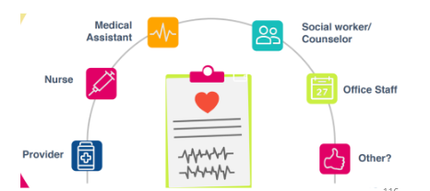
Medication Assisted Treatment & Care Management
Medication Assisted Treatment (MAT) for opioid use disorder can be done in the primary care setting with proper licensure and training and integrated within an existing care management program.
Work done by care team members as part of MAT can be captured using CM billing codes.

Slide 123
Longitudinal Care Management
Mrs. Johnson agrees to try alternative therapies for her chronic back pain.
PCP continues to manage Mrs. Johnson’s pain management and assesses whether medication assisted treatment (MAT) is needed.
Care team continues to schedule ongoing follow-up visits to monitor her progress towards her self-management goals, close gaps in care, address her SDOH needs, and help avoid hospitalization.
Notes:
CAGE-AID screening tool: A five-question tool used to screen for drug and alcohol use; answering yes to two or more questions indicates a complete assessment is advised.

Slide 124
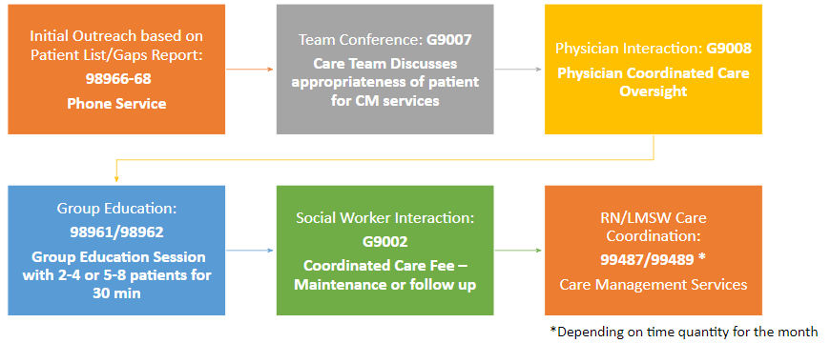
Additional Care Management
Notes:
Below is an additional example of a CM workflow your office may adopt. It doesn’t always have to start with an ED or IP admission. MA or RN staff can review the CM patient or gaps report for BCBS or Priority Health and identify patients looking at the reports. Then a team conference may take place to discuss those patients that were chosen to obtain PCP approval and agreement. Then the physician may choose to do the initial introduction of CM, or it may be the care team member who introduces CM to the patient (like a cold call) and schedules them to come into the office for follow-up. You may want to schedule group education sessions if there are multiple patients who would benefit from education. A social worker, or pharmacist, or dietitian may visit with the patient next based on the patients’ needs. All workflows and processes will be specific to each office and care team. Specialist office outreach may look slightly different as well. Work with your internal team to determine which billing codes and processes best suit your patients and your practice goals!

Slide 125
Key Takeaways
The PDCM billing codes can be utilized in many common clinical workflows within your office setting, including but not limited to: transition of care, social determinants of health screening, within specialty and primary care team interactions, gaps in care and substance use disorder.
Be sure to appropriately document your care management encounters in detail and according to the billing rules specified by each individual insurance carrier.
Notes:
The facilitator should ask the participant if their individual goals and objectives for this session were met and what to share one take-way. Also ask about what worked and what didn’t work and what else could have been introduced by the facilitator.

Slide 126
And now!!!!
Intro
Care Team Coding and Billing It’s a Team Sport
Billing Applications
Billing Optimization Opportunities
Billing Resources & Wrap Up

Slide 127
Knowing that billing encounters contributes to successful team-based care and supports value-based reimbursement, what will you start doing differently in your role?
Notes:
Activity
Ask: What have you learned today you will share with team tomorrow?
Give them a few minutes to think then depending on size of group ask for volunteers or go around room.
Consider:
What would you ask your practice?
What can you do to set yourself up for success?
5 minutes
15 minutes for report out

Slide 128
Resources

Slide 129
MICMT Billing Resources

Slide 130
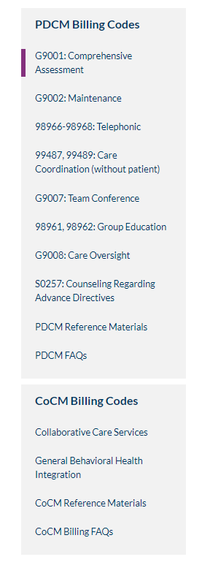
MICMT- Billing Resources
Billing Codes
Reference Documents
FAQ’s

Slide 131
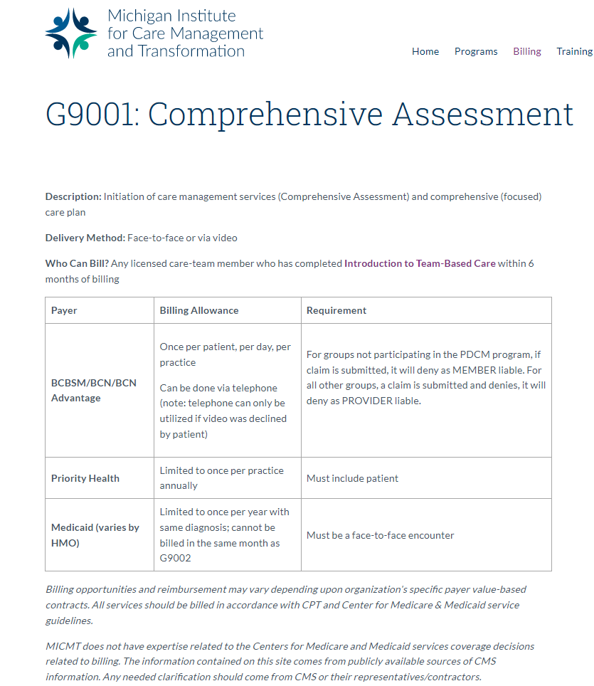
MICMT- Billing Resources
Code Descriptions

Slide 132
MICMT- Billing Resources
Documentation & FAQs

Slide 133
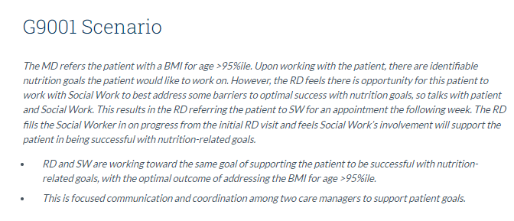
MICMT- Billing Resources
Scenarios

Slide 134
Resources: Care Management Services & Billing
Michigan Institute for Care Management and Transformation
BCBSM/BCN/BCNA
PDCM Billing Guidelines (Commercial & Medicare Plus Blue PPO)
Groups not Participating in PDCM
Multi-Payer Table: BCBSM/BCN/Priority Health
BCN/BCNA PDCM FAQ’s
Priority Health
Centers for Medicare & Medicaid
Chronic Care Management
Behavioral Health Integration

Slide 135
Additional Training Opportunities
Patient Engagement Training: learn how to use evidence based motivational interviewing and self-management support skills to engage with patients. This training is reimbursable to your affiliated Physician Organization.
General MICMT Webinar Series: participate in multiple monthly webinars on various topics.
MICMT webinars are free of charge and recorded/posted to the MICMT website. Feel free to send MICMT your ideas at https://micmt-cares.org/contact
For additional information on the Training Framework and Training Opportunities

Slide 136
REMINDER!
Successful completion of this course includes:
Completion of the one day in-person/virtual training.
Completion of the Michigan Institute for Care Management and Transformation (MICMT) post-test and evaluation.
Achieve a passing score on the post-test of 80% of greater.
*If needed, you may retake the post-test.
You will have (5) business days to complete the post-test

Slide 137
Tips for Successful Completion
Tips for Success:
At the conclusion of this training, you will receive a post-event email within 24 hours with links to the evaluation and post-test on your user dashboard.
If you do not receive the post-event email notification, please login to access your user dashboard to find the evaluation and post-test links.
If you cannot find your User Dashboard, click on "My Account" in the top-right corner if you are logged-in.
If you do not see the links to your evaluation and post-test directly under your recent training event please submit a ticket ASAP, as you only have 5-business days to complete these requirements.
PLEASE NOTE: The evaluation and post-test will become available after the official end time published for this event. Any attempts made prior to the published end time will generate an "Access Denied" message.
How To: Completing Evaluation and Post-Test (Detailed Instructions PDF).

