Slide 1
Adolescent brain development
Notes:
Today we are going to do a 15-minute mini-training, also called a Spark. We’ll be looking at the basics of what research tells us about adolescent brain development, and how that plays out in a clinical setting. We’ll also be thinking about what makes it challenging to be sensitive to teens’ needs.

Slide 2
Case Scenario: Shayla
You work at the front desk. 16 year-old Shayla is 10 minutes late for her appointment, and she comes up to the front desk to check in. She does not look up at you, but instead, she stands at the desk and appears to be texting. In an upbeat voice, you say, “Hello! Do you have an appointment?”
She continues to look at her phone,
frowns, and keeps texting while you wait. Finally, she looks up and says, “What?”
Notes:
To help us think about what this means in our day-to-day work, here’s a scenario that may seem familiar.
You work at the front desk. 16 year-old Shayla is 10 minutes late for her appointment, and she comes up to the front desk to check in. She does not look up at you, but instead, she stands at the desk and appears to be texting. In an upbeat voice you say, “Hello! Do you have an appointment?” She continues to look at her phone, frowns, and keeps texting while you wait. Finally, she looks up and says, “What?”
We’ll come back to this scenario in a few minutes, but for now, consider your gut response to this situation.

Slide 3
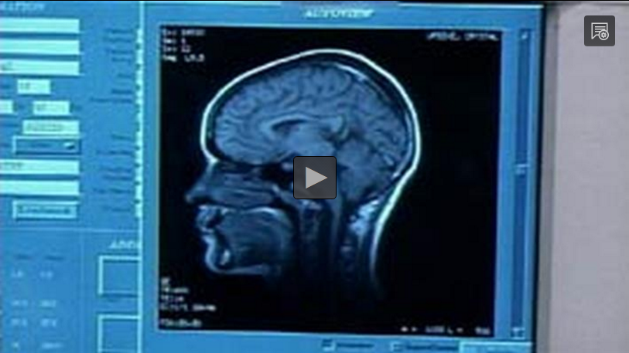
introduction
http://bit.ly/2tWg8qb
Notes:
We’re going to watch a 5 minute video clip from PBS Frontline on the teenage brain and then discuss the implications on the work we do with teens.
[This slide/video can be skipped if you need to save time.
The link is: http://bit.ly/2tWg8qb ]

Slide 4
Discussion
What are some adolescent behaviors or characteristics that could be seen as positive? What could be seen as frustrating?
Which adolescent behaviors or characteristics do you notice most in a clinical setting? Which do you find most challenging? Most rewarding?
Notes:
What are some adolescent behaviors or characteristics that could be seen as positive? What could be seen as frustrating?
[Examples include: passionate, feel strongly about social justice, trying to learn as much as possible, want to experience everything, always on their phones, do things that don’t make sense, don’t listen.]
Which adolescent behaviors or characteristics do you notice most in a clinical setting? Which are most challenging? Most rewarding?
[Examples include: give one word answers, show up late or don’t show up at all, have an interest in their health, are willing to share if asked, sense of humor.]

Slide 5
Adolescence is a vital phase
Adolescence is an essential stage of life, and its developmental characteristics are a natural part of the way the brain is changing.
Notes:
Adolescence is an essential stage of life, and its developmental characteristics are a natural part of the way the brain is changing. Even if we know that “teens will be teens,” and adolescence is an important phase of development, it can still be challenging to work with teens. Some people love working with them, some don’t – either way, understanding what’s going on for them can help us be respectful and give them the care they need so they’ll keep coming back to us.
What are some of the ways we’re trying to be respectful of the developmental needs of adolescents?
[You may choose to have staff respond, or mention any of these that apply to your site.
-Because the right to confidentiality is an important need for adolescents, we’ve posted Adolescent Confidentiality Rights posters.
-We’ve added new health education materials chosen by a teen advisory council.
-We try to avoid using medical jargon to explain things.
-We do risk assessment surveys with more teen patients, so providers can learn more about the needs of individual teen patients and address any risky behaviors.
-Add any others you want to.]

Slide 6
Brain development
Prefrontal Cortex
Limbic System
Notes:
Functional MRI has shown us how the brain develops from age 5 to age 20. There are significant changes that occur during the period of adolescence, with some parts—like the prefrontal cortex—not fully maturing until the mid-20s.

Slide 7
Brain development
Notes:
In the front of the brain is the prefrontal cortex, which is the part that controls complex decision-making, judgment, and understanding cause and effect. At the same time that the prefrontal cortex is developing, the limbic system, which is in the middle of brain, is highly active. That is the reward center and controls emotions.

Slide 8
Developmentally appropriate behaviors
Notes:
As part of their development, many adolescents crave novelty and seek new experiences. The combination of these developmental characteristics can result in behaviors that can be really challenging for both adults and teens. Also, the need for peer acceptance is at its peak, and many teens seek excitement through risk behaviors. Sometimes they don’t always have an accurate perception of the consequences of their behaviors (like using alcohol, drugs and having unprotected sex). Also, most teens are focused more on themselves and their needs than they are on others. These are all normal and developmentally appropriate when we consider the way the brain is changing.

Slide 9
Developmentally Appropriate Behaviors
Playingmom.com
raisingincrediblekids.com
Notes:
It can be hard to remember that this process is normal for teens. When a toddler has a tantrum, our first reaction might be irritation, but usually our adult brain kicks in and reminds us that they are probably hungry or they just need a nap, and this behavior is normal for a child. Often, though, when we interact with teens and see negative behaviors that can be challenging or annoying, we forget the developmental explanation for these behaviors.

Slide 10
What can we do?
Notes:
Considering this, what can we do to adjust our behaviors or reactions to give teens the patience and respect that they need? It’s up to us as adults to help them along the way, and it’s what we have to do to be truly patient-centered.

Slide 11
Beyond gut reactions
Notes:
[Pass out worksheets – Case Scenarios: Challenging Adolescent Interactions]
Let’s look at some scenarios to think more specifically about how we can do this. First, we will revisit Shayla’s scenario along the top of the worksheet together. She was late, and then was texting while the receptionist was asking her if she had an appointment.
What is your gut feeling about this?
[This might make someone annoyed or mad.
Ask staff about what negative assumptions they may have, or just say:]
Sometimes, without consciously thinking about it, we create a quick story in our heads about why someone is behaving a certain way. In this case, we might think to ourselves, “I bet she’s texting a friend about something unimportant, and she’s rude to ignore me.”
Here’s where we need to rewrite the story and imagine other possible reasons Shayla is behaving as she is. One possibility is that she was late because she had to take a bus to get here and the bus was running late. When she walked to the front desk, she frowned when she got a text from her mother saying that she needed to get home as soon as possible to watch her younger brother. Developmentally, she might be tuned in to her own needs more than the receptionist’s, so she is distracted by her text and doesn’t reply right away.
Now, this situation still might be frustrating – and the text could also really have been from a friend about something trivial – but it can help us give teens the benefit of the doubt, and not let our gut feeling control our reaction to the teen.
Turn to the people near you, and in groups of two or three, pick a scenario that applies most to the work you do. Instead of figuring out how to handle the situation, let’s focus on how we’re feeling and thinking.
Once you’ve picked your scenario, discuss these same questions we went through with Shayla across the top of the table. [You may opt to do this as a group or 2-minute discussion in pairs.]
Would anyone like to share their group’s response to their scenario?
[Allow 1-2 pairs to share, if there is time.]

Slide 12
Thank you! And Questions
Notes:
Hopefully today’s discussion has sparked some ideas on how we can all be more patient-centered with our teen patients, and meet their developmental needs. To keep this conversation going over the next month, I will share Sparklers, or case scenarios, that relate to adolescent brain development. I’ll post the Sparklers around the office in places that you all can easily see them. When you see a Sparkler, take a moment to read the scenario and think through the questions listed on the page. Thank you for your participation!

