Slide 1
Patient Self-Care
A Critical Component of Depression and Anxiety Management

Slide 2
Objective
Explain the importance of self care and the use of mindfulness in the treatment of anxiety and depression with adolescents

Slide 3
What is Self Care?
Self-care describes a conscious act one takes in order to promote their own physical, mental, and emotional health
This can be any activity that assists with helping adolescents feel happy, healthy and positive
This Photo by Unknown Author is licensed under CC BY-SA-NC
Notes:
I think of Self care about making the choice to not build a life you don’t need to regularly escape from and making your mental health a priority your happiness essential and your self care is a necessity. Discussing self care is one of the most important areas to address with adolescents. I was part of a team in a pediatric practice that provided Collaborative Care. I have seen how self care has had a direct impact on improving symptoms of anxiety and depression. And is some cases improvement occurred without the need of medication treatment.

Slide 4
Why Self-Care?
Self care is important for anyone of any age, but in the adolescent years when bodies and minds are constantly changing and adapting, it is vital
According to the Centers for Disease Control and Prevention, more than a third of our nation’s youth eat fast food daily
Many adolescents are getting too little sleep, not enough exercise and spending far too much time online and in isolation
Evidence shows that these health behaviors impact emotional health
Notes:
So we all know the importance of self care in not only preventing illness but maintaining overall health in adolescents.
Stuart J.H. Biddle, Simone Ciaccioni, George Thomas, Ineke Vergeer. Physical activity and mental health in children and adolescents: An updated review of reviews and an analysis of causality. Psychology of Sport and Exercise: Volume 42, 2019, Pages 146-155, ISSN 1469-0292, https://doi.org/10.1016/j.psychsport.2018.08.011.
Pamela Martyn-Nemeth, Sue Penckofer, Meg Gulanick, Barbara Velsor-Friedrich, Fred B. Bryant. The relationships self-esteem, stress, coping, eating behavior, and depressive mood in adolescents” https://doi.org/10.1002/nur.20304
Moitra P, Madan J, Shaikh NI. Eating habits and sleep patterns of adolescents with depression symptoms in Mumbai, India. Matern Child Nutr. 2020;16 Suppl 3(Suppl 3):e12998. doi:10.1111/mcn.12998
The Impact of Sleep on Teen Mental Health. December 1, 2017,Georgetown Behavioral Health Institute. https://www.georgetownbehavioral.com/blog/impact-of-sleep

Slide 5
Types of Self Care
Managing Internet and Social Media
Exercise
Social Supports
Nutrition
Mindfulness
Sleep
Stress Management
Notes:
These are a few areas of self care we want to consider discussing when working with adolescents on possible goals. I do want to note another area not listed but for us to mindful of is spiritual care. I think it is important again to engage with the adolescent on the different areas of self care and what they identify as important as well as always asking what has helped them in the past specific to self care strategies..

Slide 6
Case Example -
Remember Ben?
Ben is a 15-year-old male who presented to his PCP. His parents reported concerns about Ben struggling in school with trouble concentrating, not getting school-work completed, and grades dropping. He reportedly has been isolating in his room and has lost interest in activities he used to enjoy participating in. Ben is up late at night on social media and has a difficult time getting up in the morning to go to school. His mom reports he is irritable and sometimes is short with others. He complains he is just fine and wants to be left alone.
What are key issues? Answer in chat
Notes:
So lets revisit with Ben- Ben is an actual patient that I worked with in CoCM. name is changed
What issues do you see that may warrant further discussion or exploration with Ben Answer in the chat?

Slide 7
Areas to Explore with Ben
Academics: difficulty completing/turning in assignments, decline in grades
Sleep: Staying up late, difficulty getting up on time in the mornings
Mood: irritable, short with others, difficulty with concentration, decrease interests, increase isolation
Social Media: phone use late at night
Relationships: parent /teen conflict
Other areas to explore/rule out?
Screening Tools
Notes:
Correct as many of you pointed out Ben presents with a number of concerns and noting possible signs of depression/anxiety. What is revealed through interview that of these concerns sleep is a big concern possibly exacerbating his symptoms. So I will share the conversation and then share examples of the use of MI so you can get a sense in how I engaged with Ben and his parents how to begin to develop a plan.
I will reference Ben throughout this presentation when we discuss self care,
Just something to note: working with adolescents we may not always get all of the information up front as they are testing the relationship with the BHCM. So it is important to always screen and ask additional questions such as substance use where the CRAFFT is a helpful screen as well as sleep using the BEARS.
Give examples of MI conversations when exploring these areas to promote engagement and buy in from Ben:
MI Problem Recognition: Sometimes it nice to summarize Ben you shared struggles with concentration, irritability homework not getting done. In what ways has this been a problem for you?
Or:
Problem Recognition:Ben staying up late leaves you feeling tired and unmotivated.
The initial goal is to understand from Ben what he identifies as the major concerns. This will assist in buy in and continue the engagement process.

Slide 8
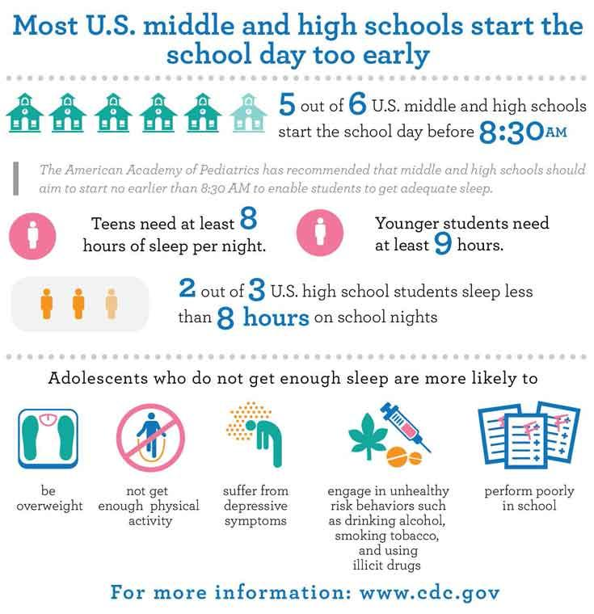
Sleep
Costs:
Lack of or disrupted sleep can impact mood and stress levels leading to problems with, memory, judgement, and decision making
Too much sleep can result in increased risk of heart problems, obesity and cognitive impairment
Persistent sleep problems despite interventions may warrant further evaluation (OSA, restless leg syndrome, narcolepsy)
Benefits:
Deep and restful sleep helps to restore energy expanded during the day which can lead to improvement in mood, focus, creativity, decision making, and concentration
Helps fight off common infections by releasing key hormones
Rejuvenates memory, learning and promotes new insights
This Photo by Unknown Author is licensed under CC BY-NC-ND
Notes:
Read Slide first: Ben he reported staying up late on social media/phone getting about 5-6 hours of sleep. We know adolescents need at least 8 hours so sleep deprivation can impact mood, concentration and most definitely academics.
So often time I use the strategy of writing a list of concerns and share with the adolescent as they are talking.
Using MI statement: I might say. Ben you shared the following areas of concern?
Bens identified sleep as the areas he would like to work on. MI- So you shared staying up late on your phone and not getting enough (5-6 hours) sleep is an area you want to work on is that correct?
MI: You know yourself best It seems safe to say that lack of sleep could be impacting your ability to get up on time, maybe concentration and your level of motivation. I am glad to see your willingness to look at this.
So in order to move into creating a plan to help you address your sleep why don’t you share what your evening routine looks like so I can have a better understanding on how I might help.
Note: adolescent drives the plan even though we may see one area as primary concern using MI skills to engage the adolescent is critical in creating the connection.
Problem Recognition: You shared struggles with concentration, disrupted sleep and irritability. In what ways has this been a problem for you? Getting enough sleep is important to you
Concern: What do you think will happen if you don't make a change?
Intention to Change: The fact that you're here indicates that at least part of you thinks it's time to do something.
What are the reasons you see for making a change?
Optimism: What makes you think that if you decide to make a change, you could do it?
What encourages you that you can change if you want to?
What do you think would work for you, if you needed to change?

Slide 9
Sleep: Strategies
8-10 hours recommended to function best.
Stop using technology (cell phone, laptop, TV, gaming) 30 minutes before bed - blue light/white tint can be stimulating
Limit caffeine and nothing after 3 pm
Try going to sleep and waking up at the same time
Sleep in a darkened room
Temperature matters- try to keep the room cool enough so that a blanket is necessary
Get outside during the day
Practice time management – set a schedule to prevent worrying about the next day or event.
Use your bed for sleeping only
Referral to cognitive behavioral therapy for insomnia (CBT-I)
Notes:
Read Sleep strategies slide first
CBT-I a form of talk therapy for sleeping problems that has demonstrated effectiveness in adults and may be helpful to teens. CBT-I works by reshaping negative ideas and thoughts about sleep and implementing practical steps for better sleep routines
Ben identified he goes to bed around 12-1:00 and gets up at 5:30-6. It is Important to review sleep hygiene/routine. Using the sleep strategy list as a guide to ask more detailed questions what does his room look like, temperature how long does it take for him to fall asleep. Sleep throughout the night ( disrupted?).Where is his phone
MI: Sleep is important to you. Staying up late and being on the phone doesn’t help. We can agree bedtime and phone use is something you have control over. What is a reasonable time to start getting ready for bed?
PLAN: be in bed phone off at 10:00, in bed 10:30, move phone from the night stand to the dresser. He would have to get out of bed vs. hitting the snooze as he uses his phone like many adolescents for an alarm.
(take baby steps to allow for success) and then revamp the plan exploring the general goal )

Slide 10
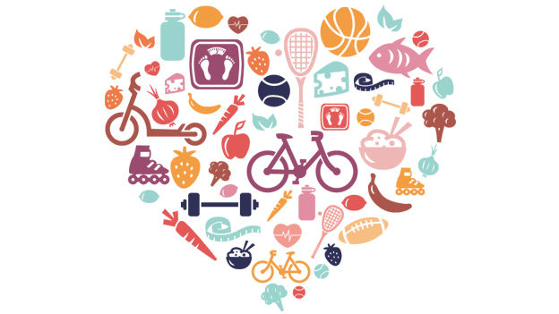
Exercise: Benefits
Burning off stress chemicals such as adrenaline
Release of endorphins-chemicals that have a naturally relaxing and calming effect on the body
Improved memory
Increased energy
Improved focus
Better regulation of mood
Increase sense of accomplishment and self-esteem
Distraction from negative thinking
Notes:
So we all know any activity is better than none and just overall physical activity has so many benefits to our overall physical, mental and emotional well being.

Slide 11
Exercise: Strategies
Generally, doctors recommend about 20-30 minutes of exercise three to five times per week.
Incorporate physical activity into daily activities
walk to school instead of taking the bus; take the stairs instead of the elevator
Sign up for a class if structured exercise is preferable
Ask a friend to join
Walk the dog
Start with whatever seems manageable. Even a 10 minute walk can be helpful.
Notes:
So again any activity can be helpful take baby steps.
So lets talk about Ben: Ben use to be involved in track. He quit but expressed missing running and working out with his friends.
We explored using MI: Ben what activities have participated in the past…. How did those activities make you feel. What would you be willing to pick up again ?

Slide 12
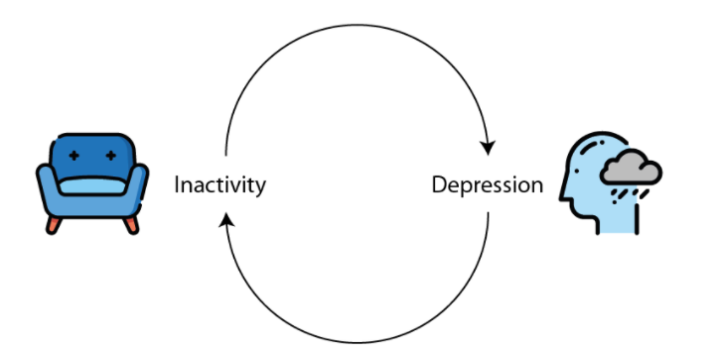
Remember to use Behavioral activation!
Cycle of Inactivity- Depression
Get Active!-
Be Kind to Yourself
Track your progress-keep a log
Set small goals-
Self-care is a great place to start. If you’ve gotten out of the habit of showering, take a shower; brush your teeth; clean your room. Notice if it makes you feel better. Even if it isn’t enjoyable immediately, try it again the next day! Even small steps count!
Pay attention to CHOICES
Notes:
Remember with Depression self care any activity is a start. Explore routines what has the adolescent done that they may have stopped doing. Repetition is the key. Ben and I discussed loss of interest, motivation and increase isolation. He stated he wanted to hang out more with his friends and when he was involved in track how much he liked hanging out with his friends at practice and weight training.
MI: working out with your friends is important. What activity can you start with and what friends could you ask to support you.
Plan: set up : working out 3 times a week and identified which buddies he could ask to work out with him.

Slide 13
Internet and Social Media
Costs:
Cyber bulling
Can increase negative thinking, poor self esteem-it can act as a source of social comparison
Feeling compelled to check-in online
People can claim to be anyone on the internet
Risk of identity theft or being “tricked” into sharing personal information
Screen time late into the evening can contribute to sleeping problems. Using devices can keep teens’ brains wired, and incoming notifications can cause disrupted and fragmented sleep
Evidence also points to suppressed melatonin production from exposure to the light from cell phones
Benefits:
Provides access to friends and support 24/7
Provides a connection to other like-minded individuals
Helps adolescents develop and express individual identity
Notes:
So lets talk about social media and technology. Given the pandemic many changes to everyone regarding socialization but even more so for adolescents. I believe it is safe to say social media has had a dramatic increase amongst adolescents. Just with schools, isolations. Social distancing in the beginning.
What I am hearing is the difficulty with transitioning back to school and re-engagement triggering increase anxiety.

Slide 14
Internet and Social Media Strategies:
Limit time spent on internet/social media, set a timer
Set a phone curfew
Learn to block negative connections/people
Avoid tech verbal wars - no response stops adding fuel to the fire
Pocket Points- App that rewards users’ points for keeping their phone off while in class. Points can be redeemed for goods and coupons at local businesses or online
Set the phone away from the nightstand if using as an alarm
Change blue light to soft evening light
AAP Family Media Plan- helps families create plans together
Notes:
Read First then slide: Internet and social media offer a wealth of information and resources. At the same time, not all social media is good for our mental health.
Research such as the 2014 Sleep in America Poll found 89% or more teens keep at least one device in their bedroom at night.
AAP Family Media Plan – helping families create plan for kids get link and add

Slide 15
Social Supports
Benefits
Strategies
Accountability- being accountable to someone is a key factor in making successful lifestyle changes
Improved physical and emotional health- supports not only help depression but other chronic diseases
Better problem solving- social supports help in brainstorming problems and relieve stress
Enhanced “brain fitness” - interacting with others helps to stay mentally sharp
List who are the positive people in their lives that are the best support for now
Do they prefer a formal or informal network –support group vs friends
Sharing with people at school
Networking opportunities on the internet that are safe with adult approval and balanced with face-to-face connections
Notes:
Read First: Important not to deal with depression/anxiety on their own. Unfortunately when dealing with depression the last thing someone wants to do is socialize. Hence the vicious cycle the more adolescents avoid contact the more depressed they become. building and maintaining a strong support system is a vital part of feeling better. Those you choose to include can provide encouragement and help you challenge your negative thinking
However, some adolescents we are aware they may not have the best support whether in their home or with peers. Some families there is generational trauma, substance use and adolescents don’t always have the parenting support available. So we really want to explore all areas of possible supports available to them.

Slide 16
Nutrition
Strategies
Impact and Benefits
Eat small and frequent meals can prevent overeating
Don’t skip breakfast which has been associated with lower energy and decreased motivation.
Think ahead, keep easy-to-grab items
Watch beverage choices
Watch portion control www.choosemyplate.gov
Keep a food journal
Restrictive eating can result in impaired concentration and memory
Eating healthy leads to “happy brain happy body”
Impacts our brain neurochemistry which controls our mood and response to stress
Impacts higher brain functions that control learning, memory and intellectual functioning
Notes:
Eating healthy can be challenging. Changes in appetite can be a result of their mental health. Side effects of medication may cause changes in appetite or weight. We as BHCM’s always want to provide education and what to watch and discuss with primary health care provider.
For example I worked with a 14 year old female adolescent. She was anxious and engaging in restrictive eating and experienced some weight loss. We talked about her worries and what that looked like. Her perception she ate fine and didn’t think much about it. Her mom however became the hovering parent out of concerns which increased conflict and power struggles. So again I shared you know yourself best and I believe your mom wants to help and is just now sure how to help. I wonder if we could look at a beginning step and I have some thoughts would it be okay to share these ideas?

Slide 17
Stress Management
Strategies
Impact and Benefits
Problem solving techniques
Coloring
Seek out friends/supports to “vent”
Watch the thoughts “shoulda, coulda, woulda’s” replace with manageable thoughts
Yoga
Setting daily goals, journaling
Watch your caffeine intake
Manage you time with fun breaks
Mindfulness strategies
Difficulty concentrating
Increased worrying
Tension, short temper, irritable
Changes in eating and sleeping habits
Stress produces hormones to help cope by concentrating or taking action
Notes:
Read First:Stress is a part of every day life, impacting our functioning at home, school and relationships. The good news is that, since we often bring about much of our own stress, we can also do much to manage stress by learning and practicing specific stress-reduction strategies.
What works for one may not work for the other. What is relaxing for one may not be for another.
First important to hear from the adolescent “what stresses you out” what helps you to de-stress? Of these strategies lets create a plan.
Reference “101 ways to cope with Stress” HANDOUT
https://whs.rocklinusd.org/documents/Counseling/101%20Ways%20to%20Cope%20with%20Stress.pdf

Slide 18
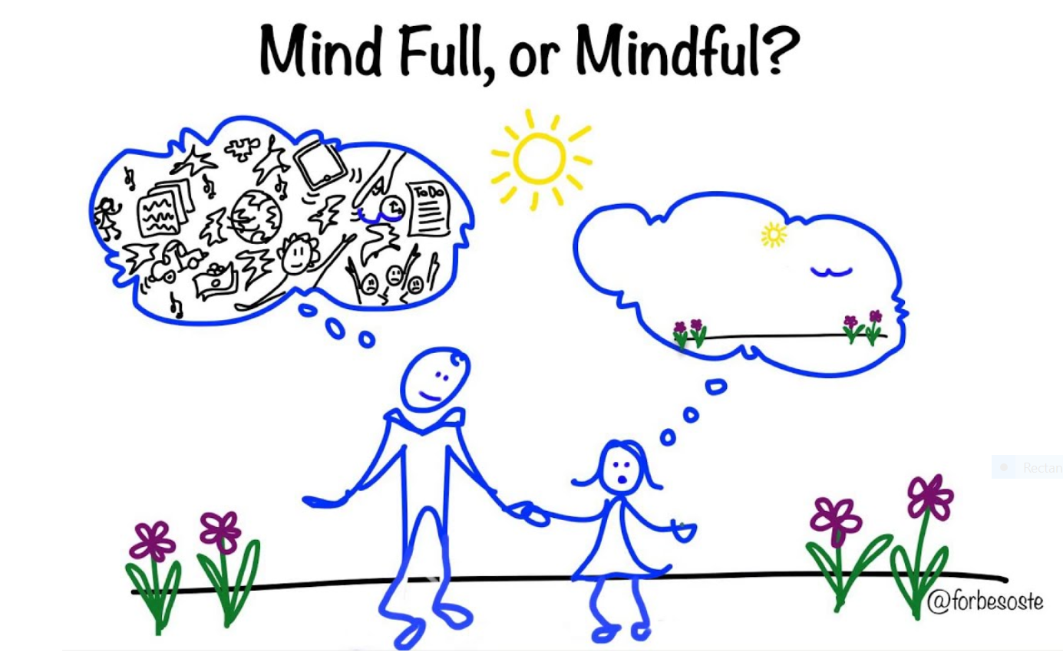
Mindfulness?
Mindfulness- the act of being present and being intentional with our attention. When we are mindful we notice what is happening in and around us, so that we can learn to accept and manage our experience, instead of allowing our thoughts or emotions to run the show
Mindfulness Skills- help us remain in the moment and more effectively notice, acknowledge, and accept our emotions and the situations around us
Trails to Wellness
Notes:
Mindfulness practice has no age limits. Adults, teenagers, school children, or toddlers. Anybody can benefit from it. Some of us today may be very informed and incorporate mindfulness in our day to day living while others not so much.
Share link to Trails to Wellness – Mindfulness resources https://trailstowellness.org/materials/cbt-and-mindfulness-groups/resources/mindfulness
.
****Have someone add link to chat trails website/link and each of the Trails mindfulness strategies handouts

Slide 19
Mindfulness
Benefits
Strategies
Decreased negative thinking,
Less judgmental
Increased compassion and forgiveness of self and others
Deep Breathing
Distress Tolerance Skills (Radical Acceptance, Five Senses, A.C.C.E.P.T.S, I.M.P.R.O.V.E)
Gratitude and Self-compassion
Grounding
Smart phone applications
Notes:
Anybody any age can benefit from it.
These examples by no means are inclusive but just a few examples that can be used when working with adolescents.
Smart phone HANDOUT-Smartphone Applications for Guided Mindfulness Meditation https://storage.trailstowellness.org/trails-2/resources/smartphone-applications-for-guided-mindfulness-meditation.pdf
Mindfulness distress tolerance https://storage.trailstowellness.org/trails-2/resources/knowing-when-to-use-mindfulness-distress-tolerance.pdf

Slide 20
Mindfulness Techniques
Notes:
So now I am going to share just a few examples with you some mindfulness techniques

Slide 21
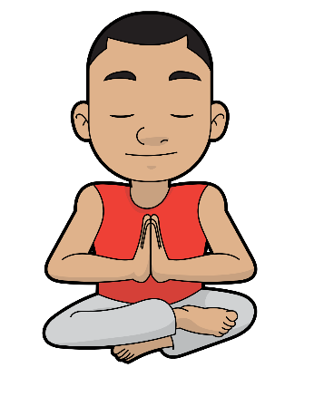
Deep Breathing
• Make sure you are sitting or lying comfortably
• Close your eyes if you are comfortable doing so
• Try to breathe through your nose rather than your mouth
• Deliberately slow your breathing down; breathe in to a count of 4, pause for a moment, then breathe out to a count of four.
• Make sure that your breaths are smooth, steady, and continuous — not jerky.
Attention to your In-breath
1...2...3...4
Pause
Out-breath
1...2...3...4
Pause
Attention to your out-breath —
make sure it is smooth and steady.
When we are anxious our body speeds up breathing to prepare for response. Relaxed breathing is slower and deeper, coming from the belly and signaling the body that it is safe to relax.
Notes:
I just wanted to share again these examples we are going to review can be found at the Trails to Wellness link shared previously. https://trailstowellness.org/
So one thing I do share with teens is we may not always have control of what's going on in our environment. But we definitely have control over how we choose to respond to it in our thoughts and physical response. One area you have control is your breathing.
Alternative styles using a feather, tissue, box breathing, bubbles
I had one teen so anxious I pulled out a bottle of bubbles and started breathing and handed her a bottle

Slide 22
Gratitude and Self-Compassion
Think of one thing for which you are grateful. (This could be something big or small, gratitude for a person who loves you, or something kind someone did for you, or just a moment where you got to laugh or make someone else laugh) Try thinking, “I am feeling grateful for…” See if you can relive that moment for a second. What do you see? What do you hear? What do you feel
Now, try to turn that gratitude toward yourself. You can start with your body: what is something your body can do that you may take for granted, but for which you are grateful? Maybe this is a way your body can move or an ability you posses. Try thinking, “I am feeling grateful that my body can…”
Notes:
Shifting one's negative thoughts to positive thoughts can be supported by introducing gratitude and self compassion. This is a helpful exercise can be broken down into sections.
Think of one thing you are grateful, affirmations, mantras
1.The first paragraph focuses general gratitude
2.The second paragraph gratitude toward yourself

Slide 23
Gratitude and Self-Compassion (continued)
Now can you extend this gratitude to another part of you, maybe a more subtle ability you have? Gratitude toward yourself for the way you handle difficult situations, or your kindness, or your dedication to justice, or for being hardworking, for caring for siblings, for dealing with a pandemic. Think about some of your abilities that you typically take for granted, and try thinking “I am feeling grateful that I…”
Now take a moment to refocus on your body. Notice your physical sensations again. How they come and go like the breath. Thoughts are like this. They are automatic, and sometimes they are uncomfortable or unkind. But we can also choose to focus on things for which we feel grateful, both outside ourselves and within ourselves. This gratitude builds our compassion, which can help us deal with challenging situations.
Notes:
3rd paragraph focus is toward self and ones abilities
4.The final paragraph focus on the body and thoughts
Other great tools is implementing a gratitude journal, gratitude jar or box that the adolescent fills with slips of daily gratitude

Slide 24
Distress Tolerance Skills (Radical Acceptance, Five Senses, A.C.C.E.P.T.S, I.M.P.R.O.V.E)
SITUATION
You find out you were not selected for a school project where you felt that you were the best choice.
TYPICAL THINKING
This isn’t fair—I did everything right! I was the best one there. They can’t do this to me.”
RADICAL ACCEPTANCE
“ “It’s frustrating that I didn’t get the part, but I accept that they felt someone else would be a better fit.”
________________________________________________________
Self-Soothe with Senses
Find a pleasurable way to engage each of your five senses.
Doing so will help to soothe your negative emotions.
Vision Go for a walk somewhere nice and pay attention to the sights.
Hearing Listen to something enjoyable such as music or nature.
Touch Take a warm bath, feel the sun on your face or get a massage.
Taste Have a small treat—it doesn’t have to be a full meal.
Smell Find some flowers or spray a perfume or cologne you like.
Distraction (A.C.C.E.P.T.S)
Negative feelings will usually pass, or at least lessen in intensity over time. It can be valuable to distract yourself until the emotions subside. The acronym,
A.C.C.E.P.T.S., serves as a reminder of this idea
Action: Engage in activities that require thought and concentration. This could be a hobby, puzzle, drawing, a project, work, or school.
Contributing: focus someone or something other than yourself
Comparisons: Look at your situation and compare to something worse.
Emotions: Do something that will create a competing emotion feeling sad watch a funny move feeling nervous listen to soothing music.
Pushing Away: Push negative thoughts out of your mind, imagine writing a problem on piece of paper and throwing it in the garbage
Thoughts: when your emotions take over, try to focus on your thoughts. Count to 10, recite the lyrics of a song in your head,
Sensations: Find safe physical sensations to distract you from intense negative emotions. Wear a rubber band and snap it on your wrist, hold an ice cube in your hand, or eat something sour like a lime.
Trails to Wellness
Notes:
Add Trails link and talk through each one briefly
Radical acceptance addresses –Thoughts and the ability to reframe
Self soothe utilizes - Senses
ACCEPTS utilizes – distraction
Show these to the adolescent and have them pick what might be a helpful tool help you and lets practice.

Slide 25
Grounding
Trails to Wellness
Notes:
Sometimes, strong emotions (and especially trauma responses) can sweep us away and out of the present moment.
Our feelings can get so strong that we feel overwhelmed.
Grounding skills help us come back to the present moment by using our senses to reconnect with what is going on around us.
These skills are available to us no matter where we are!
1.The first one 3-2-1 is utilizing your senses in an abbreviated version of what some of you may be familiar with using your 5 senses.
2. Body scan:
3. Calming touch: this is a strategy using your hands and arms massage as well as add a few breaths is helpful. 4. 4.Engage you mind: form of distraction and focus on something else for the moment
Other example 5 senses box, clay, markers,
ROLE PLAY: Now I am going to role play bringing Ben back in to introduce grounding as a tool using MI
Ben you have been working hard and starting to see some benefits. You shared sometimes you get really stressed and overwhelmed. I have some strategies that I have shared with other teens they thought were helpful. I would like to share with you is that okay?
Describe: We may not always have control over whats going on around us but there are some things we can do to manage how we respond by manage our thoughts and emotions to help us stay connected vs. letting them take over us.
I want to share these various strategies
explain briefly
then ask: which of these skills pick one you think can help that we can practice
Practice with him. 3-2-1 strategy
Whats really nice about these you can take them anywhere you go and use them.
Use the rating scale on a scale of 1-10 10 being off the charts rate before then after exercise.

Slide 26
Break out groups: practicing mindfulness
Instructions (10 minutes)
In your small groups choose one of the mindfulness/grounding tools and practice with your group members one in the role of the BHCM and teaching the tool and the others as the adolescent learning the tool.
If time allows rotate practicing being in the role of the BHCM introducing mindfulness to the adolescent.
Notes:
.
Now what I would like you to do is we will break out into groups and practice introducing mindfulness and practice one person as the BHCM and the other the adolescent and switch if you have time. Think about how do you engage and promote buy in with the adolescent.

Slide 27
Reminder: Setting personalized youth centered goals
The adolescent chooses the health behavior most important to them
How will they track progress and outcomes?
Who can help keep them accountable? (Parent, caregiver or friend?)
Change Plan
This Photo by Unknown Author is licensed under CC BY-SA
Notes:
Remember Let the Adolescent drive the process. They are the expert. You as the BHCM in CoCM are there to guide

Slide 28
Self Management Plan
Notes:
Review already covered --The Self Management plan is a great tool key component in working with adolescents in CoCM to aid in empowering and supporting the adolescent to create a realistic goal and set them up for success. Helping them in identification of potential barriers, supports and assisting them to validate when their plan is working. Finally the ruler is an additional tool to rate their level of confidence or motivation in carrying this plan out.

Slide 30
References and Relevant Resources
Trails to Wellness- https://trailstowellness.org/
American Academy of Pediatrics Family Media Plan- https://www.healthychildren.org/English/media/Pages/default.aspx
https://www.sleepfoundation.org/teens-and-sleep-Delayed Sleep Schedule and School Start Times
Stuart J.H. Biddle, Simone Ciaccioni, George Thomas, Ineke Vergeer. Physical activity and mental health in children and adolescents: An updated review of reviews and an analysis of causality. Psychology of Sport and Exercise: Volume 42, 2019, Pages 146-155, ISSN 1469-0292, https://doi.org/10.1016/j.psychsport.2018.08.011.
Pamela Martyn-Nemeth, Sue Penckofer, Meg Gulanick, Barbara Velsor-Friedrich, Fred B. Bryant. The relationships self-esteem, stress, coping, eating behavior, and depressive mood in
adolescents” https://doi.org/10.1002/nur.20304
Moitra P, Madan J, Shaikh NI. Eating habits and sleep patterns of adolescents with depression symptoms in
Mumbai, India. Matern Child Nutr. 2020;16 Suppl 3(Suppl 3):e12998. doi:10.1111/mcn.12998
The Impact of Sleep on Teen Mental Health. December 1, 2017,Georgetown Behavioral Health Institute. https://www.georgetownbehavioral.com/blog/impact-of-sleep
Notes:
Acknowledge Michigan Medicine,
Trails link-- https://trailstowellness.org/
AAP Family Media Plan--https://www.healthychildren.org/English/media/Pages/default.aspx
https://www.sleepfoundation.org/teens-and-sleep-Delayed Sleep Schedule and School Start Times

