Slide 1
The Collaborative Care Model with Adolescents – The BHCM
September 14, 2021
Presentation title, version #
Notes:
Set up*
Good Morning,
Thank you for your participation in the STBC course today.
My name . . .
XXXXX is supporting our course today and /she he will assist with questions, acknowledging attendees who have used the raise your hand feature, and unmuting attendees. XXXX please introduce yourself
Regarding video, we would like to have an interactive session and encourage you to keep your video on.
Today’s course is X hours and we will take breaks!
Announce if Two sessions: date/time of Session Two and how to join.
Our goal is to have shared learning and we have planned activities and discussion.
We will keep everyone muted.
*(remember as part of set up – check video audio)

Slide 2




Meet the Team

Slide 3
Michigan Collaborative Care Implementation Support Team – Who We Are
MCCIST is committed to expanding primary care workforce capacity to treat behavioral health conditions across Michigan.
MCISST has expertise in providing clinical training, technical assistance, and tailored approaches to successfully implement and sustain Collaborative Care Management services.
We provide the knowledge and support to facilitate the practice level changes required to successfully implement and deliver Collaborative Care.

Slide 4
Michigan Center for Clinical Systems Improvement – Who We Are
Mi-CCSI leads healthcare transformation through direct collaboration with stakeholders to:
Facilitate the training and implementation of collaborative care models
Promote best practice sharing, including regional, state and national initiatives, including evidence review
Strengthen measurement and analysis of quality improvement efforts

Slide 5
Michigan Institute for Care Management and Transformation
MICMT is committed to evaluating, expanding and supporting care management programs within primary and specialty care offices across Michigan to improve the quality and experience of care for both patients and clinicians.

Slide 6
Thank you to
Blue Cross Blue Shield of Michigan
Blue Cross Blue Shield of Michigan has contracted with the Michigan Collaborative Care Implementation Support Team (MCISST) and Michigan Center for Clinical Systems Improvement, (MCCSI) to provide training and implementation on the evidence- based treatment model of Collaborative Care to primary care practices throughout the state of Michigan.
We would like to thank BCBSM for their attention, initiation and support of this important work.

Slide 7
Topic | Objectives
Adolescent Brain Development | State primary attributes of adolescent brain development. Identify the ways that these attributes impact interactions between youth and adults in a clinical setting Identify personal biases in adolescent care and interaction
Overview of Care Management Process | At the conclusion of this activity, participants will be able to list three of the care management processes relative to CoCM
Assessing and Engaging Adolescents in Care Coordination confirmed | Review techniques for effective engagement with adolescents and their caregivers and Examine the special considerations needed when working with teens and their caregiver through the CoCM Process
Care Coordination | At the conclusion of the activity, participants will be able to provide care coordination in a planned, proactive manner
Overview of Evidence Based Psychotherapeutic Modalities | To review various psychotherapy techniques and when to consider referral to specialty mental health providers for adolescents.
Self Care, Critical Component of Adolescent Depression and Anxiety Management | Participants will be able to explain the importance of self care in the treatment of anxiety and depression in adolescence
The CoCM Model with Adolescents, the BHCM

Slide 8
Training Schedule
The Collaborative Care Model with Adolescents: The BHCM
Time | Topic
7:45 AM - 8:00 AM | Sign In
8:00 AM - 8:15 AM | Introduction and Housekeeping
8:15 AM - 8:45 AM | Adolescent Brain Development
8:45 AM - 9:15 AM | Overview of Care Management Process
9:15 AM - 10:15 AM | Assessing and Engaging Adolescents in Care Coordination
10:15 AM - 10:25 AM | Break
10:25 AM - 10:55 AM | Care Coordination
10:55 AM - 11:25 AM | Overview of Evedience Based Psycotheraputic Modalities
11:25 AM - 11:35 AM | Break
11:35 AM - 12:35 PM | Self Care, a Critical Component of Adolescent Depression and Anxiety Management
12:35 AM - 12:45 PM | Wrap-Up and Evaluation

Slide 9
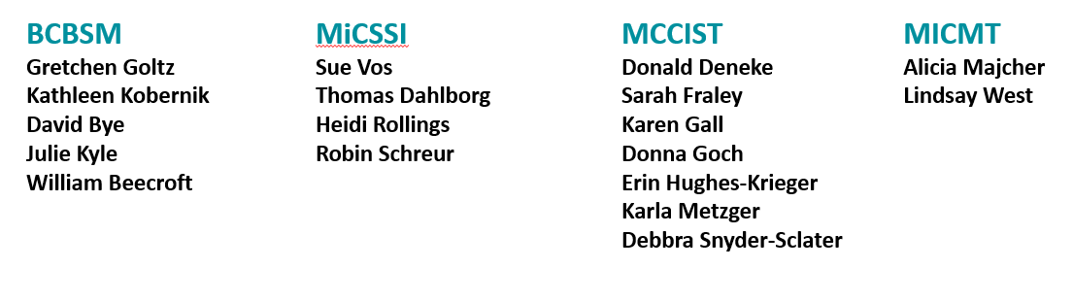
The Curriculum Was Developed in Partnership With:

Slide 10
Presenters
Sarah Fraley, LMSW | Training and Implementation Specialist Lead, MCCIST
Karen Gall, LMSW | Training and Implementation Specialist, MCCIST
Donna Goch, LPC, CAADC | Training and Implementation Specialist, MCCIST
Erin Hughes-Krieger, LMSW | Training and Implementation Specialist, MCCIST
Dayna Leplatte-Ogini, MD | Clinical Assistant Professor, Michigan Medicine Department of Psychiatry
Karla Metzger, LMSW | Program Director, MCCIST
Heidi Rollings, MD | Program Director, Pine Rest Christian Mental Health Services; Assistant Clinical Professor of Psychiatry, Michigan State University
Robin Schreur, RN, BS, CCM | CoCM Trainer, Mi-CCSI
Debbra Snyder, LLP | Project Manager, MCCIST
Sue Vos, RN, BS, CCM | Director of Programs, Mi-CCSI

Slide 11
Virtual Etiquette
Provide feedback
Be an active participant by asking questions and responding to questions through the chat feature and responding to polls
Video and Audio:
Unless distracting, please turn video ON. This is crucial for building trust and engagement.
Test your video and audio before the meeting begins.
Try to look at the camera when talking (to mimic the feeling of in-person eye contact).
Adjust your camera if it is too high or low.
Closed captioning is activated but individual users may deactivate this feature if they prefer by selecting “Hide Subtitle” under the “CC Live Transcript” tab.
Environment:
Be aware of your backgrounds to not be distracting.
Position yourself in the light.
Find a quiet place to join or mute yourself as necessary.

Slide 12
Navigating Zoom
2. You’ll be able to connect via Phone or Computer Audio once connected.
1. Follow the Zoom link shared in the meeting details. You will be prompted to open Zoom.
To share your screen or record the meeting requires permission from the host
Start/Stop sharing your video feed
Mute/Unmute yourself during the meeting
View who else is in the meeting
Send messages to the group or a specific participant
React with a “thumbs up” or “applause”

Slide 13

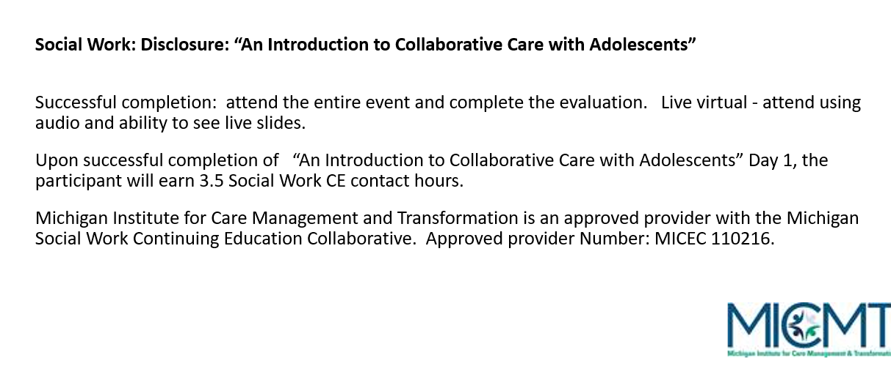

Slide 14

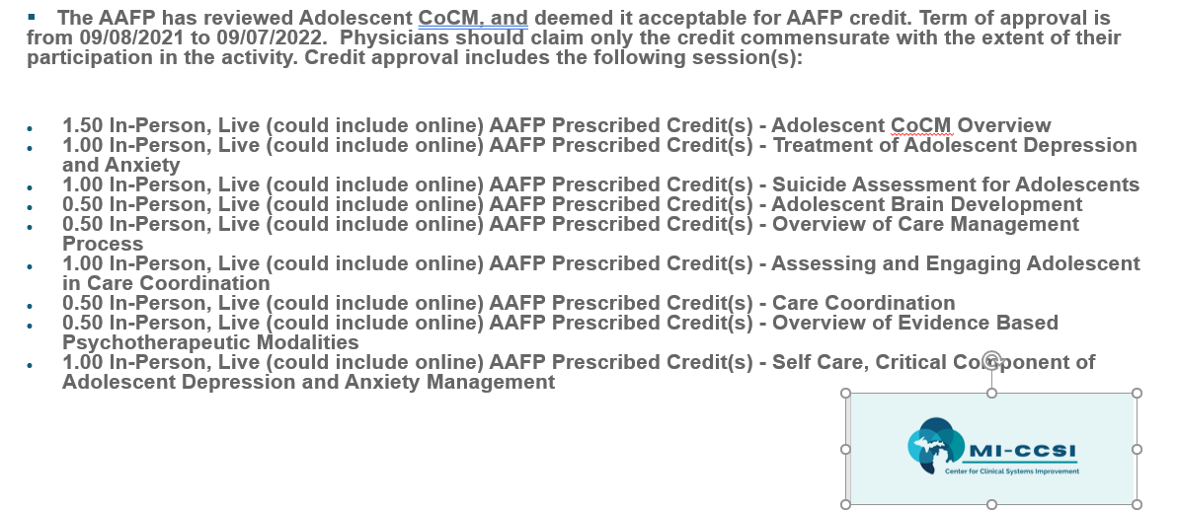

Slide 15


Disclosure
The Michigan Center for Clinical Systems Improvement (MiCCSI), Michigan Institute for Care Management and Transformation (MICMT), and Michigan Collaborative Care Implementation Support Team (MCCIST) have been contracted by Blue Cross Blue Shield of Michigan for this project.
This presentation is being recorded

Slide 16
Poll – Who’s here with us today?
Your role in your organization

