Slide 1

Assessing and Engaging Adolescents

Slide 2
Objectives
Participants will understand the implications of the adolescent development process for effective engagement
Participants will understand the unique considerations required when working with adolescents and their caregivers through the CoCM process

Slide 3
Session Introduction
Working with adolescent patients and their caregivers requires:
An awareness of adolescent development
Sensitivity to the complexity of caregiver/adolescent interactions
Respect for the adolescent as an expert in their own experience and the caregivers as the expert on being the caregiver
This session will focus on how the developmental process impacts the engagement and assessment of adolescent patients in addressing mental health concerns in CoCM

Slide 4

BHCM Starting Point

Slide 5

Notes:
Who has experience working with adolescents?
On a scale of 1-10 what is your confidence in working with Adolescents?
If given the opportunity, who would go back in time and be a teenager again?

Slide 6
BHCM Awareness
Being aware of your own starting point helps you identify possible triggers and be prepared to manage reactions
When we can empathize with the adolescents that we’re working with, it’s easier to extend compassion and understanding

Slide 7
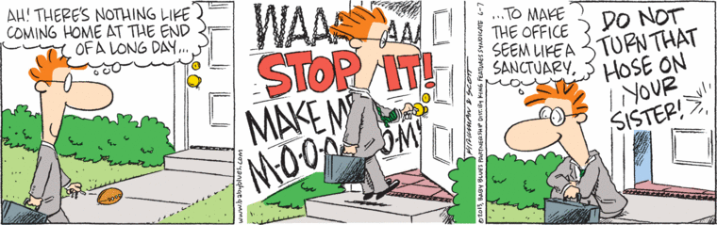

Parent/Caregiver Starting Point:
Often worried and/or tired
Often fear judgement
Often aren’t aware of developmental processes
Have competing demands/priorities
Feel their perspective is more valuable
Carry generational/cultural “shoulds”

Slide 8
Parent/Guardian Engagement
Take the time to listen to their experience and validate their feelings
Work toward understanding the family context and challenges
Arrange meaningful responses to any basic needs a family presents which often take priority over mental health
Remove barriers to participation/communication
Establish communication pathways that work for the family
Explain the CoCM program as a response to their concerns
Notes:
Privacy: this is important here too. Parents often share feelings about their teen that can be damaging to the relationship so they need a safe and private place to share their feelings/thoughts too

Slide 9

Adolescent Developmental Highlights
They are trying to function while entirely under bio psycho-social renovation
The prefrontal cortex is undergoing a growth surge
The limbic system is extremely active and in control
They are seeking independence
Notes:
The prefrontal cortex is undergoing a growth surge
The ability to engage in complex problem solving, thinking through the consequences of actions, etc. is EMERGING.
They need opportunities to practice (try, fail, reflect, try again / soft ground)
The limbic system is extremely active
Emotions are variable, the result of a bio physiological process and may not be understood by teens and bystanders alike
This is the reward center of the brain so it’s seeking positive feelings
They are seeking independence
Looking outside of their “family” unit
They need boundaries and choices

Slide 10

Motivational Interviewing
Special Considerations for use with Adolescent Patients
This Photo by Unknown Author is licensed under CC BY

Slide 11
MI with Adolescents
Particularly relevant to the developmental process of adolescence and emerging adulthood
Resistance is consistent with normal development in this age group – roll with it
Fosters the curious, genuine respect for the adolescent experience needed

Slide 12
Practice : Batter Up
Breakout rooms
The facilitator will “pitch” a statement typical of an adolescent
The group members (“batters”) will go round, using MI to reflect the statement
“Batters” take note of how you feel as you reflect – what was your initial feeling or response to the ”pitch”
Notes:
Awareness of initial emotional response to the pitch offers some insight into what you are bringing to the game – important for identifying how to manage your responses)

Slide 13

What did you notice in your practice rounds?
Let’s watch an example…

Slide 14

Here’s what it can look like…
Click Here

Slide 15
Collaborative Care Process with Adolescents
Process overview and adaptations

Slide 16
SCREENING
Screening is different with adolescents because we need to elicit information from both the caregiver and the adolescent
Giving opportunity for the adolescent patient and their parent/primary caregiver to respond independently of one another is ideal
The workflow of the practice you’re functioning in will need to be reviewed to ensure this process can occur routinely
The BHCM may screen further once referred as initial responses can change
Notes:
As we saw in the video…

Slide 17
REFERRAL TO CoCM
  Inform the parent/caregiver AND the adolescent about the program and give opportunity to ask questions (see handout)
  Early Intervention is important to prevent symptom amplification
  Normalize the need for intervention and destigmatize
  Address medication possibility early to reduce resistance later
  Consent needs to be obtained from someone legally able to do so
Notes:
Inform: they both need the information for consideration
Early Intervention: (adolescence never made anything better)
Normalize: (you’re not crazy; there’s nothing “wrong” with you)
Address: (“We consult with PC but that does not mean that medication will be required or even suggested”).

Slide 18
CoCM ASSESSMENT
Infused with Motivational Interviewing throughout
Developmental awareness is critical
Engagement of both the adolescent and the parent/caregiver is critical in this process
*** remember their starting points***
Notes:
Developmental awareness: - reflect and validate the feelings first (mid brain is in charge) and lead them toward reflection and their thoughts on the matter at hand
Engagement – what did we learn from Miguel and his mom?
Eye contact
Open body language
Use their names (not “kiddo” not “mom”)
Reflect their content (MI/active listening)
Summary statements can lead but can’t jump the tracks to your own goals)
(everything about you needs to be open and encouraging – including your mindset- they can see that too)

Slide 19
Assessment: Give Adolescents S.P.A.C.E.
S: Straightforward
P: Peer/Respect
A: Authentic
C: Curious
E: Even/Neutral
Notes:
Weave in some discussion here – present and then ask – “So what would that look like? Give an example of something you’d say or do that would communicate SPACE principals.”
S: Straightforward – be open and honest with them
P: Peer – treat them like a peer with respect for the validity of their experience and viewpoint
A: Authentic - be yourself – kids have remarkable radar for disingenuous presentations, if you don’t know something or don’t understand a reference, ask them.
C: Curiosity- if you convey genuine curiosity and talk to them like an equal it goes a long way
E: Even – keep your responses even and neutral. often kids will pitch
something to see how you handle it, the real stuff comes after they have assessed your response. Teens are accustomed to adults reacting to them vs. listening to them

Slide 20
Assessment:
Explain the Process and Rationale
Give them the steps from screening through termination
Explain the roles of the BHCM, the PC and the PCP in this process
Explain that this approach has been effective for adolescents and adults alike

Slide 21
Assessment: Sources and Set Up
  Sources of Information:
    Solicit parent/caregiver input, and in some cases teacher or other’s responses, in addition to adolescent’s responses
  Setting up the expectations:
    Patient and caregiver interviewed separately and together if that is comfortable for the patient
    Be upfront and specific in explaining confidentiality guidelines
Notes:
Double back to slide 18 and revisit BEN scenario: 15 y/o male, grades dropping, isolating, up late on social media, mom says there’s a problem and brought him in – then discuss some scenarios on how that could go down (refuse to talk – dump it all – maybe a confidentiality issue scenario)

Slide 22
A note on confidentiality
Be honest
Be specific
  Explain minor consent laws and how they apply to CoCM services
  Explain your confidentiality policy - what you will share, what you won’t, when sharing happens and how
  Explain the 21st Century Cures Act’s mandated access to patient medical notes electronically and how that impacts minor access and parental access for your practice
  Explain the nature of insurance billing and how that can sometimes betray service provision inadvertently

Slide 23
ASSESSMENT: Tools
Additional assessment tool consideration:
  Columbia (suicide)
    Control-click for Columbia Suicide Risk Assessment
  CRAFT (substance abuse)
    Control-Click for CRAFFT
  ACES measures (adverse child experiences)
    Control-click for ACES screening tools
  Y-PSC 17 (behavioral health symptoms)
    Control-click for Y-PSC 17
    Control-click for the PSC-17
  RAPPS, GAPPS, etc. (complete health)
    Control-click for RAPPS $
    Control-click for GAPS $
CoCM required:
  PHQ-9M/PHQ-A 12+
    Control-click for PHQ9M
CoCM recommended:
  GAD-7 12+*
    Control-click for GAD-7
    * Source

Slide 24


GOAL SETTING
  Step 1: Define the team
  Adolescent, Caregiver, BHCM, PCP, PC, others as appropriate
  Stress the need to work together and be open to each other’s feedback and ideas
ALL EXPERTS
Notes:
Pt. is the expert on him/her/them self
Parent/Caregiver is the expert on being Pt. caregiver
BHCM is expert on development, intervention and process
TOGETHER they create an expert team who will work together to meet goals

Slide 25

GOAL SETTING
  Step 2: Clarify Expectations
  Developmentally appropriate and respectful
  Changes are required from everyone
  There may need to be parallel goals (goals for the adolescent and the parent)
  Self-Management plans are unique to their family
Notes:
Reminding parents of the adolescent developmental process and normalizing it helps identify and address parental beliefs about motivation for adolescent behavior and opens the door for expectation discussion and adjustment
Family “Puzzle” Analogy : if one piece changes then it has to either change back or the other pieces have to change to allow it to fit again
There may need to be parallel goals (goals for the teen and the parent) and the connections between them need to be illustrated and understood.
Encourage the family to consider creative ways to meet these goals (i.e. picture or music journal vs. a written one; apps for tracking goals vs. Pt, report in summary at check-ins, etc)

Slide 26

GOAL SETTING
Step 3: Be S.M.A.R.T.
  S: Specific
  M: Measurable
  A: Attainable (no all or nothings here)
  R: Realistic
  T: Time bound
Notes:
TIME BOUND: easy build in is (easy one is the re-eval date 6-8 weeks out)
This is especially helpful for parents in operationalizing and adjusting their expectations: We can’t cure adolescence. Also helps parents and teens see the change over time since they don’t always feel the changes.

Slide 27
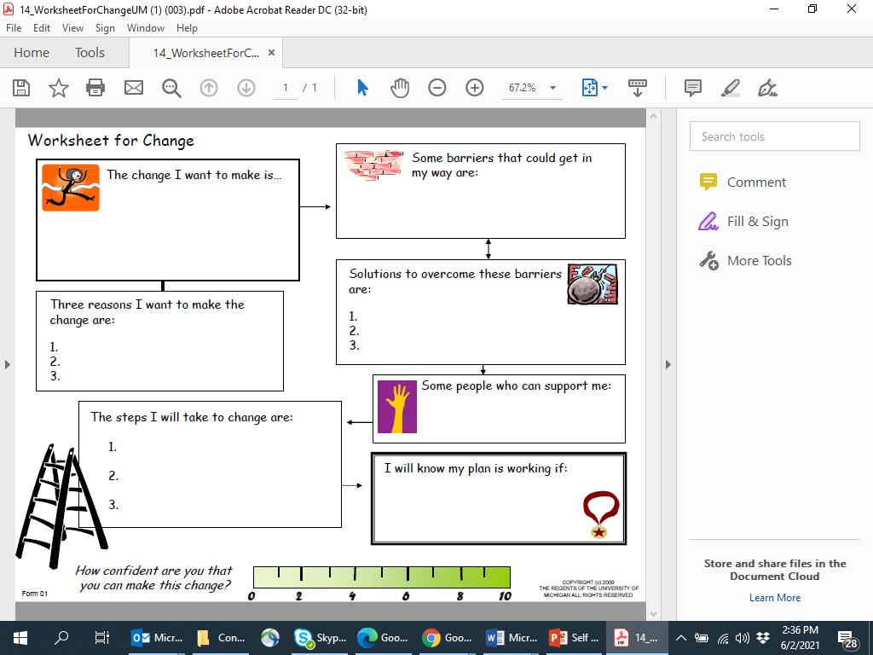
Self Management Plan
Notes:
Review already covered --The Self Management plan is a great tool key component in working with youth in CoCM to aid in empowering and supporting the teen to create a realistic goal and set them up for success. Helping them in identification of potential barriers, supports and assisting them to validate when their plan is working. Finally the ruler is an additional tool to rate their level of confidence or motivation in carrying this plan out.

Slide 28

Ben is a 15 year-old male whose parents presented concerns to his PCP re: Ben struggling in school, decreased concentration, incomplete school-work, and falling grades. He reportedly isolates in his room and has lost interest in previously enjoyed activities. Ben is up late on social media and struggles to get up in the morning for school. Mom reports he is irritable and sometimes short with others. Ben says he is just fine and wants to be left alone.
Remember Ben?

Slide 29
Special Considerations

Slide 30
Scheduling
Availability
  Typically, afternoons and evenings
  Ask them when is the best time for them
  Help them calendar in their phone and set reminders
Accessibility
  Have your number identified in their phone, suggest ringtone
  Ask them what the best way to reach/share information with them is
  Establish how follow up sessions are going to happen
  Establish how follow up measures are going to be provided and returned
Notes:
Availability
Most teens ARE NOT available early
Most teens have school commitments during the day
Primarily afternoon and evening availability
Ask them when is the best time for them
Help them calendar in their phone and set reminders possibly
Accessibility
Before they leave ensure that your number is identified in their phone, maybe have them assign a ring tone to your number, etc. - help them make the connection
Best way to reach them/share information with them (text, email, phone, portal, etc.) – what are the restrictions embedded in your practice group
How are follow up sessions going to happen? Phone, zoom, in person
How are follow up screens going to be applied? Give them hardcopy ahead of time, online – have them show you hoe to access it, via app, via phone etc.
Any plan or forms they are given – have them take a picture of them so they have electronic copy
STILL USING MI AS A PART OF THIS PROCESS TOO!!!!
SLEEP Graphic – tired not disrespectful

Slide 31
Medication Adherence
Setting it up for success
  Destigmatize/Normalize
  Educate
    What can they expect?
  Plan
    Who keeps, gives, picks up, pays for, and reminds; and how are missed doses handled, reacted to and recovered from?
Following it up
  Be specific (RE: Medication - what time of day, how do you remember, what do you do when you forget, how many days taken a week, when was the last time you took it? etc.)
Developmental reminders
  Independence
  Self efficacy
  Hesitant to discuss concerns/questions/resistance
Notes:
Things to remember
Independence
Self efficacy
Hesitant to discuss concerns/questions/resistance
Setting it up for success
Destigmatize/Normalize
Infected wound analogy
Asthma graphic/language
Educate
What can they expect
Plan – who keeps the meds, who gives the meds, whose going to pick it up from pharmacy and keep up with refills, how will you remember to take it, what happens if you miss a day (rxn, double up, wait until next dose, take when you remember, etc) , etc), parent rxn to missing a day/dose.
Keeping it going
When are you taking your medication (what time of day, how do you remember, what do you do when you forget?, how many days, when was the last time you took it)
Include Smarphrases
Video example??

Slide 32
The Role of the Schools in CoCM
  Get consent to communicate with school counselors and social workers as needed
  Schools sometimes have support resources that can support goals set in CoCM
  Coaching the parents to bridge and coordinate with school service providers
  IEPs and 504 plan education and advocacy can be provided as needed to support behavioral intervention plans and/or goals
    Control-click for 504 Plan information
    Control-click for IEP information
    Control-click for information on requesting an IEP/504

Slide 33

Other Players
Talk to the patient and the family about community resources that are willing to involve or that you need to involve:
  Courts/Probation Officers
  Community Based Therapists
  Coaches
  Ministers
  Protective Services
All will require additional, specific consent to release/share information.

Slide 34
TAKE AWAYS
CoCM is evidence based and easily adapts to an adolescent population.
Each stage of the CoCM process requires some special considerations when working with adolescents and caregivers
Motivational Interviewing is a critical part of the model applicable to adolescents and their parents.
Give kids S.P.A.C.E.
Be ready to be flexible and responsive with adolescents and parents.

Slide 35
QUESTIONS?

Slide 36
Additional Resources
Naar-King, S., and Suarez, Mariann. (2013). Motivational Interviewing with Adolescents and Young Adults . The Guilford Press.

