Slide 1
Behavioral Health Collaborative Care Model (CoCM) PGIP Initiatives and Opportunities.
Kathleen Kobernik, RPCV
Value Partnerships
Blue Cross Blue Shield of Michigan
June 8, 2021

Slide 2
Etiquette
You have not been muted on entry, so please mute your phones!
When asking questions:
  Send questions in the chat feature
  Our team will moderate the session
When speaking:
  Please minimize background noise
  Use either phone or computer audio, but not both
The session is being recorded

Slide 3
Agenda and Objectives
Review the collaborative care model (CoCM)
Review rewards/incentives available to PGIP POs and practices implementing the model
Review the expectations of POs and practices

Slide 4



Disclosure
The Michigan Center for Clinical Systems Improvement (MiCCSI), Michigan Institute for Care Management and Transformation (MICMT), and Michigan Collaborative Care Implementation Support Team (MCCIST) have been contracted by Blue Cross Blue Shield of Michigan for this project.

Slide 5
Overview of the Collaborative Care Model (CoCM)
Notes:
First we’re going to review the model to set the stage for our discussion. Some of you may have already heard this presentation in another webinar yet we find it important to continue to set the foundation and build upon this as we discuss particular aspects of implementation. Each one of us delivers this section a little differently so you may more elaboration in some areas depending on the presenter.

Slide 6
CoCM: An Overview
Most evidence-based integrated behavioral health model
  80+ randomized controlled trials prove Collaborative Care provides significantly better behavioral health outcomes than “usual care”
  2002: First big trial was published (IMPACT study out of the University of Washington)
Primary care-based: Meets behavioral health need in patient’s medical home
Patient improvements compare to those achieved in specialty care for mild-moderate conditions
Notes:
Collaborative Care originated in a research culture and has now been tested in more that 80 randomized controlled trials in the US and abroad. Research results make it clear that collaborative care consistently improves on care as usual. It leads to better pt outcomes, better pt and provider saftisfaction, improved pt functioning
Meeting BH needs in the pts medical home. We know that BH problems such as depression and anxiety are among the most disabling conditions worldwide and that these conditions are often identified in a primary care environment. About 1 in 5 Michigan adults have mental health issues in a given year. We also know that there’s still a fair amount of stigma attached to seeking BH care, therapy and psychiatry. Being able to receive treatment in the “doctor’s office “ reduces the stigma” and makes mental health care a part of medical care.
Another advantage of BH in the Pt’s medical home is addressing Gaps in service: low income adults with mild to moderated BH health conditions are often not ill enough to be treated within the public mental health system, yet there are financial barriers to accessing specialty level BH services.
Patient improvements compare to those achieved in specialty care for mild to moderate conditions. One of the great advantages of BHCM is the identification of depression and anxiety, the monitoring and the FU. We know that often patients don’t feel their symptoms are “bad enough” to seek specialist care. And if they decide to seek tx, they need to find someone and consider the cost. We also know that often people don’t follow through with a therapy referral and even when they attend the first appt, they often don’t return.
Research has also shown up to $6 can be saved in long term health costs for patients for every dollar spent on collaborative care, a return on investment of 6:1.

Slide 7
Target population
Highly evidence-based for adults with depression and anxiety
  Depression and/or anxiety population served by primary care
  Increasing evidence for adolescent depression, PTSD, and co-morbid medical conditions
  More complex patients should be served in high-need clinics
Defining the target population:
  PHQ-9 and/or GAD-7 of 10 or more
  Diagnosis of depression and/or anxiety
  Just started on a new antidepressant, regimen was changed, or PCP could use prescribing guidance

Slide 8
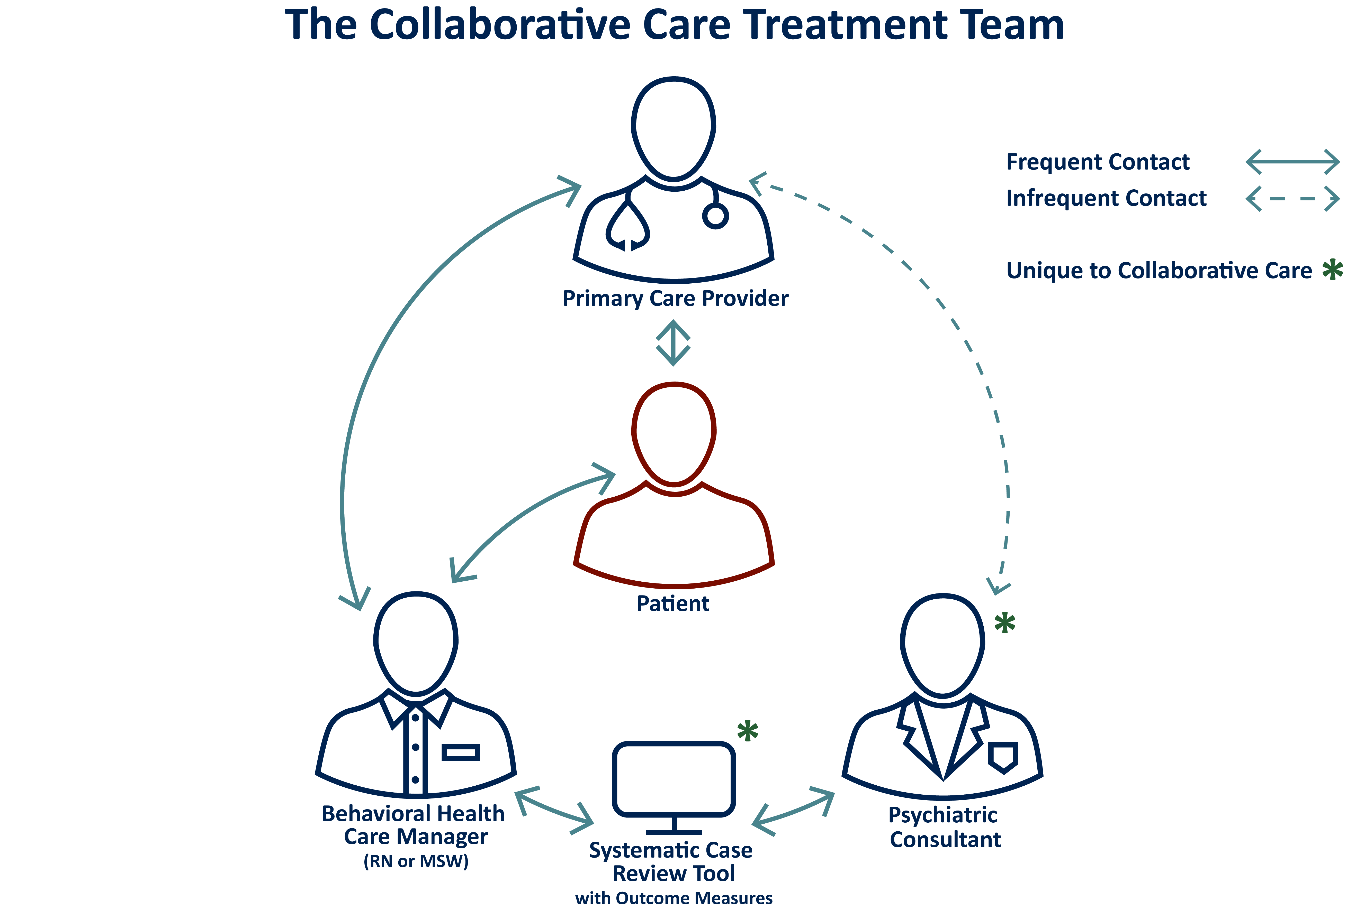
The Collaborative Care team
                Operates through a patient-centered care team that shares a registry
                Team includes a PCP, behavioral health care manager (BHCM), and a consulting/advising psychiatrist
                The psychiatrist and care manager meet weekly – typically by phone – for 1-2 hours to review the BHCM’s caseload of 60-80 patients with behavioral health issues identified through screening in the primary care office
The PCP office bills the Collaborative Care codes and reimburses the psychiatrist; the psychiatrist does not bill the insurer for his/her time
The psychiatrist’s role is to advise the PCP and BHCM
The psychiatrist rarely sees the patient; if they do, they will bill according to the member’s behavioral health benefits
Notes:
In usual primary care, the treatment team has two members:
The primary care provider
The patient
Collaborative Care adds two additional vital roles:
A care manager (typically embedded) and
A psychiatric consultant (typically engaged by phone or video link).

Slide 9
Components of the Evidence-Based Model
Patient Centered Care
  Effective collaboration between BHCMs and PCPs, incorporating patient goals into the treatment plan
Measurement-Based Treatment to Target
  Measurable treatment goals and outcomes defined and tracked for each patient (PHQ-9/GAD-7)
  Treatments are actively changed until the clinical goals are achieved
Population-Based Care
  Defined and tracked patient population to ensure no one falls through the cracks
Evidence-Based Care
  Treatments are based on evidence
Accountable Care
  Providers are accountable and reimbursed for quality of care and clinical outcomes

Slide 10
Summary: What sets CoCM apart?
Population health approach
  Use of a systematic case review tool to ensure no one falls through the cracks
  Proactive, tailored outreach, allowing for monitoring and updates in-between PCP visits
  Treatments are adjusted until patients achieve remission or maximum improvement
  Data evaluates key process measures and patient outcomes
Maximizes access to limited psychiatry time
  Multiple patients reviewed per hour as opposed to one patient
  Helps reserve specialty psychiatry time for higher level cases
Typically, a short wait time from referral to receiving an expert psychiatric recommendation (often within one week)
Notes:
CoCM allows patients to receive expert medication recommendations and adjustments from a psychiatric consultant they may other wise not have access too. There is a shortage of psychiatrists, long wait times and insurance barriers
While the psychiatrist shortage is nationwide, the situation in Michigan is even more acute. The state had 1,180 active psychiatrists in 2018, or 11.84 practitioners per 100,000 residents, which is below the national average..
We know this can be more frustrating in rural regions as Two-thirds of Michigan psychiatrists are based in the Ann Arbor-Detroit region.
http://connect.mlive.com/staff/jmack/posts.html
2020
University of Michigan Behavioral Health Workforce Research Center. Estimating the Distribution of the U.S. Psychiatric Subspecialist Workforce. Ann Arbor, MI: UMSPH; 2018.

Slide 11
How Is Blue Cross supporting CoCM?
1
PGIP reward to POs
PGIP rewards to PCP practices
PGIP value-based reimbursement to PCPs
Blue Care Network (BHIP) rewards to psychiatrists participating in CoCM
PGIP support for CoCM training and ongoing practice support
2
3
4
5

Slide 12


PGIP Rewards to Physician Organizations
POs Play a Vital Role in CoCM
1
Year
Year
PO incentives in first year:
Base reward: $50,000
Data/Tech reward: $10,000
Per practice reward: $4,000 per practice
PO incentives in second year:
Base reward: $25,000 **
Data/Tech reward: $10,000
Per practice reward: $4,000 per new practice
** New reward: Based on PO feedback

Slide 13
PGIP rewards to PCP practices
2
New practices
$1,000 base reward
Variable rewards based on training participation.
Fidelity practices
$2,500 reward per practice deemed to be using the model with fidelity
Variable rewards based on training participation.

Slide 14

CoCM Value-Based Reimbursement opportunities
3
105% VBR to PCMH-designated practices who deliver CoCM and meet VBR criteria.
  Available in addition to any other VBR the PCP is receiving
CoCM cohorts will follow PCP VBR cycles beginning Sept. 1, 2021

Slide 15

What are the changes to CoCM PCP VBR?
3
Effective Sept.1, changes to the following will be implemented:
Eligibility
Criteria
Timeline

Slide 16

What are the changes to CoCM VBR?
Updated eligibility criteria
3
For the 9/1/2021 through 8/31/2022 cycle, VBR will be available to practices who meet the following by 8/31/2021:
Completed readiness assessments with their training partner and are found to be ready for training and implementation.
Completed all required pre-work identified by the training partner.
Scheduled to participate in the upcoming training offered by the training partner.
If a practice either doesn’t go through training, or doesn’t implement, VBR will be discontinued.

Slide 17

What are the changes to CoCM VBR?
Setting a progressive path to yield results
3
Focus by year
  Year 1 – Implementation/Training
  Year 2 – Developing billing capabilities
  Year 3 – Advanced billing/shifting focus to outcomes
  Year 4 – Outcomes
Regardless of when a practice begins training and implementation, criteria progresses in years one through four.
This means that:
Cohorts will overlap and have different VBR requirements during the same time period.
Performance expectations are higher as a cohort gains knowledge, experience, and matures in CoCM delivery.
See the Behavioral Health initiative page of the PGIP Collaboration Site for full details.

Slide 18
What are the changes to CoCM VBR?
Year 1 – Implementation and training
3
Criteria by year
Year 1 Implementation/ Training | Training partner confirms the following and reports to Blue Cross: • Readiness assessments complete and practice found to be ready for training and implementation • Practice has completed all required prework identified by the training partner • Practice is scheduled to participate in a training offered by the training partner

Slide 19
What are the changes to CoCM VBR?
Year 2 – Developing billing capabilities
3
Criteria by year
Year 2 Developing billing capabilities | Practices must bill: • Ten paid CoCM claims. Must be a combination of initial and subsequent month services which include 99492, 99493 or G2214. 99494 is not included, as it is an add-on code.

Slide 20
What are the changes to CoCM VBR?
Year 3 – Advanced billing and shifting focus to outcomes
3
Criteria by year
Year 3 Advanced billing/shifting focus to outcomes | Practices must bill: • 48 paid CoCM claims. Must be a combination of initial and subsequent month services which include 99492, 99493 or G2214. 99494 is not included, as it is an add-on code. Must demonstrate ability to track outcomes.

Slide 21
What are the changes to CoCM VBR?
Year 4 – Outcomes
3
Criteria by year
Year 4 Outcomes | Must meet billing requirements and 50% of those patients must meet one of the outcomes requirements Billing • Bill 60 paid CoCM claims. Must be a combination of initial and subsequent month services which include 99492, 99493 or G2214. 99494 is not included, as it is an add-on code. Outcomes • 5-point improvement in PHQ-9 and/or GAD-7 OR • 50% improvement in PHQ-9 and/or GAD-7 OR • PHQ-9 and/or GAD-7 less than 5 points

Slide 22
What are the changes to CoCM VBR?
Which cohort is my practice in?
3
We have revised the Cohorts to align with the VBR cycle. This means that ramp-up and training activities generally starting between 9/1 of one year and 8/31 of the next year are in the same cohort. Cohort 1 started with an off-cycle VBR, so the dates are:
Cohort 1 – Began training and implementation before 10/16/2020.
  Year 1 VBR: 12/1/2020 through 8/31/2021. (This cohort had an off-cycle VBR period).
Cohort 2 – Any practice that begins training and implementation between 10/17/2020 and 8/31/2021. (Start date impacted by previous off-cycle VBR period).
  Year 1 VBR: 9/1/2021 through 8/31/2022
Cohort 3 – Any practice that begins training and implementation 9/1/2022 through 8/31/2023
  Year 1 VBR: 9/1/2022 through 8/31/2023
Cohort 4 – Any practice that begins training and implementation 9/1/2023 through 8/31/2024
  Year 1 VBR: 9/1/2023 through 8/31/2024

Slide 23
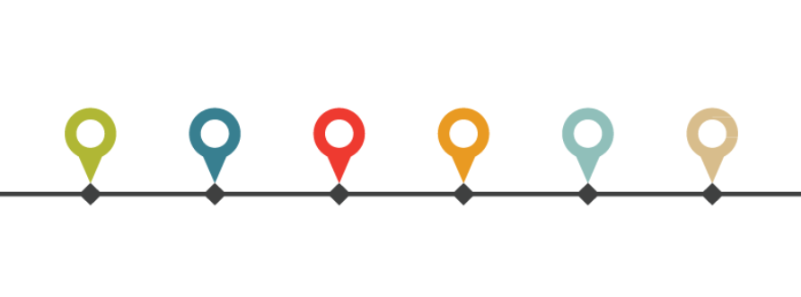
What are the changes to CoCM VBR?
Timeline description
3
Measurement periods run 12 months, then allows an additional three months for claim run out. Blue Cross then requires three months to process performance on measurements and to setup the next VBR cycle.
These three months of Blue Cross processing time overlap with a new measurement period, ensuring that the practices will have continuous measurement periods with no gap between them.
Notes:
Please note that the amount of time a practice has in a measurement period varies based on when a practice begins ramp-up and training activities.
Examples:
A practice that begins ramp-up and training in February 2021 will have six months of ramp-up time before Year 2 criteria requirements start
A practice that begins ramp-up and training in May 2021 will have four month of ramp-up time before Year 2 criteria requirements begin
A practice that begins in August 2021 will need to start Year 2 criteria requirements right away.

Slide 24
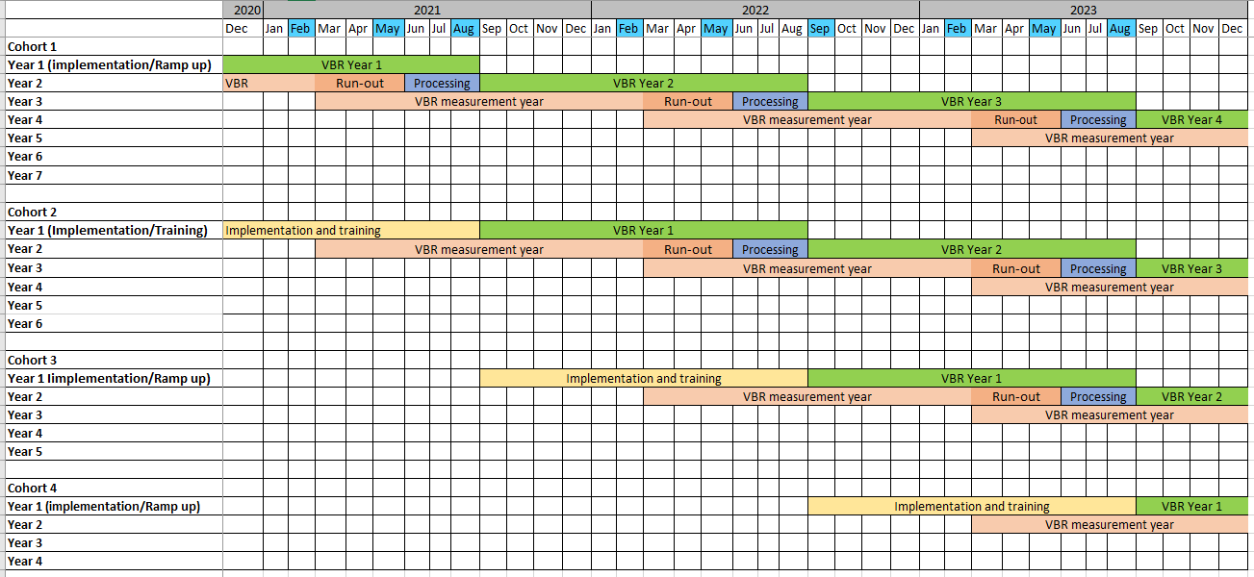
What are the changes to CoCM VBR?
VBR timeline
3

Slide 25

Rewards to Psychiatrists
Blue Care Network’s Behavioral Health Incentive Program
4
Blue Care Network will be providing a reward of $2,500 to BCN-contracted consulting psychiatrists.
Psychiatrists can receive multiple rewards if they consult with multiple practices, however we will reward no more than one psychiatrist for each practice.
POs should provide name and NPI of psychiatrists who have been supporting the CoCM model for at least 60 days
POs should indicate the names of the practices that are supported by the psychiatrist.
We will collect psychiatrist information in July and November.
This reward will be distributed to the psychiatrist’s remittance address.

Slide 26


Partners provide support for CoCM training and implementation
Who is involved and what do they do?
5
Michigan Institute for Care Management and Training (MICMT):
  Support training development
  Ensure training and program is aligned with other care management programs
  Help administer through hosting content on their website, conducting surveys, etc.
Michigan Center for Clinical Systems Improvement (Mi-CCSI)
  Training partner
Michigan Collaborative Care Implementation Support Team (MCCIST)
  Training partner
Collaborating on curriculum, content, training development and support activities. Each training partner is working with assigned POs to provide the following to their practices:
  Clinical training
  Technical assistance
  Tailored approaches to successfully implement and sustain CoCM services

Slide 27
Upcoming opportunities – Introductory PO Webinar Series
5
This webinar series has been developed to give physician organizations an understanding of what CoCM is and
what is needed to support your practices.
PO webinars
CoCM: Data and Technology | June 15, noon-1 p.m.
CoCM: Organizing an Excellent Care Team | June 22, noon-1 p.m.
CoCM: Monitoring and Sustainability | June 29, noon-1 p.m.
Register at: https://micmt-cares.org/collaborative-care-model-cocm

Slide 28
Ongoing learning webinars for practices
5
These webinars have been developed for post-training practices to give them an opportunity to gain more information on a variety of topics.
Here is a sample of webinars that have been available.
Upcoming sessions and registrations are at:
https://micmt-cares.org/collaborative-care-model-going
https://www.miccsi.org/collaborative-care-model-training/
Motivational Interviewing
Behavioral Activation & Problem Solving
Building an Effective Systematic Case Review Process
BHCM Strategies for Running a Systematic Case Review
Patient Identification Process
Time Management and Caseload Tracking
Optimizing CoCM Data for Program Review
Advanced Topics in Psychopharmacology
Substance Use Disorder: Assessment and Brief Interventions
Billing Strategies
PCP Roundtables
Psychiatrist Roundtables

Slide 29
PO Expectations

Slide 30
How to help your practices
Be ready
Learn about CoCM
Complete readiness activities
Develop care team
Consider workflows among practices
Facilitate shared care teams when appropriate
Promote tools and skills
Develop systematic case review tool
Establish workflows for routine and ongoing screening and evaluation
Identify champions
Attend practice site visits
Participate in CoCM training
Help identify or contracting with psychiatrist
Help identify or hiring a BHCM
Sponsor or promote quality improvement activities

Slide 31
Other PO expectations – related to reporting and review
Report | Used for | Frequency | Dates
Practice touch-base results – Excel spreadsheet that verifies that each practice is using CoCM (new requirement) | Ensuring appropriate practices are receiving VBR | Monthly | To training partners on the 15th of each month
Site visits – Two practice site visits with training partners and strongly recommend that practice’s SCR is shadowed at least once by their training partner. | Ensures practices are on track, answer questions or address challenges. To offer planned opportunities for support. | Between 3 and 6 months post training. Between 9 and 12 months post training. | Varies
Psychiatrist reward information – Email NPI and name of consulting psychiatrist along with practices the psychiatrist supports | Calculating and rewarding consulting psychiatrists | Twice yearly | To PGIP via email July 31 and Jan. 31
Outcomes data tracking – Complete Excel template and upload to EDDI (contains PHI) Outcomes tracking template is posted on the PGIP Collaboration site. | Reviewing practice-level progress and reporting program progress | Twice yearly | To PGIP via EDDI July 31 and Nov 30

Slide 32
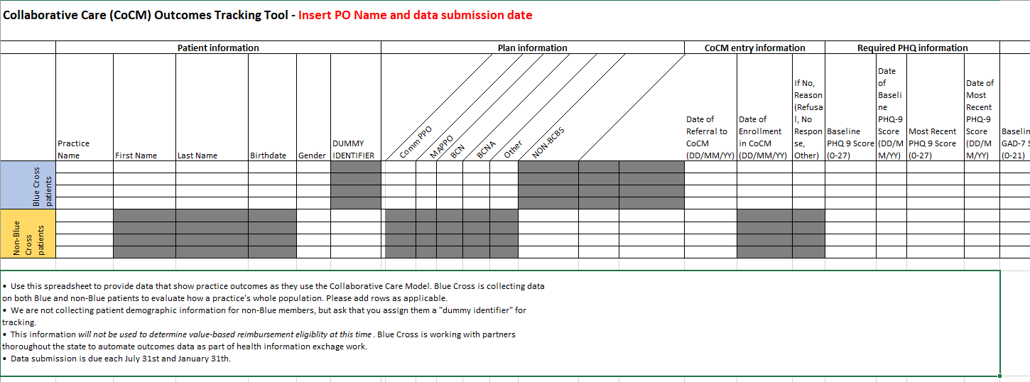
Outcomes data tracking tool
On PGIP Collaboration site
These elements would also be in the SCR tool. To access this template on the PGIP Collaboration site:
Go to the Behavioral Health initiative page of the collaboration site
BCBSM Documentation section on the left side of the screen
Click Outcomes data tracking tool

