Slide 1

Introduction to Palliative Care
Notes:
Dame Cicely Saunders, the founder of the first modern hospice for terminally ill patients, had said that her aim was, “to add life to their days, not days to their lives.”

Slide 2

Welcome!
House Keeping
Notes:
Welcome to the Introduction to Palliative Care Course
Location of bathrooms etc.
Facilitators introduce themselves
Acknowledge the hard work done with the pre-work
We will have breaks

Slide 3
Virtual Etiquette
Meeting participation:
If you’re connecting on your computer, close-down all other apps and browser windows to eliminate notifications
We will be using the raise your hand feature by clicking on the little blue hand
We will be using the chat function
When we are taking breaks be sure not to leave the meeting but rather mute your audio and video
Environment:
Be aware of your backgrounds to not be distracting.
Position yourself in the light.
https://www.gend.co/blog/best-practice-tips-for-using-zoom
Notes:
Key Speaking Points:
Use the chat function or raise your hand as preferred ways to participate
I would avoid multi-tasking during the training session
When breaks are going to take place-- don’t log out of zoom….

Slide 4
Expectations
What do you want to get out of this training?
Notes:
This is an introductory course. The idea is that is be followed up by other educational webinars and resources; list on MICMT

Slide 5
Learning Objectives
Define palliative care
Differentiate palliative care from hospice care
Explain why palliative care is integral to primary care
Describe the domains of palliative care
Discuss social aspects of care
Recognize members of the multidisciplinary care team
Identify palliative care assessment tools that may be used in primary care settings
Notes:
Facilitator notes: Recognize that it is important to understand all of the domains; however, everything cannot be covered in the time allotted.
Note: Video will be on next slide.

Slide 6
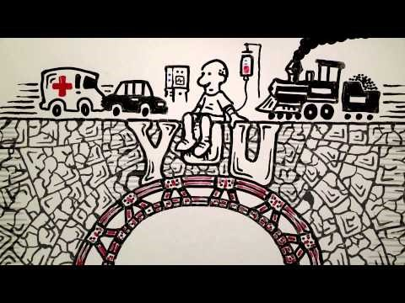
Palliative Care: YOU Are a Bridge
https://www.youtube.com/watch?v=lDHhg76tMHc

Slide 7
Palliative Care and Hospice Care
A Population Health Approach

Slide 8
Definition of Palliative Care
“Palliative care is an approach that improves the quality of life of patients and their families facing the problems associated with life-threatening illness, through the prevention and relief of suffering by means of early identification and impeccable assessment and treatment of pain and other problems, physical, psychosocial and spiritual.”
https://www.who.org/
Notes:
Palliative care is based on the needs of the patient, not on the patient’s prognosis. It is appropriate at any age and at any stage in a serious illness, and it can be provided along with curative treatment."

Slide 9
Comparing Palliative Care and Hospice Care
VS
Palliative Care
Physical and psychosocial relief
Focus on quality of life
Multidisciplinary Team Approach
Any stage of disease
May be concurrent with curative treatment
Hospice Care
Physical and psychosocial relief
Focus on quality of life
Multidisciplinary Team Approach
Prognosis 6 months or less
Excludes curative treatment
https://www.nhpco.org/wp-content/uploads/2019/04/PalliativeCare_VS_Hospice.pdf
Notes:
https://www.vitas.com/hospice-and-palliative-care-basics/about-palliative-care/hospice-vs-palliative-care-whats-the-difference/

Slide 10
Palliative Care is a Primary Care Issue
Notes:
Provides relief from pain and suffering
Enhances quality of life
Offers support system to help the family cope
Uses a team approach to address the needs of patients and their families
Is applicable in the early course of an illness
Lowers costs and extends life

Slide 11
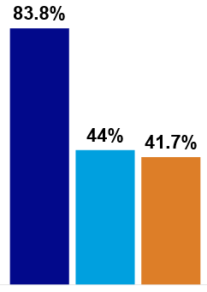
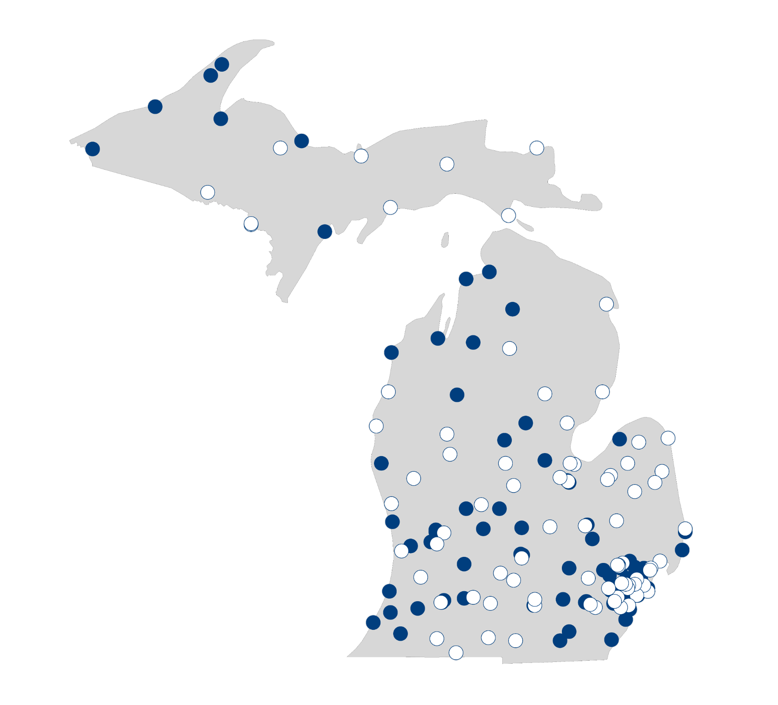
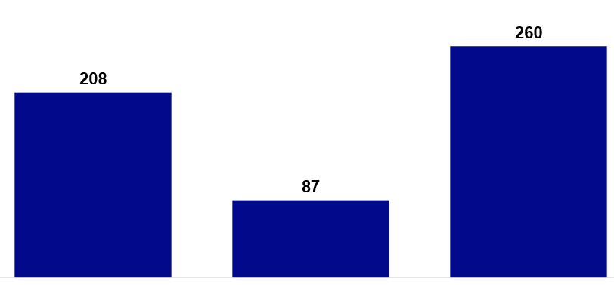
Palliative Care Now and the Future
Hospitals with palliative care programs
Hospitals that do not currently offer palliative care
Percentage of Hospitals with a Palliative Care Program by Geographic Type
3.0 certified prescribing palliative care providers (MD or APRNs) per 100,000 residents
Urban
Suburban
Rural
260
208
87
Certified MD
Certified NP or CNS
Certified RN or Pediatric RN
https://reportcard.capc.org
Notes:
Legislation to Address Gaps
October 28, 2019: Passage of the Palliative Care and Hospice Education and Training Act (H.R. 647), which received overwhelming bipartisan support in the U.S. House of Representatives
Result of years of education by stakeholders in the field, as well as leadership by members of Congress and their staffs
PCHETA would increase the number of permanent faculty in palliative care at accredited medical, nursing, and social work schools, and other programs; promote education and research in palliative care and hospice and support the development of faculty careers in academic palliative medicine
Similar measure is in the U.S. Senate (S.2080), currently being sponsored by Senators Tammy Baldwin (D-WI) and Shelley Moore Capito (R-WV)

Slide 12
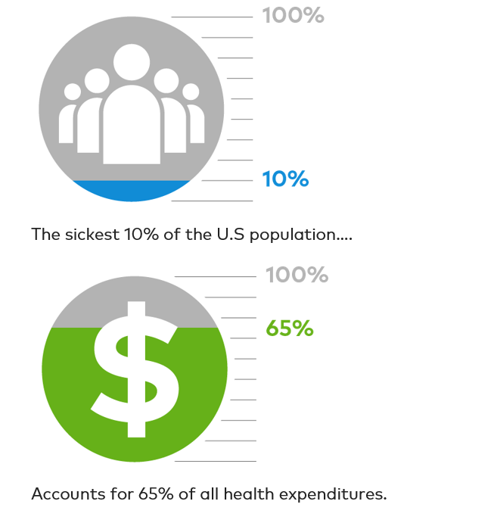
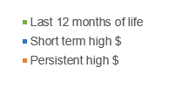
Concentration of spending in high-risk patient populations
Top 5% of Health Care Spending
Patients who live with serious illness and chronic conditions over years are likely to fall under the category of persistent high-cost patients.
When this patient population receives palliative care, quality of life increases, crises are prevented and, as a consequence, medical costs decrease.
The sickest 10% of the U.S. population….
Last 12 months of life
Short term high $
Persistent high $
Accounts for 65% of all health expenditures.

Slide 13

Palliative Care Reduces Avoidable Spending and Utilization in All Settings
48%
Readmissions
28%
Cost/Day
50%
Admissions
35%
ED Visits
43%
Hospital/
ED Transfers
36%
Total Costs
Source Centers to Advance Palliative Care
INPATIENT OUTPATIENT SKILLED NURSING HOME-BASED
Notes:
Palliative care has demonstrated that it can achieve the win-win health care scenario: higher quality care at lower cost. Since palliative care helps ensure that resources are matched to patient and family needs and priorities, it results in substantially lower hospital costs, providing patients, hospitals, the health care system, and clinicians with an effective solution to a growing challenge. By improving care and preventing crises for those at highest risk, palliative care reduces the need for burdensome and costly acute care services.
https://www.capc.org/the-case-for-palliative-care/

Slide 14
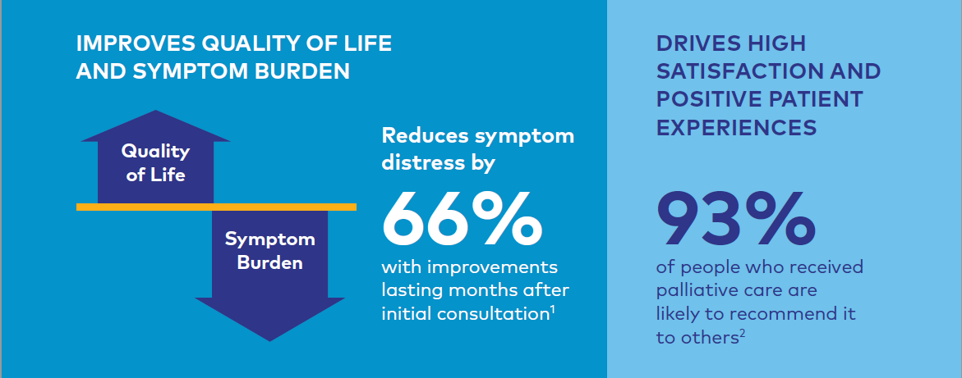
Palliative Care Improves Quality of Life
Center to Advance Palliative Care, 2018 Retrieved from https://www.capc.org/tools-for-making-the-case/downloadable-tools/
Notes:
Note: Video will be on next slide.

Slide 15

Debbie: Regaining a Quality of Life
https://www.youtube.com/watch?v=5M-b1c2spPE

Slide 16
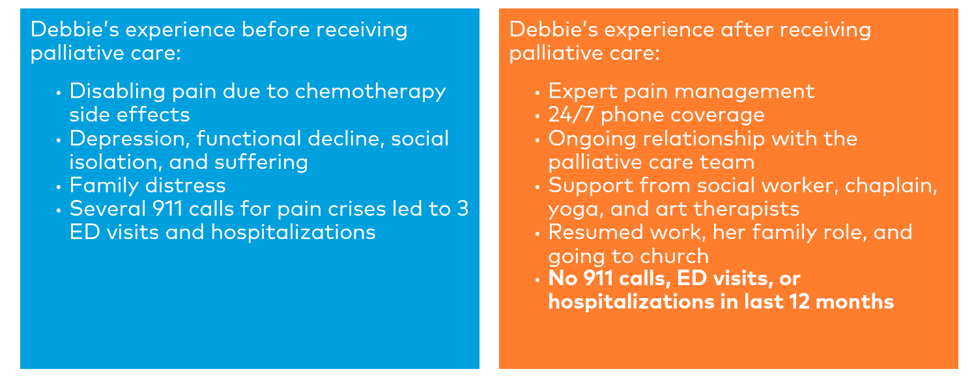
Debbie’s quality of life changed with the addition of palliative care
Notes:
Note: Video will be on next slide.

Slide 17

Break
https://www.youtube.com/watch?v=5M-b1c2spPE
Notes:
Note: Discussion will be on next slide.

Slide 18
Personal Perceptions of Palliative Care
Group Activity
Notes:
What are your perceptions and/or experiences with Palliative Care? What does it mean to you? Add some questions to the prework list so they can think through what it is means to them.
Note: Video will be on next slide.

Slide 19

“We are trained to see disease, we are not trained to see suffering…”
https://www.youtube.com/watch?v=WKSS9E2qy8A
Notes:
Refer to video: What would you think if you heard someone say “She is trying to die on us”. Declaring the relationship between the care team and patient as adversarial.

Slide 20
Domains of Palliative Care

Slide 21
Domains of Palliative Care
Structure and Processes of Care
Physical Aspects of Care
Psychological Aspects of Care
Social Aspects of Care
Spiritual Aspects of Care
Cultural Aspects of Care
Care of Imminently Dying
Ethical & Legal Aspects of Care
Derived from the Clinical Practice Guidelines for Quality Palliative Care, 4th edition
Notes:
Facilitator notes: Focus training on Social Aspects of Care. Spend 2 – 3 minutes TOTAL on other 7 domains by just introducing what the domains are.
More time can be dedicated to this portion of the slides as pre-work.

Slide 22
Structure and Process of Care
Begins with a comprehensive assessment and a care plan that is consistent with a patient’s values and goals
Advance Care Planning: patient and family treatment goals are clearly documented
The primary non-medical needs expressed most frequently include: a need to express emotional pain, a need to explore spiritual pain, and a need for practical financial and legal help.
Notes:
https://www.nursingald.com/articles/5980-the-eight-domains-of-palliative-care-the-framework-for-palliative-care-practice
See list of ACP resources from UPMC brochure and icsi: file:///C:/Users/e133800/AppData/Local/Microsoft/Windows/INetCache/Content.Outlook/KTDRFMFI/advance-care-planning.pdf
file:///C:/Users/e133800/AppData/Local/Microsoft/Windows/INetCache/Content.Outlook/KTDRFMFI/ToolsAndResources_-PalliativeCare_6th-Ed_2020_v2-2.pdf

Slide 23
Physical Aspects of Care
Assessment should focus on relieving symptoms, improving/maintaining quality of life and functional status
Symptoms may include pain, shortness of breath, fatigue, nausea, constipation, etc.
Lack of assessment is the most common cause of unrelieved pain
Care is delivered in a manner that is patient centered as defined by the patient's wishes
Notes:
You can’t focus on other domains if a patient is in pain and suffering
https://www.nursingald.com/articles/5980-the-eight-domains-of-palliative-care-the-framework-for-palliative-care-practice
Ensure that pain, other symptoms and side effects are managed based upon the best available evidence by health professionals with the appropriate technical skills and training. Pain and dyspnea are two of the most frequently experienced symptoms of chronically ill patients. Both of these symptoms are subjective. Self-report is the primary indicator.
Lack of assessment is the most common cause of unrelieved pain. The National Quality Forum’s National Framework and Preferred Practices for Palliative and Hospice Care Quality recommends frequent assessment of symptoms using standardized and validated instruments
There are many tools used to identify and assess symptoms, some of which are listed within the resources section later in this presentation.

Slide 24
Psychological and Psychiatric Aspects of Care
Psychological status needs to be assessed and managed
Watch for signs of family members struggling with psychological issues
Programs and resources should be available to patients and families based on assessed need for services
Process for appropriate referrals:
Directly
Through Consultation
Specialist Referral

Slide 25
Social Aspects of Care
Social assessment should address environmental and social factors, including, but not limited to:
Social support network
Financial barriers
Access to care (e.g. transportation, medications)
Family Meeting: powerful clinical tool for completing the comprehensive assessment and planning process
Warm handoffs and referrals to local/community service providers
Notes:
Regular meetings with the patient and family can anticipate and resolve problems and obstacles to quality care. The ‘social care plan’ that emerges from such a meeting should reflect and document the values, goals and preferences as set by the patient and family, and should be reviewed with periodic additional meetings over time. Interventions are then planned with the goal of minimizing the adverse impact of care-giving on the family and promoting caregiver and family goals and well-being.
Assessment and planning for social aspects of care for patients and families experiencing life-threatening illness requires an interdisciplinary approach, calling upon team members with a variety of knowledge and assessment skills. Planning to meet all of the social needs requires linkages across the community in which the patient and family live.
Family Meetings and community resources

Slide 26
Spiritual, Religious, and Existential Aspects of Care
Spirituality is a multifaceted, multidimensional human experience that includes religious and nonreligious factors
Care Team members must acknowledge their own spirituality
Offer support of spiritual counselor: priest, pastor, chaplain, rabbi, imam, or other religious leader
Faith, Importance, and Influence, Community and Application (FICA) assessment
Cognitive
Experiential
Behavioral
https://clinmedjournals.org/articles/jfmdp/journal-of-family-medicine-and-disease-prevention-jfmdp-3-056.php?jid=jfmdp
Notes:
May be board certified
Trained to assist people of all faiths and beliefs
Source Integration of Spiritual Needs into Patient Care, Basem Abbas Ubaidi, https://clinmedjournals.org/articles/jfmdp/journal-of-family-medicine-and-disease-prevention-jfmdp-3-056.php?jid=jfmdp
Spirituality is a fundamental aspect of palliative care. The cognitive is the mental framework, which consists of meaning, purpose, truth beliefs and values. Experiential is the quality of an individual's inner resources which consists of hope, love, connection, inner peace, comfort, support, the ability to give and receive spiritual love, and the types of relationships. Behavior perspectives are the way a person externally manifests individual spiritual beliefs and their inner spiritual state. The patient may develop spiritual distress when individual's resources are not enough to cope with crisis demand (weak meaning, hope, love, peace, comfort, strength and connection in life).
F: Faith or beliefs–Questions to pose here are: “Do you consider yourself to be a religious or spiritual person?” and “What do you believe in that gives your life meaning?”
I: Importance or influence–“What role do your beliefs play in how you deal with your illness?”
C: Community–“Are you part of a religious or spiritual community?” and “Is this group a support to you?”
A: Address–“How would you like us (members of the healthcare team) to address these issues?”
Note: Discussion on next slide.

Slide 27
Cultural Aspects of Care
Racial and ethnic minorities experience persistent health care disparities
Cultural origins influence the way patients and health care providers think about palliative and end of life care
Respect values, beliefs, and traditions related to health, illness, family caregiver roles and decision making
Incorporate culturally sensitive resources and strategies into the plan of care
Remove barriers to communication by ensuring that linguistic needs are met
Notes:
Discussion topic: Ask participants to think about what the population they serve looks like? What could be barriers for them? Prejudices they may have?
What worked and didn’t work?
Work to uncover the right language and context to describe palliative care for minority patients and ask culturally appropriate questions that can guide the provision of care. For example, health care decision-making by Latino patients is often a matter for the whole family; people of Asian origin may not wish to acknowledge an illness at all, much less discuss their discomfort with someone outside the family; African-Americans may fear that care is being withheld from them and be reluctant to engage in advance care planning.[viii] The range of views and attitudes towards health care may vary substantially between and within racial and ethnic groups, and community partners can help clinicians navigate these nuances.
barriers include deep-seated distrust of the health care system – particularly amongst African Americans who have suffered generations of segregation and discrimination in health care, and been the subject of medical experiments, most notably during the Tuskegee syphilis trials.[v] In some cultures, there is fear that acknowledging an illness will hasten the course of the disease, and for religiously devout patients, many may believe that the experience and outcomes of illness should be left in God’s hands.[vi] People from ethnic minorities also experience poor communication with their doctors, and thus may be less likely to know about palliative care, or to understand that it is appropriate at any stage of disease.

Slide 28
Care of Imminently Dying
Whenever possible, early access to hospice care should be facilitated
Place particular emphasis on days leading up to and just after death of the patient
Ensure patient receives adequate management of pain and other symptoms
Avoid inappropriate prolongation of dying
Address spiritual and cultural needs
Signs and symptoms of impending death are recognized and communicated to patients and families
Provide support and education to the family
Assist in making critical decisions
Relieve possible burdens imposed on loved ones
Develop post-death care and bereavement follow up plan

Slide 29
Ethical and Legal Aspects of Care
Address guardianship and goals of care
Identify the health proxy
Honor patient preferences or those made by legal proxies or surrogate decision makers
Maintain professional boundaries
Remain knowledgeable of organizational policies
Communicate prognosis essential for informed decision making

Slide 30
Identify Members of the Multidisciplinary Care Team

Slide 31
What patients do you think would benefit?
Notes:
Add 30 second live poll to capture audience response and show results prior to moving to next slide.
Note: Discussion will be on next slide.

Slide 32
Who do you think would benefit?
High-risk patients
Socially vulnerable
Exhausted family caregivers
Patients with:
Cognitive impairment
Multiple comorbidities
Frailty
Functional dependency
Palliative care can help with illnesses other than cancer:
Advanced lung, heart, kidney and liver disease
AIDS
Alzheimer’s disease and dementia
Cystic Fibrosis
Disabling stroke and other neurological diseases
Motor Neuron Disease and multiple sclerosis

Slide 33
Who provides palliative care?
Notes:
Add 30 second live poll to capture audience response and show results prior to moving to next slide.
Note: Discussion will be on next slide.

Slide 34
Who Provides Palliative Care?
Physician
Advanced Practice Provider
Registered Nurse
Social Worker
Pharmacist
Medical Assistant
Dietitian/Nutritionist
Patient
Family Member or other Loved Ones
Spiritual Advisor
Community Health Worker
Front Office Staff
Notes:
Discussion about broadening their perceptions around who provides PC?
MDT: Effective role blurring for palliative care, effective coordination of care.
Team is looking at how to hone communication and collaboration skills, facilitate team care
Why a team? And Why is it important to have the patient has an ACTIVE member of the care team? A palliative care program requires a team to comprehensively address patient and family need across the eight domains. The interdisciplinary palliative care team works alongside treating clinicians and family and other caregivers to provide an added layer of support concurrent with disease treatment.
Who else needs to be on the team that participants never really thought of before?
May be a priest, pastor, chaplain, rabbi, imam or other religious leader
May be board certified
Assesses and addresses unmet spiritual needs
Trained to assist people of all faiths and beliefs
Community Health Workers
Help with connecting patients to community resources
Medical Assistants
Provide screening tools to patients
Front office staff
Note: Video will be on next slide.

Slide 35
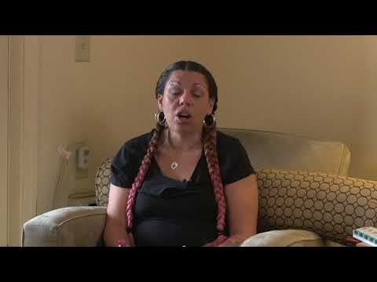
Aspen’s Palliative Care Experience
https://www.youtube.com/watch?v=OgWdwsNYY3Q
Notes:
Segue into discussing patients and caregivers.
She’s young.
Speaks about her initial reaction: thinking getting offered palliative care meant she was dying
Speaks about the types of services she received, and the benefit to her family

Slide 36
Patient Focused Approaches
Decisions are driven by the patient's goals of care and wishes
Provide support to patient to express wishes
Provide support to family and caregivers so that patients may realize goals of care
Navigate, coordinate a complex/confusing healthcare system, understand the plan of care
Notes:
https://www.chausa.org/docs/default-source/events-programs/smlf-14---yosick.pdf?sfvrsn=6
Person Centered across the continuum
Patient Centered across the encounter
“Patient Dignity Question: “What do I need to know about you as a person to give you the best care possible?””

Slide 37
Family: Members of the Care Team
Central to the delivery of care are family members and/or caregivers:
Family members benefit from the support of the palliative care team:
Provide insights into progression, improvement, and quality of life
May advocate for patient needs, wishes and desires
Source of emotional support and reliability for patients in ever-changing circumstances
Provide long-term, 24 hour care with minimal emotional and psychological support
Experience physical, emotional, and mental stress caring for family member or friend
Prone to social isolation and caregiver burden
Benefit from support of the overall palliative care team in the form of information, counselling, or practical assistance and training
Notes:
Examples include arranging respite care, improving home safety, and managing medications

Slide 38
Family Related Challenges
Family Functioning
May have less than optimal relationships
Incongruent patient and family member needs
Communication process barriers
Impaired concentration
Timing and amount of information
Family members not wanting to bother the health care team
Family members’ rejection of support
Cultural issues and provider comfort level
Notes:
Issues with family functioning can lead to restrictions in communication with health care professionals

Slide 39
Family Meeting
When possible, the patient should determine who they would like to be present
Identify the health proxy
Helpful to have members of the care team available to the patient to aid in decision making
Ensure an environment where patients and families feel comfortable sharing information
Notes:
Patients comfort and understanding should come first. this may mean multiple smaller meetings rather than one large meeting
Patients and families may disagree with one another and the medical team. this is ok and may be uncomfortable for the medical team. as long as the patient and family are comfortable sharing, understanding can be had
Patients and families should be allowed to do most of the talking i.e., telling their stories, processing experiences, asking questions, and clarifying choices and concerns.
Not allowing or allowing are not a part of these conversations. It is creating an environment in which every member of the team, most importantly patient and family, are comfortable sharing goals of care, wishes, and their truth.

Slide 40
Shared Decision Making
Engages patients and families in decisions about their care
Increases their involvement and satisfaction
Helps patients and families clearly communicate their goals and needs
No “one right way” to intervene
https://www.fairhealthconsumer.org/shared-decision-making
Notes:
https://www.icsi.org/guideline/palliative-care/
Setting realistic goals of care and providing realistic hopes are essential
Introduce Action plans/goal setting
Good palliative care involves presenting options and helping patients and families articulate their needs. The care team can connect them with the right support services

Slide 41
Integrating Palliative Care into the Primary Care Setting
Notes:
Note: Discussion will be on next slide.

Slide 42
Challenges and Opportunities
Group Activity
Notes:
What are some challenges and opportunities?

Slide 43
Challenges and Opportunities
Challenges
Opportunities
Shortage of palliative care specialists
Increase access to primary palliative care
Lack of knowledge of palliative care still exists with some providers
Develop communication strategies to help patients through the decision making process
Regional, socioeconomic, racial and ethnic groups influence access to palliative care
Leverage EHR and HIE technology to facilitate appropriate referrals
Care team members may be reluctant to discuss palliative care; fear patients will lose hope
Educate all providers and staff about palliative care
Many patients are unaware of palliative care services
Increase patient satisfaction, while reducing provider burnout
International association for hospice and palliative care

Slide 44
Value of Palliative Care in Primary Care
Increased primary care involvement in the care of seriously ill individuals is associated with:
Improved quality of life
Reduced inpatient and ED utilization for seriously ill patients
Improved quality measure outcomes near the end of life
Clear guidelines and indications for subspecialty referrals exist for hospitalized patients; these should be adapted for the outpatient setting as well
PCPs responsible for care management
Specialists available for patients with complex needs
Notes:
https://www.healthaffairs.org/do/10.1377/hblog20150803.049733/full/
One retrospective study of nearly 3,000 patients with advanced cancer found a median duration between diagnosis of cancer and death of 570 days, but only 42 days between palliative care referral and death. Waiting until the end stage of a disease before palliative care referral means that patients miss out on improving their quality of life throughout their treatment.

Slide 45
How and Where of Palliative Care
Gaining Access to Palliative Care
Locations for Palliative Care
Referral from PCP
Referral from specialist
Referral from care team member
Hospitalization
Self-referral
Hospice
Patient’s home
Nursing home
Assisted living
Hospital
Ambulatory practice/clinic (Primary Care and Specialty Care)
Community-based facility
Notes:
Discussion Point: where is the gap based on where it is taking place

Slide 46
Medicare Cost Sharing
Eliminate beneficiary cost sharing for patient-centered services
Advance Care Planning
Chronic Care Management
Create and expand existing Medicare alternative payment models
Improved quality of care
Quality of life
Health outcomes in patients with serious illness
Ensure that all models allow concurrent palliative care and disease treatment
Notes:
Commercial payers in MI paying for these services

Slide 47
Palliative Care Enhanced Care Model
Cure
Rehabilitation
Survivorship
Pain & Symptom Management
Hospice
End of Life Care
Control
Bereavement
Disease Management
Palliative
Care
Hawley, P,H. (2014). The Bow Tie Model of 21st Century Palliative Care. Journal of Pain and Symptom Management. Retrieved from http://dx.doi.org/10.1016/j.jpainsymman.2013.10.009

Slide 48
Value of Assessment Tools
Patient assessment is a critical step in identifying palliative care needs
PCPs need to consider the palliative care needs of all patients with life-limiting illnesses including metastatic cancer, end stage organ failure and advanced degenerative neurological conditions
Assessment should address prognosis, current and anticipated symptoms, distress, and the availability and support needs of family and caregivers
https://hospicecare.com/home/

Slide 49
Examples of Tools Useful in Palliative Care
Physical Aspects of Care
Edmonton Symptom Assessment Scale (ESAS)
Frailty Score
Psychological and Psychiatric Aspects of Care
PHQ9
GAD7
Social Aspects of Care
SDoH screening
Spiritual, Religious, and Existential Aspects of Care
FICA Spiritual Assessment
Ethical and Legal Aspects of Care
Advance Directives
General Assessment Tools
Karnofsky Performance Scale (KPS)
Palliative Performance Scale (PPS)
PEPSI-COLA Checklist

Slide 50
Questions

Slide 51
Criteria for Successful Completion of Introduction to Palliative Care
Attend Introduction to Palliative course, in-person or virtual
If the Learner misses > 30 minutes; the course will not be counted as “completed” and the learner will need to retake the course.
If the Learner misses < 30 minutes; the course will be counted as “completed”. The Learner will need to review the missed course content located here: https://micmt-cares.org/training
If course is virtual – must attend by audio and video/internet
Complete the Michigan Institute for Care Management and Transformation (MICMT) Introduction to Palliative Care post-test and evaluation
Achieve a passing score on the post-test of 80% or greater. If needed, participants may retake the post-test
You will have (5) business days to complete the post-test.
Notes:
Attendance is monitored by the trainer.

Slide 52






Development Team
Curriculum developed in partnership with:
Alicia Majcher
Michigan Institute for Care Management and Transformation (MICMT)
Ruth Clark
Integrated Health Partners
Kim Harrison
Priority Health
Sharon Kim
Blue Cross Blue Shield of Michigan (BCBSM)
Ewa Matuszewski
Medical Network One / Practice Transformation Institute
Michael Smith
Michigan Medicine

Slide 53
Michigan Institute for Care Management and Transformation (MICMT)
Who
We Are
Partnership between University of Michigan and
BCBSM Physician Group Incentive Program (PGIP)
Goal of MICMT
To help expand the adoption of and access to multidisciplinary care teams providing care management to populations served by the physician community in order to improve care coordination and outcomes for patients with complex illness, emerging risk, and transitions of care.

Slide 54
Introduction to Palliative Care Curriculum Development
Please provide the following as an appropriate reference if you use this material:
“Material based on the Introduction to Palliative Care course developed through a collaborative effort by the following Michigan organizations: MICMT, PTI, IHP, Priority Health, BCBSM, and Michigan Medicine.”
Questions about using or replicating this curriculum should be sent to: micmt-requests@med.umich.edu
Please follow this link to apply to become an approved trainer for this curriculum: www.micmt-cares.org

Slide 55
Appendix

Slide 56
Resources
Videos
Palliative Care, a Different Voice in Healthcare
Introducing the Palliative Care Team
Readings
Palliative Care Clinical Practice Guidelines (2018)
Implementation Tools and Resources
Advanced Care Planning
Awdish, R. (2018). In Shock: My Journey from Death to Recovery and the Redemptive Power of Hope
Ferrell, B.R., Twaddle, M.L., Melnick, A., and Meier, D. (2018). National Consensus Project Clinical Practice Guidelines for Quality Palliative Care Guidelines, 4th Edition. Journal of Palliative Medicine, Volume 21, Number 12.
Gawande, A. (2015). Being Mortal

Slide 57
Resources
American Academy of Hospice and Palliative Medicine
http://aahpm.org/
Center to Advance Palliative Care
https://www.capc.org/
National Hospice and Palliative Care Organization
https://www.nhpco.org/
National Palliative Care Research Center
http://www.npcrc.org/

Slide 58
Resources
Cain, C., Surbone, A., Elk, R. & Kagawa-Singer, M. (2018). Culture and palliative care: Preferences, communication, meaning, and mutual decision making. Journal of Pain and Symptom Management. 55:5.
Center to Advance Palliative Care. https://www.capc.org/
Faulkner, A. (1998). ABC of Palliative Care: Communication with patients, families, and other professionals. British Medical Journal. 316:130.
Ferrell, B., Twaddle, M., Melnick, A., Meier, D. (2018). National consensus project clinical practice guidelines for quality palliative guidelines, 4th edition. Journal of Palliative Medicine. 21:12.
Hawley, P,H. (2014). The Bow Tie Model of 21st Century Palliative Care. Journal of Pain and Symptom Management. Retrieved from http://dx.doi.org/10.1016/j.jpainsymman.2013.10.009
Huddleston, P. (2004). Culture and quality: An anthropological perspective. International Journal for Quality in Health Care. 16:345-46. Retrieved from: https://academic.oup.com/intqhc/article/16/5/345/1822533
Hudson, P., Aranda, S., & Kristjanson, L. (2004). Meeting the supportive needs of family caregivers in palliative care: Challenges for health professionals. Journal of Palliative Medicine. 7(1).

Slide 59
Resources
Hudson, P., & Payne, S. (2011). Family caregivers and palliative care: Current status and agenda for the future. Journal of Palliative Medicine. 14(7).
Introduction to Palliative Care & Interprofessional education/Collaboration. U of M Palliative Care Education Committee.
Kelley, S., Morrison, S. (2015). Palliative care for the seriously ill. The New England Journal of Medicine. 373:8.
Luijkx, K. & Schols, J. (2009). Volunteers in palliative care make a difference. Journal of Palliative Care. 25(1):30-9.
McCormick, E., Chai, E., & Meier, D. (2012). Integrating palliative care into primary care. Mount Sinai Journal of Medicine. 79:579-585. Retrieved from https://onlinelibrary.wiley.com/doi/epdf/10.1002/msj.21338
McPherson, M., Walker, K. (2019). How to include a pharmacist in the palliative care mix. Centers to Advance Palliative Care. Retrieved from https://www.capc.org/blog/how-include-pharmacist-palliative-care-mix/
Middleton, A., Head, B., Remke, S. n.d. Role of the Hospice and Palliative Care Social Worker. Fast Facts. Palliative Care Network of Wisconsin. Retrieved from https://www.mypcnow.org/fast-fact/role-of-the-hospice-and-palliative-care-social-worker/
OneCity Health Services. (2017). Integration of Palliative Care into the PCMH Model: Implementation Toolkit.
Palliative Care Facts and Statistics. (2014). Center to Advance Palliative Care. Retrieved from https://media.capc.org/filer_public/68/bc/68bc93c7-14ad-4741-9830-8691729618d0/capc_press-kit.pdf
Schmidt, R. n.d. Role of chaplaincy in caring for the seriously ill. Fast Facts. Palliative Care Network of Wisconsin. Retrieved from https://www.mypcnow.org/fast-fact/the-role-of-chaplaincy-in-caring-for-the-seriously-ill/

Slide 60
Resources
Sutton, S., & Grant, M. (2015). Effective public engagement to improve palliative care for Serious Illness. Health Affairs Retrieved from https://www.healthaffairs.org/do/10.1377/hblog20150310.044884/full/
The Case for Improving Communication and Symptom Management Skills. Center to Advance Palliative Care. Retrieved from https://www.capc.org/documents/699/
The National Consensus Project. (2018). Clinical Practice Guidelines for Quality Palliative Care. 4th edition
Twaddle MD,M. & McCormick MD, E.(2019). Palliative care delivery in the home. Retrieved from https://www.uptodate.com/contents/palliative-care-delivery-in-the-home
Wittenberg-Lyles E., Goldsmith, J., & Small Platt, C. (2014). Palliative care communication. Seminars in Oncology Nursing. 30:4. 280-286.

