Slide 1
Introduction to Specialty Team Based Care
Animation
Participation from learners
Video
Animation Complete
Notes:
Set up*
Good Morning,
Thank you for your participation in the STBC course today.
My name . . .
XXXXX is supporting our course today and /she he will assist with questions, acknowledging attendees who have used the raise your hand feature, and unmuting attendees. XXXX please introduce yourself
Regarding video, we would like to have an interactive session and encourage you to keep your video on.
Today’s course is X hours and we will take breaks!
Announce if Two sessions: date/time of Session Two and how to join.
Our goal is to have shared learning and we have planned activities and discussion.
We will keep everyone muted.
*(remember as part of set up – check video audio)

Slide 2
Agenda
Topic | Objectives
Introductions
Chronic Care Model | Explain how a prepared, proactive team contributes to positive patient outcomes Describe how the components of the Chronic Care Model support the practice team
Team Based Care and Care Coordination | Describe strategies to improve coordination across the care continuum Describe effective processes of communication
Outcomes | Define two outcome measures that indicate the Specialty team-based care is successful
Break
Care Management Process | Explain the care management press and actions which address the needs of high risk patients Illustrate care management interventions to decrease ED utilizations and hospital admissions
Coding and Billing | Illustrate how to use care management codes for daily care team activities
Specialty Team Based Care 4.1.20 V1

Slide 3
MICMT- Introduction to Specialty Team Based Care Disclosures
Nursing:
There is no conflict of interest for anyone with the ability to control content for this activity.
Successful completion of the Introduction to Specialty Team Based Care course includes:
Attendance at the entire course
Completion of the course post test: need to have a score of 80% or greater on the post-test
Completion of the course evaluation
Upon successful completion of the Introduction to Specialty Team Based Care Course, the participant will earn 4.5 Nursing CE contact hour.
This nursing continuing professional development activity was approved by the Ohio Nurses Association, an accredited approver by the American Nurses Credentialing Center’s Commission on Accreditation. (OBN-001-91)
ONA Activity# 2020-0000000384
Expiration date: 5/20/2022
Social Work:
Upon successful completion of the Introduction to Specialty Team Based Care course, the participant will earn 4.5 Social Work CE contact hours
Michigan Institute for Care Management and Transformation is an approved provider with the Michigan Social Work Continuing Education Collaborative. Approved provider Number: MICEC 110216.
Notes:
IMPORTANT information for all MICMT Approved Statewide Trainers:
1. The disclosure slide is specific to the MICMT CE application for Nursing and SW.
2. This disclosure slide will only be used by MICMT Approved Trainers who:
indicated they want to be under MICMT CE for Nursing and SW on the Qualtrics form,
have completed the Statewide Trainer Orientation live or recorded webinar, and
met with a MICMT team member regarding the CE requirements and Statewide Trainer areas of responsibility. This meeting is to ensure all areas of responsibility are understood and an opportunity to ask questions. This is a one time meeting (i.e. one meeting which covers CE and is not specific to each course).
3. Content of this disclosure slide must be used without modification for trainers who meet all criteria in item 2 above.
4. If you have questions – please submit to micmt-requests@med.umich.edu

Slide 4
Welcome!
House Keeping
Notes:
Before we get started we will cover a bit of housekeeping:
Zoom webinar – Host identifies that we will use raise hand and the Questions and Answers
Host shows ZOOM raise hand, Questions for attendees
Ask attendees to raise hand if they can hear.
Ask attendees to raise hand if they can see slides
Can you raise your hand if you hear me?
Please enter in Questions if you can see the screen with my slides?
Full disclosure, this is our first time using Zoom meeting.
Please enter your question using the Question feature in ZOOM. We will review questions at the end of each section.
Video and Audio:
Unless distracting, please turn video ON. This is crucial for building trust and engagement.
Try to look at the camera when talking (to mimic the feeling of in-person eye contact).
Adjust your camera if it is too high or low.
Environment:
Be aware of your backgrounds to not be distracting.
If in-person, direct attendees to the notecards on their tables. These should be used throughout the day for attendees to write questions. Place them at designated spot in the room and try to answer them during the training. If unable to answer during the training day, follow up with emails to all with the questions and answers

Slide 5
Virtual Etiquette
Video and Audio:
Unless distracting, please turn video ON. This is crucial for building trust and engagement.
Test your video and audio before the meeting begins.
Try to look at the camera when talking (to mimic the feeling of in-person eye contact).
When possible, try to use good camera quality and sound.
Adjust your camera if it is too high or low.
Meeting:
Please hold off eating during the meeting as it can be distracting.
Try not to multitask too much or make sure you’re muted.
Environment:
Be aware of your backgrounds to not be distracting.
Position yourself in the light.
Find a quiet place to join or mute yourself as necessary.
https://www.gend.co/blog/best-practice-tips-for-using-zoom

Slide 6
Michigan Institute for Care Management and Transformation (MICMT)
Who We Are
Partnership between University of Michigan and BCBSM Physician Group Incentive Program (PGIP)
Goal of MICMT
To help expand the adoption of and access to multidisciplinary care teams providing care management to populations served by the physician community in order to improve care coordination and outcomes for patients with complex illness, emerging risk, and transitions of care.

Slide 7
[Insert Organization Name]
Who We Are
[Insert text]
Goal of [Organization]
[Insert text]
[Insert Logo]

Slide 8
Introduction to Specialty Team Based Care
Curriculum developed in partnership with:
Marie Beisel, MICMT
Ruth Clark, Integrated Health Partners
Joan Kirk, Answer Health
Sheri Lee, BCBSM
Alicia Majcher, Michigan Medicine
Ewa Matuszewski, MedNetOne/PTI
Erika Perpich, Olympia Medical
Ashley Rosa, Bronson
Jackie Rosenblatt, GMP Network
Sue Vos, MiCCSI
Specialty Team Based Care 4.1.20 V1

Slide 10
Introductions: Poll
What is your role within your organization?
Notes:
Share poll results
For in person course:
Share with your table:
Name
Name of practice and where it’s located
What you “do” in your role
How long have you been in your role

Slide 11
Successful Completion of the Introduction to Specialty Team Based Care (STBC) course includes:
Attend the entire Introduction to Specialty Team Based Care course, in-person or live virtual
Attendance criteria:
If the Learner misses > 30 minutes; the Learner will not be counted as “attended” and will need to retake the course
If the Learner misses < 30 minutes; the Learner will be counted as “attended”. The Learner will need to review the missed course content located here: https://micmt-cares.org/training
If course is virtual – must attend by audio and video/internet
Complete the Michigan Institute for Care Management and Transformation (MICMT) STBC post-test and evaluation.
Achieve a passing score on the post-test of 80% or greater. If needed, you may retake the post-test
You will have (5) business days to complete the post-test.
Notes:
Attendance is monitored by the trainer.
Attendance criteria:
If the Learner misses > 30 minutes; the Learner will not be counted as “attended” and will need to retake the course.
If the Learner misses < 30 minutes; the Learner will be counted as “attended”. The Learner will need to review the missed course content located here: https://micmt-cares.org/training

Slide 12
Goal of Care Management
To achieve an optimal level of wellness and improve coordination of care while providing cost effective, non-duplicative services.
Aug 13, 2018, The Center for Health Care Strategies, Inc. (CHCS)
Notes:
The goal of care management is to improve coordination of care and provide cost effect services at the practice. This can involve directing patients away from the emergency room/hospital and to the Specialist or primary care physicians office, who provide greater care continuity.
This may include access to resources, such as behavioral health experts, pharmacists, and nutritionists, and health coaches who can more effectively address various health factors.
Care Management programs approach to improving health and reducing the cost of care is by focusing on improving the overall wellness of patients, by meeting their unique needs, by reducing unnecessary or duplicative and costly services.
Care Management programs have great potential to improve overall population health and bridge communications among specialists and primary care providers and improve patient outcomes.

Slide 13
Agenda
Topic | Objectives
Introductions
Chronic Care Model | Explain how a prepared, proactive team contributes to positive patient outcomes Describe how the components of the Chronic Care Model support the practice team
Team Based Care and Care Coordination | Describe strategies to improve coordination across the care continuum Describe effective processes of communication
Outcomes | Define two outcome measures that indicate the Specialty team-based care is successful
Break
Care Management Process | Explain the care management press and actions which address the needs of high risk patients Illustrate care management interventions to decrease ED utilizations and hospital admissions
Coding and Billing | Illustrate how to use care management codes for daily care team activities
Specialty Team Based Care 4.1.20 V1

Slide 14
Objectives
Explain how the prepared, proactive team contributes to positive patient outcomes.
Describe how the components of the chronic Care Model support the practice team.
Specialty Team Based Care 4.1.20 V1
Chronic Care slide 3.24.20 v5

Slide 15
Brief History of Chronic Care Model
MacColl Institute for Healthcare Innovation synthesized scientific literature in early 1990s.
Robert Wood Johnson Foundation funded a 9-month project that resulted in an early version of the model.
Panel of experts reviewed and compared against leading chronic illness management programs in the U.S.
Current Model was published in 1998.
Chronic Care slide 3.24.20 v5

Slide 16
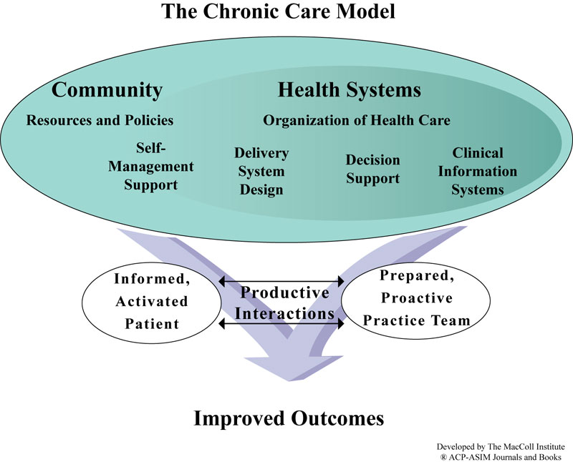
Specialty Team Based Care 4.1.20 V1
Chronic Care slide 3.24.20 v5
Notes:
Briefly describe the model and indicate we will go through each piece.
the health system sits within the community and is not the outer circle as we sometimes like to believe.

Slide 17
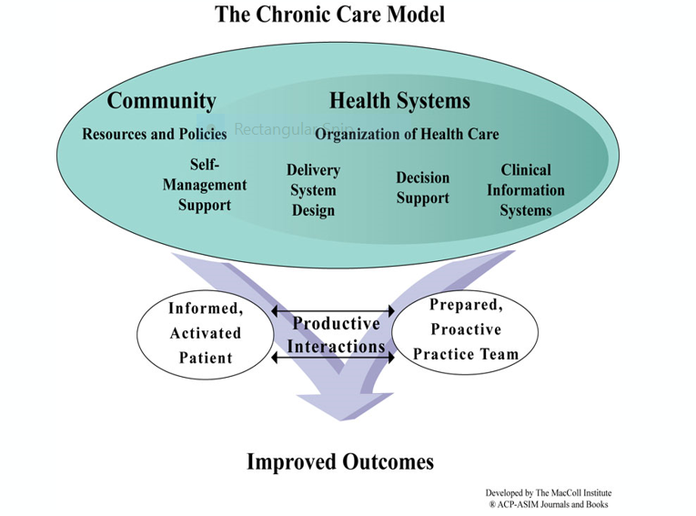
Improved Outcomes
Patient/caregiver is successful with self management of chronic condition(s) so that they do not end up having to utilize the emergency department or be hospitalized.
Outcomes are the measures used to understand the impact and success of the team-based program.
Chronic Care slide 3.24.20 v5
Notes:
Improved outcomes for patients :
The two major outcomes for a specialty team-based care program are ED and IP utilization. While there are many other metrics, these are the two that will be measured to understand program success.
The other types of improvements include:
Improved/stabilized patient quality of life
Reduced cost of health care
Patient education: access to Specialty practice, after hours who to call, a tool for decision about ED utilization or not, action plan for chronic condition Medication adherence.
Regular testing and screening
Healthier lifestyle choices

Slide 18
Prepared, Proactive Practice Team
Patient information at time of visit
Care team members available for visit
Necessary equipment available
Decision support
Adequate time to provide care
Care plan v. self-management goal
Chronic Care slide 3.24.20 v5
Notes:
Post Test Question The Prepared, Proactive Practice Team has everything they need to provide care at the time of the patient visit.
This may include lab test results, a list of gaps in care needing to be completed, equipment (such as monofilament for diabetic foot exam), and evidence-based guidelines to support.
A morning huddle may help to prepare the team for the patient’s visit.
What other examples might you have in your practice that prepares your team for the patient’s visit?
White board to indicate a team member’s schedule
Gathering the patients DME needs in advance and gathering information about how to proceed.

Slide 19
Informed, Activated Patient
Understands disease process
Understands prognosis
Includes family and caregivers in developing care plans
Views the provider as a guide
Manages daily care
Specialty Team Based Care 4.1.20 V1
Chronic Care slide 3.24.20 v5
Notes:
Post Test Question As Mike Hindmarsh often said, “education is necessary, but not sufficient.”
The patient must not only be informed regarding the disease process and recommendations, he/she must be activated.
The patient and caregiver is involved in developing the care plan. . . .
That means the patient must be an active participant in decision-making. What is your experience as it relates to patient knowledge and activation?

Slide 20
Productive Interaction
Assess self-management skills and confidence
Assess clinical status
Tailor clinical management by stepped protocol
Collaborative goal setting and problem solving in a shared care plan
Active, sustained follow-up with patient is scheduled
Chronic Care slide 3.24.20 v5
Notes:
Ultimately, the patient and care team must have a productive interaction if there is to be improved outcomes.
They must communicate in such a way that each understands the other.
What techniques or ideas do you have around making sure an interaction is productive? What barriers to a productive interaction have you experienced in your practice?

Slide 21
Self-Management Support
Emphasize patient’s central role in care
Effective self-management strategies include:
Assessment
Goal setting
Action planning
Problem solving
Follow-up
Organize resources that provide patient support
Chronic Care slide 3.24.20 v5
Notes:
Point out again that education is necessary but not sufficient. Self-management support is an important piece in patient activation. It is a collaborative approach with patient direction. It moves away from telling to guiding.
Raise your hand: if you are currently using self management support as you work with patients. What is their experience?

Slide 22
Delivery System Design
Define roles and responsibilities of team members
Planned interactions support evidence based care
Clinical case management services i.e., care managers
Ensure regular follow-up appointments
Give care patient understands and is culturally appropriate
Chronic Care slide 3.24.20 v5
Notes:
This part of the model speaks a good deal to the prepared, proactive practice team. What is the process flow from beginning interaction with the patient (even outside the office visit) through the visit itself?
How are team members used effectively? This may be identified in your work flows. For example a pharmacist who sees patients to review a complicated medication regimen or has financial barriers to afford their medications.

Slide 23
Decision Support
Incorporate evidence based guidelines into daily clinical practices
Primary care and specialty providers collaborate to provide care
Use provider education materials
Share information about care guidelines
Specialty Team Based Care 4.1.20 V1
Chronic Care slide 3.24.20 v5
Notes:
Decision support focuses on the evidence-based care guidelines used to support the decisions made related to the care of the patient.
examples of evidence based guidelines : A
What kinds of guidelines do you have in your practice?

Slide 24
Clinical Information Systems
Provide reminders for patients and providers
Identify patient populations for proactive care
Enable individual patient care planning
Share data with patients and other providers
Monitor team and system performance
Notes:
Clinical information systems support population health work.
You may have a registry, an EHR with registry capability, or something else.
The purpose is to assist you in identifying various populations and to conduct proactive outreach.
It’s not good enough to wait until someone comes to the office to provide the care they need. Outreach is critical to improved outcomes.
What’s the process for outreach in your practice? Who is the primary responsibility for the outreach?

Slide 25
Health Systems: Organization of Health Care
Senior leaders and all levels visible support improvement
Promote effective improvement approaches aimed at comprehensive system change
Encourage open and systematic problem-solving management
Provide quality of care incentives
Develop care coordination agreements
Chronic Care slide 3.24.20 v5
Notes:
Support of senior leaders for this improvement work is critical. If senior leaders don’t place a priority on it, you will easily be pulled in other directions.
The health system includes all pieces – primary care, specialty care, hospitals, ambulatory centers, etc.
Communication across all settings is key to improved patient outcomes. Where have you seen that type of communication work well? What is an example of how it has not worked well?

Slide 26
Community: Resources and Policies
Encourage patients to participate in effective community programs
Partner with community organizations in supporting and/or developing programs
Be an advocate for policy change
Chronic Care slide 3.24.20 v5
Notes:
Community includes all our community resources, such as non-profit organizations that support health care outcomes. Some examples in our community are Area Agency on Aging.
Policy change is also needed to improve health outcomes. Things such as changes to smoking laws support improved health outcomes. Be aware of what is happening at the local, state, and national levels and support policy change that will help in improving outcomes.

Slide 27
Prepared, Proactive Practice Team
Activity
Choose a chronic condition for the center bubble
Use the surrounding bubbles to map out how care team members use different Chronic Care Model (CCM) elements to provide care to a patient with that chronic condition.
Possible Care Team Members:
Physician
Specialist
Dietitian
Behavioral Health
Pharmacist
Nurse
Medical Assistant
Care Manager
Case Manager
Physician Assistant
Dentist
Administrative/support staff
Community health worker
Technician/technologist
Care Team Member and Element of CCM Responsible for
Example:
Social Worker
Element:
Chronic Condition
Example: Diabetes
Chronic Care slide 3.24.20 v5
Notes:
The center bubble should be a chronic condition, such as diabetes, CHF, COPD, hypertension, etc. In the circles around the large bubble, put the role of various care team members. Remember to not just look at internal care team members, but also at others with which you interact in the care of your patients, such as pharmacists. Next to each, indicate which element of the Chronic Care Model this person has responsibility to address, or if you don’t know in your practice, what you think is a role for that person.
Note: Trainer asks learners to identify a chronic condition. Then share the role of the care team member and the element of the Chronic Care Model the individual addresses.

Slide 28
Summary
The prepared, proactive team contributes to positive patient outcomes.
Components of the Chronic Care Model support the practice team
Specialty Team Based Care 4.1.20 V1
Chronic Care slide 3.24.20 v5
Notes:
The prepared, proactive team engages patients to realize the improved outcomes. In the of team-based care, inpatient and emergency department utilization are the outcomes that gauge success of the program.
The chronic care model shows the various elements beyond the practice that also impact the care team’s success with engaging patients and helping them self-manage to avoid unnecessary utilization.

Slide 29
Agenda
Topic | Objectives
Introductions
Chronic Care Model | Explain how a prepared, proactive team contributes to positive patient outcomes Describe how the components of the Chronic Care Model support the practice team
Team Based Care and Care Coordination | Describe strategies to improve coordination across the care continuum Describe effective processes of communication
Outcomes | Define two outcome measures that indicate the Specialty team-based care is successful
Break
Care Management Process | Explain the care management press and actions which address the needs of high risk patients Illustrate care management interventions to decrease ED utilizations and hospital admissions
Coding and Billing | Illustrate how to use care management codes for daily care team activities
Specialty Team Based Care 4.1.20 V1

Slide 30
Objectives
Describe strategies to improve coordination across the care continuum
Describe effective processes of communication
Specialty Team Based Care 4.1.20 V1

Slide 31
Team Based Care
“The high-performing team is now widely recognized as an essential tool for constructing a more patient centered, coordinated, and effective system of health care delivery.”
(Mitchell et al., 2012)
Specialty Team Based Care 4.1.20 V1
Notes:
The Institute of Medicine (IOM) defines team-based care as “the provision of health services to individuals, families, and/or communities by at least two healthcare providers who work collaboratively with patients and their caregivers—
to the extent preferred by each patient—to accomplish shared goals within and across settings to achieve coordinated high-quality care.” (Mitchell et al., 2012)

Slide 32
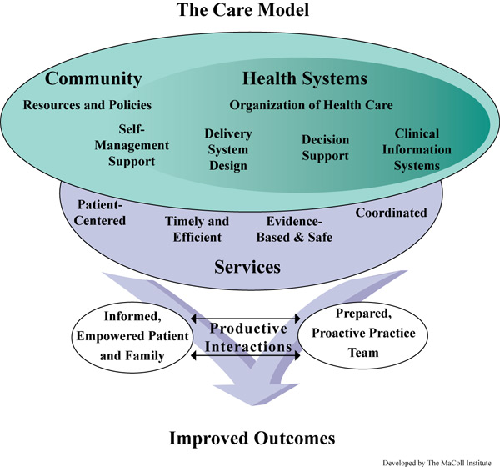
Together the clinical and community organization Care Team Members support the patients.
Effective Care Team Members apply communication skills with the other clinicians and team members within the office as well as the patient for improved outcomes.
https://www.ahrq.gov/ncepcr/tools/pf-handbook/mod16.html#fig16.2
Specialty Team Based Care 4.1.20 V1
Notes:
Note: This model was not developed by MacColl
Removed the MacColl reference - Marie (will add reference in comment to slide. Was not able to past ref into slide while in google docs.
For specialty care team members, there are two focuses: Internal focus and external focus:
external focus -->it’s critical to understand how you relate to other essential clinical care teams, such as primary care, other specialists, community resources, etc. A good way to think about this is “who do I work with outside of my practice. (The team is larger than your practice). The team includes all clinical and community entities who are working with the patient and care giver
Internal focus → is effective communication within your practice team

Slide 33
Care Coordination
“Effective Care Coordination supports achieving the Quadruple Aim: improving the care experience for individuals, improving individual health, improving the work life of health care providers, and reducing costs.”
Bodenheimer & Sinsky, 2014
Notes:
Post test question
When we think of the Quadruple aim:
There is the patient experience, improving health, improving work life experience of the healthcare team and decreasing cost of care.
Care Coordination supports the quadruple aim.

Slide 34
Activity
Where have you seen good care coordination with a patient’s Specialist(s) and Primary Care ?
What made it good?
Notes:
Select one or two attendees to share “good coordination”
Add Poll for what made it good.

Slide 35
Care Coordination: A Multidimensional Concept
Activity: How are these Care Coordination concepts linked to the Chronic Care Model (CCM)?
Effective communication among healthcare providers, patients, families, caregivers (regarding chronic conditions).
A longitudinal view of care that considers the past, while monitoring present delivery of care and anticipating future needs.
The facilitation of linkages between communities and the healthcare system to address medical, social, educational and other support needs that align with the patient goals.
Concepts
Safe care transitions
Examples
Identify the CCM Element:
Source: National Quality Forum’s Care Coordination Endorsement Maintenance Project. 2017
Notes:
fade in each concept:
Effective Communication:
Ex. Patient understands and uses written instructions about when, what and who to call.
CCM Element : Informed activated patient
Safe Care Transitions:
Ex: Care team member has Electronic Admissions, Transfers & Discharge patient list
CCM Element: Clinical Information Systems
Longitudinal view of care:
Ex. Patient lives alone. Treatment regimen causes increased weakness. Ask patient about care giver support, community resources used in the past.
CCM element: Prepared, proactive team: Decision support
The Facilitation of linkages between Communities and the health care system to address medical, social, educational and other support needs that align with the patient goals
Ex. Due to recent loss of employment, patient is experiencing food insecurity and is worried about how to feed his children. Identify resources in the patient’s community and school system.
CCM element: Community resources

Slide 36
Who is on the Patient’s Health Care Team?
Specialists Practice Team
Patient/Caregiver
PCP Practice Team
Community Resource
Hospitalist
Hospital Discharge Care Manager
Home Care Agency
Key: Specialist and PCP team – it is about communication and relationships!
Health Plan Care Manager
Notes:
In a busy day we may not think about WHO is on a patient’s team.
From the patient’s and caregiver’s experience WHO is on the team guides their understanding of how to self care and manage their chronic condition(s).
A patient centered approach is to increase our awareness about the entire team. . . including everyone – the various community organizations and health care members who communicate and support the patient and caregiver.

Slide 37
Activity
Based on the patient your practice serves, what medical healthcare agencies do you coordinate with?
Where is the opportunity?
Specialty Team Based Care 4.1.20 V1
Notes:
Ask people to talk about which types of organizations / clinics they coordinate with.
If it’s silent - prompt with some examples like: cab companies, primary care, other specialists for consults - who do they work with?

Slide 38
Care Coordination: Linkages with Community Resources
Patient education
(programs offered in community)
Patient transportation
Affording medication
Caregiver support
Activity
Which community resources do you anticipate developing a relationship with?
Notes:
Brainstorm:

Slide 39
Examples of Care Team Coordination
Share the Care
PCP and Specialist share patient care.
Consult
PCP refers patient to Specialist for consult. PCP carries out the treatment plan.
Handoff
PCP sends request, Specialist sees patient and oversees the patient’s care.
Notes:
specific examples of each
Share the care
Consult
Handoff
It isn’t necessary to define the rules of engagement with every visit. Care Team Members should find out what agreements already exist and what the expected process is for communication. If there isn’t one, then this could be an opportunity for developing an agreement.
Leverage technology – ongoing identification patient with high utilization/complexity
ADT
Health Information exchange -
Patient lists – complex patients, high utilizers
generated by BCBSM STBC Pilot, health plan(s), your practice/Physician organization

Slide 40
The Team: Specialist and PCP Partnership to Address Utilization
Care management/coordination
Consults or referrals (palliative care, pulmonary rehab)
Patient and caregiver education
Medication Reconciliation
Standardizing discharge processes and workflow
Post discharge follow-up
Notes:
Post Test Question
Specific example from Ann Arbor IMPACT → when the Cardiology and Primary Care groups discussed, it was determined that the Cardiologists could determine whether or not they should see the patient within 7 days or the PCP.
This is a critical decision point that can be supported by specialist care team members so that patients have the best care possible.

Slide 41
Communication IS the Foundation for Care Coordination
https://training.fema.gov/emiweb/is/is242b/instructor%20guide/ig_01.pdf
Notes:
Being able to communicate effectively with others facilitates collaborative working relationships and partnerships.
Find ex. Health care – statistics about communication and errors
Effective communication is essential in the workplace. The average worker spends 50 percent of the day communicating, and one-fourth of all workplace mistakes are the result of poor communication.

Slide 42
Communication IS the Foundation for Care Coordination
https://training.fema.gov/emiweb/is/is242b/instructor%20guide/ig_01.pdf
Notes:
Barriers to effective listening can be external or internal.
External roadblocks can include distracters such as:
noise, an uncomfortable temperature or seating, or an inappropriate
location.
Try to be aware of external roadblocks and offset them if possible.
Internal roadblocks include conditions or reactions within the speaker or audience, such as:
• Emotional interference or defensiveness.
• Hearing only facts and not feelings.
• Hearing what is expected instead of what is said.
• Not seeking clarification.
• Stereotyping.
• The halo effect (letting a loosely associated factor influence one’s perception).
• Resistance to change or automatic dismissal (e.g., “We’ve never done it that way before.”).
When listening it helps to :
• Keep an open mind.
• Maintain eye contact and show interest.
• Listen for the central themes.
• Consider the speaker’s nonverbal behaviors and tone of voice.
While listening, things to avoid include:
• Being judgmental.
• Interrupting the speaker.
• Formulating a rebuttal.
• Distorting the message based on your own beliefs.

Slide 43
https://training.fema.gov/emiweb/is/is242b/instructor%20guide/ig_01.pdf
Notes:
Active listening involves listening with empathy and paraphrasing. When you listen empathically, you don’t just hear words. You attend to thoughts, beliefs, and feelings.
Empathic listening is highly active and takes practice. When you paraphrase, you ensure clear understanding by restating main points in your own words. Paraphrasing also provides important feedback that helps speakers gauge how well they are getting their message across as intended.

Slide 44
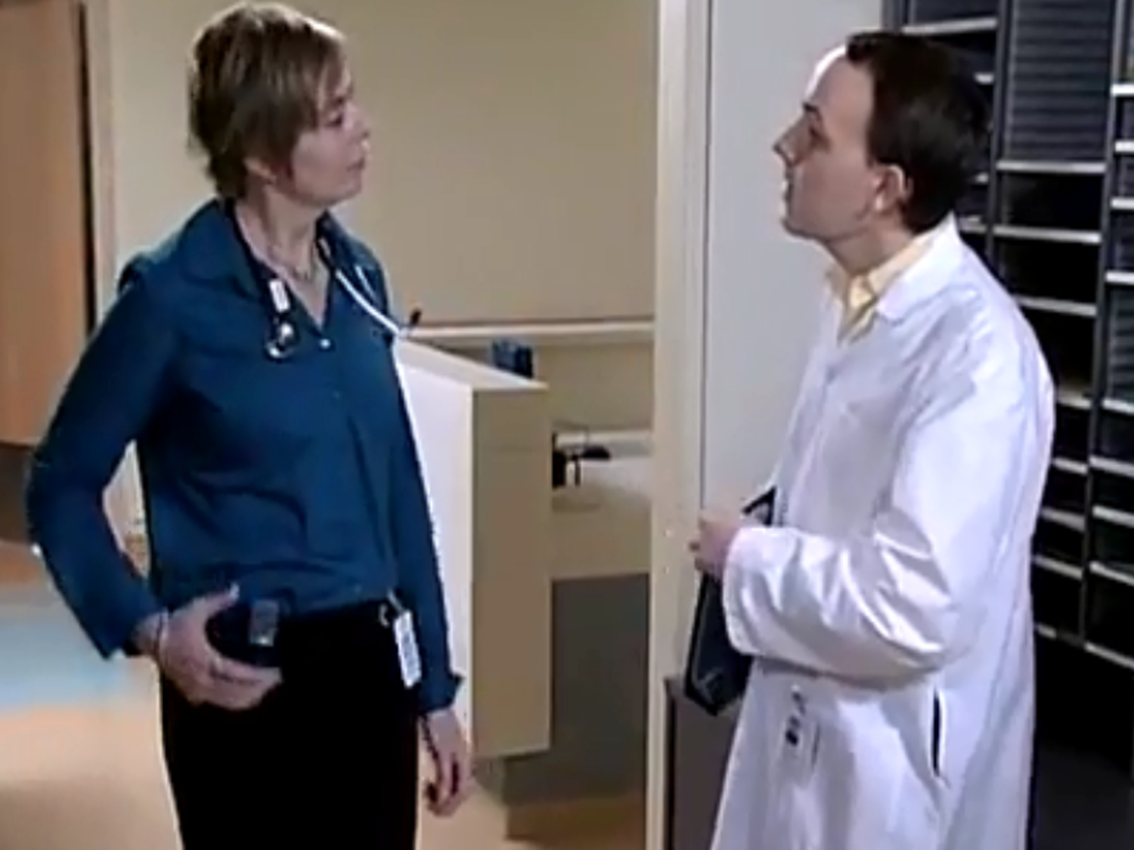
Communicate Clearly?
Notes:
We understand the importance of effective communication in health care.
Key Point(s):
Take a moment to think about the communication process - a receiver of the message and a sender of the message. How many of you - don’t name any names – know someone who’s a long winded story teller?
Ask: What happens to your attention when you are listening? Possible response: It’s really easy to lose track of the whole story! And, as the story teller you may forget to share key points and forget what you even started discussing!
I’m going to show you a video of a conversation between a pharmacist and a provider.
This is before the days of electronic records too -
Let’s see how this goes
VIDEO WILL AUTOMATICALLY START WHEN YOU ADVANCE TO NEXT SLIDE

Slide 45
Notes:
VIDEO WILL AUTOMATICALLY BEGIN

Slide 46
Communicate Clearly?
Notes:
Facilitate Discussion:
Ask:
What were your thoughts about that conversation?
What did you notice about the providers body language?
What was the outcome of the conversation?
What do you think will happen in the handoff with the next pharmacist?
Possible responses:
Provider not engaged , Nothing happens, Patient misses event
Transition out of Slide:
Fortunately, we have a structure we can use to ensure our conversations are effective. Our 4th tool supporting communication is called SBAR.

Slide 47
Tool: SBAR
Making Reports and Requesting Action
Reliability Skill: Communicate Clearly
An outline for planning and communicating information about a patient, condition or any other issue or problem. It gets to the point!
Situation: | What is the immediate problem? The headline
Background: | What is the relevant history related to the situation?
Assessment: | What is your view of the situation and your perception of the urgency of the action needed?
Recommendation: | What is your request or recommendation?
Notes:
Post Test Question
SBAR is an outline for planning and communicating information – really about anything
Present the information on the slide
SBAR is not just information packaging but also assists us in improving our Critical Thinking.

Slide 48
Tool: SBAR
Notes:
Key Point(s):
Let’s watch for how this conversation is different from the first time we watched the video
VIDEO WILL AUTOMATICALLY START WHEN YOU ADVANCE TO NEXT SLIDE

Slide 49
Notes:
VIDEO WILL AUTOMATICALLY BEGIN

Slide 50
Tool: SBAR
Notes:
Facilitate Discussion:
Ask:
What did you notice in that conversation?
Possible responses: more prepared, more engaged, seconds vs minutes, clear plan as leave conversation

Slide 51
Activity: Use SBAR Individually Prepare an SBAR for one scenario
Situation: | What is the immediate problem? The headline
Background: | What is the relevant history related to the situation?
Assessment: | What is your view of the situation and your perception of the urgency of the action needed?
Recommendation: | What is your request or recommendation?
Scenario One: A patient has been discharged from a rehabilitation center and is taking Coumadin. The Coumadin was started during an inpatient hospital stay.
The patient calls the Nephrology CM to state he is not able to locate a Home Health Agency who will draw blood to check his blood clotting time. He is due for this lab test in 2 days.
You decide a next step is to follow up with the PCP office. It is Friday afternoon.
Create your SBAR to discuss with the PCP team member.
Notes:
Facilitate Activity:
Introduce Activity:
For this practice you will prepare and deliver an SBAR
First, individually prepare an SBAR for each of the listed scenarios.
Then I’d like you to volunteer to share your SBAR
Remember to introduce yourself, and say each part of the SBAR format
Receivers please provide feedback
This will be fairly quick – just a few minutes
Total Time: 5 minutes

Slide 52
Summary
Strategies to improve coordination across the care continuum
Effective processes of communication
Specialty Team Based Care 4.1.20 V1

Slide 53
Resources
SBAR toolkit - Institute for Healthcare Improvement
Narayan, M. C. (2013). Using SBAR Communications in Efforts to Prevent Patient Rehospitalizations. Home Healthcare Nurse, 31(9), 504–515. https://doi.org/10.1097/nhh.0b013e3182a87711
Notes:
SBAR tool template on micmt website STBC course page

Slide 54
Break
Notes:
Please use this time to stretch, take a bio break, grab a snack. We will resume in 10 minutes.

Slide 55
Deskercise

Slide 56
Agenda
Topic | Objectives
Introductions
Chronic Care Model | Explain how a prepared, proactive team contributes to positive patient outcomes Describe how the components of the Chronic Care Model support the practice team
Team Based Care and Care Coordination | Describe strategies to improve coordination across the care continuum Describe effective processes of communication
Outcomes | Define two outcome measures that indicate the Specialty team-based care is successful
Break
Care Management Process | Explain the care management press and actions which address the needs of high risk patients Illustrate care management interventions to decrease ED utilizations and hospital admissions
Coding and Billing | Illustrate how to use care management codes for daily care team activities
Specialty Team Based Care 4.1.20 V1

Slide 57
Objective
Identify two outcome measures that indicate the Specialty team based care is successful.
Notes:
In summary - Outcomes measures are important to know and understand because they should shape how we organize our efforts.
The Specialty – team-based care outcomes measures are ED and IP utilization. And since we fully believe that team based care is critical to patient care, impacting these two things are important! For the STBC BCBSM Pilot participants, as measures are identified your practice leadership will share these with you.
_______________________________
Basically, we will know if your service is successful within your practice by whether or not your activities impact these two outcomes measures. While we know that other outcomes measures (such as patient satisfaction and other quality measures) are important, THESE are the ones that will result in a sustainable program. And since we fully believe that team-based care is critical to patient care, impacting these two things is important to get right.
In order to be successful in impacting these two measures, you have to do 3 things:
Be able to know who you’re supposed to be managing either by a list or designating certain criteria or patients
Know how to track the utilization of your patients so that you can intervene and support them
Figure out how to trend your performance. Even if you aren’t getting data from somewhere else, you will want to be able to demonstrate the value of your program to your clinic leadership.

Slide 58
What are Outcomes Measures?
Outcomes measures are the reason why we implement a program.
… they are what payers and organizational leadership can use to determine whether or not our programs are successful.
Notes:
Key Points:
Outcomes measures are what we use to determine the impact that our team-based care program had on the lives of our community. They are used as the elevator speech and are the reason that funding for team-based care programs can continue.
They answer the big question of WHY ARE WE DOING THIS??
Outcomes are how we measure whether or not our program actually had an impact.
We can think of this in terms of the triple aim that was developed by the Institute of Health Care Improvement : The triple aim includes
improving the health of the population,
Improving the patient experience - quality of care and satisfaction and
Reducing the cost of care.

Slide 59
Why
Notes:
Key Notes:
Discuss afterwards
This video is intended to link the outcomes with a why. We’re putting these programs in place to improve care, which should result in improvement in a healthcare outcome. So, instead of just talking about the what, we know that we’re directing people to impact these outcomes measures.

Slide 60
STBC Outcomes Measures
While there are many potential measures that could be used (patient satisfaction, quality of care, etc.), the ones that determine program success are:
Inpatient Utilization
Emergency Department Utilization
Notes:
Key Points:
The full set of metrics for the BCBSM pilot Specialty team base care are being developed.
The emergency dept utilization and inpatient utilization are two outcome metrics which health plans and organization leaders look at when determining whether or not specialty team-based care was successful.
This is why much of the conversation today has linked back with what a specialty care team member can do to help patients understand symptom management, when to use an ED and when to call you at the office.

Slide 61
Metric Definitions What does ED and IP utilization mean?
ED Utilization
The number of times per thousand that the patients attributed to your practice visited the emergency department.
IP
Utilization
The number of times per thousand that the patients attributed to your practice were admitted / readmitted.
Notes:
Post Test Question
Key Notes:
The metrics of ED utilization and IP utilization track how frequently your patients are using the emergency department and are admitted.
If patients are using the ER frequently and are being admitted to the hospital frequently, we need to understand why this is happening. Patients do not receive continuity of care if they get most of their care via the ER. If a patient’s chronic condition is not well controlled, we need start with understanding the underlying reasons.
When patients are in and out of the ED and hospital, they often are more likely to discuss their health concerns and open to exploring how to stay out of the ED and hospital
______________________________
Patients who are able to self manage their chronic conditions, as a result, will have fewer ED visits and hospitalizations. This is part of the triple aim: decreasing cost and improved patient experience.

Slide 62
What is visits per thousand?
For both ED and IP utilization, the metrics are usually calculated as “visits per thousand”, which allows for comparison across different size populations.
What does this mean?
If a hospital or ED admits/sees 500 patients from a total attributed population of 800 people, the number of admits per thousand is 625 (500 x 1,000 divided by 800 = 625)
Notes:
Key Notes:
Visits per thousand is a way of normalizing the calculation so that small practices and big practices can more easily be compared.

Slide 63
Activity
Step 1: Individually
Please take about 30 seconds to think about a loved one or patient who had a difficult experience with lots of trips to the ER or hospital.
Step 2: Individually
Now, please take 30 seconds to think about how this role could have changed that experience.
Step 3: Group sharing
Could at least 2 people share the patient/loved one experience and how they think this role could have helped them?
Notes:
3 minutes for the table/group discussion -- if there’s a lot of discussion, take more time and watch the clock; if people aren’t considering the topic then move on!
5 minutes for the group sharing / reflect -- -- if there’s a lot of discussion, take more time and watch the clock
Note: The trainer should reflect back and use what was said to kick of the next slide which is metric definition.

Slide 64
Tracking Performance
Step 1: Know who you’re responsible for keeping out of the ED and hospital!
Work with your practice administrative and clinical leadership to identify which population of patients you should be focusing on and tracking.
Notes:
Key Points:
When tracking performance, it’s important to identify your denominator first. The denominator is the population you are measuring.
This is an important step!
If you will be focusing on a specific sub-set of patients who the physicians and practice managers can help you track, then work to define that as close to the beginning of your role as possible.

Slide 65
Activity
Think on your own for a minute
What population would be considered the highest risk of emergency department and inpatient utilization in your clinics?
Is there someone who might be able to identify this subset of patients in a registry?
Group discussion
Describe your patient populations and the type of tracking that is in place.
Notes:
Individual reflection - 1 minute
Group discussion--- minutes

Slide 66
Tracking Performance
Step 2: Get notifications or find out when high risk patients …
come into the clinic
visited the ED
were admitted to the hospital
Again, clinic leadership and PO leadership can be helpful!
Notes:
Key Points:
You can check the clinic schedule to see who has an appointment and if they are on your list of patients.
Different ways to get notifications include:
Checking schedules against your list of people who are ‘your population’
Checking Admission / discharge / transfer notifications for finding out when people have gone to the ED or the hospital.
Checking with your PO and your practice to find out what kind of information you can get and how to get it. Some groups have this automated to their registry; some have it in an EHR like Epic. You will want to get linked into these notifications.
This part is incredibly important because you will use these notifications as the trigger to use your skills and knowledge to help that patient! If they are going into the clinic, you can meet him/her and develop a relationship. You can use the relationship to develop a symptom management plan so that the patient knows how to get in touch with you rather than go to the ED. If the patient has gone to the ED or is admitted, it’s a perfect time to also connect and re-do the symptom management plan, or support him/her through an appropriate admission.

Slide 67
Impacting Performance: Clinical
While ED and IP utilization are outcomes measures, lots of different factors play into whether or not your patient population has high utilization:
Medication Adherence
Treating to target
Multiple diagnoses
Quality Metrics
Clinical guidelines
Health Literacy
Symptom Management
Social Needs
Notes:
Key Notes:
Outcomes like utilization are the final measure of program success, but quality metrics and management of the patient’s disease drive the outcome measures as well.
Addressing Quality and clinical management of an individual’s chronic conditions are a key role for the care manager.
A little bit further in this course, we will discuss strategies for the care manager to work with the practice team and patients/caregivers proactively. Many factors impact a patient’s health status.
_________________________________
Addressing the social needs and behavioral health and clinical management within the assigned population leads to improved out come measures. (ie. decreased ED and hospital utilization).

Slide 68
Impacting Performance: Communication and Care Coordination
Communication among team members is key to achieving the outcomes.
Coordination with primary care is critical to helping patients/care givers understand why and how to self manage and who to call with concerns and needs.
Notes:
Key Notes:
Communication and coordination of care are integral to achieving the outcomes goals.
Getting into the details of how the patient is currently self-managing and what he/she can do to improve self-managing is critical.
We will get into more of this in subsequent presentations.

Slide 69
Impacting Performance: See Enough Patients!
Seeing patients is the way to impact your outcomes!
Seeing enough patients can be the difference between meeting outcomes goals and falling short.
We suggest at least 4 patients in a half day in order to see an outcomes impact.
Notes:
Key Notes:
It is really easy to want to go into extreme depth with patients - and sometimes, that’s needed. But people do better with frequent, shorter interactions. If you can organize your work so that you’re connecting with at least 4 patients -- this is a BASELINE / MINIMUM -- then you will see changes in outcomes.

Slide 70
Tracking Performance
Step 3: Trend performance
If you can’t track utilization, work with your leadership and PO to identify what you can track.
As a care team member, you should find out how your practice/PO tracks admissions - and if there’s a dashboard you can view.
Notes:
Key Points:
Trending once you have the data helps the entire team understand what is working and what is not working.
You want to be able to trend and track how you’re doing with this over time.
Some POs / practices (particularly those in systems) have excellent methods of tracking utilization. Many do not. You should work with your practice and PO to understand what methods are available to you, and how they might even be able to set you up with a manual tracking system to focus in on your population of patients.

Slide 71
Tracking ED and IP Utilization Tools
If your practice uses a patient ED and IP utilization tracking tool, please describe.
If you have heard of other practices using a tool to track outcomes, please describe.
Example: ED and IP utilization tracking tool
Notes:
Key Points:
Your Physician Organization and practice leaders are a significant resource for data. There might already be reports, or help with creating them.
Discuss this as the opportunity to bridge primary care and specialty care through common outcomes.

Slide 72
Summary
ED Utilization
The outcomes measures for team-based care are:
IP Utilization
Identify your population
In order to have the best chance of success:
Track your population
Trend your performance
Notes:
In summary - Outcomes measures are important to know and understand because they should shape how we organize our efforts.
The Specialty – team-based care outcomes measures are ED and IP utilization. And since we fully believe that team based care is critical to patient care, impacting these two things are important! For the STBC BCBSM Pilot participants, as measures are identified your practice leadership will share these with you.
_______________________________
Basically, we will know if your service is successful within your practice by whether or not your activities impact these two outcomes measures. While we know that other outcomes measures (such as patient satisfaction and other quality measures) are important, THESE are the ones that will result in a sustainable program. And since we fully believe that team-based care is critical to patient care, impacting these two things is important to get right.
In order to be successful in impacting these two measures, you have to do 3 things:
Be able to know who you’re supposed to be managing either by a list or designating certain criteria or patients
Know how to track the utilization of your patients so that you can intervene and support them
Figure out how to trend your performance. Even if you aren’t getting data from somewhere else, you will want to be able to demonstrate the value of your program to your clinic leadership.

Slide 73
Questions?

Slide 74
Agenda
Topic | Objectives
Introductions
Chronic Care Model | Explain how a prepared, proactive team contributes to positive patient outcomes Describe how the components of the Chronic Care Model support the practice team
Team Based Care and Care Coordination | Describe strategies to improve coordination across the care continuum Describe effective processes of communication
Outcomes | Define two outcome measures that indicate the Specialty team-based care is successful
Break
Care Management Process | Explain the care management press and actions which address the needs of high risk patients Illustrate care management interventions to decrease ED utilizations and hospital admissions
Coding and Billing | Illustrate how to use care management codes for daily care team activities
Specialty Team Based Care 4.1.20 V1

Slide 75
Objectives
Explain the care management process and actions which address the needs of high risk patients.
Illustrate care management interventions to decrease ED utilizations and hospital admissions.
Describe a process for Specialty practice team members to coordinate care with a Primary care practice.
Specialty Team Based Care 4.1.20 V1

Slide 76
Goal of Care Management
To achieve an optimal level of wellness and improve coordination of care while providing cost effective, non-duplicative services.
Aug 13, 2018, The Center for Health Care Strategies, Inc. (CHCS)
Notes:
Next we are going to look at the care management process and application of daily work of the care team members.
Let’s keep in mind the Goal of care management.
Care Management programs approach to improving health and reducing the cost of care is by focusing on improving the overall wellness of patients, by meeting their unique needs, by reducing unnecessary or duplicative and costly services.
The goal of care management is to improve coordination of care and provide cost effect services at the practice. This can involve directing patients away from the emergency room/hospital and to the Specialist or primary care physicians office, who provide greater care continuity.
This may include access to resources, such as behavioral health experts, pharmacists, and nutritionists, and health coaches who can more effectively address various health factors.

Slide 77
Care Management Process
Identify and Enroll
Assessment and Care Plan
Implement
Close
Specialty Team Based Care 4.1.20 V1
Notes:
The care management process is a process that can be used by the whole care team.
The process is how the team identifies and prepares for the patient and how the patients needs are identified and met.
The first step is to identify and enroll patients.

Slide 78
Identifying Patients for Care Management
Top Outcome Measures:
Work with your practice team and physician to identify high risk patients.
Clinical Guidelines
Lower ED Utilization
Lower Inpatient Utilization
“It is not the number of diagnoses that determines the need for care coordination, but the complexity of health problems, complexity of social situations and complexity manifested by frequent use of healthcare services.”
Predicting use of nurse care coordination by older adults with chronic conditions. (2017). Western Journal of Nursing Research. https://doi.org/10.1186/s12913-019-2016-5
Notes:
Check with your Practice Leadership - What is the criteria for Identification of High risk patients for care management?
Identifying high risk patients for care management
High Risk patients often are high utilizers of health care services. Due to the complexity of their health problems , they often have a high rate of ED visits and Hospital admissions.
Population/patients may need Chronic condition management may include uncontrolled chronic conditions: diabetics with high A1c or uncontrolled hypertensive patients or COPD and Asthma not in control.
Specialty Practices do not all function the same; impacts how the Specialty practice will .

Slide 79
Risk Stratification
Risk stratification is ideally an intentional, planned and proactive process carried out at the practice level to effectively target clinic services to patients.
http://www.njafp.org/sites/ethos.njafp.org/files/risk_strat_peskin_distribution_final.pdf
Specialty Team Based Care 4.1.20 V1
Notes:
The goal of risk stratification is to segment patients into distinct groups of similar complexity and care needs to identify patients who will benefit the most from care management services, i.e. those that may be at risk for hospitalization, high use of ED, chronic condition not in control.
(http://www.nachc.org/wp-content/uploads/2018/02/Action-Guide_Pop-Health_Risk-Stratification-Sept-2017.pdf)
INSERT Notes here - slide 88
There are multiple ways to risk stratify population that can range from various single focus tools to comprehensive embedded tools.
Some practices have an automatic risk scoring process.
Homework: Investigate what’s happening at your office and Physician Organization concerning risk stratification to identify high risk patients and create your proactive outreach process in the office.
How does risk stratification and patient identification fit with Chronic Care model? It is part of the foundation. Patients at high risk need to be identified, activated and informed in order to manage their condition.

Slide 80
High Risk: the Initial Focus!
SOURCE: “Mind the Gap", The Advisory Board Company.
https://www.advisory.com/-/media/Advisory-com/Research/PHA/Research-Study/2017/Mind-the-Gap-Managing-the-Rising-Risk-Patient-Population.pdf
Notes:
Post Test Question
Advisory Board identify High-risk patients typically have: Three or more chronic conditions. At least one of these chronic conditions is severe and not in control. They require constant and individualised care team interventions.
These high risk patients will most likely need the intervention of a multiple team members, pharmacist and SW requiring team-based planning and team based care plan. Cognitive or functional decline can also move patient into high risk.

Slide 81
Identify High Risk Patients
Identify the population of patients to work with: predicting risk in specific patients to reduce hospital admission or recurrent, unnecessary ED visits.
Physician identification
ADT alerts
Medical record review – how many admission and/or ED visits in past 6 months? In the past year?
Risk score
Care Sensitivity
Discussion: Who is the high risk patient population in your practice?
Notes:
Predicting care sensitivity: the likelihood that a particular high risk patient will respond to the are management intervention. Specialist Physician Input !
Incentive Program Patient Lists
Lists have a column that describes # of hospitalizations/ED visits, diagnoses, etc.
Discussing the patients with the provider is a good first step!
Social Determinants of Health Screenings
A strong predictor of readmission is social isolation - so knowing whether or not a patient has social support can help inform the best approach for supporting the patient.
Patient Activation Screening
Patient activation Measure (PAM) by Insignia, other patient activation tools.
Behavioral Health Screenings
PH-Q9 and other mental health screenings.

Slide 82
Proactive Outreach and the Provider Discussion
The provider often has knowledge of patient’s circumstances - psychosocial, readiness for change.
Provider input saves time!
The provider can help you identify a group of people who he/she considers important for outreach, and write a standing order - this allows you to provide outreach proactively!
Setting up a regular time for discussion of patients is not only helpful, but billable (more to come later).
Specialty Team Based Care 4.1.20 V1
Notes:
Once you have identified a patient for care management a Provider discussion and agreement is a necessary step prior to enrolling the patient into care management services
This discussion may occur
Prior to you meeting with the patient if the provider has already identified the need and is referring the patient to you
During huddle while the team is reviewing the patients for the day
After TOC calls
As early as you have identified the need, it does not need to wait until all the assessment data is obtained.
Purpose of this discussion is to gain agreement with the provider and determine that this patient will benefit from care management services.

Slide 83
If you can’t enroll the patient, who else can provide support?
If you can’t support the patient because of insurance, they don’t meet the qualifications of high risk, or any other reason, the best option for the patient is a referral to a community resource that can support them. Often, payers have centralized care teams that can also provide support.
For Coordinated Care Program Blue Cross and BCN: call 1-800-845-5982
For Coordinated Care Program Blue Cross Complete: call 888-288-1722
For Blue Cross Health and Wellness: call 800-775-2583
Notes:
There are times you may identify the patient has needs but not enrolled or engage patient in care management. Looking for other resources for the patient may include.
Health plan or community resources. This may be the extent of your involvement
Contacting the health plan care manger can clarify how each can assist.
Linking to a community resource.
BCBSM offers Coordinated Care
Coordinated Care is care management provided by Blue Cross to specifically targeted patients. The program looks similar to PGIP Provider-Delivered Care Management, in that multi-disciplinary care teams comprised of providers such as social workers and pharmacists are aligned by region.
Coordinated Care may help address gaps where there is no PDCM provider, or there are limited care team members to address member needs.
__________________________
Value Partnerships distributed a contact list for Coordinated Care in September 2019, and it is available on the PDCM page of the collaboration site. Alternatively, you can use the phone number provided above for both BCBSM and BCN patients: 800-845-5982.

Slide 84
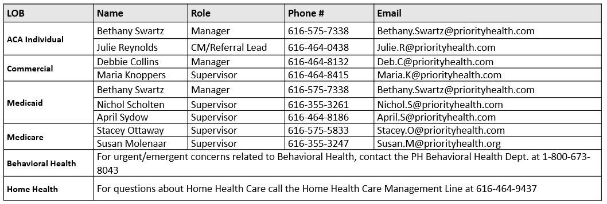
Priority Health Outpatient Care Management Contacts
Specialty Team Based Care V8 5.5.2020
84

Slide 85
How to Start the Conversation
Introducing care management to patient/caregiver
What is your elevator speech?
What are your concerns and what would you like to work on?
Asking patient/caregiver
Notes:
If a warm hand-off is not possible and you need to engage the patient by phone or in-person an elevator speech comes in handy.
Tips for elevator speech: ask learners to brainstorm their elevator speech.
Note: Could add slide with example of CM elevator speech - following the poll

Slide 86
Patient Agreement to Care Management Services
What is agreement?
How do you document agreement?
Notes:
Agreement to care management services is essential prior to any coding or billing. The agreement can be verbal or written. The patients agreement to participate in Care Management services must be documented in the patient’s medical record.

Slide 87
Care Management Process
Identify and Enroll
Assessment and Care Plan
Implement
Close
Notes:
The care management process is a process that can be used by the whole care team.
The process is how the team identifies and prepares for the patient and how the patients needs are identified and met.

Slide 88
Assessment and Care Planning
Assessment provides patient context and supports development of the individualized Patient Care Plan and use of Action plans for symptom management.
Notes:
Assessment provides the information needed to develop the patient care plan.
The team uses a variety of screening and assessment tools.

Slide 89
Assessments and Screenings
Key Area of Focus | Screening tools / methods
Medical | Chronic conditions Functional status Utilization Who else is on the care team? Is there a PCP care manager?
Behavioral | PHQ-9 GAD-7 Cognitive status
Social | Social Needs Assessment Nutritional Status What is the support level? Does the patient have a caregiver?
Patient ability / Desire | Discussion about ideal state / goals Confidence in achieving goals
Patient / Caregiver Understanding | Teach-back processes
Notes:
Functional status → activities of daily living
Utilization → how many times they’re in and out of the hospital / ER
Care team → who else is caring for the patient?
PHQ - 9 → Patient HEalth Questionnaire - 9 questions

Slide 90
Care Plan:
For High Risk Patients Episodic vs. Longitudinal
Determine Care Management services to match needs of patient:
Episodic: Short-term, goal oriented
Longitudinal:
High Risk, goal oriented
Exacerbation of condition and has confidence/knowledge to self manage
Social needs, short term and need can be addressed
Lack of knowledge regarding accessing care (how to reach Specialist care team weekends and after hours)
Elective surgery
Frequent use of healthcare services
Combination of multiple comorbidities
Complexity of health problems
Complexity of treatment regimens
Behavioral and social risks
Notes:
Thinking about two ways to classify patients may help.
Provide short-term (episodic) CM services to patients with acute or urgent needs, i.e.
Episodic care management and coordination focuses on provision of short-term care management services, related to acute events
Longitudinal care management and coordination focuses on patients identified as high risk or rising risk by your practices stratification approach, who are likely to benefit from ongoing proactive care management. This includes the use of an individualized care plan, centered on the patient’s actions and support needs in the management of chronic conditions for care management and care coordination interventions. Building a relationship over time with the patient and their support system and delivery of intensive care management services, are elements of longitudinal care management and coordination.

Slide 91
Patient Plan and Goals: Shared Decision Making
The patient plan and goals:
Conversations with the patient to develop goals and interventions
Cover plan areas:
To guide care, evaluate during follow up and refocus as needed - basing changes on patient desire and ability.
Symptom management: ex. stop light action plan; when to call and who to call
Medication management
Planned interventions
Community and other resources or referrals
Follow-up schedule, calls with CM Team members, planned visits
Specialty Team Based Care 4.1.20 V1
Notes:
Patient Care plan is a collaboration between the clinical care plan and the patient’s goals and achievable next steps.
The goal of patient engagement is to facilitate patient self-management.

Slide 92
Activity: Practice creating a Care Plan
Enter into the comments: What types of screenings does your practice use?
Now, please enter into the comments: What might you add to support your patients more holistically and create care plans that align with improving utilization?
Discussion: How might you use these assessments to help the patient create goals that would decrease their need for ED / IP use?

Slide 93
Communicate the Plan to the Care Team
1
Confirm with patient/caregiver: “Who is the person you work with the most at your PCP practice?”
“I work with Dr. Smith and he asked that I call/meet you. He mentioned your [ ] is something we could work on together to address your health concerns…”
2
Let the PCP know your Care Plan:
If patient has a PCP care team member (the person patient identifies), call PCP care team member to coordinate.
Discuss how to work together to address patient’s health concerns
Share assessment findings
Notes:
Connecting with the PCP care team member that works with the patient the most is an important initial step.
We want to avoid asking patient assessment questions that PCP care team may already have gathered.

Slide 94
Care Plan Summary
The care plan is collaboratively developed by the patient and care team to identify clinical plan and set mutual goals and actions for the patient.
Symptom Management
Medication Management
Education and coaching to self-manage condition/health
Planned interventions: tests, procedures
Follow up schedule: planned visits, phone calls
Coordination of care across settings: Primary care, Specialists, Community
Components include
Notes:
It is important to help new team based care individuals understand and visualize the care plan and where it is located.
Ask How is the provider, team and patient involved in Care Plan?
Ask what does the patient receive (discharge summary, action plan)?
Ask where are care plans documented?
Asks what do they look like?

Slide 95
Care Management Process
Identify and Enroll
Assessment and Care Plan
Implement
Close

Slide 96
Implementation and Follow Up
The follow-up plan is based on patient level of:
Risk
Safety issues
Changes in condition or care (new diagnosis or medication)
Treatment to target goals/trend
Self-management abilities
Support needed to accomplish their goals
Notes:
Post Test Question
Implementation and follow-up are based on many factors. Cues for follow up the follow up plan include patient level of risk. . . . .
The care plan is reviewed and used by team members. Goals are monitored and modified as needed to meet the patient’s current state.

Slide 97
Symptom Management
Stoplight Tools
Used by patients to recognize and monitor their symptoms and collaborate with providers to recognize early systems and manage condition with office to prevent ED and hospital.
Symptom to be aware of and actions to take at each level.
Green: Goal
Yellow: Warning when to call provider/office
Red: Emergency symptoms
Notes:
Patient activation is defined as “understanding one’s own role in the care process and having the knowledge, skills, and confidence to take on that role.”
Patient activation and early intervention support this goal by facilitating patient understanding symptoms of exacerbation and when to take action and what action to take.
When should an individual take simple steps at home to address temporary shortness of breath and when to call the office for same day appointment rather than rush to urgent care or the emergency room?
Think about your practice: What are the common, mismanaged situations lead to unnecessary ER use and higher costs?

Slide 98
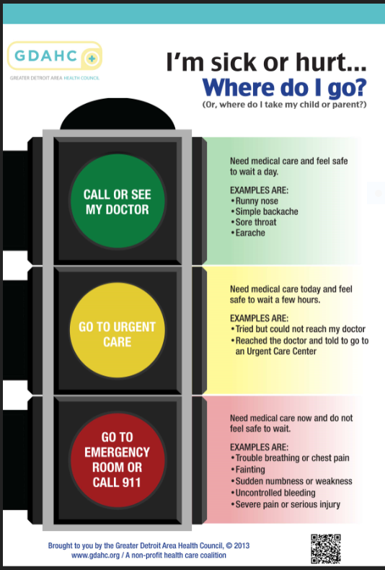
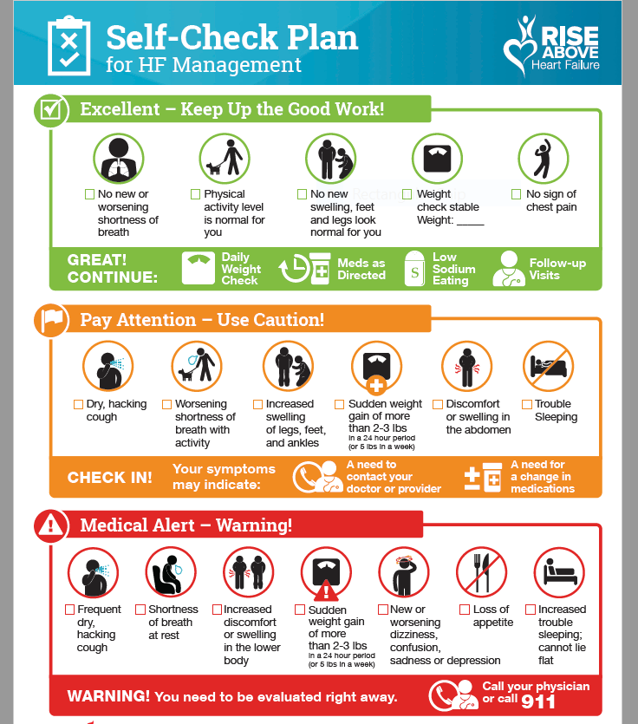
Patient Education:
Proactive Action Plans
Emergency Room Utilization
Symptom Management

Slide 99
Definition of Transitions of Care (TOC)
A set of actions designed to ensure the coordination and continuity of health care as patients transfer from hospital to home.
. . .TOC services are provided after a patient is discharged from one of these inpatient settings
Inpatient acute care hospital
Hospital outpatient observation
Skilled nursing facility (SNF)
And other
inpatient settings
https://apps.who.int/iris/bitstream/handle/10665/252272/9789241511599-eng.pdf;jsessionid=15B79538FFD509D36F09E059C4CD6BB2?sequence=1

Slide 100
Your Transition of Care Experience: Poll
Please rate your experience in working with patients to address Transition of Care.

Slide 101
Why is TOC Important?
20% of patients experience an adverse event
(66% drug related).
“US health care spending increased 4.6% to reach $3.6 trillion in 2018, a faster growth rate than the rate of 4.2% in 2017 but the same rate as in 2016.” (Health Affairs, January 2019)
20% of Medicare patients are readmitted within 30 days of discharge.
Analysis conducted by the Medicare Payment Advisory Committee (MedPAC) US data
Reference: Schall M, Coleman E, Rutherford P, Taylor J. How-to Guide: Improving Transitions from the Hospital to the Clinical Office Practice to Reduce Avoidable Re-hospitalizations. Cambridge, MA: Institute for Healthcare Improvement; June 2013. Available at www.IHI.org.
https://healthinsight.org/outpatient-clinicians/strengthening-primary-care/transitional-care-management
National Health Care Spending In 2017,” Health Affairs, January 2019
Notes:
Managing transitions effectively from the primary care into hospital care and from hospital into primary care are essential
Discharge: confusing discharge instructions leading to poor self-management and medication errors.
Delayed Follow-Up: delays or omissions of follow-up appointments.
Social Support: assessment of current social support or need of additional social support.
Contact Information: patients are unaware of who to notify if faced with worsening symptoms post-discharge
Appointment Barriers: physician office unaware of discharge or barriers contributing to patient’s inability to keep the follow-up appointment.
Need for a Follow-Up: patients unaware of the importance of the follow-up visit with the PCP.

Slide 102
Goals for a Positive Transitions of Care
Patient receives the continuity of care they need to keep condition stable or recognize warning signs and actions to take
Health outcomes are consistent with patient’s wishes
Avoid hospital readmission
Patient and family’s experience and satisfaction with care received.
Providers have the information they need to understand and bridge care.
Nielsen GA, Bartely A, Coleman E, Resar R, Rutherford P, Souw D, Taylor J. Transforming Care at the Bedside How-to Guide: Creating an Ideal Transition Home for Patients with Heart Failure. Cambridge, MA: Institute for Healthcare Improvement; 2008. Available at http://www.ihi.org
Notes:
POST TEST Question

Slide 103
TCM Element: KEY Identify who is LEAD: Specialist or PCP?
Call patient within 2 days of discharge
Visit Prep
(Same day as provider visit or prior to)
TCM Visit
Follow Up Support
Bill
Unlicensed Team Member
Licensed Team Member -LEAD
Provider- LEAD
Unlicensed / Licensed Team Member-LEAD
Office Staff - LEAD
Obtain and Review discharge information
Confirm LEAD: office visit scheduled with PCP or Specialist (7 business days complex, 14 business days moderate)
LEAD: communicate with appropriate PCP/Specialist team members
LEAD: Identify if patient has urgent needs prior to F2F visit: ex. SDOH, clinical needs – connect patient with appropriate PCP team member to address SDOH
Complete medication reconciliation
Discuss patient’s goals and concerns
Provide relevant education
Conduct screenings
Coordinate Specialists, Primary care, community resources, other care plan needs.
Address medical treatment plan
Assess for complications
Review need for and/or follow up on pending tests/treatments
Interact/coordinate with Specialists
Educate patient/caregiver
Discuss patient’s goals and concerns
Discuss care team member support opportunities
Regularly check in with high risk / moderate risk patients to review care plan, self-management goals, and any patient concerns.
Goal is to avoid readmission.
Bill the TCM if the practice is assured that there have been no readmissions within 30 days.
99495 = Visit completed within 14 days.
99496 = Visit completed within 7 days.
Notes:
For High Risk patients – Why the 7 day follow up matters?
Closely manage chronic conditions
Address barriers, symptoms, and coordination of care issues quickly
Help patients reduce emergency department utilization
Help prevent patient readmissions to the hospital

Slide 104
TOC Case Study: Mary
Mary is an 80 year old African American female with diagnoses of Heart Failure, Congestive Obstructive Pulmonary Disease, Diabetes Type II, and Hypertension. In the past 6 months, Mary had 3 ER visits and 2 Hospital admissions.
Yesterday Mary was discharged from the hospital with a diagnosis of ketoacidosis.
Mary is a widow and lives alone; her daughter lives nearby.
After speaking with Mary and her daughter you gather:
Daughter notices her Mom is more and more isolated and has observed a decline in her Mom’s memory.
Mary shares she is having difficulty affording medication and food.
Most days Mary has anxiety.
Takes 8 prescription medications daily.
Meals consist of canned and prepared food.
Understanding of self management for her chronic conditions is limited.
Notes:
Instructor:
Prompt participants to identify barriers that may contribute to her hospitalizations.
TOC
Screening:
Where would you obtain information to help screen for Mary’s appropriate for care management
Discharge summary, EHR
Assumption: Care Management enrollment completed previous to this hospital admission. This is the beginning of TOC visit which resulted in patient needing longitudinal care management

Slide 105
TOC Activity: Identify Mary’s Team
Provider(s) (Specialty & PCP)
Think about your role and scope
Pharmacist
Dietitian
Social Worker/behavioral health
Medical Assistant
RN
Notes:
Activity: Ask participants to answer the following question:
Who is missing on the team? pt., caregiver, community organizations
______________
Notes
a. ask what the care team member sees him/herself doing to support transitions of care and perhaps mapping out according to the process just described above.

Slide 106
Care Management Process
Identify and Enroll
Assessment and Care Plan
Implement
Close

Slide 107
Case Close and Evaluation
Reasons for case close and discharged from care management services:
Patient /caregiver successful and confident with self management
Patient moves out of region/state
Patient is admitted to Skilled nursing facility, hospice care
Patient declines further services
Patient expires
Notes:
The final phase is close and evaluation.

Slide 108
Patient Met Goals
Prepare for transition back to team monitoring
Prepare patient for ongoing self-management and relapse prevention*
Keep door open for support that may be needed in the future
*Note: Patients with longitudinal needs will benefit from periodic follow up by the care management team.
Notes:
Example: Follow up phone visit frequency is adjusted based on patients symptoms and ability to self manage the symptoms and know when to call if symptoms are in the yellow zone.
a lapse is a small, temporary slip in self-management efforts, while a relapse is a return to previous non-self-management behaviors. The relapse chain is a series – or chain reaction – of events that can lead to a full relapse.
In order to avoid or effectively deal with lapses, it is important to identify situations that might be high-risk (eating out, holiday party, vacation), and prepare a plan to deal with those situations.
https://clinicaltrials.gov/ct2/show/NCT00362193
http://wearediabetes.org/learn/treatment/relapse-prevention
https://www.cdc.gov/diabetes/prevention/pdf/postcurriculum_session11.pdf

Slide 109
Summary
The care management process describes the method care team members use to collaborate with the patient and care team to support improved patient self-management and outcomes.
Specialty Team Based Care 4.1.20 V1

Slide 110
Resources
MQIC Guidelines
https://www.ahrq.gov/evidencenow/tools/standing-orders.html
https://www.cdc.gov/diabetes/prevention/pdf/postcurriculum_session11.pdf
Relapse Prevention Strategies
Essential Steps of Shared Decision Making, AHRQ
Patient Engagement - a variety of resources - www.micmt-cares.org
Tools
Care Management Flyer
Care Management Introduction Phone Script
Symptom Management Stoplight tool Emergency room visit decision - GDHAC Tool
Symptom Management Stoplight tool Heart Failure – Chronic conditions
Introducing Care Management – script follow up TOC call

Slide 111
Questions?

Slide 112
Break
Notes:
Please use this time to stretch, take a bio break, grab a snack. We will resume in 10 minutes.

Slide 113
Deskercise

Slide 114
Agenda
Topic | Objectives
Introductions
Chronic Care Model | Explain how a prepared, proactive team contributes to positive patient outcomes Describe how the components of the Chronic Care Model support the practice team
Team Based Care and Care Coordination | Describe strategies to improve coordination across the care continuum Describe effective processes of communication
Outcomes | Define two outcome measures that indicate the Specialty team-based care is successful
Break
Care Management Process | Explain the care management press and actions which address the needs of high risk patients Illustrate care management interventions to decrease ED utilizations and hospital admissions
Coding and Billing | Illustrate how to use care management codes for daily care team activities
Specialty Team Based Care 4.1.20 V1

Slide 115
Objective
Illustrate how to use the Care Management codes in daily care team activities.
Notes:
Learning Notes
What codes can be used
What codes can be used by licensed and unlicensed care team members
Diagnosis codes and importance/impact on billing
Stress need for PO/practice follow up

Slide 116
Different payers, Different rules!
Not all of the payers interpret/pay for these codes in the same way. As we discuss each code, please refer to the Multi-Payer handout for additional detail regarding how the two main payers (Priority Health and BCBSM) interpret these codes and who they pay to deliver service.
Billing resources are posted on MICMT website: https://micmt-cares.org/bcbsm-billing
Specialty Team Based Care V1 5.5.2020
116
Notes:
The Multi Payer table is a document which includes a high level summary of the care management billing codes and descriptions for each code by BCBSM and PH.
Note: The multi payer table is being updated by BCBSM and Priority Health and currently is not available. We anticipate in about 1-2 weeks the updated Multi Payer table will be available on MICMT website: micmrc-cares.org

Slide 117
Different payers, Different rules!
BCBSM
BCBSM removed the distinction between lead care managers and qualified health professionals – now they simply have “physicians” and “care team members,” and those care team members are either licensed (e.g., social workers, nurses) or unlicensed (e.g., MAs, CHWs).
The care team can be comprised of any health care or behavioral health professional the provider believes is qualified to serve on the care team.
Priority Health
QHPs include: RNs, certified NPs, PA-Cs, licensed Master social workers (LMSWs), psychologists (LLPs and PhDs.), certified diabetes educators (CDEs), Registered Dieticians, Masters'-trained nutritionists, clinical pharmacists and respiratory therapists.
PH: https://www.priorityhealth.com/provider/manual/services/medical/care-management
BCBSM: March, 2020 FAQ document
Specialty Team Based Care 4.1.20 V1

Slide 118
Care Management Codes
for Care Team Members
BCBSM |  | Priority
Licensed | X | QHP | X
Unlicensed MA, CHW
Face to Face w/ patient
G9001: Initiation of Care Management (Comprehensive Assessment)
G9002: Individual Face-to-Face Visit
98961: Education and training for patient self-management for 2–4 patients; 30 minutes
98962: Education and training for patient self-management for 5–8 patients; 30 minutes
Group Visits w/ patient
End of Life Counseling
Advanced Directive
S0257: Counseling and discussion regarding advance directives or end of life care planning and decisions
Provider liability if patient does not have the Care Management Benefit.
Specialty Team Based Care 4.1.20 V1
Notes:
Give as a handout in addition to the slide
Removed: Licensed
X

Slide 119
G9001 Comprehensive Assessment Code
BCBSM |  | Priority
Licensed | X | QHP | X
Unlicensed MA, CHW
The Comprehensive Assessment (G9001) is a face to face meeting which results in a patient centered care plan that the care team and the patient agree upon and follow.
The comprehensive assessment is a holistic approach and involves screenings (ex. SDOH, PQ 2), understanding and discussion of patient’s concerns/goals and the medical treatment plan.
The care plan:
Guides the patient and caregiver towards self-management
Requires monitoring and evaluation of the effectiveness of the plan over time
Adjust goals and interventions as needed, until goals are met

Slide 120
G9001 Comprehensive Assessment Code
BCBSM |  | Priority
Licensed | X | QHP | X
Unlicensed MA, CHW
BCBSM
Individual, face to face (or video for commercial)
One per patient per day
Priority Health
Individual, face to face
May be billed once annually for patients with ongoing care management.
Specialty Team Based Care 4.1.20 V1
Notes:
The goal is to develop a plan of care that is based on how well the patient is able to steward their own care and the provider’s care plan goals.
Patient self-management goals are an integral piece.
Removed : Licensed – replaced with : BCBSM Licensed, PH QHP
X

Slide 121
G9002 Face-to-Face
BCBSM |  | Priority
Licensed | X | QHP | X
Unlicensed MA, CHW
BCBSM (Commercial and Medicare Advantage):
Quantity Billing
Individual, face to face or video
If the total cumulative time with the patient adds up to:
1 to 45 minutes, report a quantity of one; 46 to 75 minutes, report a quantity of two; 76 to 105 minutes, report a quantity of three; 106 to 135 minutes, report a quantity of four.
Priority Health (Commercial, Medicare Advantage, Medicaid):
No Quantity Billing
In person visit with patient, may include caregiver involvement.
Used for treatment plan, self management education, medication therapy, risk factors, unmet care, physical status, emotional status, community resources, readiness to change.
BCBSM: 2P Modifier for G9002- Payable when contact is made with patient to discuss the program and patient does
not enroll in care management.
Notes:
BCBSM:
LMR – to be clear, the G9002 does not have to be quantity billed if you’re under 45 minutes (in other words, there is no need to report a 1 if it’s under 45 minutes).
2P Modifier
Priority Health:

Slide 122
Face to Face or Video Codes
BCBSM |  | Priority
Licensed | X | QHP | X
Unlicensed MA, CHW
G9001 Comprehensive Assessment
A face to face or video meeting
Duration at least 30 minutes, that results in a care management plan that all care management team members and the patient will follow.
This is a holistic, encompassing type of patient visit that helps define a significant change in how the patient approaches managing their health: new diagnosis, transition of care, addressing a symptom that requires a significant change to the previous care plan.
G9002 Patient Visit
A face to face or video meeting that is focused on addressing a piece of the care management plan.
This type of visit should additionally address patient goals and a follow up plan.
Specialty Team Based Care 4.1.20 V1
Notes:
** The G9001 doesn’t have to be the first code billed on a patient.
Either modifier 95 or GT can be used to indicate this is a video code.

Slide 123
98961, 98962 Group Education Code
BCBSM |  | Priority
Licensed | X | QHP | X
Unlicensed MA, CHW
98961 Group Education
2-4 patients for 30 minutes
Face to Face with patient or caregivers
Quantity bill per 30 minutes
98962 Group Education
5-8 patients for 30 minutes
Face to Face with patient or caregivers
Quantity bill per 30 minutes

Slide 124
S0257 End of Life Counseling Advanced Directive Discussion Code
BCBSM |  | Priority
Licensed | X | QHP | X
Unlicensed MA, CHW
Individual face to face, video or telephone
BCBSM: one per patient per day
Priority: no quantity limits
Specialty Team Based Care 4.1.20 V1
Notes:
Priority does reimburse S0257 End of Life Counseling but they also reimburse Advanced Directive code 99497 and 99498 F2F conversation concerning advanced directives
BCBSM reimburses both End of Life Counseling and Advanced Directive conversation with the SO257
Removed: Licensed/Provider
X

Slide 125
S0257 End of Life Counseling Advance Directive Discussion Code
BCBSM |  | Priority
Licensed | X | QHP | X
Unlicensed MA, CHW
Discussion with patient/caregiver may include one of the following:
Share information and answering questions: “what is an advance directive?”, “what is advance care planning? what is Physician Orders for Life Sustaining Treatment (POLST)?
Patients wishes:
Types of medical care preferred
Comfort level that is preferred
Identify a person to make decisions for the Patient if the Patient cannot speak for him or herself
How the patient prefers to be treated
What the patient wishes others to know
Individual face to face, video or telephone
BCBSM: one per patient per day
Priority: no quantity limits
Notes:
BCBSM reimburses both End of Life Counseling and Advanced Directive co
conversation with the SO257
Removed; Licensed/Provider
X

Slide 126
Care Management Codes for:
QHPs, Licensed, and Unlicensed
98966: Telephone visit 5-10 minutes of medical discussion
98967: Telephone visit 11-20 minutes of medical discussion
98968: Telephone visit 21-30 minutes of medical discussion
99487: First 31 to 75 minutes of clinical staff time directed by a physician or other qualified healthcare professional with no face-to-face visit, per calendar month
99489: Each additional 30 minutes after initial 75 minutes of clinical staff time directed by a physician or other qualified healthcare professional, per calendar month. (An add-on code that should be reported in conjunction with 99487)
Telephone with patient
Care Coordination (not with patient or provider)
Provider liability if patient does not have the Care Management Benefit for BCBSM.
Specialty Team Based Care 4.1.20 V1
126
Notes:
Give as a handout in addition to the slide
Provider lability if the patient does not have the Care Management Benefit (for BCBSM this is several clients for Priority Health it is mainly Medigap members) KH

Slide 127
98966, 98967, 98968 Phone Service Codes
BCBSM |  | Priority
Licensed | X | QHP | x
Unlicensed MA, CHW | X
Call with patient or caregiver to discuss care issues and progress towards goals.
98966 for 5-10 minutes
98967 for 11-20 minutes
98968 for 21-30 minutes
BCBSM: 2P Modifier for 98966, 98967, 99868 - Payable when contact is made with patient to discuss the program and patient does not enroll in care management.
Notes:
BCBSM This code can be billed with modifier 2P if care team member discusses the PDCM program with patient but the patient declines engagement. This code can be billed once per condition per year.

Slide 128
BCBSM |  | Priority
Licensed | X | QHP | X
Unlicensed MA, CHW | X
99487, 99489 Care Coordination Codes
Call on behalf of the Patient to coordinate care.
99487 for first 31 to 75 minutes of clinical staff time working on behalf of the patient with someone other than the patient or provider.
Examples: coordinating DME for a patient; reaching out to a community resource to help support a SDOH need.
99489 for each additional 30 minutes after 75 minutes per calendar month.
Specialty Team Based Care 4.1.20 V1
Notes:
Distinction: BCBSM allows CHWs and MAs to bill these two codes which is new for 2020. For BCBSM this became effective Jan 1, 2020.

Slide 129
Care Management Codes for Providers / Physicians
Care Team Member and Provider Discussion
G9007: Coordinated care fee, scheduled team conference
G9008: Physician Coordinated Care Oversight Services (Enrollment Fee)
S0257: Counseling and discussion regarding advance directives or end of life care planning and decisions
Physician discussion with patient, other physicians, extended care team members not part of the care team.
End of Life Counseling
Advanced Directive
Provider liability if patient does not have the Care Management Benefit.
Notes:
Note: If in person: Give as a handout in addition to the slide

Slide 130
Provider Code: G9007 Team Conference Code
PCP and a care team member formally discuss a patient’s care plan.
Can be billed once per day per patient regardless of time spent.
May be billed by a physician or APP.
Notes:
Billed under the provider but documentation can be done by CM team member - LN

Slide 131
Physician Code: G9008 Physician Coordinated Care Oversight Services (Enrollment Fee)
BCBSM – Physician only
No quantity limit.
May be conducted face to face, via video, or by telephone.
This does not include email exchange or EMR messaging.
Communication with paramedic, patient, other health care professionals not part of the care team when consulting about patient who is engaged in care management.
Priority Health – Physician only
One time per practice.
Only be conducted face to face.
Can only be billed when the physician has discussed the care plan with the patient and if the licensed care team member has had a face to face with the patient on or before the day of the physician’s discussion with the patient.
Specialty Team Based Care 4.1.20 V1
Notes:
Billed under the provider but documentation can be done by CM team member – LN
LMR – Under the BCBSM third bullet, please specify that “Communication with paramedic, patient, other health care professionals not part of the care team when consulting about a patient who is engaged in care management”.

Slide 132
Coding Examples Specialist Team Based Care Management

Slide 133
Before we start…
The following series of examples are intended to show a couple of common situations for using the billable codes. They are NOT comprehensive.
Resources offered by BCBSM
Monthly Billing Q&A session 1st Thursday of every month at noon
Questions on specific situations valuepartnerships@bcbsm.com
Notes:
Does Priority Health have Q&A opportunity? Not at this time - KH

Slide 134
High Risk Patient
Identify the codes
Oncology practice Care Manager (RN) reviews patient’s recent screenings (SDOH, PHQ-9), problem list, medications, and ED/hospital utilization history. The patient is identified as High Risk:
Patient has transportation issues
Financial barriers including not being able to afford prescription medications to manage nausea/side effects of chemotherapy
Patient has been seen in the ED twice in the past 3 months and was admitted to the hospital each time due to dehydration and uncontrolled nausea
Care Manager obtains referral from provider and meets with the patient.
During the face to face visit, the patient agrees to care management. The Care Manager completes the comprehensive assessment and plan of care.
Care Manager then discusses the care plan with the provider who agrees with the care plan.
GOAL: Reduce ED and hospital utilization
Code: G9007, G9001
Notes:
Debrief:
Patient agree to care management
G9001 Completed comprehensive assessment and plan of care
G9007 Provider and care manager discuss and agree on care plan
Care Team Member works with the practice team to connect the patient with various resources to address identified barriers.
Medical assistant follows up with community organization to assist with transportation.
Patient agrees to phone meeting with pharmacist to address financial barriers to purchase medications
Care team member discusses with Patient: symptom management “call me first”
Education about how to avoid going to the ED – ex. ED stop light tool

Slide 135
Note how this is different from the G9001!
Identify the codes: G9002, G9008 BCBSM
Face to Face Visit and Follow Up Plan
Patient has an appointment with the Pulmonologist regarding diagnosis of end stage COPD. During the appointment the provider discusses with the patient the benefits of care management.
Provider and patient discuss a care plan building on the patient’s goals.
Patient agrees to participate in care management; provider introduces the patient to the Care Manager
Care Manager meets with the patient and identifies patient
lacks understanding of COPD
reports increased difficulty with shortness of breath (SOB), coping, and feels discouraged about limited activities
Care Manager initiates the care plan
discusses referral to home care agency to arrange for a respiratory therapist to teach breathing techniques, Care Manager conducts a medication review and provides education to ensure patient is safe with the current medication plan
Provider and patient discuss and agree with the action plan
Care Manager and patient agree to follow-up in one week via a phone visit
NOTE: PH also includes in person with patient and CM with CM/PCP direct
involvement on a separate occasion.
Specialty Team Based Care 4.1.20 V1
Notes:
physician discussion of care management and action plan with patient (Mbeisel checked with Kim Harrison 3/30/30: CM and patient refine the care plan. Provider and patient agree on the care plan – This is a G9008
G9002- Face to Face visit with patient and care manager ( comprehensive assessment not completed, care plan not developed just COPD action plan symptom management and when to call office)
G9008 BCBSM – PCP and patient agree on care management and action plan
G9008 Priority - only if this was the one time enrollment

Slide 136
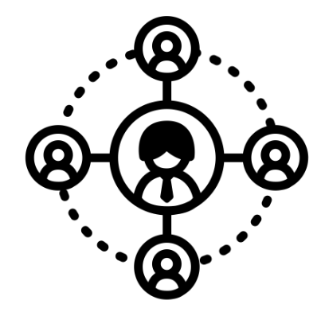
Identify the code: 99487
Coordination of Care
Care Team Member contacts the home health agency to schedule in-home visits and conduct a safety assessment. Includes Respiratory Therapist and Occupational Therapist in home visits.
In addition, a call was made to the DME provider to arrange for delivery of home O2.
Time spent coordinating care was 35 minutes.
Specialty Team Based Care 4.1.20 V1

Slide 137
Multidisciplinary Team
Identify the code: G9007
Patient with diagnosis of diabetes, end stage COPD, HTN, completed a comprehensive assessment with the MSW care manager one week ago.
A multidisciplinary team conference was held with the Clinical Pharmacist, MSW and Specialty Provider to discuss the initial plan of care with the team, which includes:
The MSW to schedule a virtual face to face visit with the patient regarding the lack of caregiver support and social isolation, which is linked with hospital admissions.
The Clinical Pharmacist to follow up with the patient on the ability to afford medications and the chronic diseases management also linked to frequent ED visits.
Both MSW and Clinical Pharmacist follow up with the team at their regular huddle.
Specialty Team Based Care 4.1.20 V1
Notes:
Reminder- CM can be the licensed individual in the practice acting in this role, i.e. nurse, MSW, Pharmacists, dietician
G9001 – comprehensive assessment completed and care plan developed
G9007 – Team Conference conducted

Slide 138
Advance Directives End of Life
Identify the code: S0257
*Note: this code allows for phone visit, face to face visit or video and may be with the patient, caregiver, or family member.
Care Team Member conducts a 20 minute in person visit* meeting with a patient regarding their advance directives.
During the visit, discussion occurs and written information about advance directives is shared.
Care Team Member and Patient discussion includes:
How the patient prefers to be treated.
What the patient wishes others to know.
Care Team Member and patient agree to follow up via a phone call in 2 weeks.
Notes:
Priority does reimburse S0257 End of Life Counseling but they also reimburse Advanced Directive code 99497 and 99498 F2F conversation concerning advanced directives. Not part of the PH for Incentive program for Primary Care. (no
BCBSM reimburses both End of Life Counseling and Advanced Directive conversation with the SO257
BCBSM SO257
Priority SO257 and 99497,99498

Slide 139
Identify the code: 98966 BCBSM
Reducing ED visits
Follow up each ED visit with a call to identify issues, coordinate follow up care, and encourage seeking care through the practice rather than the ED when appropriate. Often, this can be performed by a Medical Assistant.
Medical Assistants, operating under a protocol, may call patients:
Example: MA asks if the ED physician recommended follow up care, coordinates the needed care, transfers to clinician for issues requiring immediate medical assessment or guidance, and encourages the patient to bring in all medications to office visit.
Call takes between 5 and 10 minutes.
Proactive patient education examples:
Call Specialist related to disease focus needs/concerns: ex. Call Oncologist for chemotherapy side effects
Call PCP care team for mild cold symptoms, new onset
Suggest nearby urgent care, or ED for true emergency
Specialty Team Based Care 4.1.20 V1
Notes:
98966 MA call with patient would apply to BCBSM.
MA not a QHP for Priority

Slide 140
Phone Service
Identify the code: 98967
Pulmonologist Care Team Member speaks conducts a patient phone visit
Care Team Member:
Discusses patient’s COPD action plan with patient; reviews “in control”, “worsening symptoms” and “exacerbation.”
In reviewing patient with Pulmonologist, the CM understands: Pulmonologist introduced the benefits of having an advance directive at the last visit. Following up, CM asks the patient about interest in meeting with Specialist practice team member to discuss Advance Directive. Patient indicates interest and CM sends referral to Specialist team member.
Also reinforced when to call the office.
CM and patient agree on follow up in one week via in person visit at the office.
Phone visit = 20 minutes.
Specialty Team Based Care 4.1.20 V1
Notes:
98967 CM call with patient 20 minutes

Slide 141
Identify the codes: 3 patients: 98961
6 patients: 98962, x2 quantity bill
Group Education Visit
Patient has a new diagnosis of Chronic Kidney Disease.
Patient and caregiver indicate interest in Chronic Kidney Disease Group Education class.
Patient attends with caregiver and with 3 other patients for 30 minutes.
Patient attends a second class with 6 other patients for 60 minutes.
Notes:
98961 education class with 2 to 4 patients for 30 minutes
98962 education class with 5 to 8 patients for 30 minutes

Slide 142
Medical Community
Identify the code:
G9008 BCBSM
Primary Care Physician calls a Pulmonologist to discuss a joint treatment plan for a patient with diagnosis of severe Pulmonary Hypertension.
Notes:
G9008 – BCBSM coordinating care with healthcare professional not part of internal team
KH BCBSM distinction not necessary applies to Priority as well. Scott again we need to follow up on this.

Slide 143
Summary
The Care Management codes in daily care team activities
Notes:
Learning Notes
What codes can be used
What codes can be used by licensed and unlicensed care team members
Diagnosis codes and importance/impact on billing
Stress need for PO/practice follow up

Slide 144
Resources – Billing and Coding Care Management Services
The following documents are available on the MICMT Billing Resource web page https://micmt-cares.org/billing-resources
BCBSM PDCM Billing online course
BCBSM PDCM Billing Guidelines for Commercial
Multipayer table – Summary of Priority Health and BCBSM care management billing and coding
Priority Health – web link
Centers for Medicare & Medicaid
Chronic Care Management
Medicare Mental Health
Specialty Team Based Care 4.1.20 V1

Slide 145
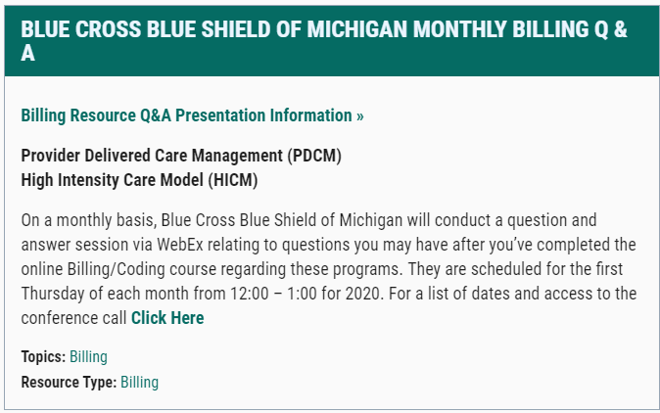
BCBSM Monthly Billing Q & A
To access the dates for the BCBSM Q & A:
https://micmt-cares.org/billing-resources

Slide 146
Appendix: At a Glance Resources
https://micmt-cares.org/training/specialty-team-based

Slide 147
Communication and Telehealth Visits
Medicare March 2020 Expansion of Telehealth Visit Reimbursement:
Includes a range of providers, such as doctors, nurse practitioners, clinical psychologists, and licensed clinical social workers, who can offer a specific set of telehealth services.
The specific set of services beneficiaries can get include evaluation and management visits (common office visits), mental health counseling, and preventive health screenings.
This change broadens telehealth flexibility without regard to the beneficiary’s diagnosis.
Note: Due to COVID-19, many Health Plans have activated telehealth visit coding and billing. Check with your manager for details.
Medicare Telemedicine Health Care Provider Fact Sheet
CMS Medicare Learning Network March 2020 - Telehealth Services
Notes:
Due to COVID 19, US Telehealth Visits are surging. March 2020 Medicare began temporarily paying clinicians to furnish beneficiary telehealth services residing across the entire country.
BCBSM and PH have expanded billing codes that now allow telehealth. You can check with your BCBSM and PH liaison for the details.
Medicare telehealth was expanded to include a range of providers, such as doctors, nurse practitioners, clinical psychologists, and licensed clinical social workers, who can offer a specific set of telehealth services.
The specific set of services beneficiaries can get include evaluation and management visits (common office visits), mental health counseling, and preventive health screenings.
Beneficiaries can get telehealth services in any health care facility including a physician’s office, hospital, nursing home or rural health clinic, as well as from their homes.
This change broadens telehealth flexibility without regard to the beneficiary’s diagnosis, because at this critical point it is important to ensure beneficiaries follow CDC guidance including practicing social distancing to reduce the risk of COVID-19 transmission. This change will help prevent vulnerable beneficiaries from unnecessarily entering a health care facility when clinicians can meet their needs remotely.

Slide 148
Questions? MICMT Team Mailbox: micmt-requests@med.umich.edu

